Slide 1

ELE 523E
COMPUTATIONAL NANOELECTRONICS
Mustafa Altun
Electronics & Communication Engineering
Istanbul Technical University
Web: http://www.ecc.itu.edu.tr/
FALL 2021
W6: Probabilistic and Approximate Computing, 8/11/2021

Slide 2
Outline
Overview of probabilistic computing
  Strengths
  Weaknesses
  Application areas
Stochastic computing with logic gates
  Circuit analysis
  Synthesis of stochastic inputs
  Synthesis of polynomial functions
Probabilistic switches
Approximate computing
  Software level
    Appling probabilistic or heuristic methods
    Skipping tasks
    Memoization
  Hardware level
    Voltage and size scaling
    Inexact structures

Slide 3
Probabilistic Computing
Deterministic
Subsequent state of the system is determined deterministically
Probabilistic
Subsequent state of the system is determined probabilistically
Deterministic
Deterministic
Deterministic
Probabilistic

Slide 4
Why Probabilistic Computing?
Strengths
  Easier to implement arithmetic operations.
  Works efficiently in encoding/decoding
  High degree of transient error tolerance.
  Exploit randomness that is a fact in nanoscale.
  Used in modeling probabilistic behavior of nanotechnologies.
Weaknesses
  Accuracy problems.
  Long computational times.

Slide 5
Stochastic Computing
Stochastic computing (SC) is a probability computing that depends on random bit streams.
Random Bit Streams
Stochastic Computing
0,1,0,1,1,0,1,0
x
P(x=1) = 4/8
x=4/8
AND
z
y=2/8
0,1,0,0,0,1,0,0
y
P(y=1) = 2/8

Slide 6
Random Bit Streams
Randomly assigning each bit value
CONVENTIONAL
The stream probability p represents the probability of having 1 for each bit
The stream has a binomial distribution in terms of the number of 1s
Less accurate
Perfectly random
Randomly shuffling a bit stream
The stream probability p represents (total number of 1s)/(total number of bits)
The stream has a deterministic behaviour in terms of number of 1s
More accurate
The longer the streams the closer these methods.

Slide 7
Stochastic Computing
Stochastic circuit
Probabilistic
Deterministic
Probabilistic
p₁=2/6, p₂=2/6, p₃=2/6, p₄=1/6, p₅=5/6, p₆=2/6

Slide 8
Accuracy of SC
x=4/8
AND
z
y=2/8
0,1,0,1,1,0,1,0
z=1/8
0,1,0,0,0,1,0,0
Which one is right?
0,1,0,1,1,0,1,0
z=2/8
0,1,0,0,1,0,0,0
0,1,0,1,1,0,1,0
z=0/8
1,0,0,0,0,1,0,0

Slide 9
Accuracy of SC
x=4/8
AND
z
x=4/8
0,1,0,1,1,0,1,0
0,1,0,1,1,0,1,0
0,1,0,1,1,0,1,0
z=4/8
Dependency is important!
Conventionally, input streams are independent

Slide 10
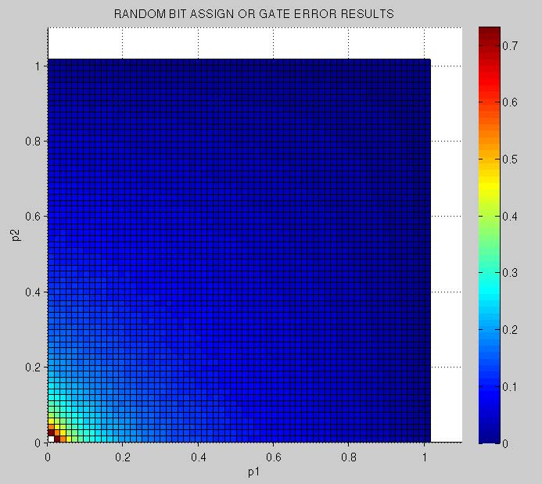
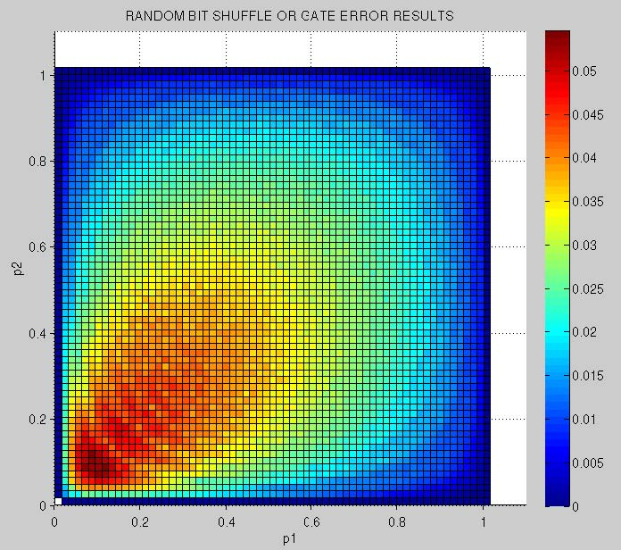
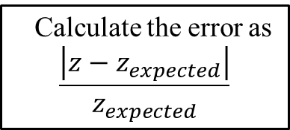
Accuracy of SC
Randomly assigning each bit value
CONVENTIONAL
The stream probability p represents the probability of having 1 for each bit
The stream has a binomial distribution
Randomly shuffling a bit stream
The stream probability p represents (total number of 1s)/(total number of bits)
Calculate the error rate?
Calculate the error as
$$\frac{\left|z−z_{expected}\right|}{z_{expected}}$$
AND

Slide 11
Randomly Assigning
Example:
Consider 4-bit input bit streams x and y such that each bit is 1 with an independent probability of p=1/2.
Find the probability of accurate computation z=1/4.
Find the probability of having z=0/4.
Find the probability of having z=2/4.
Find the probability of having z=3/4.
Find the probability of having z=4/4.
Find the everage error rate.
x=2/4
AND
z
y=2/4

Slide 12
Randomly Shuffling
Example:
Consider randomly distributed 4-bit input bit streams x and y such that half of its bits are 1 and the other half 0.
Find the probability of accurate computation z=1/4.
Find the probability of having z=0/4.
Find the probability of having z=2/4.
Find the probability of having z=3/4.
Find the probability of having z=4/4.
Find the everage error rate.
x=2/4
AND
z
y=2/4

Slide 13
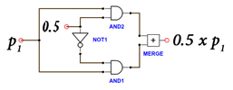
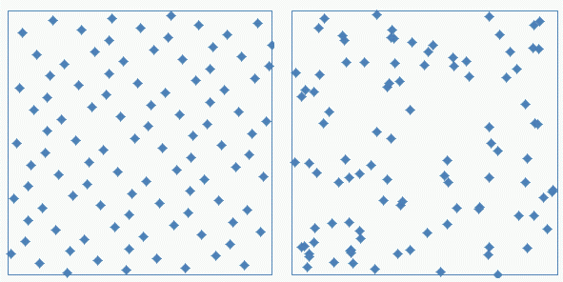
Improving the Accuracy
Using correlated bit streams
Error-free computing
Using quasi-random bit streams
1 gate vs. 1000 gates doing the same job
Low-discrepancy vs. random sequence

Slide 14
Defect Tolerance in SC
x=4/8=(0.100)₂
AND
z=1/8=(0.001)₂
y=2/8=(0.010)₂
What if there is a bit-flip in an input?
0,1,0,1,1,0,1,0
z=1/8
0,1,0,0,0,1,0,0
(0.100)₂ x (0.010)₂ = (0.001)₂

Slide 15
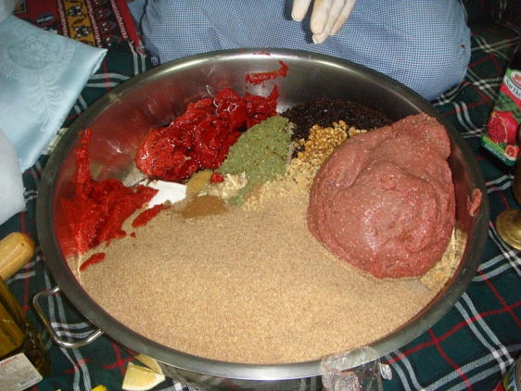
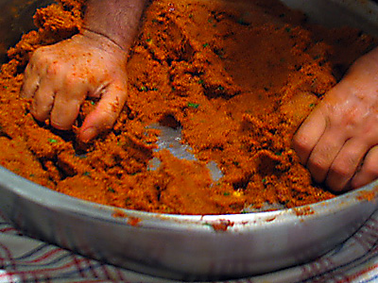
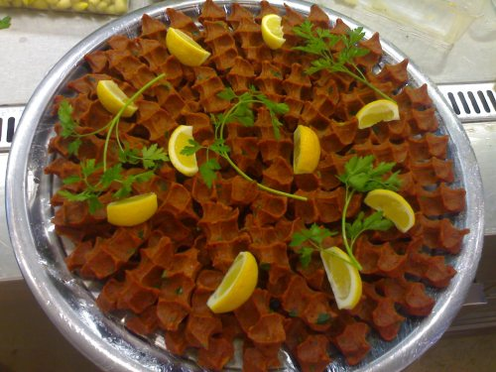
Performance of Randomness
Ingredients of “Çiğ Köfte”
Kneading “Çiğ Köfte”
Ready to serve “Çiğ Köfte”
Heterogeneous to Homogeneous: HOW?
The longer the kneading time the tastier the “Çiğ Köfte”.
The longer the kneading time the more homogeneous (accurate) the “Çiğ Köfte”.

Slide 16
Performance of SC
Bit Streams
0,1,0,1,1,0,1,0,…..
The longer the bit streams the more accurate the computation.
The longer the bit streams the more reliable the computation.
The longer the bit streams the slower the computation.

Slide 17
Arithmetic Operations with SC
Multiplication: : x x y = z
3-bit deterministic multiplier (30 gates)
3-bit stochastic multiplier (1 gate)
x=(0.100)₂
AND
z=(0.010)₂
y=(0.100)₂
At least how many bits shoud a stream have?
At least how many stream bits for an n-bit multiplier?

Slide 18
Arithmetic Operations with SC
Scaled addition: : x(s) + y(1-s) = z
1,1,1,1,1,0,1,1
1
x
1
MUX
1,0,1,1,0,0,1,1
z
0,0,1,0,0,1,1,0
0
MUX
y
0
1,0,0,1,0,1,0,1
s
x=7/8, y=3/8, s=4/8, z=5/8

Slide 19
Arithmetic Operations with SC
Example:
Find the expression of z for both stochastic and deterministic inputs applied.
x₁
AND
1
x₂
MUX
NOT
z
x₃
0
x₄

Slide 20
Synthesis Problem-1
Problem: How to construct a logic circuit in order to implement given output probabilities with a set of input probabilities?
Example:
Implement output probabilities 0.6, 0.2, and 0.3 with using input probabilities of 0.4 and 0.5.
P(x = 1) = 0.4
P(x = 1) = 0.4
0,0,1,0,1,0,1,0,1,0
0,1,0,1,0,0,1,1,0,0
P(z = 1) = 0.3
P(z = 1) = 0.2
P(x = 1) = 0.4
P(z = 1) = 0.6
0,1,0,0,0,1,0,0,0,1
0,0,0,1,0,0,1,0,0,0
1,0,1,1,0,1,0,0,0,0
0,1,0,0,1,0,1,1,1,1
1,0,0,1,1,0,0,1,1,0
1,0,1,1,0,0,1,0,0,1
P(y = 1) = 0.5
P(y = 1) = 0.5
P(z = 1) = P(x = 0)
P(z = 1) = P(x = 0) P(y = 0)
P(z = 1) = P(x = 1) P(y = 1)

Slide 21
Synthesis Problem-1
Theorem (Qian et al. 2011): With input probabilities = {0.4, 0.5}, we can synthesize arbitrary decimal output probabilities.
Example: Synthesize q = 0.757
(Black dots
are inverters)

Slide 22
Synthesis Problem-2
Problem: How to construct a logic circuit in order to implement a polynomial g(t) where both t and g(t) are in unit interval?

Slide 23
Synthesis Problem-2
Example:
Implement g(t) = 3/8 t² + 5/8 t.
t
AND
1
t
g(t)
MUX
t
0
3/8

Slide 24
Synthesis Problem-2
Example:
Implement g(t) = t³ – 2t² + 1.
t
NOR
1
t
g(t)
MUX
1
0
t

Slide 25
Synthesis Problem-2
Example:
Implement g(t) = 9/4 t² – 15/8 t + 5/8 and test on g(1/2).
t
t
t
5/8
0
0
1
MUX
g(t)
1/8
2
1
3

Slide 26
Synthesis Problem-2
Theorem (Qian et al. 2012): With using Bernstein polynomials, we can synthesize any polynomial g(t).
Example:
Implement g(t) = 9/4 t² – 15/8 t + 5/8.
g(t) = 9/4 t² – 15/8 t + 5/8
= 5/8 B₀ + 0 B₁ + 1/8 B₂ + 1 B₃
B_{i} = probability that the output of the adding unit is i.
B₀ = (1-t)³
B₁ = 3 t(1-t)²
B₂ = 3 t²(1-t)
B₃ = t³

Slide 27
Probabilistic Two-Terminal Switch
A probabilistic switch is ON with a probability of p.
Can be implemented with stochastic bit streams.
0,1,0,1,1,0,1,0
x
P(x=1) = p = 4/8
Can be used to model probabilistic phenomena in nanoscale such as random defects.

Slide 28
Probabilistic Two-Terminal Switch
A probabilistic MOS is a probabilistic switch.
* Probabilistic CMOS technology: A survey and future directions

Slide 29
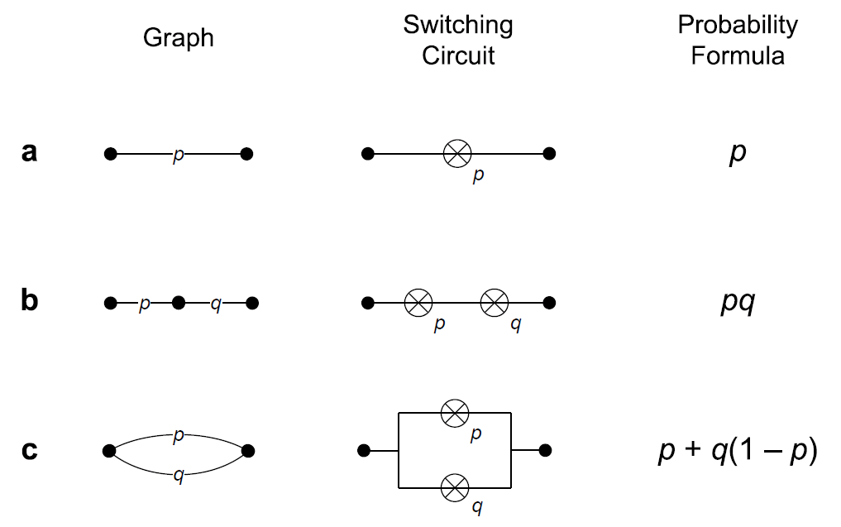
Probabilistic Two-Terminal Switch

Slide 30
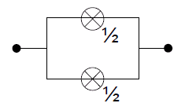
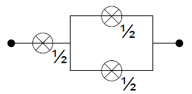
Synthesis Problem
Problem: How to construct a circuit in order to implement a given binary decimal numbers using p-switches with p=1/2 ?
Example:
Implement the output probabilities 0.11₂ and 0.011₂ with p-switches with p=1/2.
0.11₂
0.011₂

Slide 31
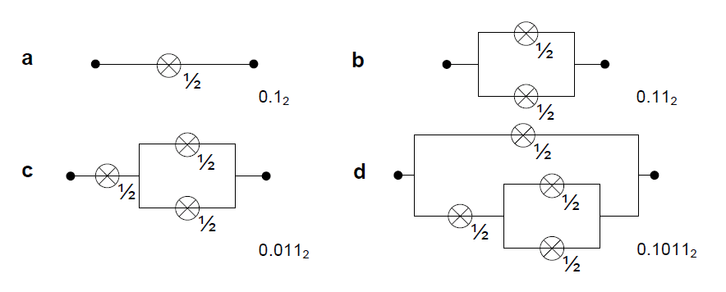
Synthesis Problem
Example:
Implement the output probability 0.1011₂ with p-switches with p=1/2.
Progressing from the least-significant to the most-significant bits

Slide 32
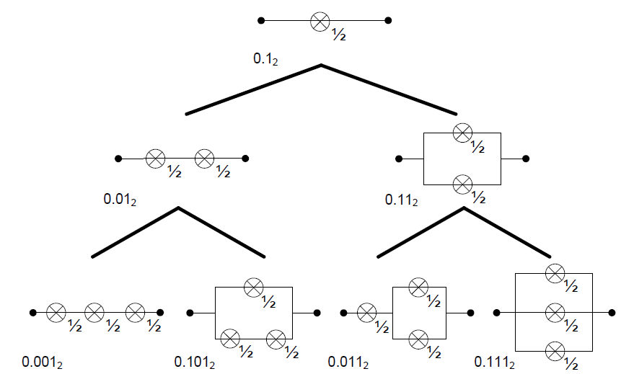
Synthesis Problem
Binary tree showing how to generate all possible switching circuits
(Wilhelm et al. 2008)

Slide 33
Why Approximate?
Benefits
  Power saving
  Energy saving
  Time saving
  Area saving
At the cost of accuracy
Parallel Processing
Serial Processing
Power?
Energy?
Time?
Area?

Slide 34
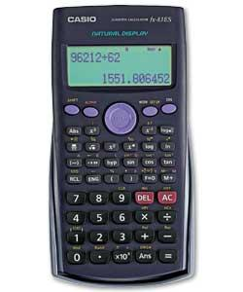
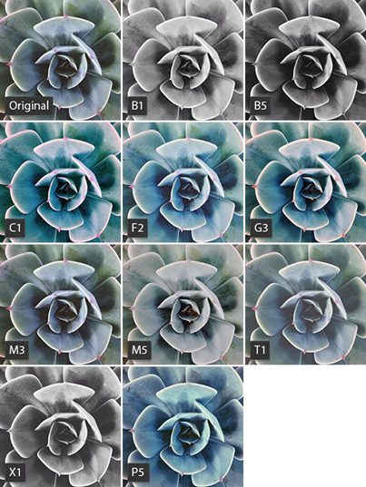
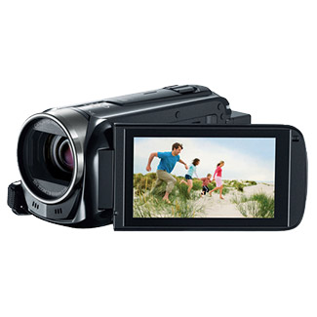
Why Approximate?
Applications
  Problems not having a unique solution
  Solution space is large
  Video, audio, and image applications not requiring perfect accuracy
Calculator
Image processing
Scheduling the exam week with exam dates and hours
Synthesizing a circuit with gates doing a certain task
Finding a logic truth table of a certain task

Slide 35
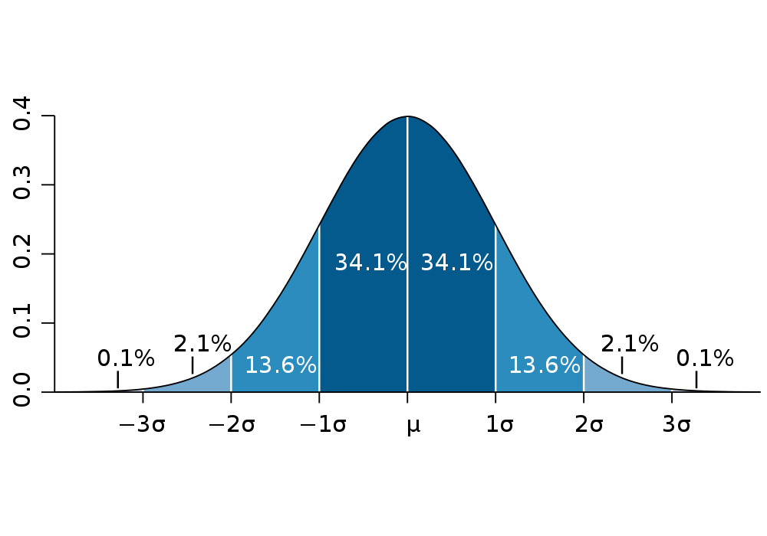
Software Level Approximation
Genetic/evolutionary and heuristic algorithms
Distrubution of random input assignements
Solution Space

Slide 36
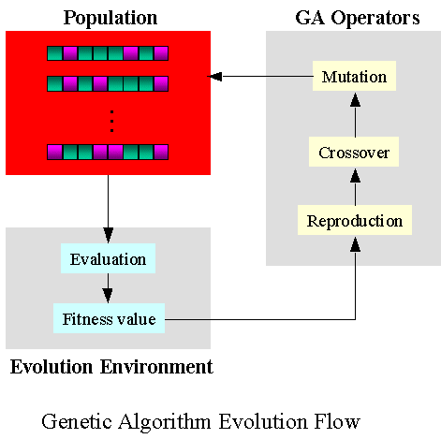
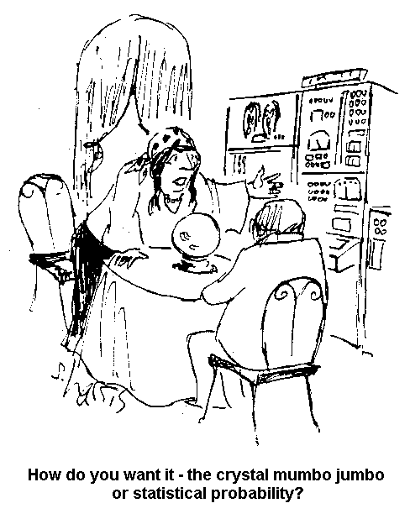
Software Level Approximation
Genetic/evolutionary and heuristic algorithms

Slide 37
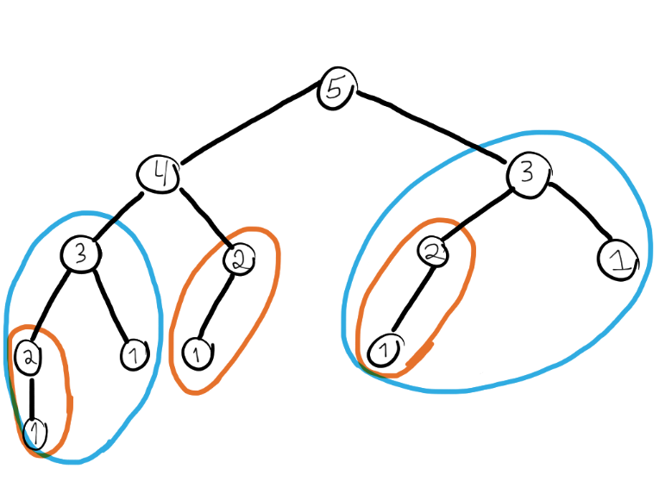


Software Level Approximation
Memoization: remembering the past, use for the future
Our brains use it all the time. How about accuracy?
Suitable for applications having small variances.
Low variance

Slide 38
Hardware Level Approximation
Voltage scaling
Ideally zero variance; decreasing Vdd results in a variance increase
* Probabilistic CMOS technology: A survey and future directions

Slide 39
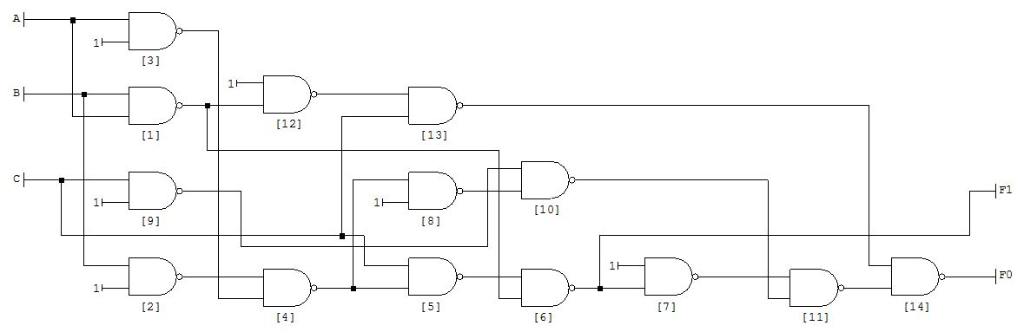
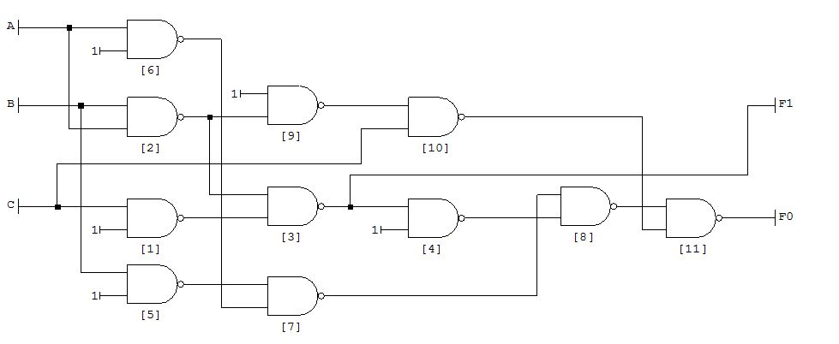
Hardware Level Approximation
Approximate circuits are achieved by changing truth tables or target Boolean functions.
Exact adder (14 Gates)
App. adder (11 Gates)

Slide 40
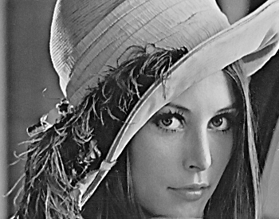


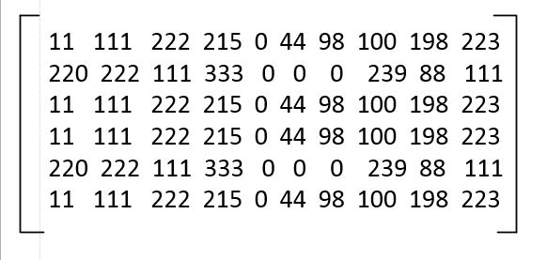
App. Adders for Image Processing
Noise
Matrix
Mean filter with Approximate adders

Slide 41
App. Adders for Image Processing
Mean filter
New value= (11+111+222+220+222+111+11+111+222)/9=134

Slide 42
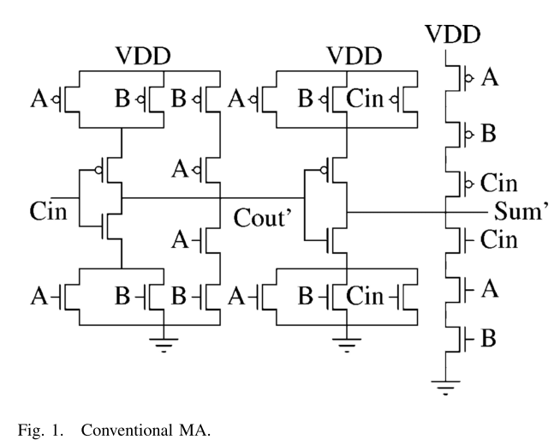
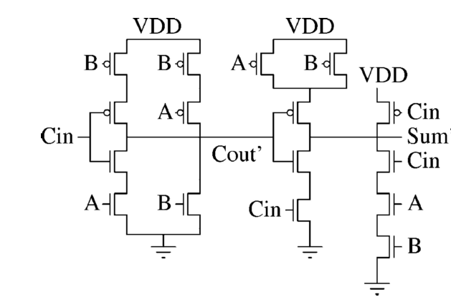
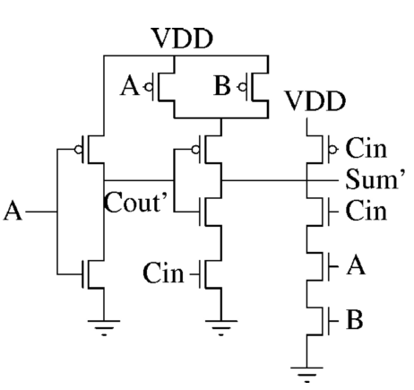
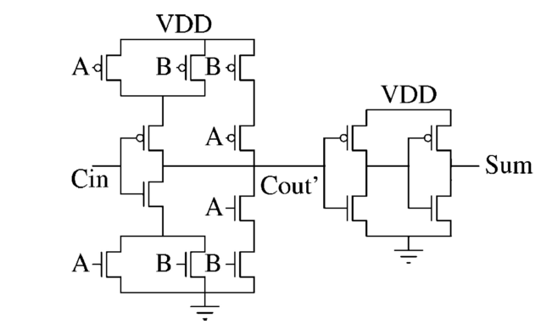
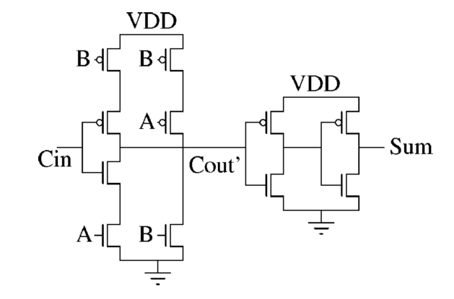
Approximate 1-bit Full Adders
Approximate 1
Accurate Adder
Approximate 2
Approximate 3
Approximate 4

Slide 43
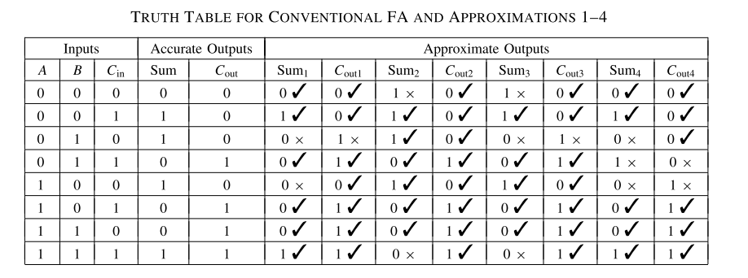
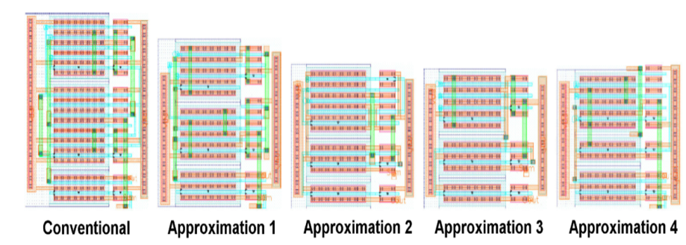
Approximate 1-bit Full Adders
IMPACT: imprecise adders for low-power approximate computing

Slide 44
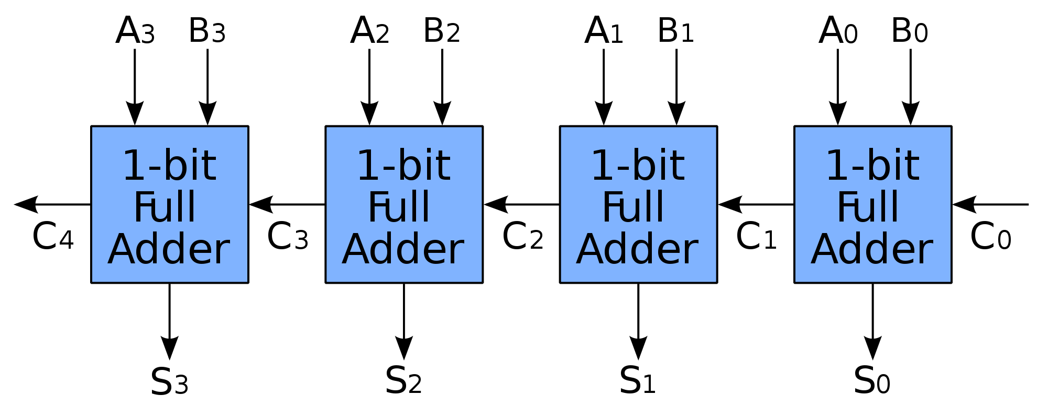
Approximate Ripple Carry Adders
Most significant
Least significant
Which full adders are approximate?
How to calculate an average error?

Slide 45
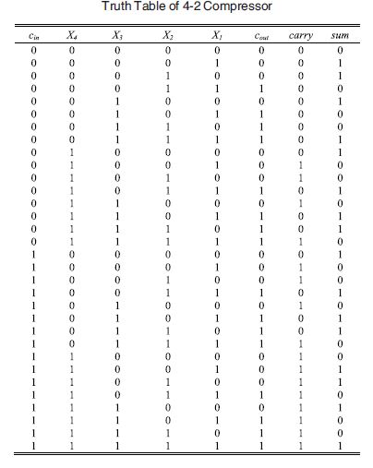
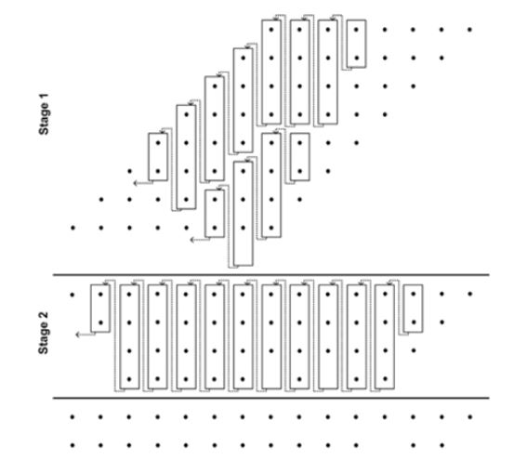
Approximate Multiplier

Slide 46
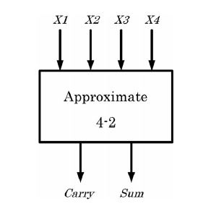
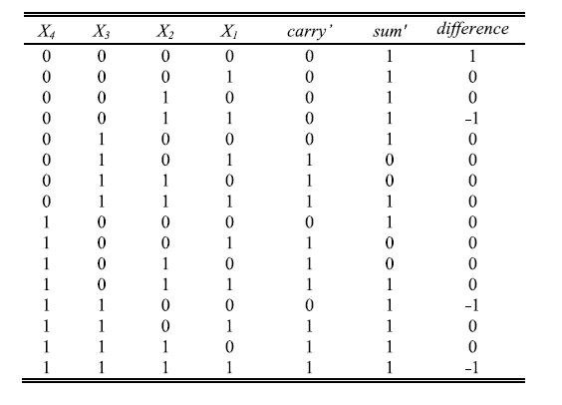
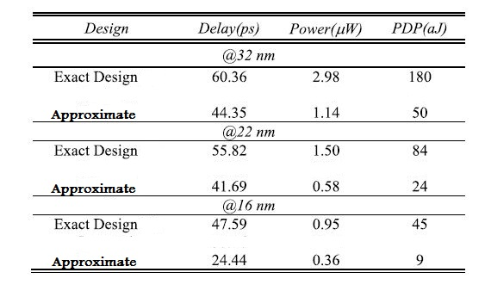
Approximate Multiplier
Costs

Slide 47
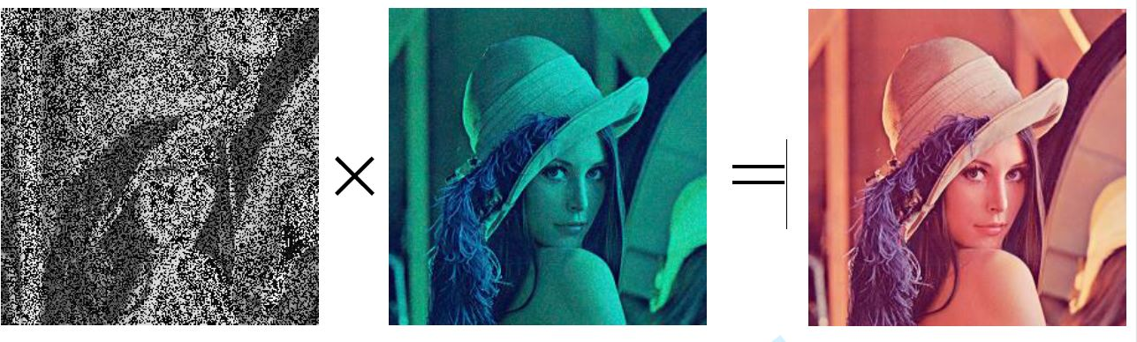
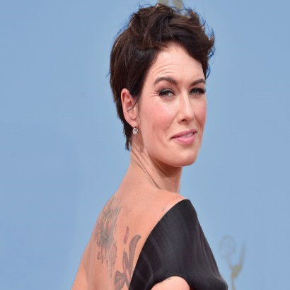



Application of Approximate Multiplier
Power Save=40%
Power Save=60%
Power Save=90%

Slide 48
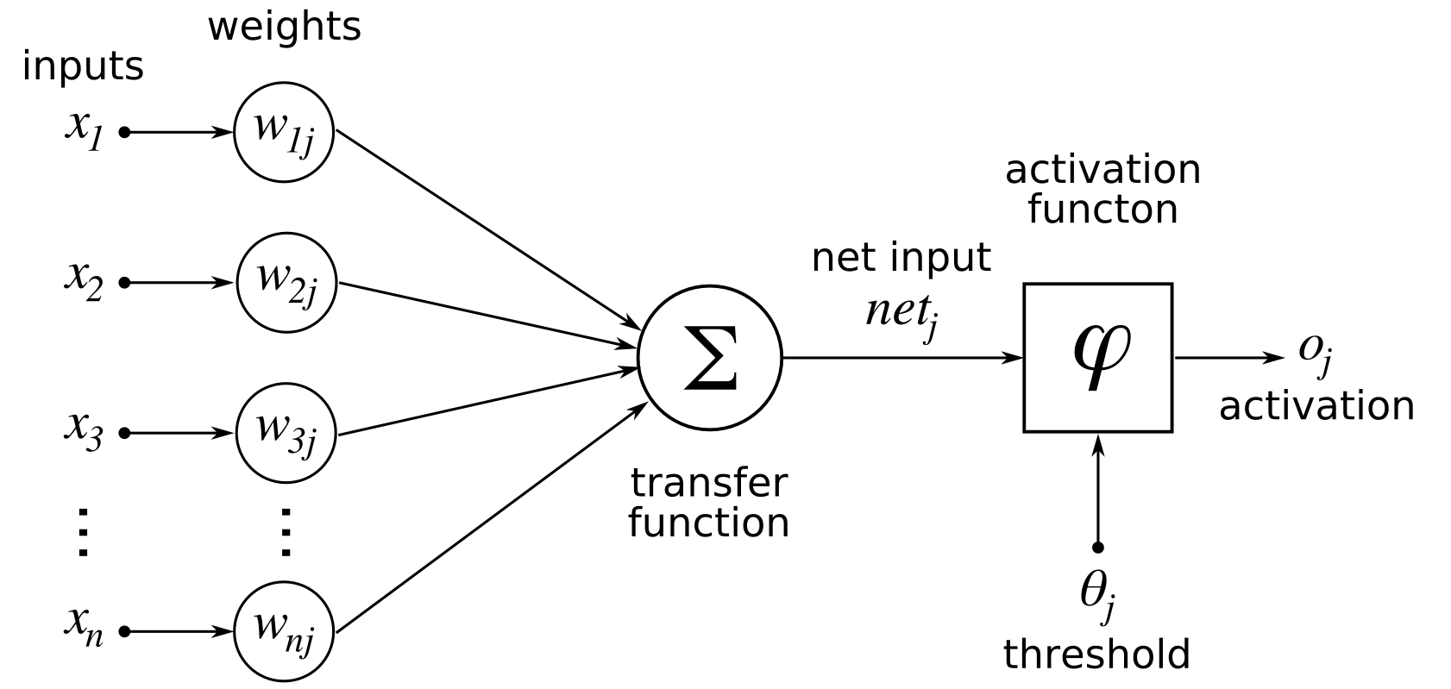
App. Computing in Machine Learning
Neural Network:
Simple NN Structure

Slide 49
Suggested Readings
Qian, W., & Riedel, M. D. (2008, June). The synthesis of robust polynomial arithmetic with stochastic logic. In Design Automation Conference, 2008. DAC 2008. 45th ACM/IEEE (pp. 648-653). IEEE.
Alaghi, A., & Hayes, J. P. (2013). Survey of stochastic computing. ACM Transactions on Embedded Computing Systems (TECS), 12(2s), 92.
Vahapoglu, E., & Altun, M. (2016, July). Accurate Synthesis of Arithmetic Operations with Stochastic Logic. In VLSI (ISVLSI), 2016 IEEE Computer Society Annual Symposium on (pp. 415-420). IEEE.
Wilhelm, D., & Bruck, J. (2008, July). Stochastic switching circuit synthesis. In Information Theory, 2008. ISIT 2008. IEEE International Symposium on(pp. 1388-1392). IEEE.
Moore, E. F., & Shannon, C. E. (1956). Reliable circuits using less reliable relays. Journal of the Franklin Institute, 262(3), 191-208.
Mittal, S. (2016). A survey of techniques for approximate computing. ACM Computing Surveys (CSUR), 48(4), 62.

