Slide 1
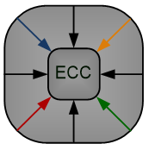
A Study on Hardware-Aware Training Techniques for Feedforward Artificial Neural Networks
Sajjad Parvin and Mustafa Altun
Emerging Circuits and Computation (ECC) Group
Istanbul Technical University
This work is supported by the TUBITAK-1001 project #119E507.
1
IEEE Computer Society Annual Symposium on VLSI 2021

Slide 2
Outline
Introduction
Background
Idea
Experimental Results
Conclusions
2

Slide 3
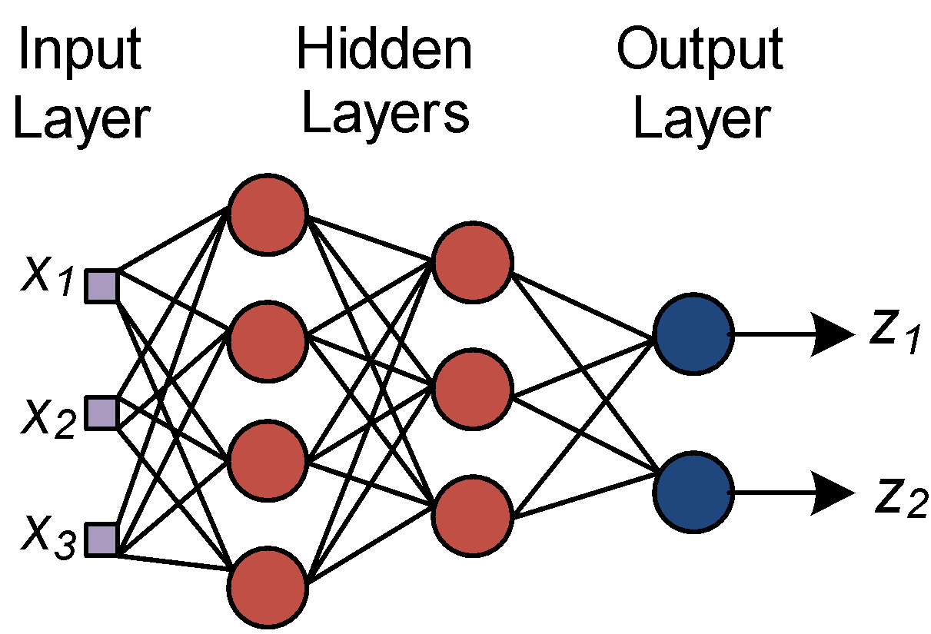
Introduction
Fully connected neural network is a computing system made up of a number of simple and highly interconnected processing elements
An Fully Connected NN architecture
3
Notes:
3

Slide 4
Introduction
ANNs have been realized in different design platforms
analog, digital, hybrid very large scale integrated (VLSI) circuits, field programmable gate-arrays (FPGAs), and neuro-computers
GPUs and CPUs provide generous memory and computation speed
impractical for portable devices where the number of processing units, battery capacity, and memory is limited
ASIC implementation of an ANN; Multiplierless implementation
4

Slide 5
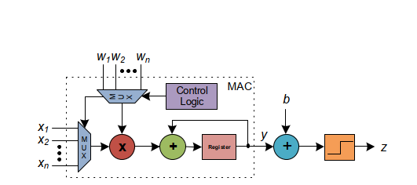
Background
The architecture used here for hardware implementation is:
Parallel and Time-Multiplexed
Cost metric during training : CSD representation
Less non-zero digits → Less adders for multiplierless implementation of ANN.
Weightset’s CSD representation is monitored; this helps to have a sense how large the final circuit will be.
Motivation:
To have a hardware-aware training tool for ANN
5

Slide 6
Idea
The effect of initialization on the final hardware-cost
Hardware-aware training
Instead of Xavier initialization technique, let’s generate weightset randomly with various standard deviation in each run.
Expectation : area reduction.
Set bit-width of hardware before training,
Initialize the weightset with the pre-determined quantization value,
Train the network using fixed-point numbers.
After a fixed number of training→ Keep track of CSD cost of the ANN.
Apply truncation on the weighset’s CSD representation to reduce the hardware cost.
Resume training the ANN, until the desired termination condition is met.
Zaal toolbox
All these approaches are included in a toolbox called ZAAL.
6

Slide 7
Experimental Results - Weight initialization
THE COMPUTATIONS OF A CONVOLUTIONAL LAYER.
PROPOSED DATA FLOW FOR CONVOLUTIONAL COMPUTATIONS
19%-119% area saving in comparison to Xavier
7

Slide 8
Experimental Results - Hardware-Aware Training
THE COMPUTATIONS OF A CONVOLUTIONAL LAYER.
PROPOSED DATA FLOW FOR CONVOLUTIONAL COMPUTATIONS
Pen-digit dataset
On Average:
ZAAL PQ achieved 20-25% better area in comparison to MATLAB and PYTORCH.
ZAAL PQ achieved 75-78% better energy efficiency in comparison to MATLAB and PYTORCH.
ZAAL PQAP achieved 40-43% better area in comparison to MATLAB and PYTORCH.
ZAAL PQAP achieved 50-56% better energy efficiency in comparison to MATLAB and PYTORCH.
8

Slide 9
Experimental Results - Hardware-Aware Training
THE COMPUTATIONS OF A CONVOLUTIONAL LAYER.
PROPOSED DATA FLOW FOR CONVOLUTIONAL COMPUTATIONS
MNIST dataset
On Average:
MATLAB and PYTORCH resulted in 4.18 and 3.34 more area in comparison to ZAAL PQ , respectively.
MATLAB and PYTORCH resulted in 4.6 and 3.7 more area in comparison to ZAAL PQAP, respectively.
ZAAL PQ toolbox achieved 75-78% better energy efficiency in comparison to MATLAB and PYTORCH.
ZAAL PQAP = 10% better than ZAAL PQAP
9

Slide 10
Conclusions
In this paper, we presented hardware-aware training toolbox for ANN using multiplierless implementation.
Our approaches yielded significant reduction in area and energy efficiency.
10

Slide 11
Questions
THANKS for YOUR ATTENTION
Contact: Mohammadreza Esmali Nojehdeh
E-mail: nojehdeh@itu.edu.tr
11

