Slide 1
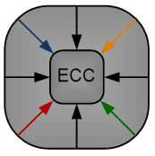

Efficient Hardware Implementation of
Convolution Layers
Using Multiply-Accumulate Blocks
Mohammadreza Esmali Nojehdeh, Sajjad Parvin and Mustafa Altun
Emerging Circuits and Computation (ECC) Group
Istanbul Technical University
IEEE Computer Society Annual Symposium on VLSI 2021

Slide 2
Outline
Introduction
Background
Motivation
Idea
Proposed Method
Experimental Results
Conclusions

Slide 3
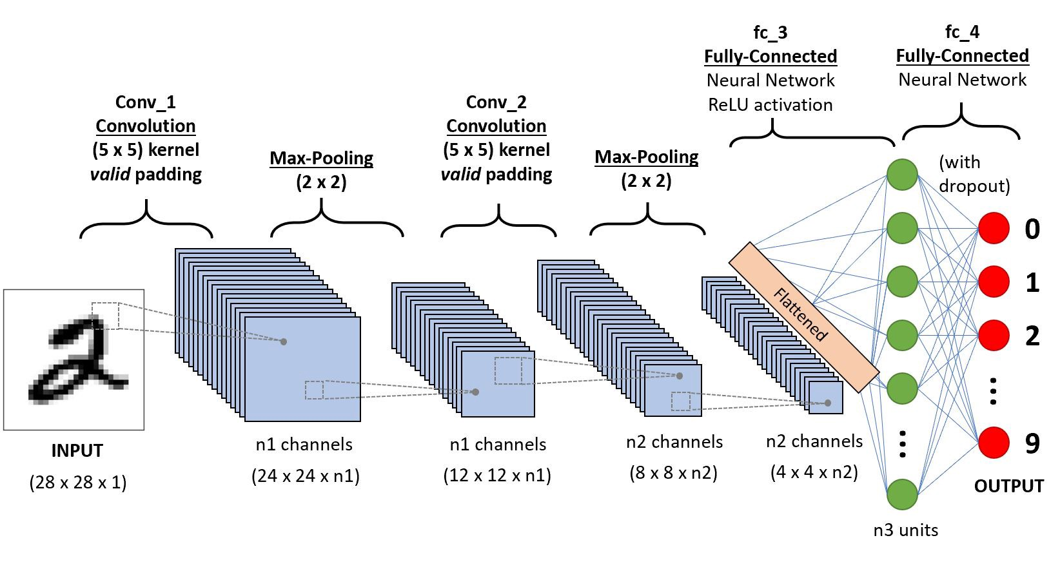
Introduction
Fully connected neural network
is a computing system made up of a number of simple and highly interconnected processing elements
Convolutional neural networks (CNN) provide remarkable results in achieving better performances
An Fully Connected NN architecture
An CNN architecture

Slide 4
Introduction
ANNs have been realized in different design platforms
  analog, digital, hybrid very large scale integrated (VLSI) circuits, field programmable gate-arrays (FPGAs), and neuro-computers
GPUs and CPUs provide generous memory and computation speed
  impractical for portable devices where the number of processing units, battery capacity, and memory is limited
ASIC implementation of a CNN with millions of parameters is impractical in the parallel fashion.
  Alternative is serial computing method

Slide 5
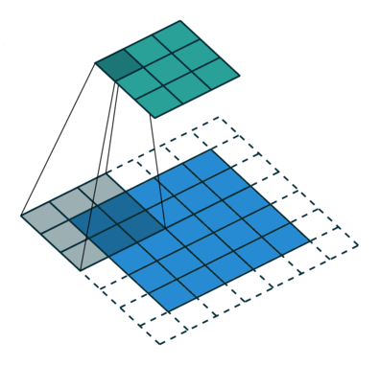
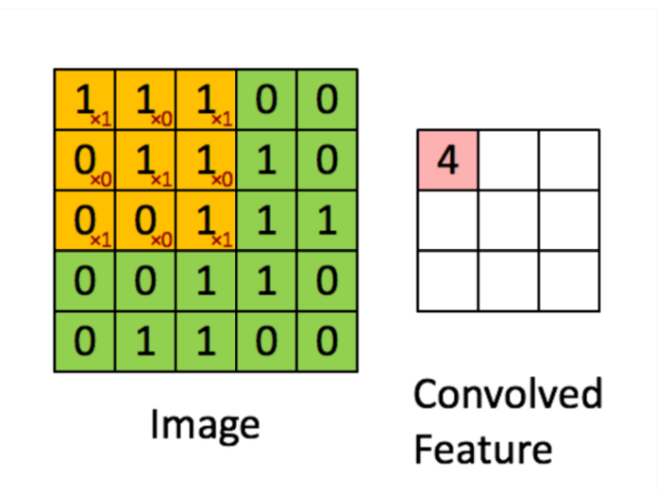
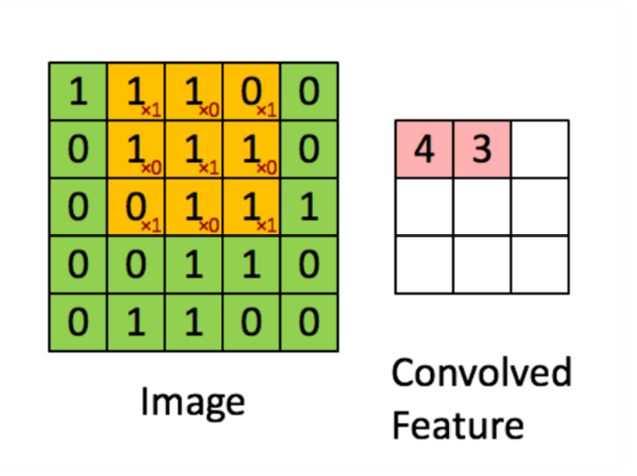
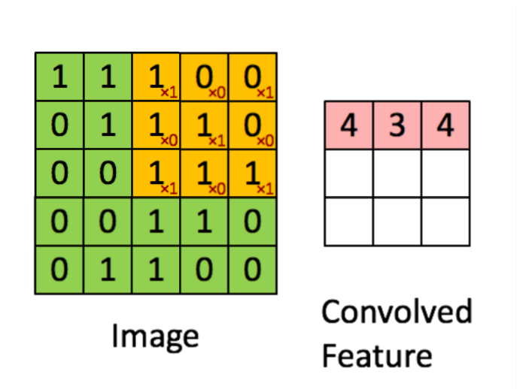
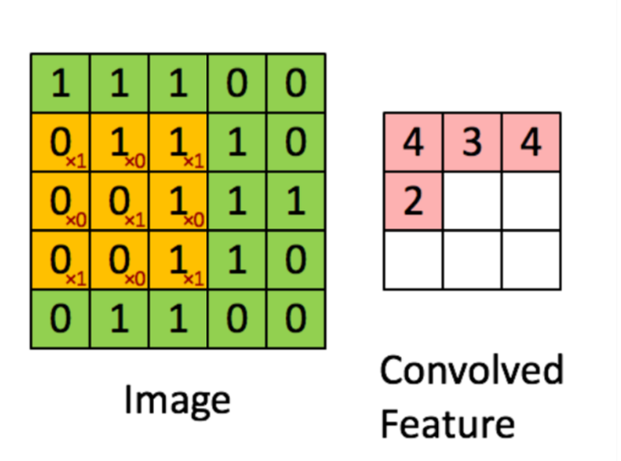
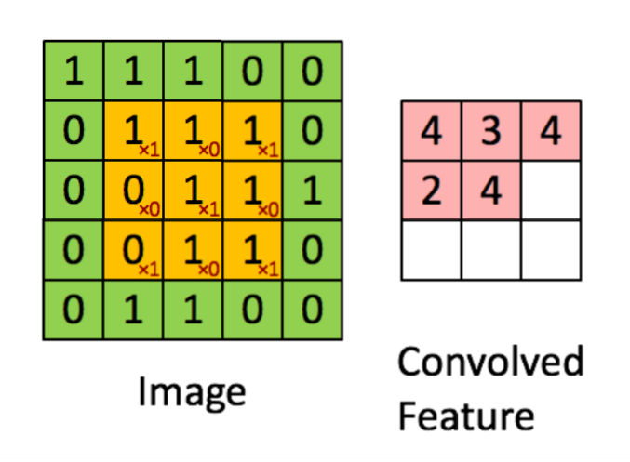
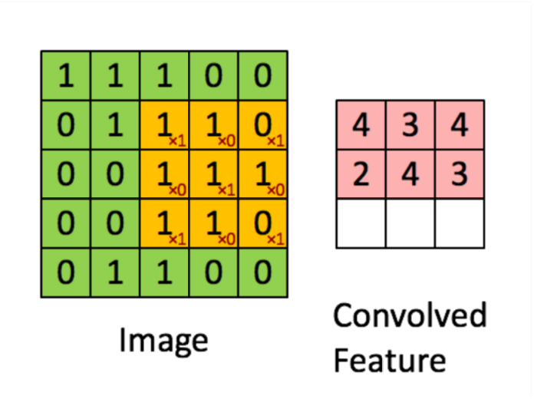
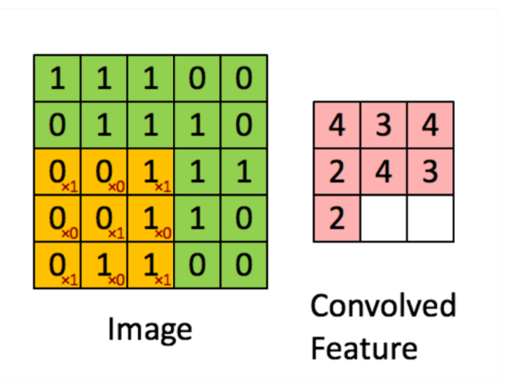
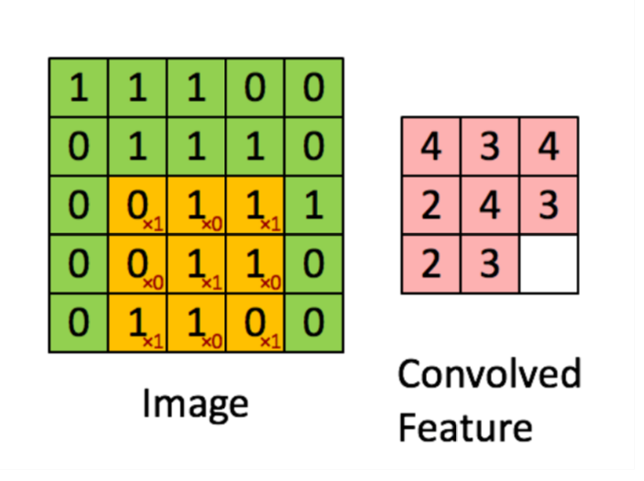
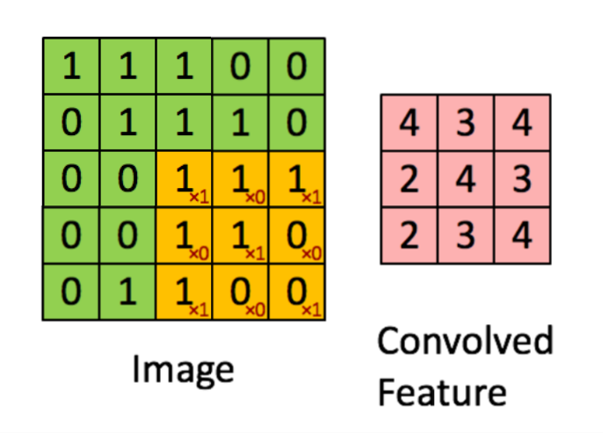
Background
Convolutuional layers
Convoluting a 5x5x1 image with a 3x3x1 kernel to get a 3x3x1 convolved feature

Slide 6
Motivation
Similarity of the fully-connected ANNs and the convolution operation
Convoluting a 5x5x1 image with a 3x3x1 kernel to get a 3x3x1 convolved feature

Slide 7
Motivation
Multipliers and adders are frequently used in ANNs and dominate the hardware complexity.
Neuron structure
An Fully Connected NN architecture
Time-multiplexed design of a neuron

Slide 8
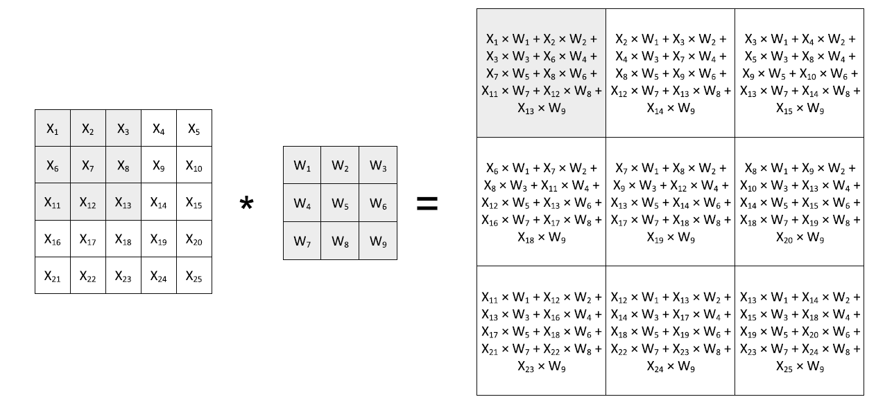
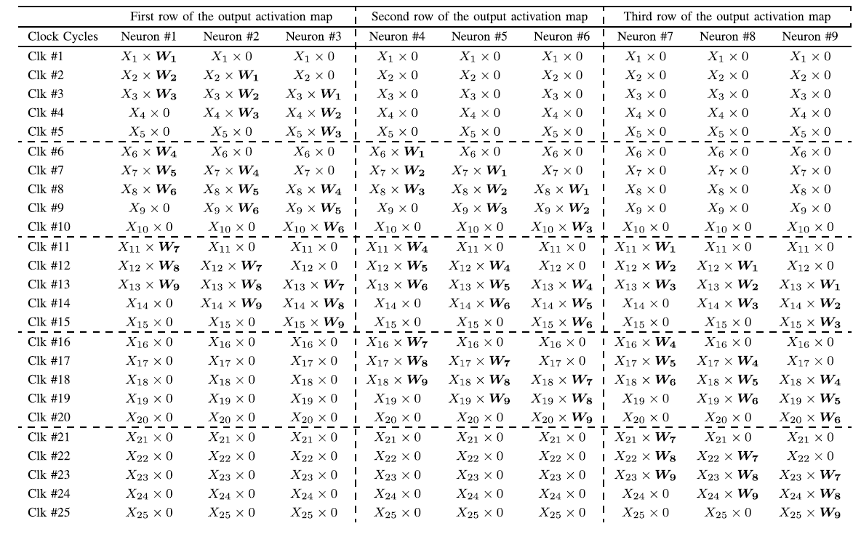
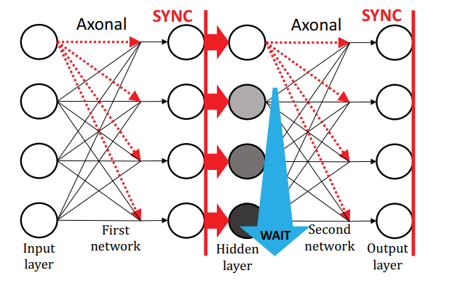
Idea
THE COMPUTATIONS OF A CONVOLUTIONAL LAYER.
PROPOSED DATA FLOW FOR CONVOLUTIONAL COMPUTATIONS IN [1]
THE COMPUTATIONS OF A CONVOLUTIONAL LAYER.
PROPOSED DATA FLOW FOR CONVOLUTIONAL COMPUTATIONS IN [1]
AXONAL- BASED MODEL
[1]Ardakani, Arash, et al. "An architecture to accelerate convolution in deep neural networks." IEEE Transactions on Circuits and Systems I: Regular Papers 65.4 (2017): 1349-1362.

Slide 9
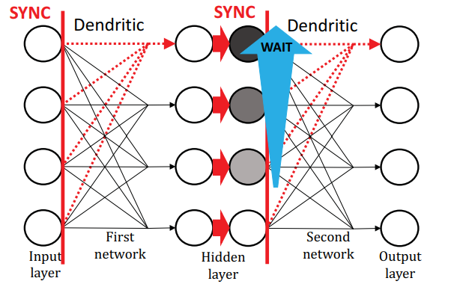
The Proposed Method
THE COMPUTATIONS OF A CONVOLUTIONAL LAYER.
PROPOSED DATA FLOW FOR CONVOLUTIONAL COMPUTATIONS IN [1]
Clock cycle | Neuron#1 | Neuron#2 | Neuron#3 | Neuron#4 | Neuron#5 | Neuron#6 | Neuron#7 | Neuron#8 | Neuron#9
clK#1 | W1 × X1 | W2 × X2 | W3 × X3 | W4 × X6 | W5 × X7 | W6 × X8 | W7 × X11 | W8 × X12 | W9 × X13
clK#2 | W1 × X2 | W2 × X3 | W3 × X4 | W4 × X7 | W5 × X8 | W6 × X9 | W7 × X12 | W8 × X13 | W9 × X 14
clK#3 | W1 × X3 | W2 × X4 | W3 × X5 | W4 × X8 | W5 × X9 | W6 × X10 | W7 × X13 | W8 × X14 | W9 × X15
clK#4 | W1 × X6 | W2 × X7 | W3 × X8 | W4 × X11 | W5 × X12 | W6 × X13 | W7 × X16 | W8 × X17 | W9 × X18
clK#5 | W1 × X7 | W2 × X8 | W3 × X9 | W4 × X12 | W5 × X13 | W6 × 14 | W7 × X17 | W8 × X18 | W9 × X19
clK#6 | W1 × X8 | W2 × X9 | W3 × X10 | W4 × X13 | W5 × X14 | W6 × X15 | W7 × X18 | W8 × X19 | W9 × X20
clK#7 | W1 × X11 | W2 × X12 | W3 × X13 | W4 × X16 | W5 × X17 | W6 × 18 | W7 × X21 | W8 × X22 | W9 × X23
clK#8 | W1 × X12 | W2 × X13 | W3 × X14 | W4 × X17 | W5 × X18 | W6 × 19 | W7 × X22 | W8 × X23 | W9 × X24
clK#9 | W1 × X13 | W2 × X14 | W3 × X15 | W4 × X18 | W5 × X19 | W6 × X20 | W7 × X23 | W8 × X24 | W9 × X25
PROPOSED DATA FLOW FOR CONVOLUTIONAL COMPUTATIONS
DENDRITIC- BASED MODEL

Slide 10
The Proposed Method
PROPOSED DATA FLOW FOR CONVOLUTIONAL COMPUTATIONS IN [1]
OUR PROPOSED DATA FLOW FOR CONVOLUTIONAL COMPUTATIONS
Clock cycle | Neuron#1 | Neuron#2 | Neuron#3 | Neuron#4 | Neuron#5 | Neuron#6 | Neuron#7 | Neuron#8 | Neuron#9
clK#1 | W1 × X1 | W2 × X2 | W3 × X3 | W4 × X6 | W5 × X7 | W6 × X8 | W7 × X11 | W8 × X12 | W9 × X13
clK#2 | W1 × X2 | W2 × X3 | W3 × X4 | W4 × X7 | W5 × X8 | W6 × X9 | W7 × X12 | W8 × X13 | W9 × X 14
clK#3 | W1 × X3 | W2 × X4 | W3 × X5 | W4 × X8 | W5 × X9 | W6 × X10 | W7 × X13 | W8 × X14 | W9 × X15
clK#4 | W1 × X6 | W2 × X7 | W3 × X8 | W4 × X11 | W5 × X12 | W6 × X13 | W7 × X16 | W8 × X17 | W9 × X18
clK#5 | W1 × X7 | W2 × X8 | W3 × X9 | W4 × X12 | W5 × X13 | W6 × 14 | W7 × X17 | W8 × X18 | W9 × X19
clK#6 | W1 × X8 | W2 × X9 | W3 × X10 | W4 × X13 | W5 × X14 | W6 × X15 | W7 × X18 | W8 × X19 | W9 × X20
clK#7 | W1 × X11 | W2 × X12 | W3 × X13 | W4 × X16 | W5 × X17 | W6 × 18 | W7 × X21 | W8 × X22 | W9 × X23
clK#8 | W1 × X12 | W2 × X13 | W3 × X14 | W4 × X17 | W5 × X18 | W6 × 19 | W7 × X22 | W8 × X23 | W9 × X24
clK#9 | W1 × X13 | W2 × X14 | W3 × X15 | W4 × X18 | W5 × X19 | W6 × X20 | W7 × X23 | W8 × X24 | W9 × X25
PROPOSED DATA FLOW FOR CONVOLUTIONAL COMPUTATIONS

Slide 11
Experimental Results

Slide 12
Conclusions
In this paper, we presented hardware efficient implementation of the convolution layers under the time-multiplexed architecture.
We introduced a novel computing approach to speed up the convolutional computation by 2× while only use roughly 2% of the area, power and, energy of the conventional MAC-based method.

Slide 13
ACKNOWLDGEMENT
This work is supported by the TUBITAK-1001 projects, #119E507
and Istanbul Technical University BAP projects #42446.

Slide 14
Questions
THANKS for YOUR ATTENTION
Contact: Mohammadreza Esmali Nojehdeh
E-mail: nojehdeh@itu.edu.tr

