Slide 1
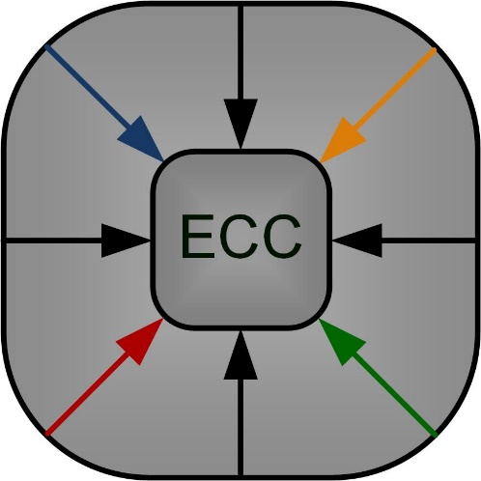
Parameter Extraction Method Using Hybrid Artificial Bee Colony Algorithm for an OFET Compact Model
Nihat Akkan¹, Mustafa Altun² and Herman Sedef¹
nakkan@yildiz.edu.tr
¹Yildiz Technical University, ²Istanbul Technical University Electronics and Communication Engineering Department
Emerging Circuits and Computation (ECC) Group – ITU

Slide 2
Outline
Introduction
Compact Model ̶ Estrada’s organic TFT Compact Model
Hybrid Artificial Bee Colony Algorithm ̶ Parameter Extraction
Results
Conclusion

Slide 3
Organic Field Effect Transistors (OFETs)
Analogous to its inorganic counterpart in basic design and function
A three terminal device – Source, Drain and Gate.
Advantages:
Lightweight, flexible structure – compatible with plastic substrates
Cost effective
Large area fabrication
Disadvantages:
Conductive polymers have high resistance
Lower mobility
Smaller bandwidth
Shorter lifetime

Slide 4
Estrada’s OTFT Compact Model
Current Model:
Mobility Model: Saturation Model:
V_{DSAT} = α_{s}(V_{GS}–V_{T})
Fitting parameters
$α_{s} : s$aturation voltage dependence
m : knee region sharpness
λ : channel length modulation
V_{AA} : mobility fitting factor
$γ_{a}$: mobility degradation
V_{T} : threshold voltage
R : the sum of source and drain res.
M. Estrada, A. Cerdeira, J. Puigdollers, L. Reséndiz, J. Pallares, L. F. Marsal, C. Voz, B. Iñiguez, “Accurate modeling and parameter extraction method for organic TFTs,” Solid State Electronics, vol. 49, no. 6, pp. 1009-1016, 2005

Slide 5
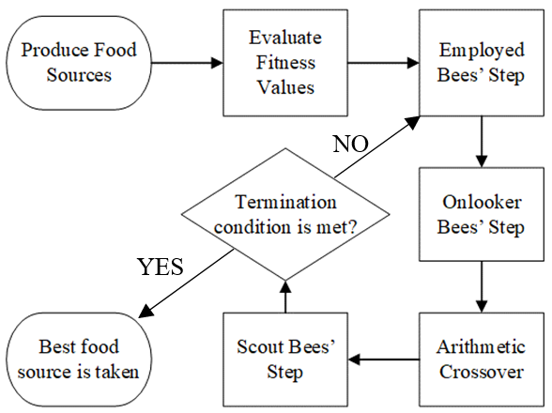
Hybrid Artificial Bee Colony (h-ABC) Algorithm
Fig. The Flowchart of h-ABC algorithm
Initialization Step:
The food sources are produced randomly within the range of the boundaries of the parameters.
${ x}_{i,j}=x_{j}^{min}$+rand(0,1)$\left(x_{jmax}−x_{jmin}\right)$
The fitness of the food sources will be avaluated.
Define a counter and initialize it as 0

Slide 6
Hybrid Artificial Bee Colony (h-ABC) Algorithm
Fig. The Flowchart of h-ABC algorithm
Employed Bees’ Step:
Each employed bee is sent to the food source and produces a neighbouring food source by this equation.
$v_{i,j}=x_{i,j}+∅\left(x_{i,j}−x_{k,j}\right)$
$∅$: uniformly distributed between -1 and 1
New food source is evaluated
Apply greedy selection
Keep the better food source
Any improvement?
YES : reset counter to 0
NO : increment it by 1

Slide 7
Hybrid Artificial Bee Colony (h-ABC) Algorithm
Fig. The Flowchart of h-ABC algorithm
Onlooker Bees’ Step:
Choose a food source to exploit depending on a probability related to its nectar amount.
$$P_{i}=\frac{{fitness}_{i}}{\sum_{j=1}^{SN}{{fitness}_{j}}}$$
After that, produced a neighbour food source according to equation below
$$v_{i,j}=x_{i,j}+∅\left(x_{i,j}−x_{k,j}\right)$$
Greedy selection is applied on the new and old food sources

Slide 8
Hybrid Artificial Bee Colony (h-ABC) Algorithm
Fig. The Flowchart of h-ABC algorithm
Crossover Step:
Arithmetic crossover method is applied in this paper. The offspring is produced according to equation below,
$child=α×{parent}_{1}+$(1-α)$×{parent}_{2 }$
where$, α is rand(0,1)$
Calculate fitness of offspring
Apply greedy selection
Replace the selected food source with offspring if it has better fitness

Slide 9
Hybrid Artificial Bee Colony (h-ABC) Algorithm
Fig. The Flowchart of h-ABC algorithm
Scout Bee’s Step:
If there is no improvement in the food source for a predetermined counter limit,
Abandon food source and
Produce a new one randomly
Reset counter to zero
Check whether the termination condition is met, if the answer is
YES : Terminate the algortihm
No : Recycle the process

Slide 10
T1 and T2 Transistor Structures
T1 is taken from literature (Klauk,2007) and T2 is fabricated in our laboratory
T1 has Bottom Gate Top Contact (BGTC) structure
T2 has Bottom Gate Bottom Contact (BGBC) structure.
Both transistors have pentacene OSC.
H. Klauk, U. Zschieschang, M. Halik, “Low-Voltage Organic Thin-Film Transistors with Large Transconductance,” Journal of Applied Physics, 102(7), 074514, 2007

Slide 11
Extracted Model Parameters

Slide 12
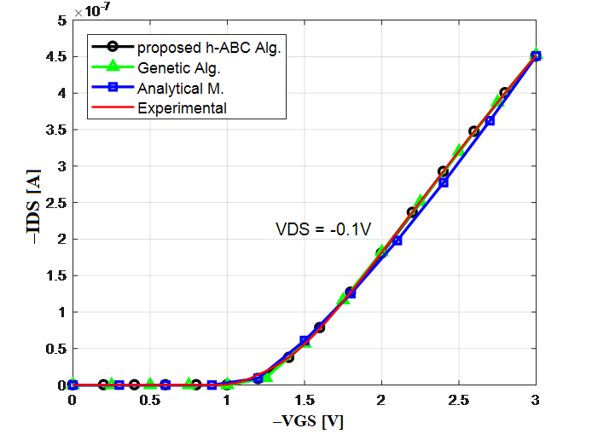
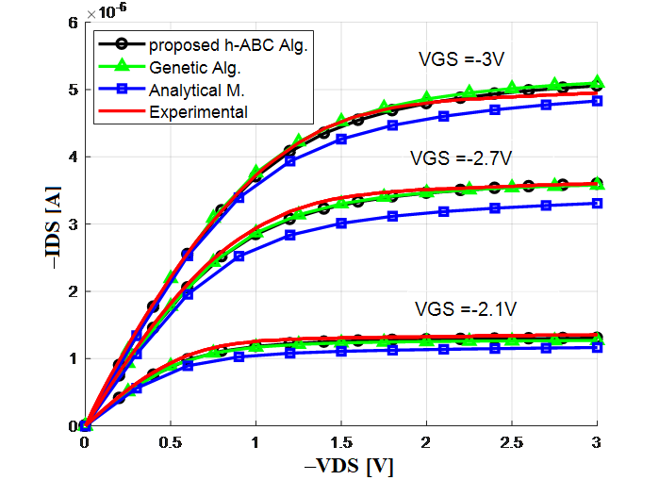
Simulation Results – T1
Transfer and Output Characteristics of T1.

Slide 13
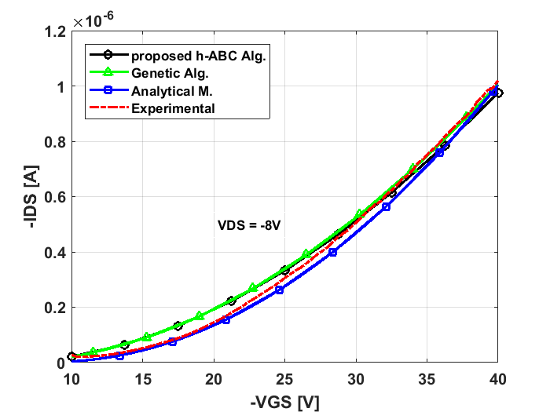
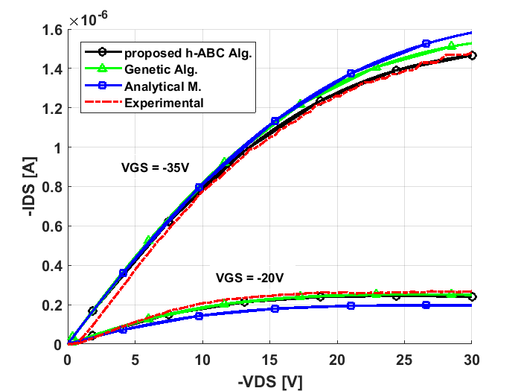
Simulation Results – T2
Transfer and Output Characteristics of T2

Slide 14
Conclusion
GA and h-ABC algorithm based approaches fit very well for T1.
h-ABC based approach gives the closest characteristic curves to those achieved experimentally.
Simulated model of T2 has less accuracy than the one of T1. We think that it is due to lack of measured data.
The proposed algorithm is easy to implement and its performance is satisfactory with the minimum error of %0.26 for T1 and %1.86 for T2.
This project is funded by TUBITAK (The Scientific and Technological Research Council of Turkey) 1001 Project # 116E250.

Slide 15
THANKS
nakkan@yildiz.edu.tr
Yildiz Technical University
Istanbul Technical University
Emerging Circuits and Computation (ECC) Group

