Slide 1

ELE 523E
COMPUTATIONAL NANOELECTRONICS
Mustafa Altun
Electronics & Communication Engineering
Istanbul Technical University
Web: http://www.ecc.itu.edu.tr/
FALL 2021
W1: Introduction, 4/10/2021

Slide 2
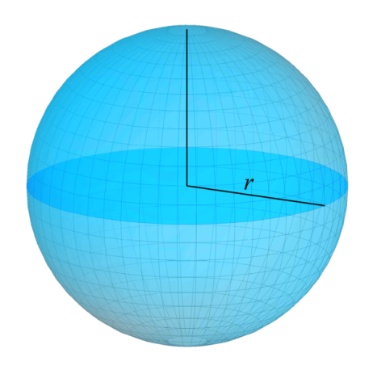
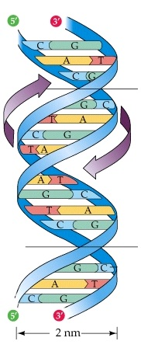
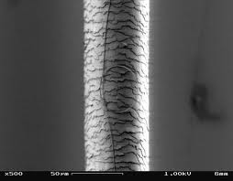
What is Nanoelectronics?
Nano Electronics
1 nm = 10⁻⁹m = 10 angstroms.
Atomic Van der Waals radius r: 0.3 to 3 angstroms.
Silicon Van der Waals radius: 2 angstroms.
Diameter of DNA helix: 2nm.,
Thickness of a cell membrane: 7.5nm.
Currently, commercially used, the smallest CMOS technology: 5nm.
Thickness of a human hair: 50um = 50000nm.
Sphere model of an atom
DNA helix
Human hair

Slide 3
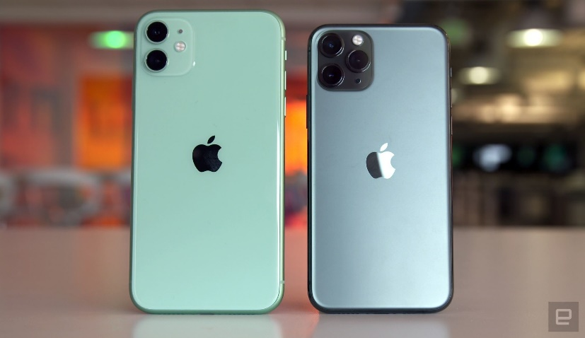
What is Nanoelectronics?
Example:
Consider a human hair with a thickness of 50um. Suppose that the shape of a human hair is cylinder. Consider a nano transistor with dimensions of L=30nm, W=30nm, and H=10nm. How many transistors can we fit into a 1mm human hair?
> 200,000,000,000
Practically, where are we now in 2020?
A13 Bionic chip in Iphone12 has "over 8.5 billion" transistors with TSMC FinFET 7nm technology that fit in a die area of 98 square millimeters.

Slide 4
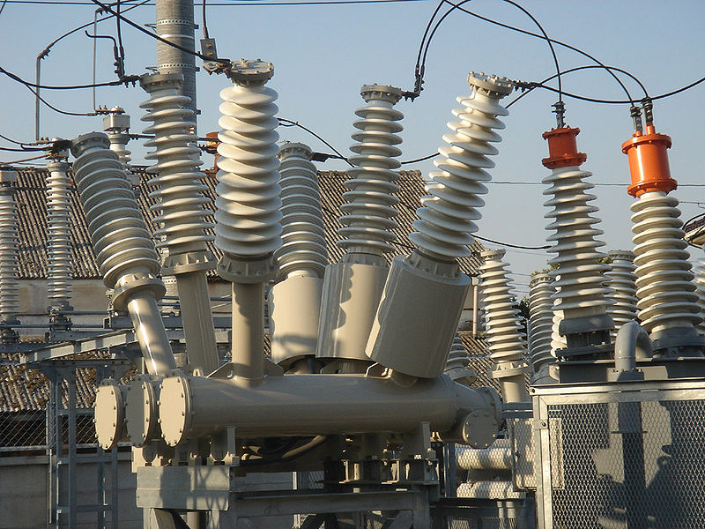
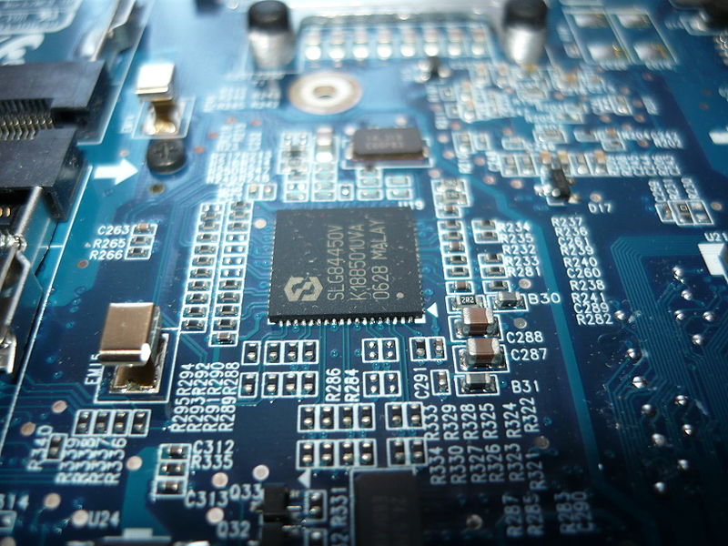
What is Nanoelectronics?
Nano Electronics
Electrical engineering
  HIGH VOLTAGE/CURRENT
  Power transmissions
  Electrical machines
Electronics engineering
  LOW VOLTAGE/CURRENT
  Computers
  Integrated circuits
Electrical
Electronics

Slide 5
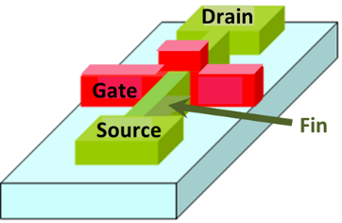
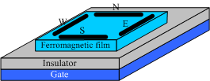


What is Nanoelectronics?
Nanoelectronics is not exactly nanoscale electronics, but emerging and nanoscale electronics.
  New future technologies
  Disruptive, completely new (disrupt an existing market)
  In an exploratory phase, not commercially used
  Beyond CMOS devices
FinFET transistor
Nanowire transistor
Spin wave switch
Single electron transistor

Slide 6

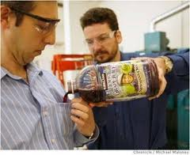
Why Nanoelectronics?
Non-stinky socks
Water resistant cloths
Main goal: to beat CMOS technology
CMOS shrinking problems
  Moore’s Law’s anticipated limit, approaching the size of atoms
  Short channel affects and leakage
  Uncertainty, probabilistic phenomena
  Fabrication challenges
  Power challenges
  5nm is seen as a critical point

Slide 7
Moore’s Law
1963: CMOS
1965: Moore’s Law
  Transistor count doubles every year.
1975: Moore’s Law updated
  Transistor count doubles every two years.
2015: Gordon Moore: «I see Moore’s law dying here in the next decade or so»
2015: Intel confirming the slowdown in pace of advancement, from two to two and a half years.
  Uncertainty, probabilistic phenomena
  Fabrication challenges
  Power challenges
New technologies emerge

Slide 8
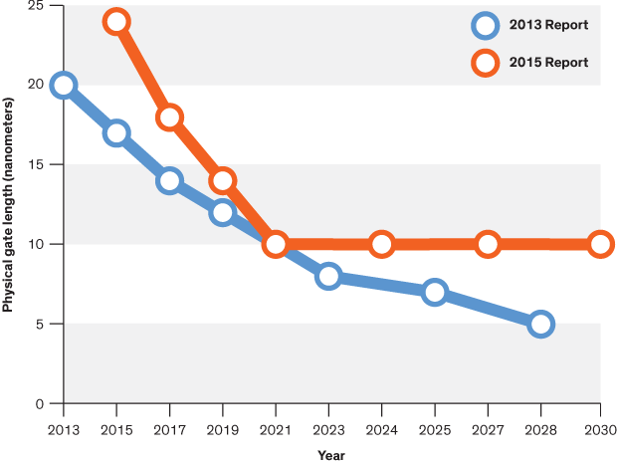
Critical Limits in Circuit Performance
f vs. year
Vdd vs. L
Energy ~ Vdd² × C
Power ~ Vdd² × C × f
C ~ Cox × W × L
Cox ~ 1/tox
f ~ 1/delay
P vs. year
L vs. year
delay~ W × L × 1/tox
* Vdd is limited by transistor threshold voltage
* tox is limited by leakage current
* W and L is limited by controllability
*Source: Computing’s Energy Problem in ISSCC, http://cpudb.stanford.edu/

Slide 9
Why Emerging Technologies and Computing?
Probabilistic phenomena
  Every physical behavior is probabilistic!
  The smaller the more probabilistic
Example:
  A transistor with 1 electron vs. 10 electrons vs. 100,000 electrons in conduction. When applied a controlling gate voltage of 1V, each electron passes from source to drain with a probability of 0.9. What are the probabilities that the transistor conduct current (at least one electron passes from source to drain)?

Slide 10
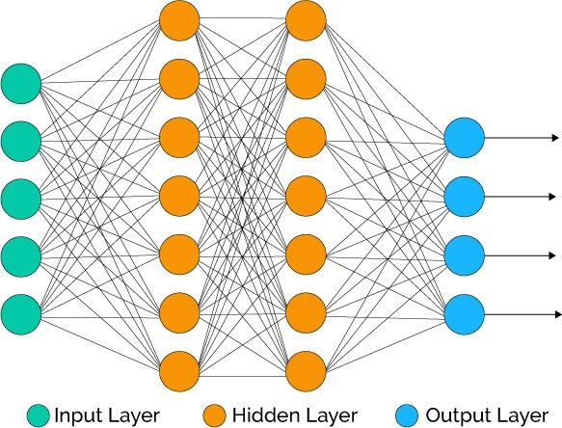
Why Emerging Technologies and Computing?
Technology scaling is stuck!
  To further decrease power and area
  To achieve mobile ultra-low power and area devices
    Mobile artificial intelligence?
    Efficient computing with large-area electronics?
Example:
  Assume that an 8-bit multiplier consumes 1mW power, and an 32-bit adder consumes 1mW power. Calculate the total power consumed by a neuron (perceptron) having 7 input/weights? How about area, especially for deep learning?

Slide 11
Nanoelectronics Research
Dramatic increase in interest and funding of nanoelectronics.
Top funding agencies (Horizon 2020-$20b, NSF-$7b, NIH- $30b, Tubitak- $1b …) pour money to nanoengineering and emerging computing.
  Leading universities have research groups on nanoelectronics.
  The most prestigious conferences on circuit design DAC, ICCAD, DATE, and ISSCC have increasing number of papers targeting emerging technologies.
Better to add the word “nano and emerging” to your paper/presentation/proposal!

Slide 12
Computational Nanoelectronics
Theoretical - Physics
  Physics rules – probability based
  Quantum mechanics
    The uncertainty principle
  Schrödinger equation
  Theory of relativity
Experimental – Materials and Fabrication
  Fabrication processes
  Self assembly
Computational
  Computing 0s and 1s
  Achieve logic and memory operations
  Algorithms, design techniques, CAD tools

Slide 13
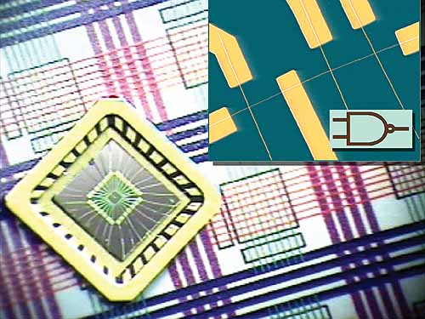
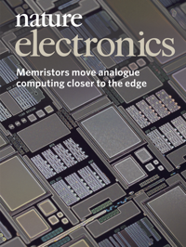
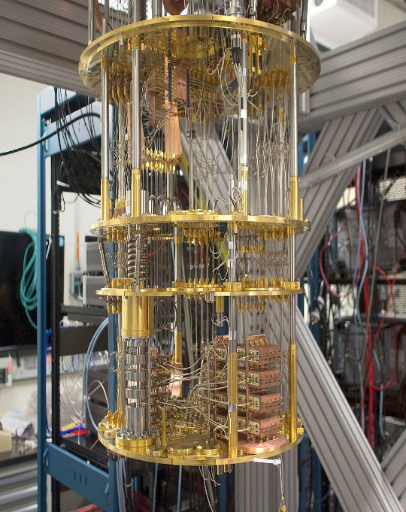
Computational Nanoelectronics
Emerging computers get real
Ultra-tiny computer from an assembly of nanowires, Harvard University, 2016
UMASS Memristor Computer, 2018
IBM, quantum computer, 2017

Slide 14

Suggested Readings/Videos
Feynman, R. P. (1960). There's plenty of room at the bottom. Engineering and Science, 23(5), 22-36.
Iwai, H. I. R. O. S. H. I. (2009). Roadmap for 22nm and beyond.Microelectronic Engineering, 86(7), 1520-1528.
Conte, T.; Gargini, P. (2015), On The Foundation Of The New Computing Industry Beyond 2020, IEEE, International Technology Roadmap for Semiconductors (ITRS)
Waldrop, M. M. (2016). More than Moore. Nature, 530(7589), 144-148.
Richard Feynman Nanotechnology Lecture, 1984
http://www.youtube.com/watch?v=4eRCygdW--c

Slide 15
Course Information
A research course
Make you think out of the box
Unconventional
Computing and circuit based icluding the probability theory
http://www.ecc.itu.edu.tr/index.php/ELE_523E

