Slide 1
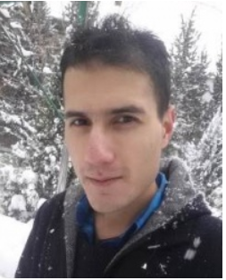
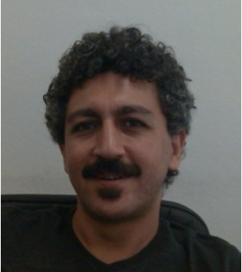
SAMPLING BASED RANDOM NUMBER GENERATOR (SBRNG) FOR STOCHASTIC COMPUTING
M.Burak KARADENIZ & Mustafa ALTUN
Emerging Circuits and Computation (ECC) Group
Istanbul Technical University
ICECS 2017
Notes:
HI MY NAME IS BURAK KARADANIZ FROM ISTANBUL TECHNICAL UNIVERSITY. I AM DOCTOROTE CANDITATE IN ELECTRONIC ENGINEERING. I HAVE MASTER DEGREE IN VLSI NOW, I WORK IN THE MUSTAFA ALTUN EMERGING CIRCUIT AND COMPUTATATION GROUP WHICH IS LEADER GROUP ON EMERGING TECHNOLGY STUDYS IN TURKEY. HE IS ALSO COWRITER AND DIRECTOR OF THIS STUDY ABOUT SAMPLING BASED RANDOM NUMBER GENERATOR (SBRNG) FOR STOCHASTIC COMPUTING.

Slide 2
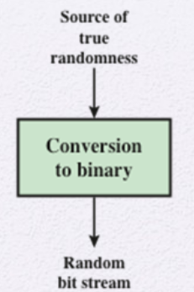
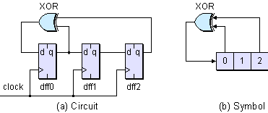
LITERATURE
LFSR
Problems
Lack in Randomness
Area Consumption
TRNG
Problems
Speed
Feasibility
Uncontrollability
Notes:
FIRST IF WE LOOK AT THE LITERATURE, LINEAR FEEDBACK SHIFT REGISTERS AND TRUE RANDOM NUMBER GENERATOR HAVE BEEEN WIDELY USED TO GENERATE RANDOM BIT STREAMS BUT THEY HAVE SOME PROBLEMS. IN LFSRS THE NUMBER OF BIT STREAM IS INCREASED BY THE DFF AND CORRELATION OF THIS BIT STREAM IS NOT RICH, WHILE IN TRNG FEASIBILITY WHICH MEANS THAT PLUGGIN THE CIRCUTRY INTO CMOS APPLICATION IS HARD BECAUSE OF THE HARVESTING OF TRUE RANDOM SOURCE.

Slide 3
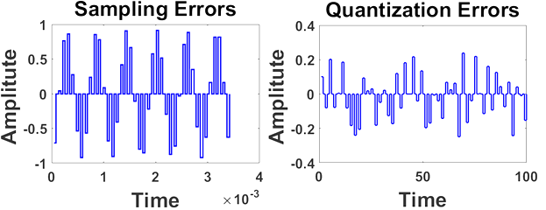
SAMPLING BASED RANDOM NUMBER GENERATOR (SBRNG)
Quantization Error ($E_{Q}$) is random but process is complex and slow
Sampling Error ($E_{A}$) is random also process is simple and fast
Notes:
SO WE PROPOSE NEW SAMPLING BASED RANDOM NUMBER GENERATOR TO OVERCOME THESE DRAWBACKS AND AIM TO COMBINE THE ADVANTEGE OF THE SPEED OF LFSR TO THE RANDOMNESS OF TRNG. BASICALLY WE KNOW THAT QUANTIZATION ERRORS ARE RANDOM BETWEEN HALF OF QUANTIZATION STEPS. BUT TO EXTRACT QUANTIZATION ERROR ONE NEEDS DAC AND ADC, WHICH WILL NOT BE EFFICIENT TO COMPARE LFRS WHOSE SPEED IS IN CLK FREQUENCY BUT WE PROOVE THAT JUST BEFORE THE QUANTIZATION WE CAN GET SAME RANDOM PROCESS AFTER SAMPLING OF PERIODIC SIGNAL WITH A FREQUENCY OF CO-PRIME WITH THE SIGNAL SOURCE.

Slide 4
BLOCK DIAGRAM
Source can be any periodic signal (Sine, Square, Triangular etc.)
Probability of Random Bit Stream ${(P}_{X})$ is can be set
$f_{sto}>f_{CLK}$
Notes:
THE BASIC BLOCK DIAGRAM IS BEGIN WITH THE GENERATING SOURCES TO BE SAMPLED AND THAN FEED THROUHT THE SAMPLING WITH AN SAMPLE AND HOLD CIRCUITY AND THAN SUBTRACTING THIS OUTPUT FROM THE ORIGINAL SIGNAL TO GET THE SAMPLING ERRROS. AND FINALLY TO COMPRESS THESE ERRORS BETWEEN REFERNCES LEVEL TO GET DIGITAL STOCHASTIC OUTPUT WITH DESIRED PROBABILITY WHICH MEANS THAT THE NUMBER OF 1 OVER THE LENGTH OF THE BIT STREAM. THIS METHOD PROVIDE THAT THE STOCHASTIC OUTPUT FREQUENCY IS MUCH HIGHER THAN THE SAMPLING FREQUENCY BECAUSE OF THE FACT THAT THE ANALOG OUTPUT EVEN MORE SQUEEZE IN AMPLITUDE

Slide 5
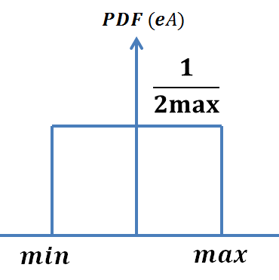
THEORY
Sampling frequency and the source frequency are co-prime (no common divider), ($E_{A}$) has maximum randomness or stochastic behavior.
Sampling Errors ($E_{A}$) are accumulated in uniform distribution between positive and negative maximum values
$$P_{x}=(b−a)/{\left|{2eA}_{max}\right|}$$
Notes:
THE BASIC THEOREY BEHIND THIS PROCESS IS SET THE SAMPLING FREQUENCY COPRIME WITH THE SIGNAL FREQUENCY SO THAT THEY CANNOT BE CONVERGED IN TIME DOMAIN. WHICH IS A KNOWN PHONEMENO IN ADC S WHICH IS ALSO TRUE IN SAMPLING PROCESS. AFTER GETTING ERRORS FROM THE PROCESS THE ERRORS ACCUMULATED AS UNIFORM, AND KNOWING THE PROBABILITY DISTRIBUTION FUNCTION OF THE ERRORS WE GENERATE RANDOM NUMBERS WITH THE REFERENCES LEVELS HERE IS A AND B

Slide 6
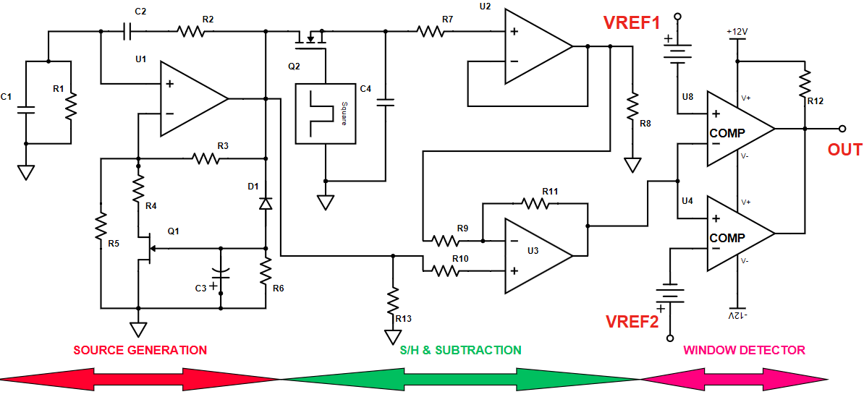
PROPOSED CIRCUIT DIAGRAM
Signal Frequency and Amplitude are set by R1, R2, C1, C2
Notes:
THE PROPOSED CIRCUITRY BEGIN WITH THE GENERATING THE SIGNAL SOURCE THROUG WIEN BRIDGE OSCILLATOR WHOSE FREQUENCY AND AMPLITUTED CAN BE ADJUSTABLE THROGH RC NETWORK AND THAN SAMPLING THIS SIGNAL BY SAMPLE AND HOLD CIRCUITRY AND AFTER SUBTRACTION WE USE TWO COMPARATOR AS AN WINDOW DETECTOR TO OUT STOCHASTIC BIT STREAM OUT.

Slide 7
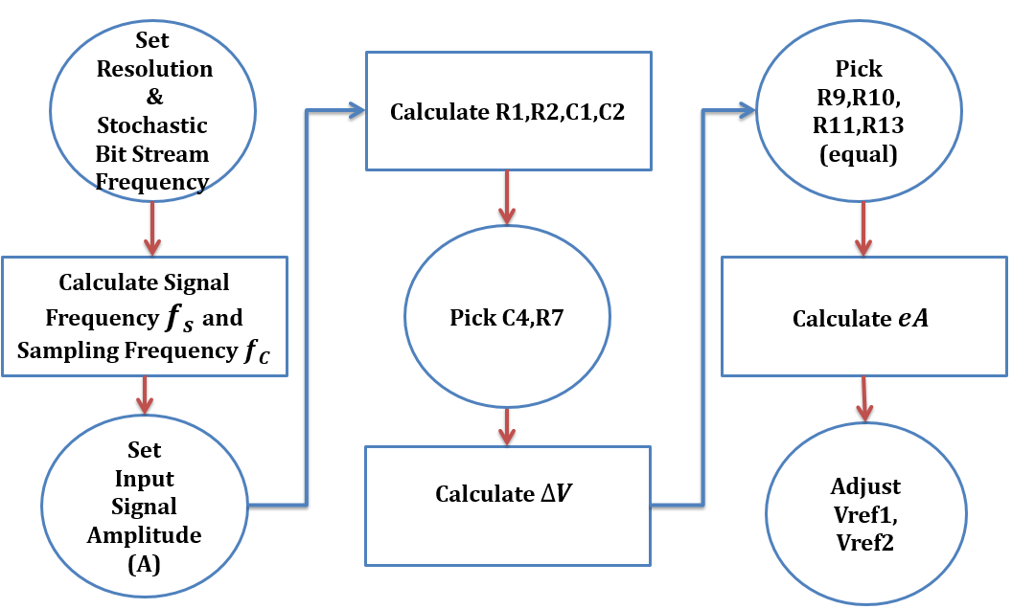
DESIGN FLOWCHART
Stochastic Bit Stream Speed and Resolution are Specs
$f_{s}=f_{sto} x Sampling Rate {(SR}^{−1}) x Resolution$
Notes:
IN STOCHASTIC APPLICATIONS THE SPECS ARE DETERMINED SO THAT THE STOCHASTIC BIT STREAM HAS A CERATIN SPEED AND RESOLUTION. THE FLOW CHART THAT IS DISPLAYED ON THE SLIDE SHOW THAT FIRST WE DETERMINE SIGNAL (OSCILLATING) FREQUENCY AND THAN IN THE CIRCUITRY WE ADJUST THE RC NETWORK AND SAMPLING CLOCK WITH IN THE SAMPLE AND HOLD CIRCUIT. THE LAST STEP IS TO ABOUT TO SET THE PROBABILITY OF THE BIT STREAM WHICH IS DISCCUESSED BEFORE TO DETERMINE THE REFERNCE VOLTAGES

Slide 8
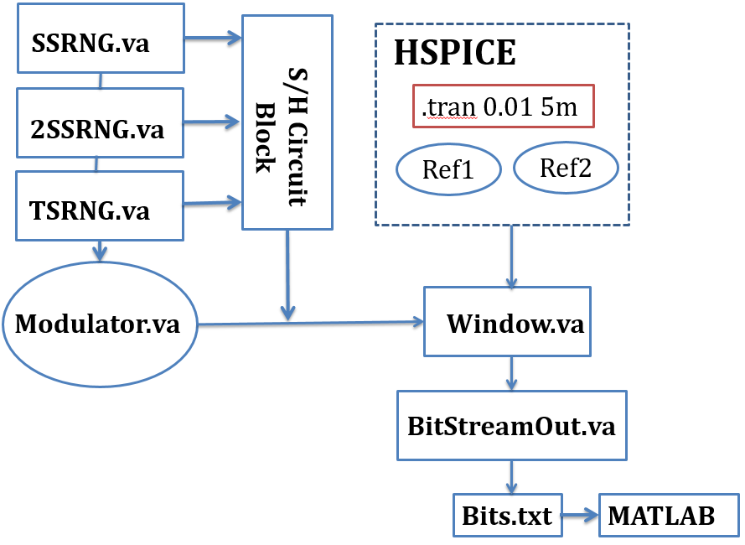
ANALYSIS OF BIT STREAM COMPATIBILITY
HSPICE simulation is set and embedded into MATLAB code
Notes:
SO FAR SO GOOD THAT WE FINALLY ANALYZE THE SBRNG OUTPUT IN HSPICE WITH THE FOLLOWING SETUP IN HSPICE. AND THAN WE GET TXT BIT STREAM AND FEED INTO MATLAB CODE TO COMPARE AND ANALYZE THE DISTRIBUTION, RANDOMNESS OF THE BIT STREAMS

Slide 9
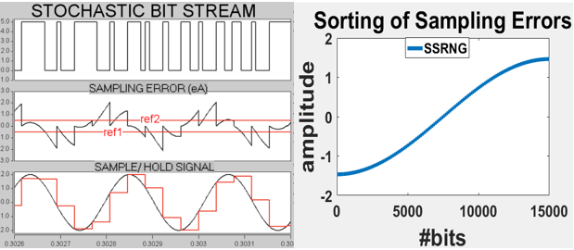
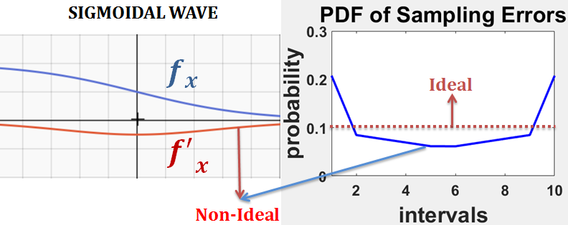
UNIFORM DISTRIBUTION COMPATIBILITY
Sampling Errors from Single Sine Wave Sampling Based Random Number Generator (SBRNG) is not perfectly uniform distributed
Uniform Signals (such as Triangular Wave) can be used but yields poor randomness
Notes:
SAMPLING ERRORS GENERATED FROM THE SINGLE SINE WAVE IS NOT PERFECTLY DISTRIBUTED. (LEFT BELOW PICTURE) SHOWS THE SIGNAL AND THE SAMPLING ERRORS AND GENERATED STOCHASTIC BIT STREAM AND WHILE LOADING THIS OUTPUT TO THE MATLAB SHOW THAT FIFTEEN THOUSAND BITS HAVE BEEN SORTED AS A SIGMOIDAL WAVE AND THE PDF OF THIS ERRORS (RIGHT BELOW PICTURE) IS NOT IDEAL AS EXPECTED.
IF THE SIGNAL SOURCE THAT IS TO BE SAMPLED SOMEHOW IS UNIFORM THAN WE CAN GET PERFECTLY UNIFORM DISTRIBUTED SAMPLING ERRORS BUT THIS SPOILS THE RICHNESS OF THE RANDOMNESS IN WHICH PORCESS THAT WE USE THE SINE WAVE SOURCES AS ALSO THE SOURCE OF RANDOMNESS APART FROM THE RANDOMNESS THAT WE GET FROM THE RANDOM CONVERGING OF THE SAMPLING AND SOURCE SIGNAL

Slide 10
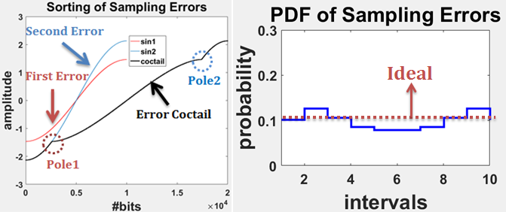
UNIFORM DISTRIBUTION COMPATIBILITY
Sampling Errors Coctail from Multiple Sine Wave Sampling Based Random Number Generator (2SBRNG) is compensated each other to form uniform distribution
Gibbs Phonemonen is applied
$x_{t}=\frac{4}{π}(sin\left(x\right)+\frac{1}{3}\sin\left(3x\right)+\frac{1}{5}\sin\left(5x\right)+…)$
Notes:
THEN HOW ABOUT THE SQUARE WAVE, IT CANNOT BE USED TO BE SAMPLED BECAUSE THE SAMPLING ERRORS WOULD BE SAME THROUG THE TIME
BUT WE CAN USE TWO SIGNAL SOURCES APPLIYNG GIBBS PHONEMONEN WHICH IMPLIES THAT THE SQUARE WAVE IS COMPOSED OF MANY SINE WAVES WHICH HAS FREQUENCY THAT IS ODD NUMBER TIMES OF THE FREQUENCY OF BASE SINE WAVE. THAN WITH THE TWO SIGNAL WHOSE FREQUENCY SET TO BE SUM OF THE SIGNAL AS SQUARE AS STATED BY THE GIBBS WE GET PRETTY WELL UNIFORM DISTRIBUTED SAMPLING ERORS (RIGHT BELOW PICTURE)

Slide 11
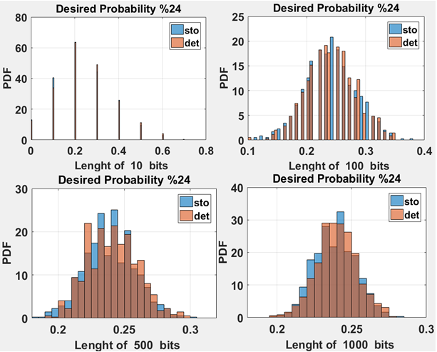
BİNOMİAL DİSTRİBUTİON COMPATIBILITY
SBRNG generated bit streams are compared to MATLAB’ s.
Probability Density Function (PDF) of SBRNG is binomial
Notes:
SAMPLING BASED RANDOM NUMBER GENERATOR OUTS THE BIT STREAM IN BINOMIAL DISTRIBUTION WHICH IS OFFERED IN STOCHASTIC APPLICATIONS. THE DESIRED PROBABILITY IS SET TO 24 PERCENT IN DIFFERENT SIZE OF RANDOM BITS IN THE LENGTH OF TEN HUNDRED FIVE HUNDRED THOUSAND BITS AND WE SEE THE THE PROBABILITY DENSITY FUNCTION IS BINOMIAL COMPARING SAME WITH THE PROGGRAM GENERATED BIT STREAMS

Slide 12
PERFORMANCE of SBRNG
 | LFSR 8 | LFSR 13 | MATLAB Randn (1,160000) | GLFSR [3] | STT-MTJ [4] | SRAM Based [6] | All- Digital PVT Variation Tolerant [5] | SBRNG2 (this work) | SBRNG3 (this work) | SBRNG4 (this work)
Effective number of bits | 256 | 8192 | 160000 | 256 | 256 | 256 | 1048576 | 8100 | 60000 | 160000
Transistor count with normalized%50 probability output | 114 | 174 | NA | 108 | 9719 | 1536 | 734693 | 61 | 81 | 101
Transistor count with desired probability output | 290 | 460 | NA | Not reported | Not reported | Not reported | Not reported | 101 | 121 | 141
Speed $f_{sto}$ (GHz) | Clock Frequency (CLK) |  | Non-Available (NA) | CLK | 0.177-0.2 | NA | 0.1-2.9 | CLKx100
Notes:
HERE WE DISCUSS THE PERFORMANVE OF THE SBRNG WITH TWO THREE FOUR SOURCES AND WE COMPARE WITH THE LFSR EIGHT BITS AND THIRTEEN BITS AND WE ALSO COMPARE SBRNG WITH THE TRUE RANDOM GENERATORS THAT HAVE BEEN PUBLISHED RECENTLY ON THE LITERATURE. WE GET SUPERIOR NUMBER OF RANDOM BITS (WHICH IS NON OVERLAPPING BITS) COMPARING TO THE LFSR AND WE CLOSE TO THE RANDOM NUMBER THAT IS GENERATED FROM THE TRNG AND ALSO THE SPEED OF SBRNG IS BETTER THAN THE CONVENTIONAL LFSR TECHNIQUE.

Slide 13
CONCLUSION
PROPOSED SBRNG’S HAVE A REAL POTENTIAL TO REPLACE LFSR BASED TECHNIQUES.
Proposed design gives 640x higher throughput over conventional methods with enhanced simplicity of SBRNG network.
Speed of SBRNG is 100x better compared to traditional LFSR (RNG speed is critical for security issues)
RNG stream probability can be controlled in SBRNG (very handful in Stochastic Applications)

Slide 14
FUTURE WORK
Very Fast Highly Random Probability Controllable Sampling Based Random Number Generator will be Tape-out based on theoratical assumptions and simulations on this work.

Slide 15
THANK YOU FOR LISTENING.
This work is supported by the TUBITAK 1001 project # 116E250.

