Slide 1
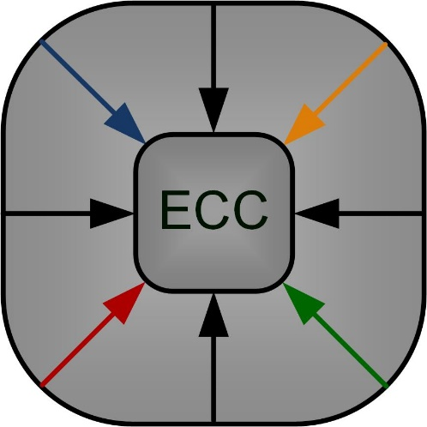
Approximate Fully Connected Neural Network Generation
Tuba Ayhan, Mustafa Altun
tuba.ayhan@itu.edu.tr
Istanbul Technical University
Electronics and Communication Engineering Department
Emerging Circuits and Computation (ECC) Group – ITU

Slide 2
Approximate computing
X0
O0
X1
O1
Exact implementation
High performance
High area and power consumption

Slide 3
Approximate computing
X0
X0
O0
O0
X1
O1
X1
O1
Exact implementation
High performance
High area and power consumption
Approximate implementation
Lower performance
Low area and power consumption

Slide 4
Outline
Network architecture
  Layer architecture
  Constant multiplier block
Area reduction
  Error propagation
  Area reduction algorithm
Test results
Conclusion
Layer information
Error tolerance
Area reduction
Area cost estimation
Approximation model
Performance loss estimation
w, b
Network generation
Multiplier library
Architecture template
Network implementation

Slide 5
Outline
Network architecture
  Layer architecture
  Constant multiplier block
Area reduction
  Error propagation
  Area reduction algorithm
Test results
Conclusion
Layer information
Error tolerance
Area reduction
Area cost estimation
Approximation model
Performance loss estimation
w, b
Network generation
Multiplier library
Architecture template
Network implementation

Slide 6
Outline
Network architecture
  Layer architecture
  Constant multiplier block
Area reduction
  Error propagation
  Area reduction algorithm
Test results
Conclusion
Layer information
Error tolerance
Area reduction
Area cost estimation
Approximation model
Performance loss estimation
w, b
Network generation
Multiplier library
Architecture template
Network implementation

Slide 7
Outline
Network architecture
  Layer architecture
  Constant multiplier block
Area reduction
  Error propagation
  Area reduction algorithm
Test results
Conclusion
Layer information
Error tolerance
Area reduction
Area cost estimation
Approximation model
Performance loss estimation
w, b
Network generation
Multiplier library
Architecture template
Network implementation

Slide 8

Network architecture – Layer architecture 1/2
X0
X
X
X
X
X
w₀₀
w₀₁
w₀₂
w₀₃
w₀₄
X0
O0
+
+
+
+
+
X1
O1
X1
X
X
X
X
X
w₁₀
w₁₁
w₁₂
w₁₃
w₁₄
LAYER 1
+
+
+
+
+
1
X
X
X
X
X
b₀
b₁
b₂
b₃
b₄
$$y_{n}=f\left(w_{0n}.x_{0}+w_{1n}.x_{1}+b_{n}.1\right)$$
$$O_{0}=\left(w_{00}.x_{0}+w_{01}.x_{1}+b_{0}.1\right)$$
O0
O1
O2
O3
O4
$$O_{1}=\left(w_{01}.x_{0}+w_{11}.x_{1}+b_{1}.1\right)$$
....
....
Layer 1 architecture
$$O_{4}=\left(w_{04}.x_{0}+w_{14}.x_{1}+b_{4}.1\right)$$

Slide 9
Network architecture – Layer architecture 2/2
X0
X
w₀₀
X
w₀₁
X
w₀₂
X
w₀₃
X
w₀₄
+
+
+
+
+
X0
LAYER 1
O0
X1
X
w₁₀
X
w₁₁
X
w₁₂
X
w₁₃
X
w₁₄
+
+
+
+
+
X1
O1
1
X
b₀
X
b₁
X
b₂
X
b₃
X
b₄
O0
O1
O2
O3
O4
1
O0
LAYER 3
O1
O2
LAYER 2
1
O0
O1

Slide 10
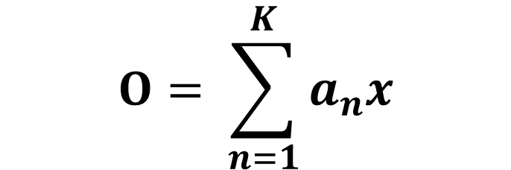
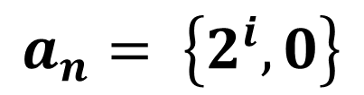
Network architecture – Constant multiplier block 1/2
Xi
<<0
<<1
<<2
<<3
<<4
<<5
<<6
<<7
0
+
+
+
+
+
CMB-L1
O0
O1
O2
O3
O4
$$O= \sum_{n=1}^{K}{a_{n}x}$$
Constant multiplier block for layer 1:
5 outputs → 5 adders
8 bit input → 8 shifted versions and a 0.
$$a_{n}= \left\{2^{i},0\right\}$$

Slide 11
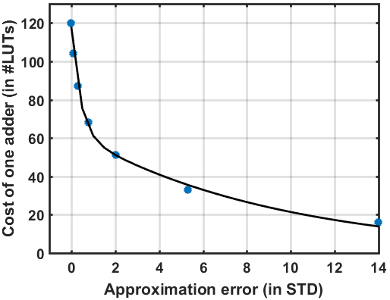
Network architecture – Constant multiplier block 2/2
8-bit signed multiplication
Error:
Mean = 0
std = depends on # addends
Implemented on
Spartan6 FPGA

Slide 12
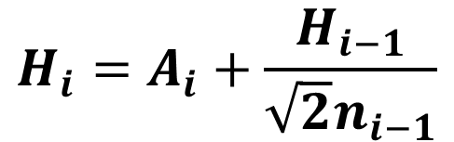

Area reduction – Error propagation
Take binary classification problem
Exact:
Class0
Class1
X0
O0
O₀-O₁
X1
O1
Error
A₃
H₃
A₂
H₂
Approx.:
A₁
H₁
Class0
Class1
Approximation level of layer i: A_{i}
Noise added at layer i: H_{i}
# neurons in layer i: n_{i}
O₀-O₁
Error tolerance, e_{T}
$$H_{i}=A_{i}+\frac{H_{i−1}}{\sqrt{2}n_{i−1}}$$
$$H_{3}≤e_{T}$$

Slide 13

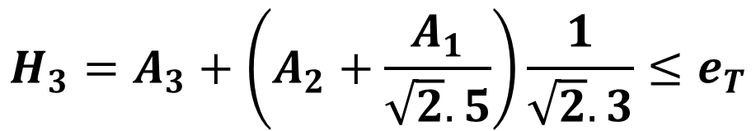


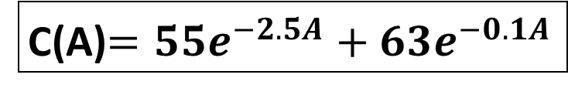

Area reduction – Area reduction algorithm
$$min\left(N^{T}.C\left(x\right)\right)$$
s.t. $H_{L}≤e_{T}$
$lb≤x≤ub$
Curve fitting applied:
C(A)$=55e^{−2.5A}+63e^{−0.1A}$
Example
$$L=3$$
$$x=\left[\begin{matrix}A_{1} \\ A_{2} \\ A_{3}\end{matrix}\right]$$
$$N=\left[\begin{matrix}10 \\ 15 \\ 6\end{matrix}\right]$$
X0
O0
X1
O1
$$H_{3}=A_{3}+\left(A_{2}+\frac{A_{1}}{\sqrt{2}.5}\right)\frac{1}{\sqrt{2}.3}≤e_{T}$$

Slide 14
Simulation results
Simulation Setup
#neurons | Exact | e_{T} = 0.5% | e_{T} = 5% | e_{T} = 10%
120 | 1826 | 1521 | 513 | 380
96 | 1463 | 1431 | 529 | 328
72 | 1026 | 927 | 497 | 286
60 | 745 | 617 | 314 | 216
36 | 614 | 292 | 165 | 163
12 | 252 | 252 | 106 | 104
Implement
Define architecture
Approximation
Include weights
Exact
Problem 1
X0
.
.
O0
.
.
.
Problem 2
X1
.
O1
Approx.with e_{T}=0.5
120 Neurons
.
.
Approx.with e_{T}=5
.
.
.
.
12 Neurons
Approx.with e_{T}=10
Problem 10
Xilinx Spartan6 FPGA with ISE 14.7 design tools
Networks have 12 ~120 neurons. 1 exact and 3 approximate implementations are available.
Each network is trained for 10 different classification problems. Results are given as average over 10 problems.

Slide 15
Conclusion
Approximate FCNN generation framework is proposed with:
  An FCN structure and
  An area reduction algorithm utilizing the proposed structure
The approximation error of the constant multiplier blocks can be altered.
The area consumption of the network is reduced, yet the network can provide targeted classification performance.
The area optimization can be completely detached from FCN training.
Without prior information on network constants, the framework can still achieve up to 73% area saving with less than 5% loss in classification accuracy, in our examples.
This project is funded by TUBITAK (The Scientific and Technological Research Council of Turkey) 1001 Project # 117E078.

Slide 16
Thank you.
tuba.ayhan@itu.edu.tr
Istanbul Technical University
Emerging Circuits and Computation (ECC) Group

