Slide 1
ELE 523E COMPUTATIONAL NANOELECTRONICS
Mustafa Altun
Electronics & Communication Engineering
Istanbul Technical University
Web: http://www.ecc.itu.edu.tr/
FALL 2021
W3: Reversible Quantum Computing, 18/10/2021

Slide 2
Outline
Quantum computing
Gates and circuits
Algorithms
Reversible circuit design
Toffoli gate
Circuit analysis
Circuit synthesis
Irreversible to reversible transformation
Video: Quantum Computers

Slide 3
Quantum Gates - NOT
Quantum gates are reversible

Slide 4
Quantum Gates - Hadamard

Slide 5
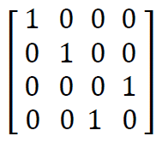
Quantum Gates - CNOT
A
A′
B
B′

Slide 6
Quantum Gates - CNOT
A
A′
B
B′
INPUT | OUPUT
A | B | A′ | B′
0 | 0 | 0 | 0
0 | 1 | 0 | 1
1 | 0 | 1 | 1
1 | 1 | 1 | 0
Truth table

Slide 7
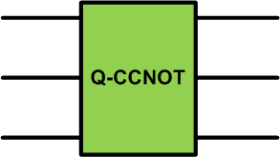
Quantum gates – CCNOT
A
A′
B
B′
C
C′
A | B | C | A′ | B′ | C′
0 | 0 | 0 | 0 | 0 | 0
0 | 0 | 1 | 0 | 0 | 1
0 | 1 | 0 | 0 | 1 | 0
0 | 1 | 1 | 0 | 1 | 1
1 | 0 | 0 | 1 | 0 | 0
1 | 0 | 1 | 1 | 0 | 1
1 | 1 | 0 | 1 | 1 | 1
1 | 1 | 1 | 1 | 1 | 0

Slide 8
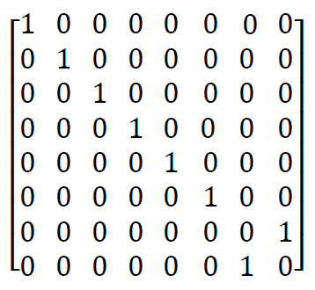
Quantum gates – CCNOT
A
A′
B
B′
C
C′
Toffoli gate

Slide 9
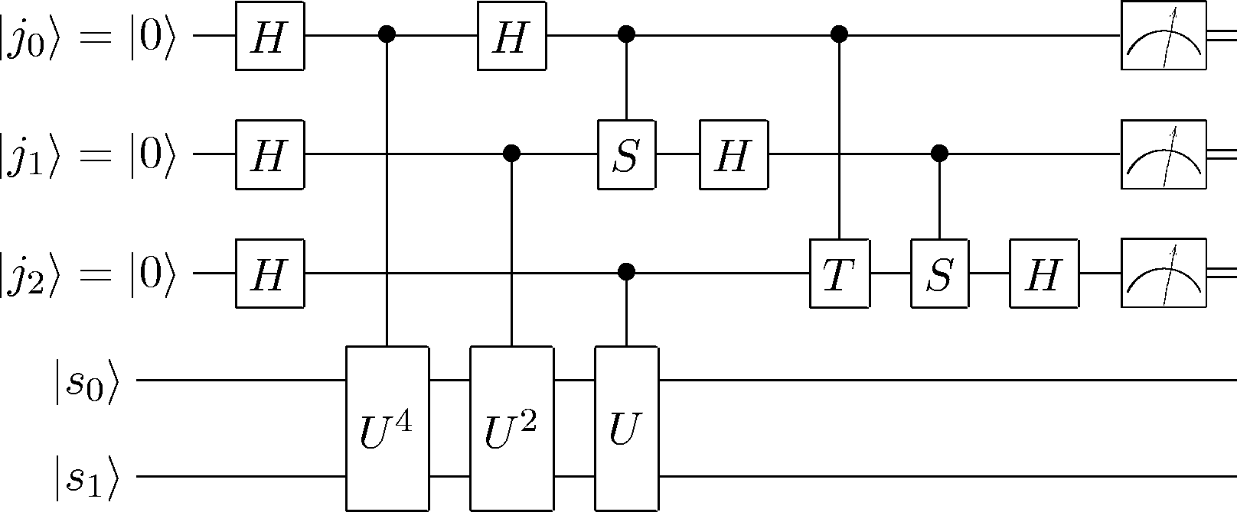
Quantum Circuits
There is no way of efficiently preparing the input state.
There is no way of reading out the output precisely.
This is in the nature of measurement in quantum mechanics.
Measurement symbol

Slide 10
Quantum Circuits
Severe restrictions on measuring and copying signals

Slide 11
Quantum Circuits
Example:
Find the output quantum states and probabilities.
?
?
How about the truth table?

Slide 12
Quantum Circuits
Example:
Find the output quantum states and probabilities.
?
?
How about the truth table?

Slide 13
Factorizing RSA Numbers
RSA numbers are semi-prime numbers. For each RSA number n, there exist prime numbers p and q such that n = p × q.
15 = 3 × 5
77 = 7 × 11
529 = 23 × 23
4633 = 41 × 113
RSA-100 = 15226050279225333605356183781326374297180681
14961380688657908494580122963258952897654000350692006139 =
37975227936943673922808872755445627854565536638199 ×
40094690950920881030683735292761468389214899724061
The prize for RSA-1024 is $100.000.
RSA-2048 takes approximately 10 billion years with the best known algorithm.

Slide 14
Classical Factorizing
The Classical Algorithm
Input: A semi-prime number n.
Output: Prime numbers p and q such that n = p × q.
Steps:
Arbitrarirly select a number x such that 1<x<n.
Find x^{i} mod n for i = 1,2,3,… until finding the period R.
Calculate greatest common divisor (GCD) of (x^{R/2} -1, n) and (x^{R/2} +1, n).
GCDs give the numbers p or q.
What if R is odd?
What if the algorithm results in 1 and n ?

Slide 15
Classical Factorizing
Example: If n=15 what are p and q?
Arbitrarirly select a number x such that 1<x<n.
x=7
Find x^{i} mod n for i = 1,2,3,… until finding the period R.
7¹ mod 15 = 7
7² mod 15 = 4
7³ mod 15 = 13
7⁴ mod 15 = 1
7⁵ mod 15 = 7
Find GCDs.
GCD(7^{4/2}-1, 15) = 3, GCD(7^{4/2}+1, 15) = 5
R = 4

Slide 16
Classical Factorizing
Example: If n=15 what are p and q?
Arbitrarirly select a number x such that 1<x<n.
x=9
Find x^{i} mod n for i = 1,2,3,… until finding the period R.
9¹ mod 15 = 9
9² mod 15 = 6
9³ mod 15 = 9
Find GCDs.
GCD(9^{2/2}-1, 15) = 1, GCD(9^{2/2}+1, 15) = 5
R = 2

Slide 17
Classical Factorizing
Example: If n=15 what are p and q?
Arbitrarirly select a number x such that 1<x<n.
x=14
Find x^{i} mod n for i = 1,2,3,… until finding the period R.
14¹ mod 15 = 14
14² mod 15 = 1
14³ mod 15 = 14
Find GCDs.
GCD(14^{2/2}-1, 15) = 1, GCD(14^{2/2}+1, 15) = 15
R = 2

Slide 18
Classical Factorizing
Example: If n=15 what are p and q?
Arbitrarirly select a number x such that 1<x<n.
x=10
Find x^{i} mod n for i = 1,2,3,… until finding the period R.
10¹ mod 15 = 10
10² mod 15 = 10
R = 1
Is there a way of properly selecting x ?

Slide 19
Classical Factorizing
The Classical Algorithm
Arbitrarirly select a number x such that 1<x<n.
Find x^{i} mod n for i = 1,2,3,… until finding the period R.
Calculate greatest common divisor (GCD) of (x^{R/2} -1, n) and (x^{R/2} +1, n).
Step-2 is problematic for large numbers.
Shor’s algorithm completes step-2 efficiently.
Step-3 can be done polynomially in time with using Euclidean algorithm.

Slide 20
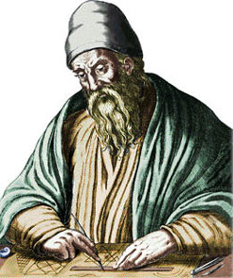
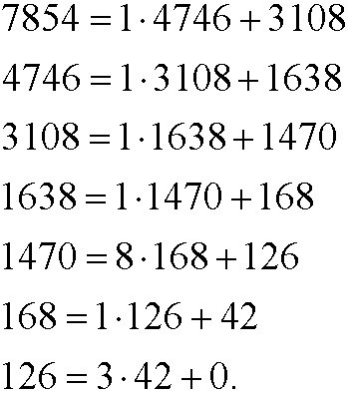
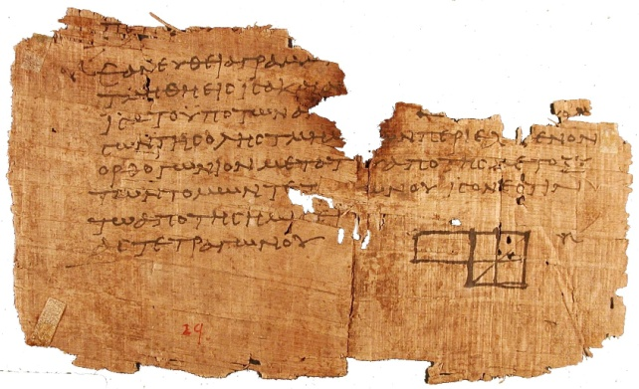
Euclidean Algorithm
GCD(7854, 4746) = ?
Euclid, 300 BC
Euclid’s Elements

Slide 21
Shor’s Algorithm
Time complexity: O((log N)³).
N is number of digits of the given semi-prime number.
Based on quantum Fourier transform and modular exponentiation.
Success rate is 50%.
Currently no practical and useful implementation.

Slide 22
Reversible Circuits
Main motivation: energy efficiency.
Energy efficient in error correction and detection.
Restart or reset a system.
source: http://www.cise.ufl.edu/research/revcomp/

Slide 23
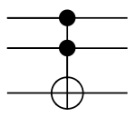
Reversible Circuits
Toffoli gates with circuit representations
Toffoli
NOT
CNOT
CCNOT
CONTROL
TARGET
1s applied to the control bits makes the target bit negated (flipped)
Work with truth tables and deterministic bits

Slide 24
Analysis: Circuits to Tables
IN
cba
000
001
010
011
100
101
110
111
OUT
cba
OUT
cba
100
111
101
110
000
011
010
001
IN
OUT
a
b
c
a
b
c

Slide 25
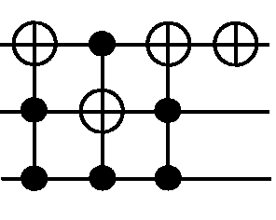
Analysis: Circuits to Tables
IN
cba
000
001
010
011
100
101
110
111
OUT
cba
OUT
cba
001
000
011
010
101
111
100
110
IN
OUT
a
b
c
a
b
c

Slide 26
Synthesis: Tables to Circuits
IN
cba
000
001
010
011
100
101
110
111
OUT
cba
001
000
011
010
101
111
100
110
Brute force algorithm
Complexity - how many cases to consider?
(if # of gates is upper bounded by 10)

Slide 27
Synthesis: Tables to Circuits
First Greedy Algorithm:
Matching input and output rows
Start from the top row and proceed one-by-one to the bottom
Operations on a row should not affect the preceding matched rows
$$p_{j}$$
Step 0.
For the case 000,
If output $≠$000
invert the outputs corresponding to 1 bits with NOT gates.
If output = 000
Do nothing.
Step i. $(1≤i<2^{n−1})$
Using Toffoli gates
$p_{j}$ -> Shows bits that must be 1 instead of 0
$q_{k}$ -> Shows bits that must be 0 instead of 1
1- For each $p_{j}$, apply Toffoli gates with control lines -> all i=1 at output state target line -> j
2- For each $q_{k}$, apply Toffoli gates with control lines -> all i=1 at output state except all «k»’s target line -> k
In
010
110
Out
100
111
$$q_{k}$$

Slide 28
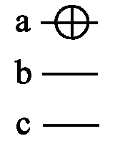
Synthesis: Tables to Circuits
Applying the Algorithm
IN
cba
000
001
010
011
100
101
110
111
OUT
cba
001
000
011
010
101
111
100
110
S1
000
001
010
011
100
110
101
111
S1
000
001
010
011
100
110
101
111
S1
000
001
010
011
100
110
101
111
S2
000
001
010
011
100
111
101
110
S3
000
001
010
011
100
101
111
110
S3
000
001
010
011
100
101
111
110
S4
000
001
010
011
100
101
110
111
IN
OUT
a
b
c
a
b
c

Slide 29
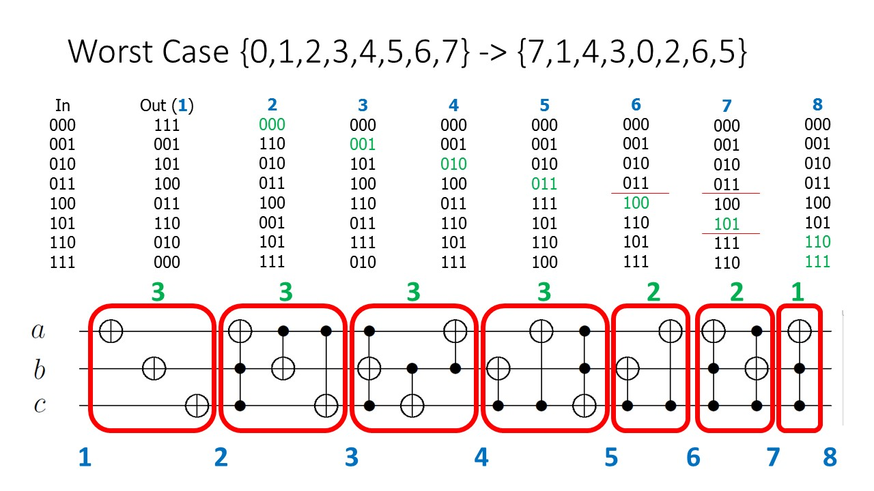
Synthesis: Tables to Circuits
Worst Case of the Algorithm

Slide 30
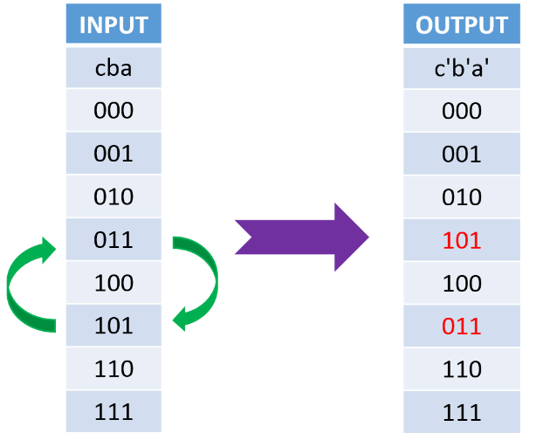
Synthesis: Tables to Circuits
Second Greedy Algorithm:
Matching input and output rows
Find unmatched rows
Match them arbitrarily using pairwise matchings
Each pairwise matching corresponds to an «essential function»
Essential Functions: Interchange two rows; others are all same
# of essential functions=# of rows choose 2
Bit Size | Functions
 | # of Essential Functions | # of Total Functions
2 | 6 | 24
3 | 28 | 40320
4 | 120 | 20922789888000
5 | 469 | 2.613308e + 35
6 | 2016 | 1.268869e + 89

Slide 31
Synthesis: Tables to Circuits
1
2
3
4
5
6
7
8
Input
$$cba$$
000
001
010
011
100
101
110
111
$$f_{1}$$
$$c^{′}b^{′}a^{′}$$
0 0 0
0 0 1
0 1 0
1 0 1
1 0 0
0 1 1
1 1 0
1 1 1
1
2
3
6
5
4
7
8
1
2
3
4
5
6
7
8
Input
$$cba$$
000
001
010
011
100
101
110
111
$$f_{2}$$
$$c^{′}b^{′}a^{′}$$
1 0 0
0 0 1
0 1 0
0 1 1
0 0 0
1 0 1
1 1 0
1 1 1
5
2
3
4
1
6
7
8
1
2
3
4
5
6
7
8
Input
$$cba$$
000
001
010
011
100
101
110
111
$$F$$
$$c^{′}b^{′}a^{′}$$
1 0 0
0 0 1
0 1 0
1 0 1
0 0 0
0 1 1
1 1 0
1 1 1
5
2
3
6
1
4
7
8

Slide 32
Synthesis: Tables to Circuits
# of essential functions = # of unmatched rows -1
Is ordering important? Which essential function to apply?
(a)
(b)
Top-Down $↓$ |  |  |  |  |  | Optimum
f |  |  |  |  |  | f
000 | 0 | 0 | 0 | 0 |  | 000 | 0 | 0 | 0 | 0
111 | 7 | 1 | 1 | 1 |  | 111 | 7 | 3 | 1 | 1
001 | 1 | 7 | 2 | 2 |  | 001 | 1 | 1 | 3 | 2
010 | 2 | 2 | 7 | 3 |  | 010 | 2 | 2 | 2 | 3
100 | 4 | 4 | 4 | 4 |  | 100 | 4 | 4 | 4 | 4
101 | 5 | 5 | 5 | 5 |  | 101 | 5 | 5 | 5 | 5
110 | 6 | 6 | 6 | 6 |  | 110 | 6 | 6 | 6 | 6
011 | 3 | 3 | 3 | 7 |  | 011 | 3 | 7 | 7 | 7
Essential Function | 1-7 | 2-7 | 3-7 | ✓ |  | Essential Function | 7-3 | 1-3 | 2-3 | ✓
Cost | 4 | 4 | 1 | 9 |  | Cost | 1 | 2 | 2 | 5

Slide 33
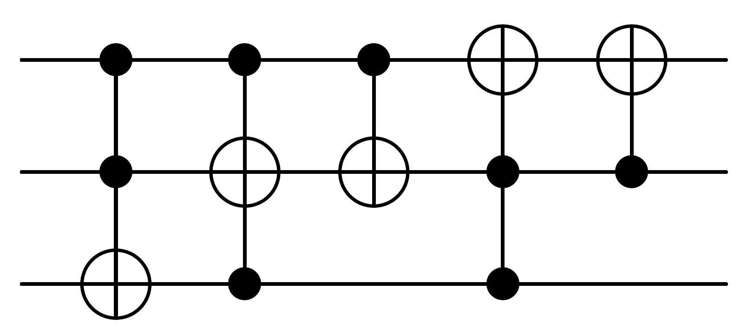
Synthesis: Tables to Circuits
Contd.
Is ordering important? Which essential function to apply?
$$1−7$$
$$2−7$$
$$3−7$$
(a)
$$7−3$$
$$1−3$$
$$2−3$$
(b)

Slide 34
Synthesis: Tables to Circuits
Contd.
Is ordering important? Which essential function to apply?
Sequence Comparison
 | TD | PS | OPT
R.C. | 16.69 | 15.75 | 14.48
Time | 8 | 8 | 377
Complexity | $$O\left(k\right)$$ | $$O\left(k^{2}\right)$$ | $$O\left(k^{k}\right)$$
TD : Top Down
PS : Pick Smallest
OPT : Optimum
R.C. : Reversible Cost

Slide 35
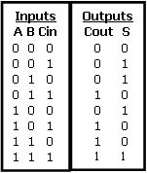
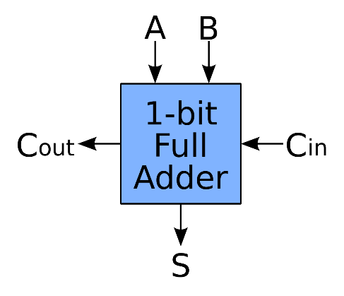
Irreversible to Reversible Transformation
Given an irreversible function or truth table:
Having either same or different number of inputs and outputs
Result is a reversible function or truth table:
Might need extra bits (garbage bits)
Larger circuit size
Example: Given a 1-bit full adder, make it reversible.

Slide 36
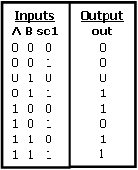
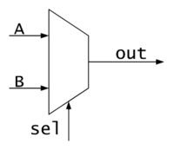
Irreversible to Reversible Transformation
Example: Given a 2-to-1 Multiplexer, make it reversible.
What type of functions are more efficient to be transformed?
Don’t care conditions are important and to be reduced.

Slide 37
Suggested Readings
Nielsen, M. A., & Chuang, I. L. (2010). Quantum computation and quantum information. Cambridge university press.
MIT Technology Review Article, http://www.technologyreview.com/view/422511/the-fantastical-promise-of-reversible-computing/
Maslov, Dmitri, Gerhard W. Dueck, and D. Michael Miller. "Toffoli network synthesis with templates." Computer-Aided Design of Integrated Circuits and Systems, IEEE Transactions on 24.6 (2005): 807-817.
Susam, Omercan, and Mustafa Altun. "Fast Synthesis of Reversible Circuits using a Sorting Algorithm and Optimization" Journal of Multiple-Valued Logic and Soft Computing, accepted for publication, 2016.
Parvin, Sajjad, and Mustafa Altun. "Perfect Concurrent Fault Detection in CMOS Logic Circuits Using Parity Preservative Reversible Gates." IEEE Access 7 (2019): 163939-163947.

