Slide 1
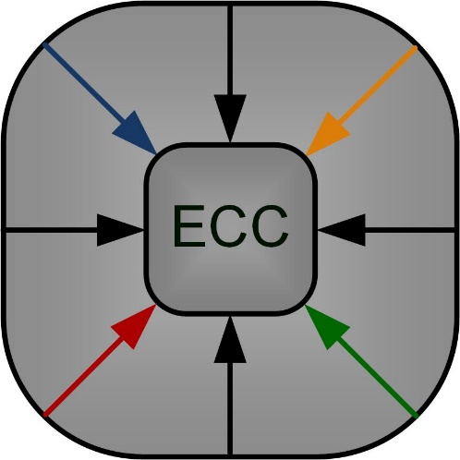
A Power Efficient System Design Methodology Employing Approximate Arithmetic Units
Tuba Ayhan, Fırat Kula, Mustafa Altun
Istanbul Technical University
Electronics and Communication Engineering Department
Istanbul, Turkey
Emerging Circuits and Computation (ECC) Group – ITU

Slide 2
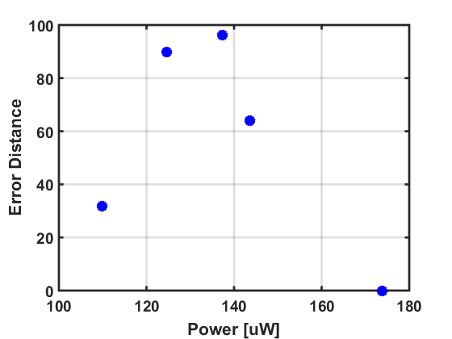
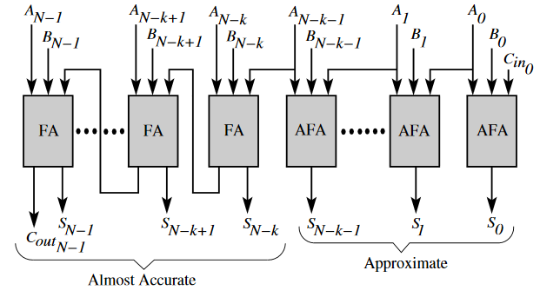
Approximate Adders
Dutt et.al. 2016
Shin & Gupta, 2008
Zhu et.al. 2010
Avg. Error Distance
Mahdiani et. al. 2010
Fig. Dutt et.al. 2016, VLSID
Exact Adder
Error Distance = |S_{a} - S_{e}|
A library for approximate adders and multipliers: Mrazek et. al. 2017, DATE
http://www.fit.vutbr.cz/research/groups/ehw/approxlib/index.html

Slide 3
Input
Processing
Desired output
LPF
MEM
IN
+
Power consumption
PSNR
SNR
Compression Ratio
Error rate
…
Z^{-n}
X
MACC
xCOR
+
RecF

Slide 4
Input
Processing
Desired output
MEM
LPF
MEM
IN
LPF
IN
+
+
Power consumption
PSNR
SNR
Compression Ratio
Error rate
…
Z^{-n}
Z^{-n}
X
X
ACC
COR
MACC
xCOR
+
+
RecF2
RecF

Slide 5
Input
Processing
Desired output
LPF
MEM
IN
+
+
Power consumption
PSNR
SNR
Compression Ratio
Error rate
…
Z^{-n}
X
X
MACC
xCOR
+
+
RecF

Slide 6
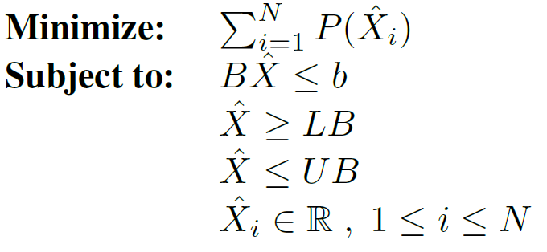
Forward Analysis
SYS
Performance metrics
Performance correlation
Block Analysis
B1
B4
Arithmetic errors sensitivity
Arithmetic units’ correlation
B2
B3
Power model
Power – error relationship:
P_{u} = f(E_{u})
Power
Accuracy: RMSE
Optimization
Linear/nonlinear programming with linear constraints
Realization

Slide 7
Total power consumption of arithmetic computing units will be minimized.
The desired performance will be maintained → b
Ultimate performance depends on
1. Arithmetic computing → X
2. Connections between and within the blocks → B

Slide 8
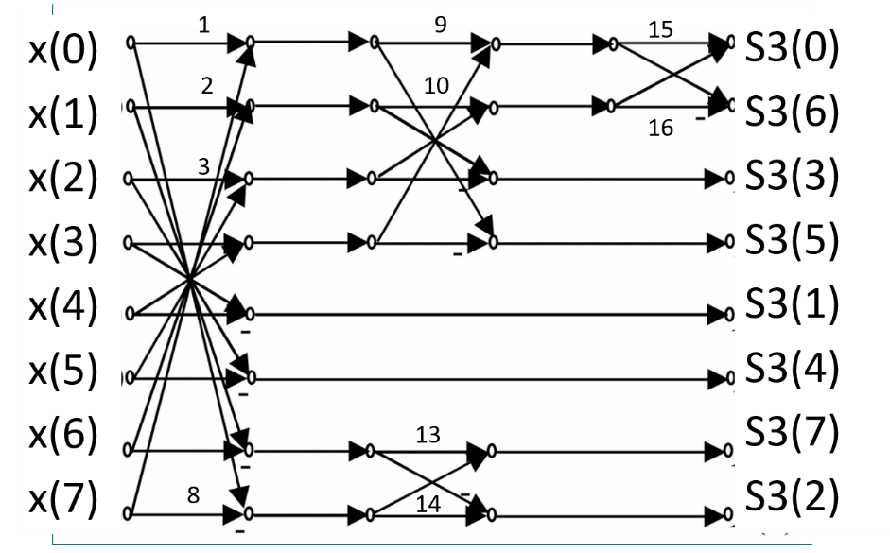
DCT
MSE
Compression ratio
Quantizer
Encoder
Constant multiplication
JPEG code
R
PSNR
IDCT
Quantizer
Decoder

Slide 9
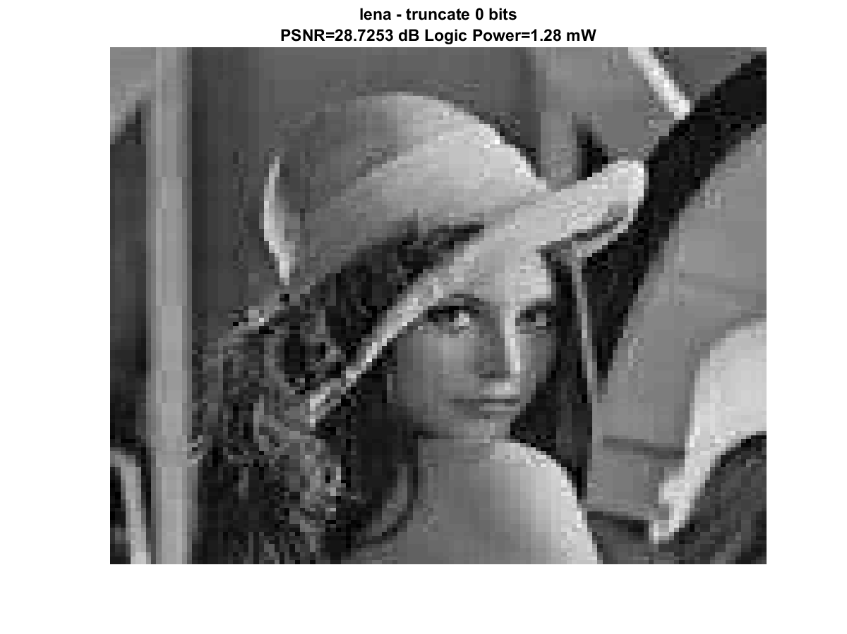
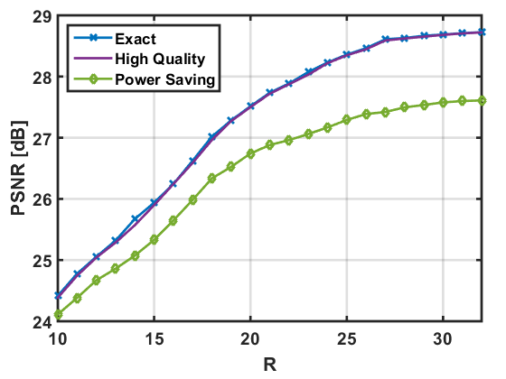
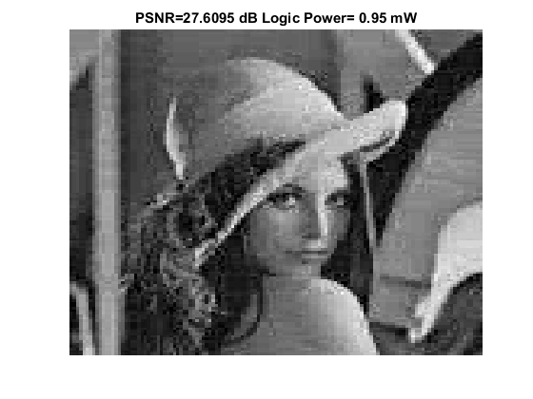
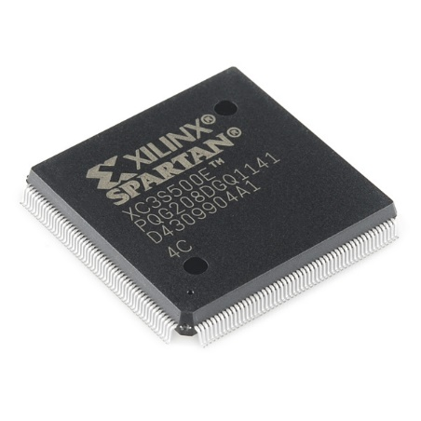
25.1% PS
Exact
(c)
High Quality:
7.9% power saving
Power Saving:
25.1% power saving

Slide 10
Tuba Ayhan
Poster Session: Tuesday July 4th, 2017
16:00 - 17:00
tuba.ayhan@itu.edu.tr
Istanbul Technical University
Electronics and Communication Engineering Department
Istanbul, Turkey

