Slide 1
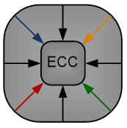

Efficient Hardware Implementation of Artificial
Neural Networks Using Approximate
Multiply-Accumulate Blocks
Mohammadreza Esmali Nojehdeh, Levent Aksoy and Mustafa Altun
Emerging Circuits and Computation (ECC) Group
Istanbul Technical University
IEEE Computer Society Annual Symposium on VLSI 2020

Slide 2
Outline
Introduction
Background
Motivation
ANN Design by Exploiting Approximate blocks
Experimental Results
Conclusions

Slide 3
Introduction
Artificial neural network (ANN) is a computing system made up of a number of simple and highly interconnected processing elements
ANNs have been applied to a wide range of problems
  classification and pattern recognition
They have been realized in different design platforms
  analog, digital, hybrid very large scale integrated (VLSI) circuits, field programmable gate-arrays (FPGAs), and neuro-computers

Slide 4


Background
Neuron - a fundamental unit of ANN
An ANN architecture
$$y= \sum_{i=1}^{n}{w_{i}x_{i}}$$
$$z= ∅(y+b)$$
Hardware complexity of an ANN is dominated by the multiplication of weights by input variables.

Slide 5
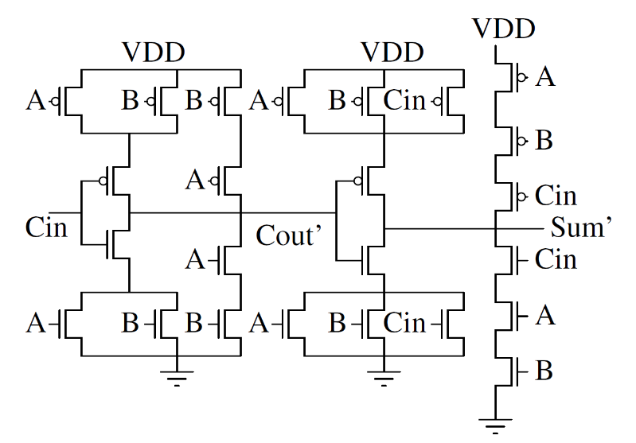
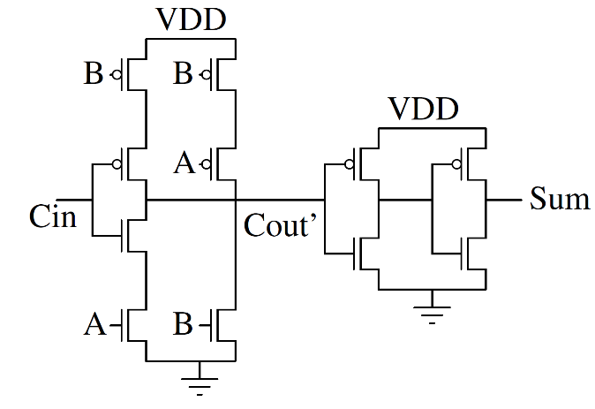
Background
Approximate computing is used for area, power, and energy improvement, targeting applications not strictly requiring high accuracy including image processing and learning.
Conventional mirror adder cell transistor level schematic[1]
Truth table for conventional full adder and approximate adder[1]
Inputs |  |  | Accurate |  | Approximate
A | B | Cin | Sum | Cout | Sum | Cout
0 | 0 | 0 | 0 | 0 | 0 | 0
0 | 0 | 1 | 1 | 0 | 0 | 0
0 | 1 | 0 | 1 | 0 | 1 | 0
0 | 1 | 1 | 0 | 1 | 1 | 0
1 | 0 | 0 | 1 | 0 | 0 | 1
1 | 0 | 1 | 0 | 1 | 0 | 1
1 | 1 | 0 | 0 | 1 | 1 | 1
1 | 1 | 1 | 1 | 1 | 1 | 1
Layout Area of mirror adders[1]
Mirror Adder Cell | Area(μm²)
Conventional | 40.66
Approximate | 13.54
Approximate mirror adder cell transistor level schematic[1]
[1]Almurib, H.A.F., Kumar, T.N., Lombardi, F., 2016. Inexact designs for approximate low power addition by cell replacement, in: 2016 Design, Automation Test in Europe Conference Exhibition .

Slide 6
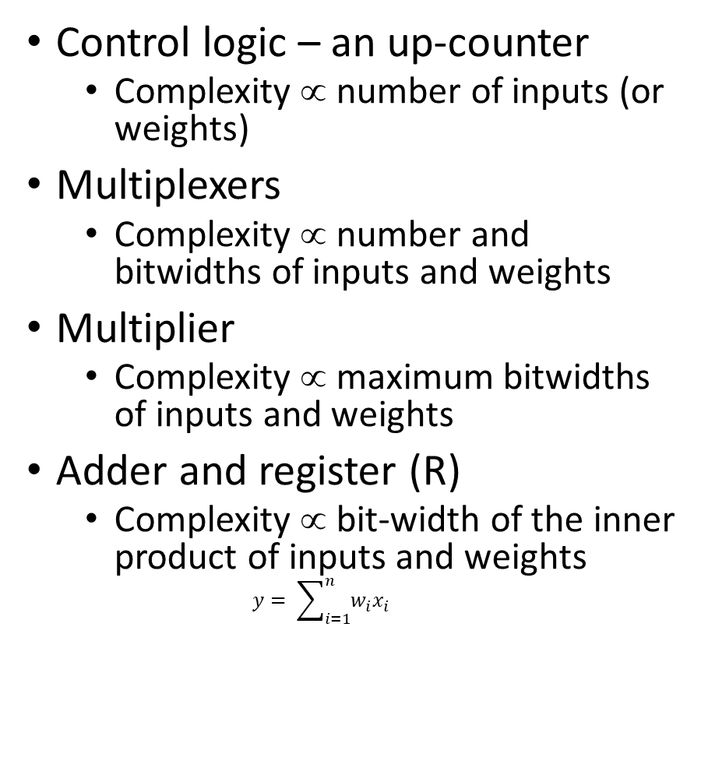

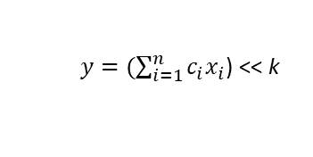
Motivation
Time-multiplexed design of a neuron
Control logic – an up-counter
  Complexity ∝ number of inputs (or weights)
Multiplexers
  Complexity ∝ number and bitwidths of inputs and weights
Multiplier
  Complexity ∝ maximum bitwidths of inputs and weights
Adder and register (R)
  Complexity ∝ bit-width of the inner product of inputs and weights
  $$y= \sum_{i=1}^{n}{w_{i}x_{i}}$$
Simplified time-multiplexed design of a neuron
  $c_{i}$= $w_{i}$/$2^{k}$
  $y=(\sum_{i=1}^{n}{c_{i}x_{i}}$) << k

Slide 7

Motivation
Multipliers and adders are frequently used in ANNs and dominate the hardware complexity.
Since exploiting approximate multipliers and adders for neuron computation can be significantly reduces hardware complexity, taking into account the deviation in ANN accuracy.
Approximate
Approximate
X
+

Slide 8
Time-Multiplexed ANN Design
The design procedure has three main steps:
  Given the ANN structure, train the ANN using state-of-art techniques and find the weight and bias values
  Post-training stage
    Determine the minimum quantization value
    Convert the floating-point weight and bias values to integers
    Replace multipliers and adders by approximate version and check accuracy
  Describe the time-multiplexed ANN design in hardware

Slide 9
Training
Our training tool includes
  several iterative optimization algorithms, namely conventional and stochastic gradient descent methods and Adam optimizer [2]
  different weight initialization techniques, namely Xavier [3], He [4], and fully random
  several stopping criteria, namely number of iterations, early stopping using validation data set, and saturation of logic functions
  different activation functions for neurons in each layer, namely sigmoid, hyperbolic tangent, hard sigmoid, hard hyperbolic tangent, linear rectified linear unit, and softmax
[2] D. P. Kingma and J. Ba, “Adam: A method for stochastic optimization,” arXiv e-prints, 2014, arXiv:1412.6980.
[3] X. Glorot and Y. Bengio, “Understanding the difficulty of training deep feedforward neural networks,” in International Conference on Artificial Intelligence and Statistics, 2010, pp. 249–256.
[4] K. He, X. Zhang, S. Ren, and J. Sun, “Delving deep into rectifiers: Surpassing human-level performance on imagenet classification,” arXiv e-prints, 2015, arXiv:1502.01852.

Slide 10
Hardware-aware Post-training
Computing the minimum quantization value
  Set the quantization value, q, and the related ANN accuracy in hardware, ha(q), to 0
  Increase q by 1
  Convert each floating-point weight and bias value to an integer by multiplying it 2^{q} and ceiling this multiplication result
  Compute ha(q) value on the validation data set using the integer weight values
  If ha(q) > 0 and ha(q) – ha(q-1) > 0.1%, go to Step 2
  Otherwise, return q as the minimum quantization value

Slide 11
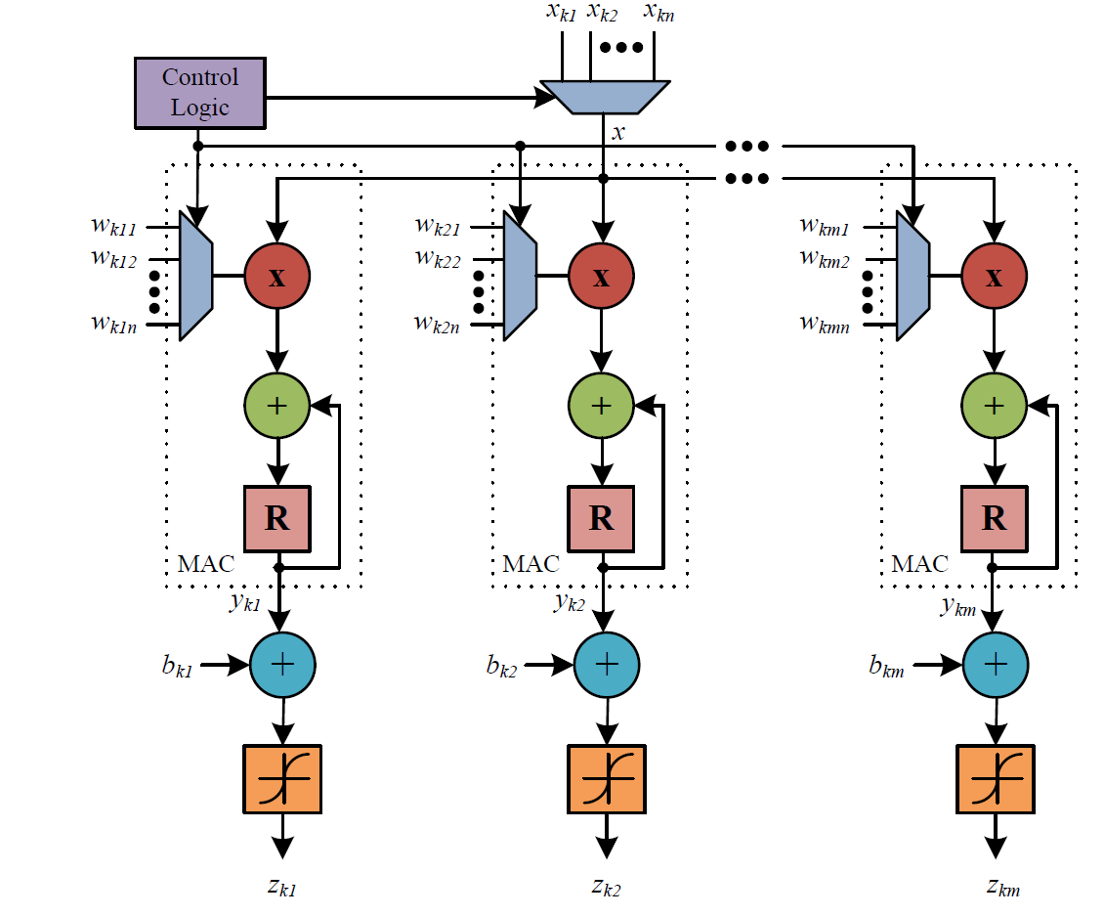
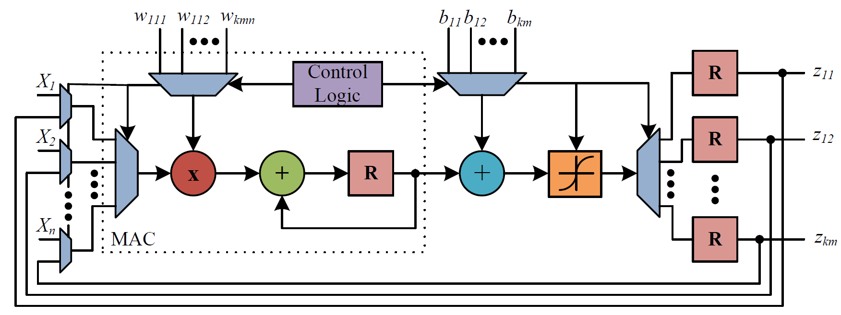
Hardware Design
ANN Design Using a MAC Block for each Neuron (SMAC NEURON)
ANN Design Using a Single MAC Block
(SMAC ANN)

Slide 12
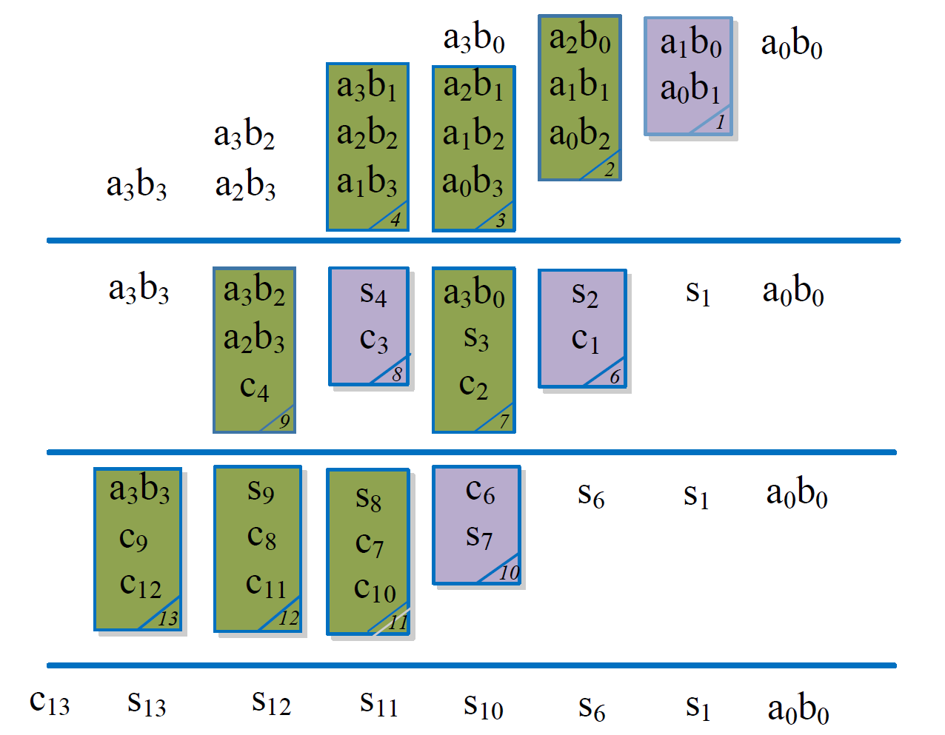
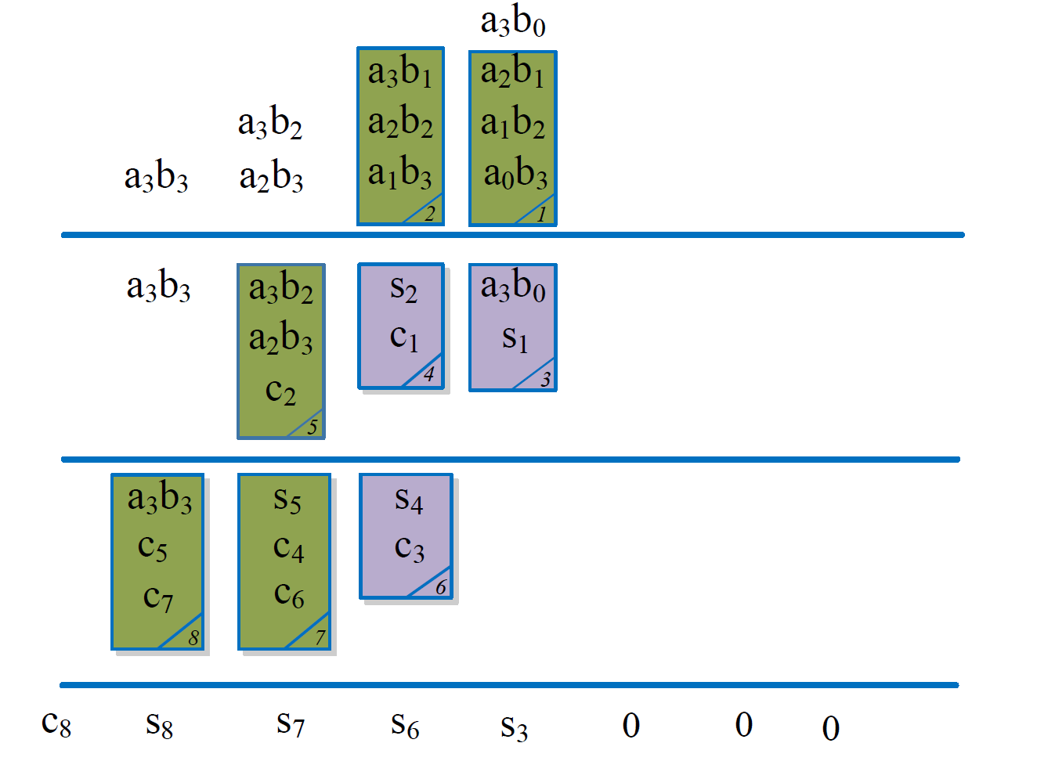
Hardware Design
Approximate multiplier is implemented by setting r least significant output of an exact multiplier to zero, where r denotes its approximation level.
Exact 4-bit Unsigned Multiplier
Approximate 4-bit Unsigned Multiplier with Lest 3 bits are set to logic value 0
✗
✗
✗
✗
✗
✗
✗
✗
✗
✗
✗
✗
0
0
0

Slide 13
Experimental Results
Pen-based handwritten digit recognition problem [24] was used as an application.
In the convolutional neural network design of this application, 5 ANN structures with different number of hidden layers and number of neurons in the hidden layers were used.
ANN structure is 16-16-10 and was implemented in two different architectures
  Time-multiplexed using a MAC block for each neuron
  Time-multiplexed using a single MAC block for ANN
ANN designs were described in Verilog and synthesized using the Cadence RTL Compiler with the TSMC 40nm design library.

Slide 14
Experimental Results
RESULTS OF SMAC NEURON ARCHITECTURE USING APPROXIMATE MULTIPLIERS.
Multiplier Type | Approximate level |  | area (μm²) | delay (ns) | latency (ns) | power (mW) | energy (pj) | HMR | area gain | energy gain
 | Hidden | Output
Behavioral | 0 | 0 | 15327 | 3.58 | 121.68 | 1.44 | 174.77 | 5.00 | 0% | 0%
mul12s_2NM[5] | NA | NA | 13929 | 3.72 | 126.31 | 1.23 | 155.04 | 5.12 | 9% | 11%
Mul_12s_2KM[5] | NA | NA | 17227 | 3.70 | 125.80 | 1.44 | 181.33 | 5.00 | -12% | -3%
PBAM[6] | 7 | 11 | 13276 | 3.57 | 121.35 | 1.31 | 159.14 | 4.85 | 13% | 9%
PBAM[6] | 7 | 12 | 12,992 | 3.66 | 124.37 | 1.30 | 161.52 | 5.03 | 7% | 15%
PBAM[6] | 8 | 11 | 12761 | 3.41 | 115.91 | 1.26 | 145.51 | 5.37 | 17% | 17%
LEBZAM | 6 | 9 | 11999 | 3.68 | 125.02 | 1.00 | 125.21 | 5.03 | 28% | 22%
LEBZAM | 7 | 11 | 10224 | 3.45 | 117.40 | 1.04 | 122.05 | 4.80 | 30% | 33%
LEBZAM | 7 | 12 | 9723 | 3.41 | 116.01 | 0.94 | 109.41 | 5.09 | 37% | 36%
[5] V. Mrazek, R. Hrbacek, Z. Vasicek, and L. Sekanina, “Evoapproxsb:Library of approximate adders and multipliers for circuit design and benchmarking of approximation methods,” in Design, Automation and Test in Europe Conference and Exhibition (DATE), 2017, pp. 258–261.
[6] M. E. Nojehdeh and M. Altun, “Systematic synthesis of approximate adders and multipliers with accurate error calculations,” Integration, vol. 70, pp. 99 – 107, 2020.

Slide 15
Experimental Results
RESULTS OF SMAC NEURON ARCHITECTURE USING APPROXIMATE MULTIPLIERS AND ADDERS.
Multiplier Type | Approximate level |  |  |  | area (μm²) | delay (ns) | latency (ns) | power (mW) | energy (pj) | HMR | area gain | energy gain
 | Hidden |  | Output
 | Mul | Add | Mul | Add
Behavioral | 0 | 0 | 0 | 0 | 15327 | 3.58 | 121.68 | 1.44 | 174.77 | 5.00 | 0% | 0%
mul12s_2NM[5] | NA | 10 | NA | 14 | 11854 | 3.92 | 133.14 | 0.59 | 78.76 | 5.17 | 23% | 55%
Mul_12s_2KM[5] | NA | 9 | NA | 15 | 13133 | 3.95 | 134.30 | 0.69 | 92.48 | 5.35 | 14% | 47%
PBAM[6] | 7 | 7 | 12 | 11 | 10226 | 3.66 | 124.37 | 0.61 | 76.25 | 5.03 | 21% | 56%
PBAM[6] | 7 | 7 | 12 | 12 | 9798 | 3.64 | 123.86 | 0.61 | 75.70 | 5.20 | 37% | 57%
PBAM[6] | 7 | 7 | 12 | 13 | 9354 | 3.66 | 124.37 | 0.62 | 77.25 | 5.17 | 39% | 56%
LEBZAM | 6 | 10 | 9 | 13 | 10392 | 3.58 | 121.72 | 0.58 | 70.11 | 5.32 | 32% | 60%
LEBZAM | 7 | 12 | 10 | 13 | 8801 | 3.61 | 122.88 | 0.55 | 67.32 | 4.89 | 43% | 61%
LEBZAM | 7 | 11 | 10 | 14 | 8989 | 3.61 | 122.81 | 0.52 | 63.68 | 4.97 | 63% | 41%
[5] V. Mrazek, R. Hrbacek, Z. Vasicek, and L. Sekanina, “Evoapproxsb:Library of approximate adders and multipliers for circuit design and benchmarking of approximation methods,” in Design, Automation and Test in Europe Conference and Exhibition (DATE), 2017, pp. 258–261.
[6] M. E. Nojehdeh and M. Altun, “Systematic synthesis of approximate adders and multipliers with accurate error calculations,” Integration, vol. 70, pp. 99 – 107, 2020.

Slide 16
Experimental Results
RESULTS OF SMAC ANN ARCHITECTURE USING APPROXIMATE MULTIPLIERS.
Multiplier Type | Approximate level | area (μm²) | delay (ns) | latency (ns) | power (mW) | energy (pj) | HMR | area gain | energy gain
Behavioral | 0 | 3180 | 3.52 | 1646.42 | 0.35 | 569.33 | 5.00 | 0% | 0%
mul12s_2NM[5] | NA | 3278 | 3.72 | 1738.62 | 0.29 | 499.80 | 5.00 | -3% | 12%
Mul_12s_2KM[5] | NA | 3279 | 3.77 | 1764.83 | 0.29 | 504.74 | 5.00 | -3% | 11%
PBAM[6] | 0 | 3287 | 3.79 | 1774.19 | 0.29 | 518.38 | 5.00 | -3% | 9%
PBAM[6] | 7 | 3194 | 3.76 | 1760.15 | 0.28 | 499.60 | 4.83 | -1% | 12%
PBAM[6] | 8 | 3148 | 3.24 | 1518.19 | 0.28 | 431.60 | 5.35 | 2% | 24%
LEBZAM | 5 | 3189 | 3.69 | 1725.98 | 0.27 | 472.95 | 4.95 | -2% | 8%
LEBZAM | 6 | 3152 | 3.69 | 1724.58 | 0.28 | 490.38 | 4.94 | 1% | 14%
LEBZAM | 7 | 3091 | 3.56 | 1664.68 | 0.27 | 449.89 | 4.80 | 3% | 21%
[5] V. Mrazek, R. Hrbacek, Z. Vasicek, and L. Sekanina, “Evoapproxsb:Library of approximate adders and multipliers for circuit design and benchmarking of approximation methods,” in Design, Automation and Test in Europe Conference and Exhibition (DATE), 2017, pp. 258–261.
[6] M. E. Nojehdeh and M. Altun, “Systematic synthesis of approximate adders and multipliers with accurate error calculations,” Integration, vol. 70, pp. 99 – 107, 2020.

Slide 17
Experimental Results
RESULTS OF SMAC ANN ARCHITECTURE USING APPROXIMATE MULTIPLIERS AND ADDERS.
Multiplier Type | Approximate level |  | area (μm²) | delay (ns) | latency (ns) | power (mW) | energy (pj) | HMR | area gain | energy gain
 | Mul | Add
Behavioral | 0 | 0 | 3180 | 3.52 | 1646.42 | 0.35 | 569.33 | 5.00 | 0% | 0%
mul12s_2NM[5] | NA | 13 | 2908 | 3.40 | 1590.26 | 0.25 | 391.63 | 5.06 | 9% | 31%
Mul_12s_2KM[5] | NA | 13 | 3140 | 3.68 | 1721.30 | 0.26 | 451.51 | 5.46 | 1% | 21%
PBAM[6] | 7 | 10 | 2972 | 3.55 | 1659.53 | 0.26 | 426.62 | 5.03 | 7% | 25%
PBAM[6] | 8 | 9 | 2978 | 3.59 | 1679.18 | 0.25 | 421.98 | 5.03 | 6% | 26%
PBAM[6] | 7 | 11 | 3029 | 3.84 | 1798.52 | 0.25 | 448.54 | 4.66 | 5% | 21%
LEBZAM | 6 | 14 | 3046 | 3.53 | 1652.51 | 0.28 | 469.89 | 4.95 | 4% | 17%
LEBZAM | 7 | 12 | 3041 | 3.62 | 1692.29 | 0.26 | 440.25 | 4.66 | 4% | 23%
LEBZAM | 7 | 13 | 3021 | 3.53 | 1650.17 | 0.26 | 426.73 | 5.40 | 5% | 25%
[5] V. Mrazek, R. Hrbacek, Z. Vasicek, and L. Sekanina, “Evoapproxsb:Library of approximate adders and multipliers for circuit design and benchmarking of approximation methods,” in Design, Automation and Test in Europe Conference and Exhibition (DATE), 2017, pp. 258–261.
[6] M. E. Nojehdeh and M. Altun, “Systematic synthesis of approximate adders and multipliers with accurate error calculations,” Integration, vol. 70, pp. 99 – 107, 2020.

Slide 18
Experimental Results
RESULTS OF SMAC NEURON ARCHITECTURE USING APPROXIMATE MULTIPLIERS.
RESULTS OF SMAC NEURON ARCHITECTURE USING APPROXIMATE MULTIPLIERS AND ADDERS.
Multiplier Type | Approximate level |  | area (μm²) | delay (ns) | latency (ns) | power (mW) | energy (pj) | HMR | area gain | energy gain
 | Hidden | Output
Behavioral | 0 | 0 | 15327 | 3.58 | 121.68 | 1.44 | 174.77 | 5.00 | 0% | 0%
mul12s_2NM[5] | NA | NA | 13929 | 3.72 | 126.31 | 1.23 | 155.04 | 5.12 | 9% | 11%
Mul_12s_2KM[5] | NA | NA | 17227 | 3.70 | 125.80 | 1.44 | 181.33 | 5.00 | -12% | -3%
PBAM[6] | 7 | 11 | 13276 | 3.57 | 121.35 | 1.31 | 159.14 | 4.85 | 13% | 9%
PBAM[6] | 7 | 12 | 12992 | 3.66 | 124.37 | 1.30 | 161.52 | 5.03 | 7% | 15%
PBAM[6] | 8 | 11 | 12761 | 3.41 | 115.91 | 1.26 | 145.51 | 5.37 | 17% | 17%
LEBZAM | 6 | 9 | 11999 | 3.68 | 125.02 | 1.00 | 125.21 | 5.03 | 28% | 22%
LEBZAM | 7 | 11 | 10224 | 3.45 | 117.40 | 1.04 | 122.05 | 4.80 | 30% | 33%
LEBZAM | 7 | 12 | 9723 | 3.41 | 116.01 | 0.94 | 109.41 | 5.09 | 37% | 36%
Multiplier Type | Approximate level |  |  |  | area (μm²) | delay (ns) | latency (ns) | power (mW) | energy (pj) | HMR | area gain | energy gain
 | Hidden |  | Output
 | M | A | M | A
Behavioral | 0 | 0 | 0 | 0 | 15327 | 3.58 | 121.68 | 1.44 | 174.77 | 5.00 | 0% | 0%
mul12s_2NM[5] | NA | 10 | NA | 14 | 11854 | 3.92 | 133.14 | 0.59 | 78.76 | 5.17 | 23% | 55%
Mul_12s_2KM[5] | NA | 9 | NA | 15 | 13133 | 3.95 | 134.30 | 0.69 | 92.48 | 5.35 | 14% | 47%
PBAM[6] | 7 | 7 | 12 | 11 | 10226 | 3.66 | 124.37 | 0.61 | 76.25 | 5.03 | 21% | 56%
PBAM[6] | 7 | 7 | 12 | 12 | 9798 | 3.64 | 123.86 | 0.61 | 75.70 | 5.20 | 37% | 57%
PBAM[6] | 7 | 7 | 12 | 13 | 9354 | 3.66 | 124.37 | 0.62 | 77.25 | 5.17 | 39% | 56%
LEBZAM | 6 | 10 | 9 | 13 | 10392 | 3.58 | 121.72 | 0.58 | 70.11 | 5.32 | 32% | 60%
LEBZAM | 7 | 12 | 10 | 13 | 8801 | 3.61 | 122.88 | 0.55 | 67.32 | 4.89 | 43% | 61%
LEBZAM | 7 | 11 | 10 | 14 | 8989 | 3.61 | 122.81 | 0.52 | 63.68 | 4.97 | 63% | 41%
[5] V. Mrazek, R. Hrbacek, Z. Vasicek, and L. Sekanina, “Evoapproxsb:Library of approximate adders and multipliers for circuit design and benchmarking of approximation methods,” in Design, Automation and Test in Europe Conference and Exhibition (DATE), 2017, pp. 258–261.
[6] M. E. Nojehdeh and M. Altun, “Systematic synthesis of approximate adders and multipliers with accurate error calculations,” Integration, vol. 70, pp. 99 – 107, 2020.

Slide 19
Experimental Results
RESULTS OF SMAC ANN ARCHITECTURE USING APPROXIMATE MULTIPLIERS.
RESULTS OF SMAC ANN ARCHITECTURE USING APPROXIMATE MULTIPLIERS AND ADDERS.
Multiplier Type | Approximate level | area (μm²) | delay (ns) | latency (ns) | power (mW) | energy (pj) | HMR | area gain | energy gain
Behavioral | 0 | 3180 | 3.52 | 1646.42 | 0.35 | 569.33 | 5.00 | 0% | 0%
mul12s_2NM[5] | NA | 3278 | 3.72 | 1738.62 | 0.29 | 499.80 | 5.00 | -3% | 12%
Mul_12s_2KM[5] | NA | 3279 | 3.77 | 1764.83 | 0.29 | 504.74 | 5.00 | -3% | 11%
PBAM[6] | 0 | 3287 | 3.79 | 1774.19 | 0.29 | 518.38 | 5.00 | -3% | 9%
PBAM[6] | 7 | 3194 | 3.76 | 1760.15 | 0.28 | 499.60 | 4.83 | -1% | 12%
PBAM[6] | 8 | 3148 | 3.24 | 1518.19 | 0.28 | 431.60 | 5.35 | 2% | 24%
LEBZAM | 5 | 3189 | 3.69 | 1725.98 | 0.27 | 472.95 | 4.95 | -2% | 8%
LEBZAM | 6 | 3152 | 3.69 | 1724.58 | 0.28 | 490.38 | 4.94 | 1% | 14%
LEBZAM | 7 | 3091 | 3.56 | 1664.68 | 0.27 | 449.89 | 4.80 | 3% | 21%
Multiplier Type | Approximate level |  | area (μm²) | delay (ns) | latency (ns) | power (mW) | energy (pj) | HMR | area gain | energy gain
 | Mul | Add
Behavioral | 0 | 0 | 3180 | 3.52 | 1646.42 | 0.35 | 569.33 | 5.00 | 0% | 0%
Mul12s_2NM[5] | NA | 13 | 2908 | 3.40 | 1590.26 | 0.25 | 391.63 | 5.06 | 9% | 31%
Mul_12s_2KM[5] | NA | 13 | 3140 | 3.68 | 1721.30 | 0.26 | 451.51 | 5.46 | 1% | 21%
PBAM[6] | 7 | 10 | 2972 | 3.55 | 1659.53 | 0.26 | 426.62 | 5.03 | 7% | 25%
PBAM[6] | 8 | 9 | 2978 | 3.59 | 1679.18 | 0.25 | 421.98 | 5.03 | 6% | 26%
PBAM[6] | 7 | 11 | 3029 | 3.84 | 1798.52 | 0.25 | 448.54 | 4.66 | 5% | 21%
LEBZAM | 6 | 14 | 3046 | 3.53 | 1652.51 | 0.28 | 469.89 | 4.95 | 4% | 17%
LEBZAM | 7 | 12 | 3041 | 3.62 | 1692.29 | 0.26 | 440.25 | 4.66 | 4% | 23%
LEBZAM | 7 | 13 | 3021 | 3.53 | 1650.17 | 0.26 | 426.73 | 5.40 | 5% | 25%
[5] V. Mrazek, R. Hrbacek, Z. Vasicek, and L. Sekanina, “Evoapproxsb:Library of approximate adders and multipliers for circuit design and benchmarking of approximation methods,” in Design, Automation and Test in Europe Conference and Exhibition (DATE), 2017, pp. 258–261.
[6] M. E. Nojehdeh and M. Altun, “Systematic synthesis of approximate adders and multipliers with accurate error calculations,” Integration, vol. 70, pp. 99 – 107, 2020.

Slide 20
Experimental Results
RESULTS OF SMAC ANN ARCHITECTURE USING APPROXIMATE MULTIPLIERS.
RESULTS OF SMAC NEURON ARCHITECTURE USING APPROXIMATE MULTIPLIERS.
Multiplier Type | Approximate level | area (μm²) | delay (ns) | latency (ns) | power (mW) | energy (pj) | HMR | area gain | energy gain
Behavioral | 0 | 3180 | 3.52 | 1646.42 | 0.35 | 569.33 | 5.00 | 0% | 0%
mul12s_2NM[5] | NA | 3278 | 3.72 | 1738.62 | 0.29 | 499.80 | 5.00 | -3% | 12%
Mul_12s_2KM[5] | NA | 3279 | 3.77 | 1764.83 | 0.29 | 504.74 | 5.00 | -3% | 11%
PBAM[6] | 0 | 3287 | 3.79 | 1774.19 | 0.29 | 518.38 | 5.00 | -3% | 9%
PBAM[6] | 7 | 3194 | 3.76 | 1760.15 | 0.28 | 499.60 | 4.83 | -1% | 12%
PBAM[6] | 8 | 3148 | 3.24 | 1518.19 | 0.28 | 431.60 | 5.35 | 2% | 24%
LEBZAM | 5 | 3189 | 3.69 | 1725.98 | 0.27 | 472.95 | 4.95 | -2% | 8%
LEBZAM | 6 | 3152 | 3.69 | 1724.58 | 0.28 | 490.38 | 4.94 | 1% | 14%
LEBZAM | 7 | 3091 | 3.56 | 1664.68 | 0.27 | 449.89 | 4.80 | 3% | 21%
Multiplier Type | Approximate level |  | area (μm²) | delay (ns) | latency (ns) | power (mW) | energy (pj) | HMR | area gain | energy gain
 | Hidden | Output
Behavioral | 0 | 0 | 15327 | 3.58 | 121.68 | 1.44 | 174.77 | 5.00 | 0% | 0%
mul12s_2NM[5] | NA | NA | 13929 | 3.72 | 126.31 | 1.23 | 155.04 | 5.12 | 9% | 11%
Mul_12s_2KM[5] | NA | NA | 17227 | 3.70 | 125.80 | 1.44 | 181.33 | 5.00 | -12% | -3%
PBAM[6] | 7 | 11 | 13276 | 3.57 | 121.35 | 1.31 | 159.14 | 4.85 | 13% | 9%
PBAM[6] | 7 | 12 | 12992 | 3.66 | 124.37 | 1.30 | 161.52 | 5.03 | 7% | 15%
PBAM[6] | 8 | 11 | 12761 | 3.41 | 115.91 | 1.26 | 145.51 | 5.37 | 17% | 17%
LEBZAM | 6 | 9 | 11999 | 3.68 | 125.02 | 1.00 | 125.21 | 5.03 | 28% | 22%
LEBZAM | 7 | 11 | 10224 | 3.45 | 117.40 | 1.04 | 122.05 | 4.80 | 30% | 33%
LEBZAM | 7 | 12 | 9723 | 3.41 | 116.01 | 0.94 | 109.41 | 5.09 | 37% | 36%

Slide 21
Conclusions
This paper presented efficient techniques to reduce the hardware complexity of a time-multiplexed feedforward ANN design
  Approximate multipliers and adders are employed to reduce the hardware complexity
It is shown that the proposed techniques yield a significant reduction in design complexity

Slide 22
ACKNOWLDGEMENT
This work is supported by the TUBITAK-1001 projects #117E078 , #119E507
and Istanbul Technical University BAP project #42446.

Slide 23
Questions
THANKS for YOUR ATTENTION
Contact: Mohammadreza Esmali Nojehdeh
E-mail: nojehdeh@itu.edu.tr

