Slide 1

ELE 523E
COMPUTATIONAL NANOELECTRONICS
Mustafa Altun
Electronics & Communication Engineering
Istanbul Technical University
Web: http://www.ecc.itu.edu.tr/
FALL 2021
W4: Molecular Computing, 25/10/2021

Slide 2
Outline
Molecular computing
  Working with individual molecules
    Fundamentals
    Implementing arithmetic operations
  DNA strand displacement
    DNA basics
    DNA strand displacement
    Implementing logic operations

Slide 3
  Computing with Individual Molecules
+
x
+
y
2z
types
count
cell/test tube
x
9
8
y
6
5
z
7
9
Discrete quantity of molecules

Slide 4
Computing with Individual Molecules
+
x
+
y
2z
types
count
x
9
3
What are the final quantities of molecules?
y
6
0
Write an equation with initial and final quantities.
z
19
7

Slide 5
Computing with Individual Molecules
slow
+
medium
+
fast
+
Reaction rates used for step-by-step procedure.
UNI or BI directional

Slide 6
Computing with Individual Molecules
test tube
Initial condition
slow
+
medium
+
fast
+
10 blue and 5 black
What will happen? Explain step-by-step.

Slide 7
Computing with Individual Molecules
test tube
Initial condition
slow
+
medium
+
fast
+
6 blue, 6 black, and 6 orange
What will happen? Explain step-by-step.

Slide 8

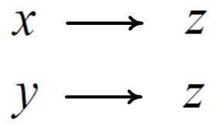
Addition
biochemical code
How to select reaction rates (slow or fast)?

Slide 9

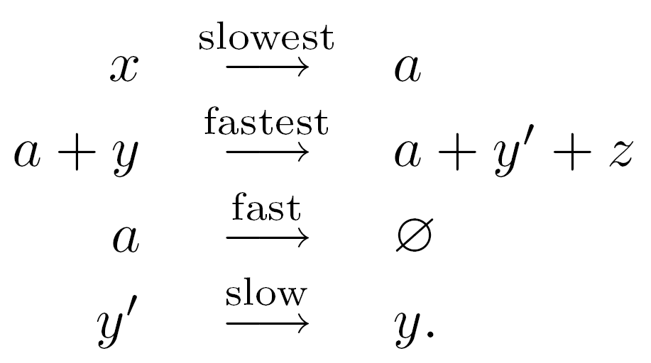
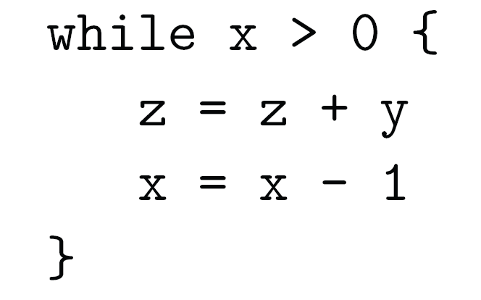
Multiplication
pseudo-code
biochemical code

Slide 10
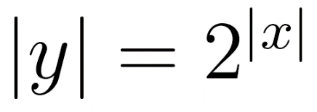
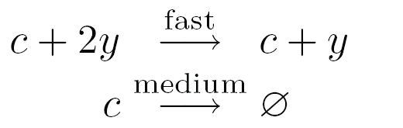
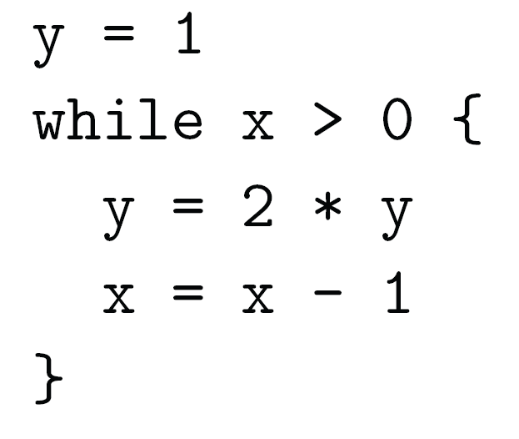
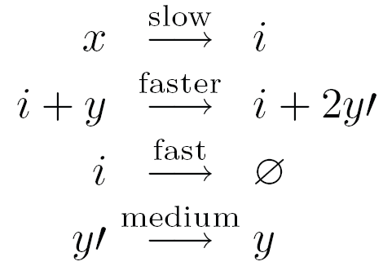
Exponentiation
pseudo-code
biochemical code

Slide 11
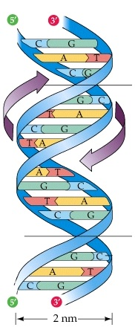
DNA Basics
Biological DNA stores hereditary information
Width of the double helix: 2nm
Distance between base pairs (bp): 0.34 nm
Carsonella rudii (smallest non-viral genome): 160,000 bp
Human genome: 3.2 Billion bp
Lungfish (largest vertebrate genome): 130 Billion bp
DNA helix

Slide 12
DNA Basics: Nucleotides

Slide 13
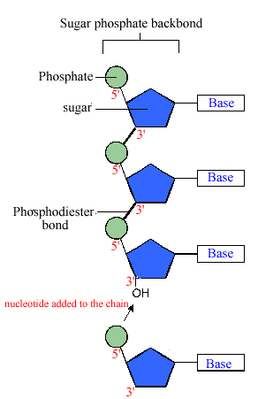
DNA Basics: Strands

Slide 14
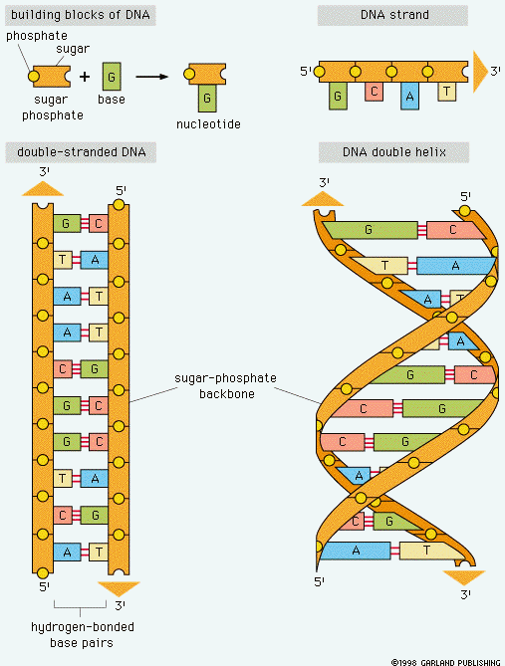
DNA Basics: Base Pairs

Slide 15
DNA Basics: Base Pairs

Slide 16
DNA Basics: Synthesis

Slide 17
DNA Basics: Complementary

Slide 18
DNA Basics: Binding
Direction is important!
1) DNAs tend to have more binded (matched) parts!
2) DNA binded strands tend to comprise minimum number of single strands!

Slide 19
DNA Basics: Binding

Slide 20
DNA Strand Displacement
Input and Gate
Input and Gate
Binding
Replacing
Output and Gate
VIDEO

Slide 21
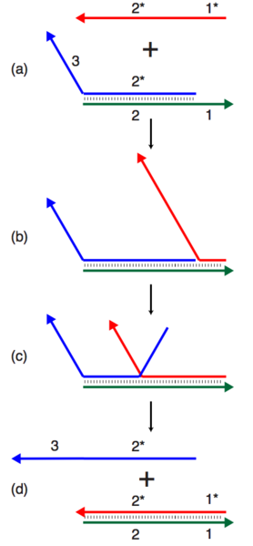
DNA Strand Displacement
x
x
y
Outputs can be used as inputs.
Inputs and outputs are single strands
Gates are double stranded
Different types of strand displacements with different reaction rates.
Waste molecules!
y

Slide 22
DNA Strand Displacement
What happens?
x
x
y
y
z

Slide 23
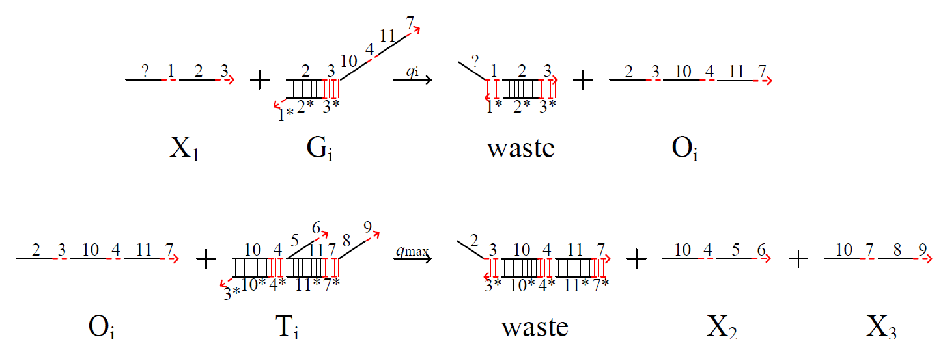
DNA Strand Displacement
x
y
+
z
x
y
z

Slide 24
Logic with DNA Strand Displacement
x
z
x
+
y
z
y
z
OR
AND

Slide 25
Logic with DNA Strand Displacement
x
z
OR
y
z

Slide 26
Logic with DNA Strand Displacement
x
z
OR
y
z

Slide 27
Logic with DNA Strand Displacement
x
z
OR
y
z

Slide 28
Logic with DNA Strand Displacement
x
z
OR
y
z

Slide 29
DNA Strand Displacement Software

Slide 30
Suggested Readings
Soloveichik, D., Seelig, G., & Winfree, E. (2010). DNA as a universal substrate for chemical kinetics. Proceedings of the National Academy of Sciences, 107(12), 5393-5398.
Article in MIT Technology Review: http://www.technologyreview.com/featuredstory/400728/molecular-computing/
Petersen, R. L., Lakin, M. R., & Phillips, A. (2016). A strand graph semantics for DNA-based computation. Theoretical Computer Science, 632, 43-73.
Microsoft DNA Displacement Tool: http://research.microsoft.com/en-us/projects/dna/

