Slide 1
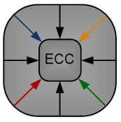

Efficient Time-Multiplexed Realization of Feedforward Artificial Neural Networks
Levent Aksoy, Sajjad Parvin, Mohammadreza Esmali Nojehdeh and Mustafa Altun
Emerging Circuits and Computation (ECC) Group
Istanbul Technical University
This work is supported by the TUBITAK-1001 project #117E078
International Symposium on Circuits and Systems (ISCAS), 10-21 October 2020, Seville Spain

Slide 2
Outline
Introduction
Background
Motivation
Time-Multiplexed ANN Design
Experimental Results
Conclusions

Slide 3
Introduction
Artificial neural network (ANN) is a computing system made up of a number of simple and highly interconnected processing elements
ANNs have been applied to a wide range of problems
  classification and pattern recognition
They have been realized in different design platforms
  analog, digital, hybrid very large scale integrated (VLSI) circuits, field programmable gate-arrays (FPGAs), and neuro-computers

Slide 4


Background
Neuron - a fundamental unit of ANN
An ANN architecture
$$y= \sum_{i=1}^{n}{w_{i}x_{i}}$$
$$z= ∅(y+b)$$
Hardware complexity of an ANN is dominated by the multiplication of weights by input variables.

Slide 5
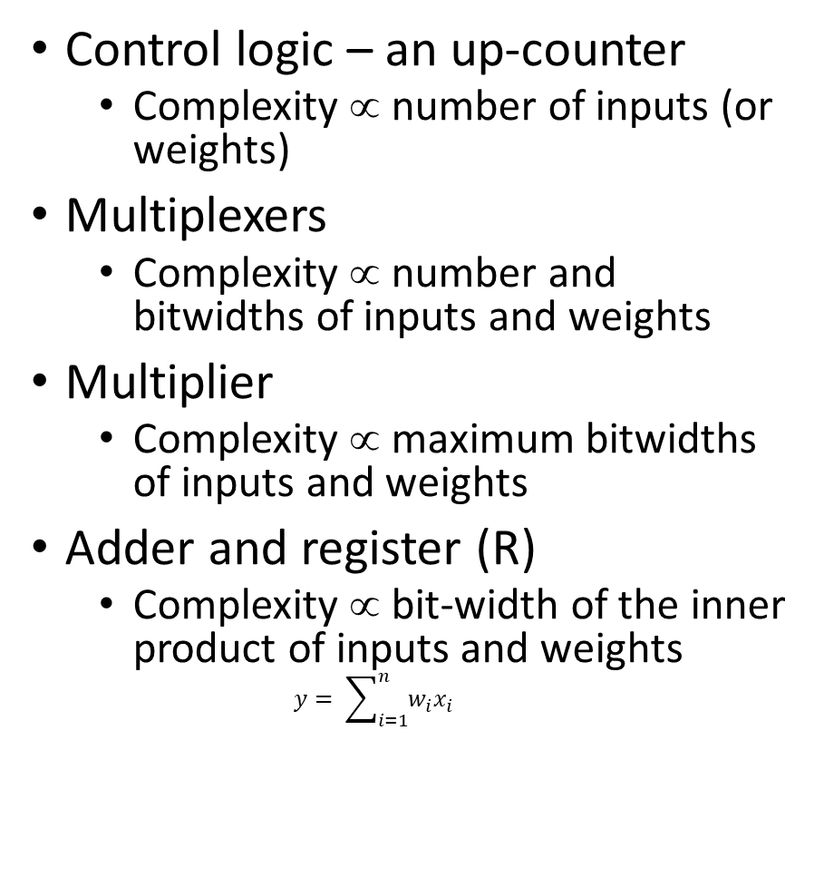

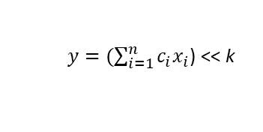
Motivation
Time-multiplexed design of a neuron
Control logic – an up-counter
  Complexity ∝ number of inputs (or weights)
Multiplexers
  Complexity ∝ number and bitwidths of inputs and weights
Multiplier
  Complexity ∝ maximum bitwidths of inputs and weights
Adder and register (R)
  Complexity ∝ bit-width of the inner product of inputs and weights
  $$y= \sum_{i=1}^{n}{w_{i}x_{i}}$$
Simplified time-multiplexed design of a neuron
  $c_{i}$= $w_{i}$/$2^{k}$
  $y=(\sum_{i=1}^{n}{c_{i}x_{i}}$) << k

Slide 6
Motivation
Multiple constant multiplications (MCM) operation realizes the multiplication of multiple constants by an input variable x
  Since constants are determined beforehand, the MCM block can be realized under the shift-adds architecture using only addition, subtraction, and shift operations
Digit Based Recoding [1]
29x = (11101)₂x = x<<4 + x<<3 + x<<2 + x
43x = (101011)₂x = x<<5 + x<<3 + x<<1 + x
Exact Method [2]
[1] M. Ercegovac and T. Lang, Digital Arithmetic. Morgan Kaufmann, 2003.
[2] L. Aksoy, E. O. Gunes, and P. Flores, “Search algorithms for the multiple constant multiplications problem: Exact and approximate,” Microprocessors and Microsystems, Embedded Hardware Design (MICPRO), vol. 34, no. 5, pp. 151–162, 2010.

Slide 7
Time-Multiplexed ANN Design
The design procedure has three main steps:
  Given the ANN structure, train the ANN using state-of-art techniques and find the weight and bias values
  Post-training stage
    Determine the minimum quantization value
    Convert the floating-point weight and bias values to integers
    Tune the weight and bias values such that the time-multiplexed design complexity is reduced
  Describe the time-multiplexed ANN design in hardware

Slide 8
Training
Our training tool includes
  several iterative optimization algorithms, namely conventional and stochastic gradient descent methods and Adam optimizer [3]
  different weight initialization techniques, namely Xavier [4], He [5], and fully random
  several stopping criteria, namely number of iterations, early stopping using validation data set, and saturation of logic functions
  different activation functions for neurons in each layer, namely sigmoid, hyperbolic tangent, hard sigmoid, hard hyperbolic tangent, linear rectified linear unit, and softmax
[3] D. P. Kingma and J. Ba, “Adam: A method for stochastic optimization,” arXiv e-prints, 2014, arXiv:1412.6980.
[4] X. Glorot and Y. Bengio, “Understanding the difficulty of training deep feedforward neural networks,” in International Conference on Artificial Intelligence and Statistics, 2010, pp. 249–256.
[5] K. He, X. Zhang, S. Ren, and J. Sun, “Delving deep into rectifiers: Surpassing human-level performance on imagenet classification,” arXiv e-prints, 2015, arXiv:1502.01852.

Slide 9
Hardware-aware Post-training
Computing the minimum quantization value
  Set the quantization value, q, and the related ANN accuracy in hardware, ha(q), to 0
  Increase q by 1
  Convert each floating-point weight and bias value to an integer by multiplying it 2^{q} and ceiling this multiplication result
  Compute ha(q) value on the validation data set using the integer weight values
  If ha(q) > 0 and ha(q) – ha(q-1) > 0.1%, go to Step 2
  Otherwise, return q as the minimum quantization value

Slide 10
Hardware-aware Post-training
Tuning the weight and bias values
  Set ha(q) to the best ANN accuracy in hardware, bha
  For each neuron in the ANN design, n_{i}, compute the smallest left shift value, sls, among its weights
    For each weight associated with n_{i}, wn_{i}j, find its largest left shift value, lls
    If lls is equal to sls, determine possible weights as pw₁ = wn_{i}j – (wn_{i}j mod 2^{lls+1}) and pw₂ = pw₁ + 2^{lls+1}, compute the ANN accuracy ha₁ and ha₂ when wn_{i}j is replaced by pw₁ and pw₂, respectively
    If max(ha₁, ha₂) ≥ bha, replace wn_{i}j by the associated weight and update bha
    Otherwise, assume wn_{i}j is replaced by a possible weight with a maximum accuracy, change bias value, bn_{i} in between [bn_{i} - 4, bn_{i} + 4] and compute ANN accuracy. If ANN accuracy is equal to or better than bha, update the values of wn_{i}j, bn_{i} ,bha
  If sls value of any neuron is improved, go to Step 2
  Otherwise, return the weight and bias values

Slide 11
Hardware Design and Multiplierless Design Optimization
Each layer of the ANN design is implemented using MAC blocks
With Multipliers
Without Multipliers

Slide 12
Experimental Results
Pen-based handwritten digit recognition problem [21] was used as an application.
In the convolutional neural network design of this application, 5 ANN structures with different number of hidden layers and number of neurons in the hidden layers were used.
ANN structures were implemented in three different architectures
  Parallel
  Time-multiplexed using multipliers – TM-MUL
  Time-multiplexed using multiplierless MCM blocks – TM-MCM
ANN designs were described in Verilog and synthesized using the Cadence RTL Compiler with the TSMC 40nm design library.

Slide 13
Experimental Results
ANN Design Results without Post-Training
Structure | Training Details |  | Parallel |  |  |  | TM-MUL |  |  |  | TM-MCM
 | sta | hta | area (μm²) | latency (ns) | power (mW) | energy (pJ) | area (μm²) | latency (ns) | power (mW) | energy (pJ) | add | area (μm²) | latency (ns) | power (mW) | energy (pJ)
16-10 | 84.6 | 83.3 | 19779 | 3.3 | 8.6 | 28.4 | 6098 | 55.0 | 0.6 | 35.4 | 110 | 9222 | 63.5 | 0.9 | 57.7
16-10-10 | 94.1 | 92.9 | 30765 | 6.2 | 15.8 | 98.4 | 11682 | 96.7 | 1.2 | 113.9 | 169 | 15854 | 110.7 | 1.2 | 128.4
16-16-10 | 96.0 | 94.7 | 42464 | 6.5 | 24.0 | 155.7 | 14301 | 127.3 | 1.5 | 186.3 | 212 | 18941 | 148.4 | 1.4 | 213.4
16-10-10-10 | 94.7 | 91.9 | 39952 | 9.0 | 26.1 | 235.2 | 16697 | 145.3 | 1.6 | 226.8 | 216 | 19909 | 153.4 | 1.1 | 172.1
16-16-10-10 | 96.6 | 94.6 | 50737 | 7.3 | 28.7 | 209.3 | 19100 | 168.3 | 1.7 | 293.1 | 232 | 23001 | 183.3 | 1.2 | 228.4
Average | 93.2 | 91.5 | 36739.4 | 6.5 | 20.6 | 145.4 | 13575.6 | 118.5 | 1.3 | 171.1 | 187.8 | 17385.4 | 131.9 | 1.2 | 160.0
ANN Design Results with Post-Training
Structure | Post-Training Details |  | Parallel |  |  |  | TM-MUL |  |  |  | TM-MCM
 | q | hta | area (μm²) | latency (ns) | power (mW) | energy (pJ) | area (μm²) | latency (ns) | power (mW) | energy (pJ) | add | area (μm²) | latency (ns) | power (mW) | energy (pJ)
16-10 | 5 | 86.6 | 8943 | 2.8 | 2.7 | 7.4 | 4278 | 47.2 | 0.4 | 19.0 | 11 | 3633 | 47.8 | 0.4 | 17.8
16-10-10 | 7 | 93.5 | 16838 | 5.4 | 8.6 | 46.0 | 8676 | 85.8 | 0.9 | 76.1 | 34 | 7648 | 91.5 | 0.6 | 57.5
16-16-10 | 7 | 95.9 | 20063 | 5.5 | 10.7 | 58.6 | 10014 | 114.0 | 1.0 | 112.3 | 33 | 8358 | 122.4 | 0.8 | 101.2
16-10-10-10 | 7 | 93.5 | 22994 | 7.9 | 13.7 | 108.4 | 13020 | 121.2 | 1.2 | 150.1 | 43 | 10743 | 134.6 | 1.0 | 132.1
16-16-10-10 | 7 | 95.6 | 25181 | 5.5 | 13.2 | 73.2 | 13368 | 147.8 | 1.3 | 199.3 | 29 | 11033 | 152.4 | 1.0 | 152.1
Average | 6.6 | 93.0 | 18803.8 | 5.4 | 9.8 | 58.7 | 9871.2 | 103.2 | 1.0 | 111.4 | 30.0 | 8283.0 | 109.7 | 0.8 | 92.1

Slide 14
Conclusions
This paper presented efficient techniques to reduce the hardware complexity of a time-multiplexed feedforward ANN design
  a post-training stage where the size and values of constant weights are explored to reduce the hardware complexity
  the multiplierless realization of the time-multiplexed ANN design
It is shown that the proposed techniques yield a significant reduction in design complexity
This work is supported by the TUBITAK-1001 project #117E078

Slide 15
Questions
THANKS for YOUR ATTENTION
Contact: Sajjad Parvin
E-mail: sajadparvin.stu93@gmail.com

