Slide 1
THE ENHANCED ELECTRONIC PROPERTIES OF P3HT-WO₃ HYBRID THIN FILM TRANSISTORS
*F.Beyza Yedikardeş, Fereshteh Ordokhani, Nihat Akkan, Ece Kurt, Esra Zayim, Nilgün Yavuz, Mustafa Altun

Slide 2
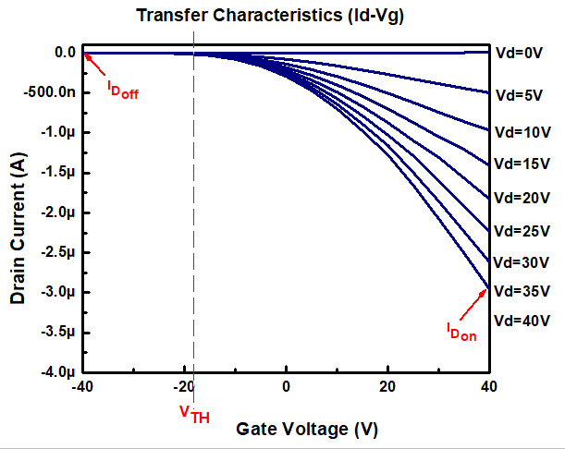
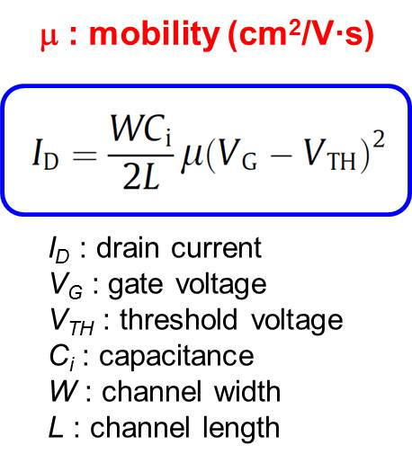
What is a Field Effect Transistor?
Performance Parameters
Threshold Voltage (V_{TH}) : min. voltage generates a conductive path between S and D
Current on-off ratio (I_{Don}/I_{Doff}) : ratio of currents in the on-state and off-state
Field effect mobility (µ) : how quickly a charge carrier can move
Amplifier
Collector
Voltage controlled switching devices
Oscillator

Slide 3
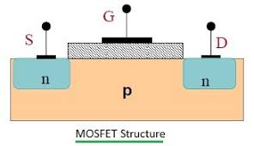
Motivation
Conventional Silicon Based Transistors | Organic Field Effect Transistors
High temperature, vacuum needed (sputtering, evaporation..) | Low temperature, solution-based techniques (spin coating, ink-jet printer)
Small scale application, expensive | Large scale application, cheap
Mobility (µ) > 1 cm².V⁻¹.s⁻¹ | Mobility (µ) : 10⁻⁶ - 10⁻³ cm².V⁻¹.s⁻¹
Amplifying circuits, ossilator, inverter in electronic circuits | Flexible, wearable electronics, color displays, sensors, IoT technology

Slide 4
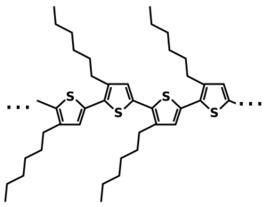
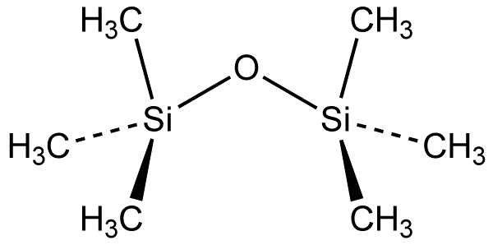
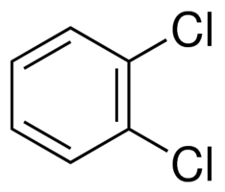
Materials
vacuum
E_{ea}
3 eV (LUMO)
E_{ea}
E_{g}
5.2 eV (CB)
5 eV (HOMO)
Poly (3-hexylthiophene)
P3HT
E_{g}
7.9 eV (VB)
P3HT
E_{g}= 2 eV
E_{ea}= 3 eV
WO₃
E_{g} = 2.7 eV
E_{ea}= 5.2 eV
Hexamethyldisilazane
(HMDS)
1,2 dichlorobenzene (DCB)
Notes:
Organic semiconductors essentially come in two ﬂavors: conjugated polymers and conjugated small-molecule materials. However,
polymers are usually difficult to evaporate due to the large molecular weight and tangling between polymer chains. P3HT is most commonly used conjugated polymer, which has excellent solubility in organic solvents. Unfortunately, the large extent of the p-conjugation in regioregular poly(3-hexylthiophene) also leads to a signiﬁcantly reduced ionization potential that makes the material very susceptible to oxygen and moisture. On account of the alkyl side group, P3HT is rendered hydrophobic in neutral state.
Doping için Wo3 ün CB’si ve polimerin HOMO’su yakın olmalı. WO3 ün elektron ilgisi P3HT den yüksek olduğundan, HOMO bandından elektron alarak yerine hole bırakıyor. P3HT’de hole taşıyıcıları arttığından akım da artıyor.

Slide 5
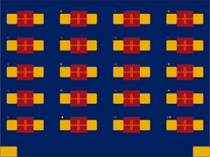
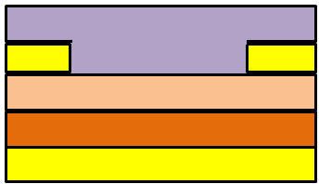
Organic Field Effect Transistors (OFETs)
Source
Drain
L : 30 µm
W : 1 mm
Channel length (L)
P3HT
P3HT polymer
Au
Au
SiO₂ gate dielectric
V_{source}
V_{drain}
Highly doped Si wafer
Au
Pre-fabricated Ossila test chips, top view
20 mm x 15 mm
Gate
Cross-section view
V_{gate}
Crystallization degree is crucial !!!
Solvent (concentration, boiling point)
Coating paremeters (spin speed, time)
Annealing condition (temperature and time)
Notes:
300 nm SiO2 (R:10 üzeri -4 ohm.cm2) alttan gate alacak kadar iletken, growth with dry oxidation, <100> orientation
2 nm Cr / 70 nm Au
700 mikron p doped Si substrate

Slide 6
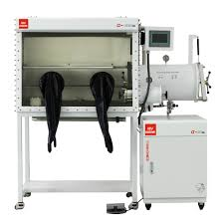
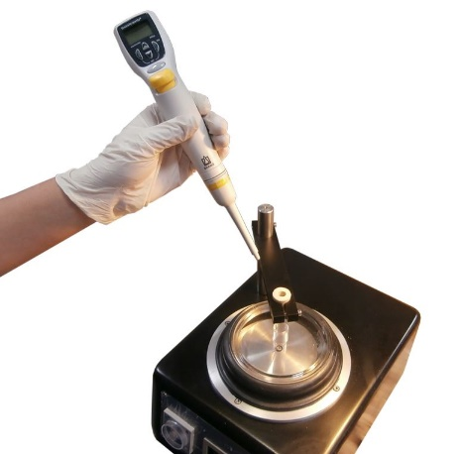
Method
1) Solvent Preparation
2) Chip cleaning
15 min. sonication with DCB
15 min. Sonication with IPA
Dry with N₂ gun
10 min. Uv-Ozone Cleaner
3) Coating
Pre-heating at 70°C 30 min.
HMDS treatment
4000rpm 40 sec. spin
120 °C 5 min. annealing
Solvent coating
2500 rpm 90 sec. spin
100 °C 30 min. annealing
Sample Code | P3HT | WO₃ | DCB
PWO | 5 mg | - | 1 ml
PW10 | 5 mg | 0.6 | 1 ml
PW30 | 5 mg | 2.2 | 1 ml
PW40 | 5 mg | 3.3 | 1 ml
PW50 | 5 mg | 5 | 1 ml
Stirring under magnetic stirrer at 70°C overnight in glovebox ambient.

Slide 7
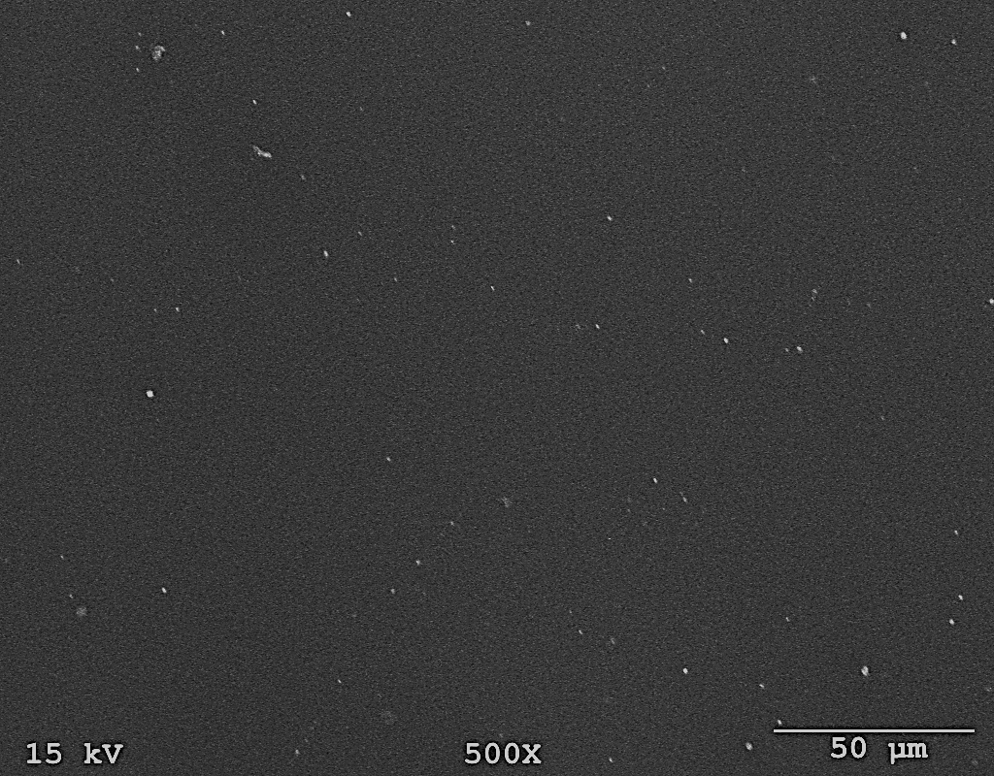
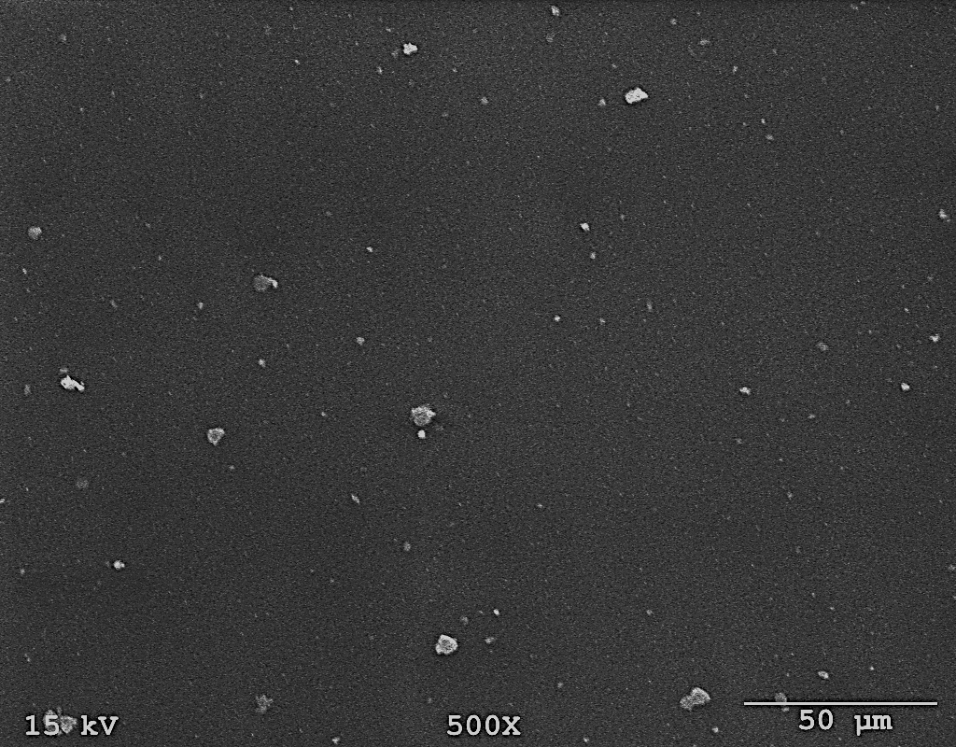
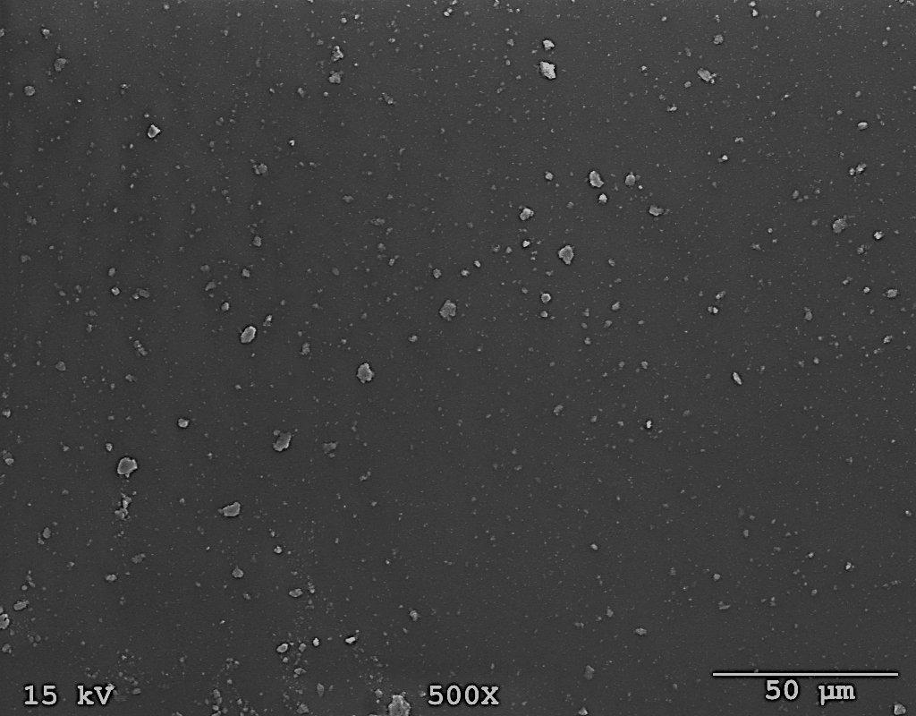
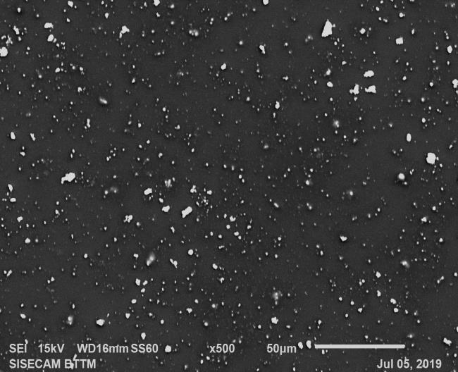
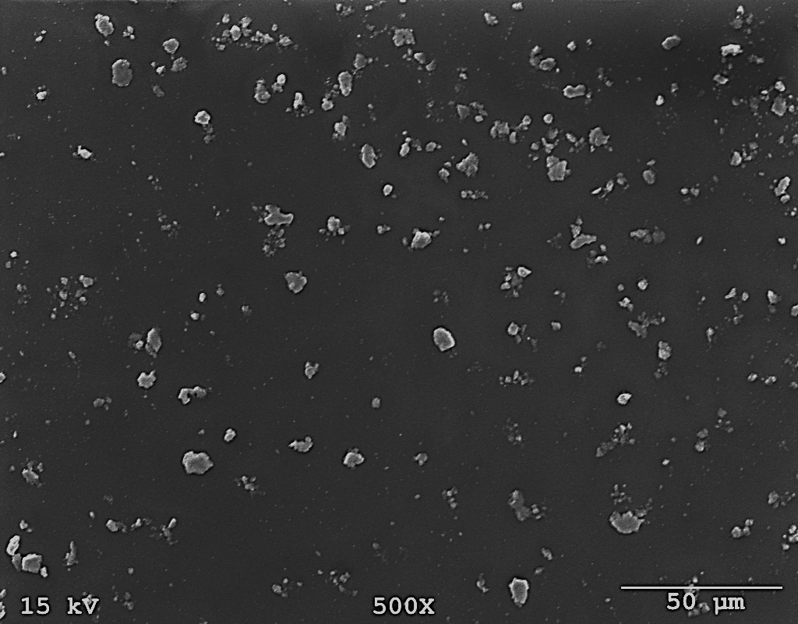
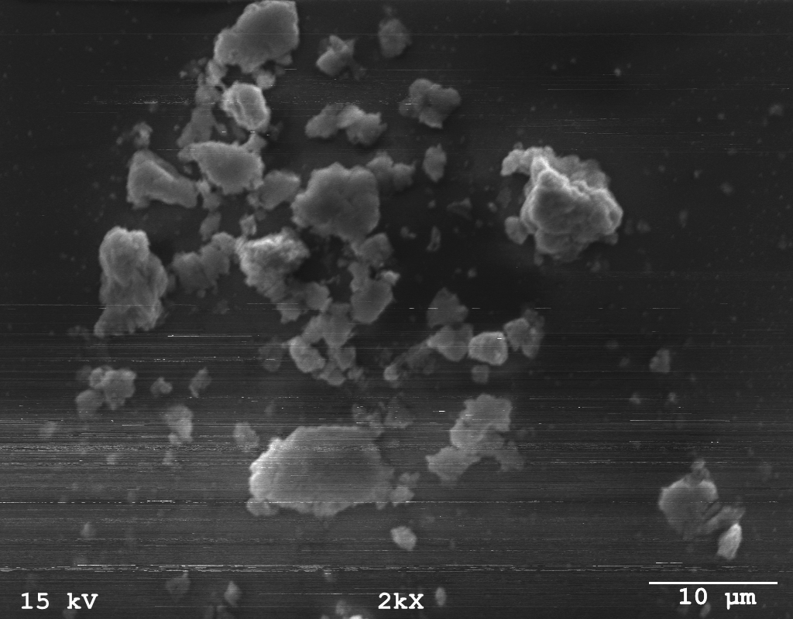
Surface Characterization (SEM-EDS)
P3HT (PW0)
PW10
PW30
Spectrum Label | O | Si | S | W
P3HT | 55.72 | 44.04 | 0.25 | 0
Spectrum Label | O | Si | S | W
PW10 | 47.92 | 46.35 | 0.69 | 5.04
Spectrum Label | O | Si | S | W
PW30 | 47.92 | 42.60 | 2.33 | 7.14
PW40
PW50
PW50
Spectrum Label | O | Si | S | W
PW40 | 50.19 | 39.48 | 2.38 | 7.94
Spectrum Label | O | Si | S | W
PW50 | 42.29 | 36.67 | 2.90 | 18.14
Agglomerated nanoparticles

Slide 8
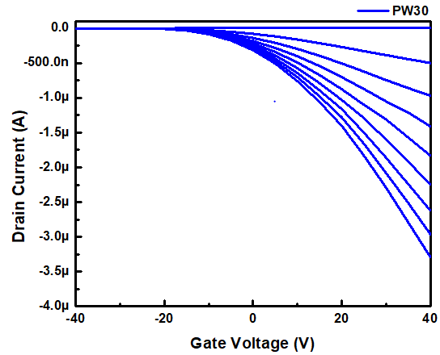
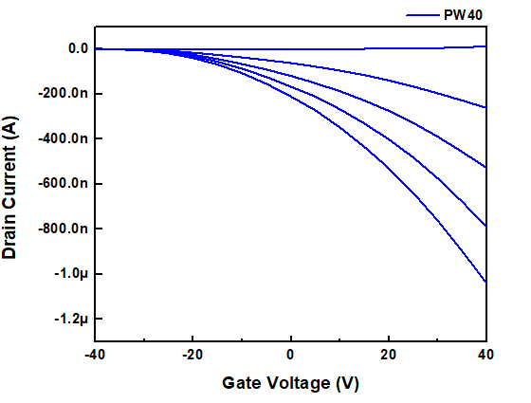
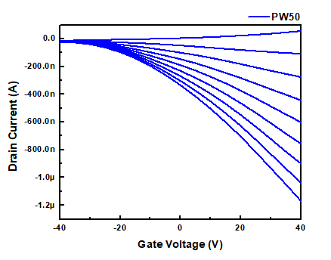
Electronic Characterization of Chips
P3HT (PW0)
PW10
PW30
PW40
PW50
Notes:
It can be seen from the transfer characteristics that dispersion of WO3 in the polymer enhances drain current and the mobility. Threshold voltage can be almost the same, this can be explained by the presence of density of traps at the interface controlled by HMDS.
Polythiophene behaves as ap-type semiconductor, and WO3 is a n-type semiconductor. So the P3HT/WO3 hybrids contain the properties of p-n junctions. A positively charged depletion layer is formed on the P3HT surface owing to the interparticle electron migration from P3HT to WO3 at p-n heterojunctions.
%40 tan sonra artık on/off düşüyor çünkü this is due to the fact that apart from an increase in the on current for composite based transistors, there is also a corresponding rise in o® current.
?? There is a slight but systematic shift of threshold voltages towards zero, between pristine and composite transistors, representing a reduction in trap density in the polymer, which is responsible for the enhanced mobility.

Slide 9
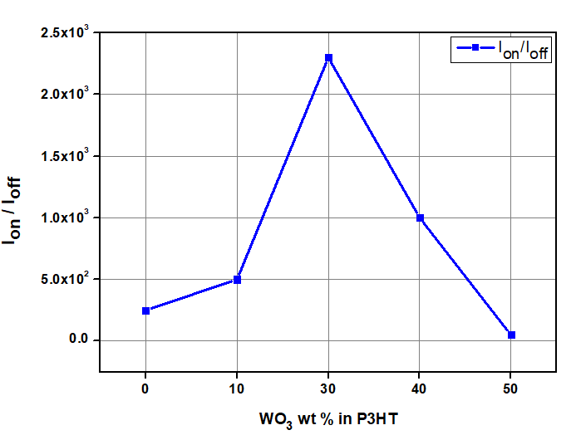
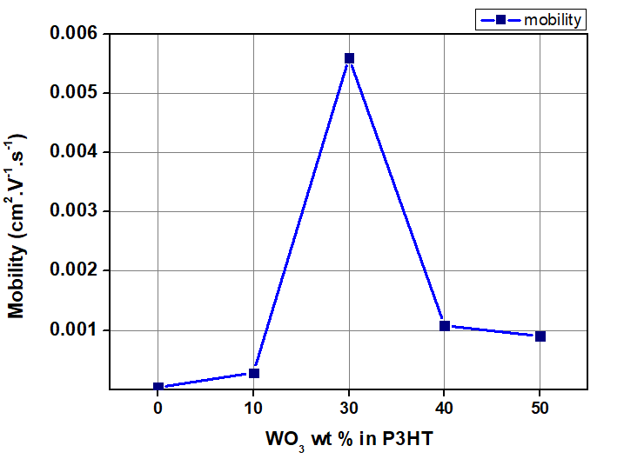
Electronic Characterization
P3HT (PW0)
PW10
PW30
Sample Code | Mobility (cm².V⁻¹.s⁻¹) | I_{Don}/I_{Doff} | V_{TH} (V)
P3HT | 5.3x10⁻⁵ | 2.5x10² | 40.1
PW10 | 2.8x10⁻⁴ | 5.0x10² | 37.2
PW30 | 5.6x10⁻³ | 2.3x10³ | 17.7
PW40 | 1.1x10⁻³ | 1.0x10³ | 32.7
PW50 | 9.0x10⁻⁴ | 5.0x10¹ | 45.1
PW40
PW50
Notes:
It can be seen from the transfer characteristics that dispersion of WO3 in the polymer enhances drain current and the mobility. Threshold voltage can be almost the same, this can be explained by the presence of density of traps at the interface controlled by HMDS.
Polythiophene behaves as ap-type semiconductor, and WO3 is a n-type semiconductor. So the P3HT/WO3 hybrids contain the properties of p-n junctions. A positively charged depletion layer is formed on the P3HT surface owing to the interparticle electron migration from P3HT to WO3 at p-n heterojunctions.
%40 tan sonra artık on/off düşüyor çünkü this is due to the fact that apart from an increase in the on current for composite based transistors, there is also a corresponding rise in o® current.
?? There is a slight but systematic shift of threshold voltages towards zero, between pristine and composite transistors, representing a reduction in trap density in the polymer, which is responsible for the enhanced mobility.

Slide 10
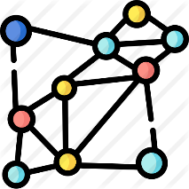
Structural Characterization (XRD)
intermolecular π → π* stacking, corresponding to the (100) reflection of the polymer backbone at 2θ = 5.4°
new peaks possibly related to crystalline orientations of the thiophene units with the attachment of WO₃
Successful incorporation of nano-WO₃ in P3HT network

Slide 11
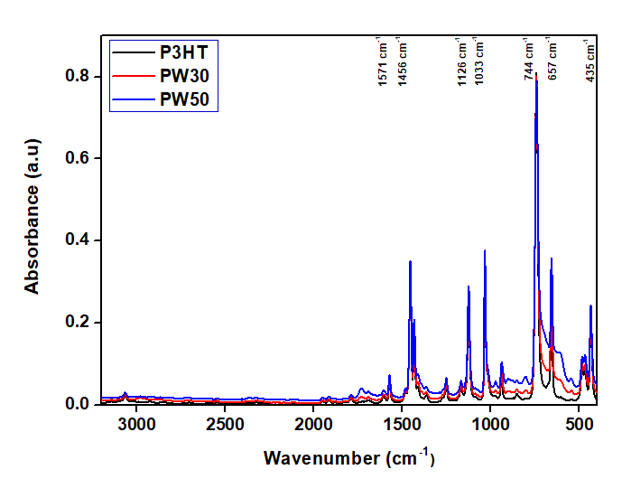
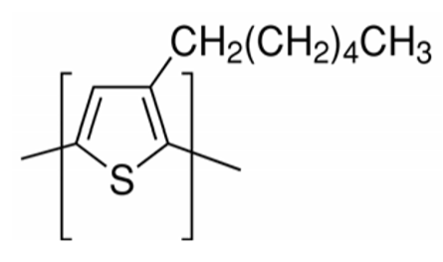
Chemical Characterization (FTIR)
Wavenumber (cm⁻¹) | Group
1571 | Symmetric C=C streching in thiophene ring
1456 | Asymmetric C=C streching in thiophene ring
1126, 1003 | C-H bonds from CH₃
744, 657 | C-S streching
No peak shifting
It is evident that FTIR spectra of P3HT/WO₃ hybrid structures seem to be a mixture of both WO₃ and P3HT.
Electrostatic interaction between nano-WO₃ and P3HT network
Notes:
3066, 1571-1456 and 744,657 cm-1 were associated with vibrations of P3HT thiophene rings. The small peak at 3066 cm-1 is assigned to the aromatic C-H
stretching vibration of the thiophene ring. The two peaks in the band between 1571 and 1456 cm-1 are assigned to the stretching vibration of the thiophene ring (symmetric and asymmetric C=C rings). 1500 lerdeki pikin şidddeti polimerin oryantasyonu değiştikçe değişir.
The hexyl side chains are confirmed by the range of 1126-1003 cm-1 which confirms C-H bonds coming fom CH3 groups.
The P3HT/WO3 hybrid srtuctrues also show the same characteristic peaks. It is evident that FTIR spectra of P3HT/WO3 hybrid structures seem to be a mixture of both WO3 and P3HT.

Slide 12
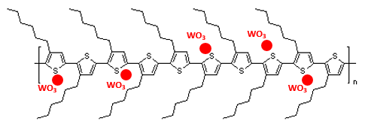
Chemical Characterization (Raman)
Main in-plane ring skeleton C=C at 1452 cm⁻¹
C-C inter-ring streching at
1380 cm⁻¹
C-S-C deformation mode at 726 cm⁻¹
30 wt % shows the best electronic transfer with the polymer network
$$Frequency= \frac{1}{2} \sqrt{\frac{k}{m}}$$
Bond strength

Slide 13
Conclusion
Transistor performance of pristine P3HT was enhanced with the incorporation of WO₃ nanoparticles.
30 wt % WO₃ showed the best attachment to the polymer system considering the spectroscopic characterization.
Threshold voltage was improved from 48.5 V to 17.7 V
The field-effect mobility of pristine P3HT based transistors improved by 165 times for 30 wt. % of WO₃.
The on/off current ratio of P3HT based device increased by approximately 10 times at 30 wt. % WO₃ concentration.

Slide 14
Future Work
Electrochromic transistors: Both P3HT and WO₃ show electrochromic behavior.
Sensor applications: Both materials are susceptible for gas sensing.
Acknowledgement
TUBITAK 1001 (The Scientific and Technological Research Council of Turkey) Project #116E250
Istanbul Technical University, Scientific Research Project #41312
Emerging Circuits and Computation Group, www.ecc.itu.edu.tr
- ‘’A person who never made a mistake never tried anything new.’’
Albert Einstein

