Slide 1

ELE 523E
COMPUTATIONAL NANOELECTRONICS
Mustafa Altun
Electronics & Communication Engineering
Istanbul Technical University
Web: http://www.ecc.itu.edu.tr/
FALL 2021
W5: Computing with Nano Arrays, 1/11/2021

Slide 2
Outline
Computing with nano arrays
  Motivation: CMOS gets regular
  Motivation: Self-assembly
  Two-terminal vs. four-terminal
Arrays of two-terminal devices
  Diode based
  Transistor based
Arrays of four-terminal devices

Slide 3
Motivation: CMOS Gets Regular
Moore's Law is dead

Slide 4
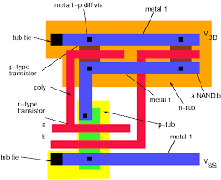
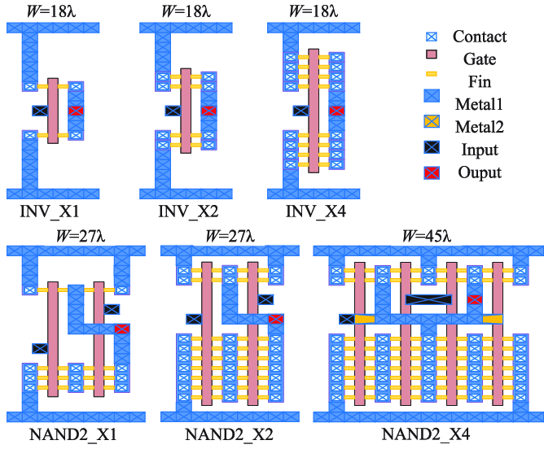
Motivation: CMOS Gets Regular
>40nm – Planar CMOS <40nm - FinFET

Slide 5
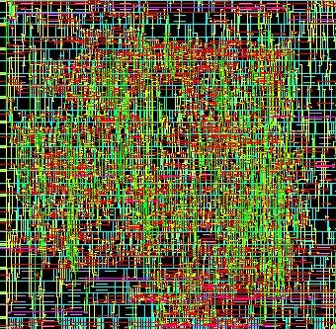
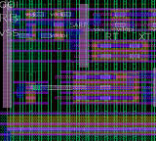
Motivation: CMOS Gets Regular
>40nm – Planar CMOS <40nm - FinFET

Slide 6
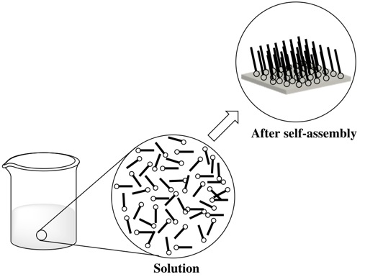
Motivation: Self-assembly
From disordered to ordered and regular structure

Slide 7
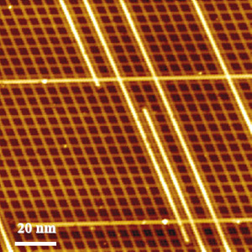
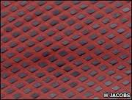
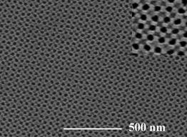
Why Self-assembly?
We prefer order to disorder.
Living cells self-assemble.
Self-assembly is practical to manufacture nano structures.
Self-assembled nano structures

Slide 8
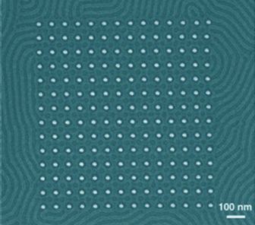
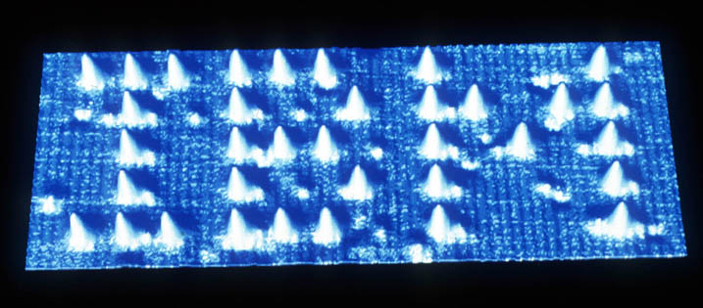
Why Self-assembly?
Directed assembly
  Advantages
    Results in a functional construct from a print/layout
  Disadvantages
    Costly in nanoscale
    Time consuming
Self assembly
  Advantages
    Fast and efficient in nanoscale
    Results in condensed structures
  Disadvantages
    Not results in a functional construct

Slide 9
Research on Self-assembly
VİDEOS FROM LABS:
Video-1: Self-Assembly of Lithographically Patterned 3D Micro/Nanostructures
Lab: Gracias Lab
University: John Hopkins University
Video-2: It's Not Magic: Watch How Smart Parts Self-Assemble
Lab: Self-assembly Lab
University: Massachusetts Institute of Technology (MIT)

Slide 10
Nano Arrays
REGULAR
NANO
ARRAYS
SELF
ASSEMBLY

Slide 11
Modelling Nano Arrays

Slide 12

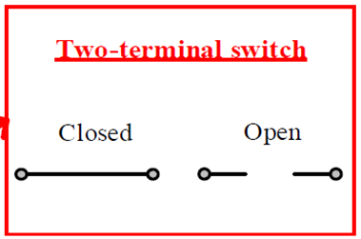
Modelling Nano Arrays

Slide 13
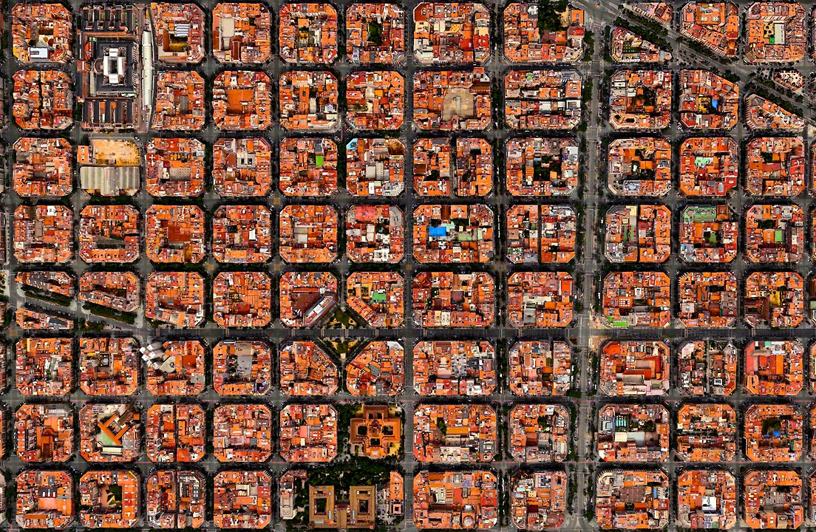
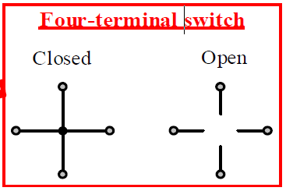
Modelling Nano Arrays

Slide 14
Two-terminal Diode-based Model

Slide 15
Two-terminal Diode-based Model
Example:
Implement the Boolean function f = A+B with diode based nanoarrays.
Diode-resistor logic

Slide 16
Two-terminal Diode-based Model
Example:
Implement the Boolean function f = A B with diode based nanoarrays.
Diode-resistor logic

Slide 17
Two-terminal Diode-based Model
Example:
Implement the Boolean function f = A B + C D with diode based nanoarrays.

Slide 18
Two-terminal Memristor-based Model
How a memristor works?

Slide 19
Two-terminal Memristor-based Model
Example:
Analyze the memristor based nanoarrays given below

Slide 20
Two-terminal Memristor-based Model
Example:
Implement the Boolean function f = XOR₂ = x1⊕ x2
with memristor based nanoarrays.

Slide 21
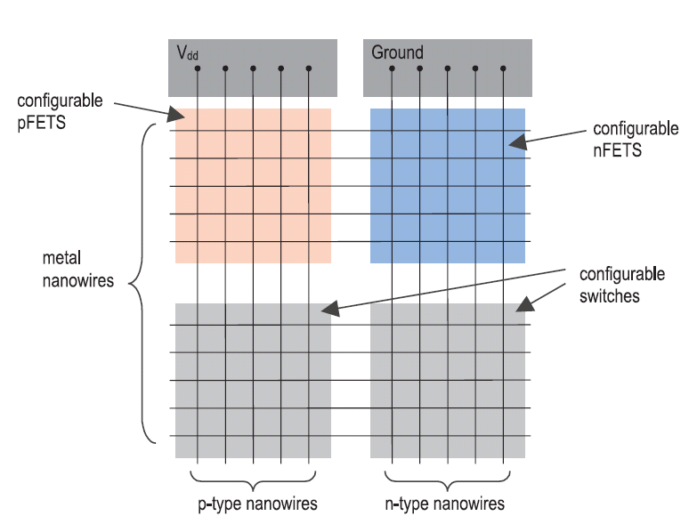
Two-terminal FET-based Model
From Snider, G., et al., (2004). CMOS-like logic in defective, nanoscale crossbars. Nanotechnology.

Slide 22
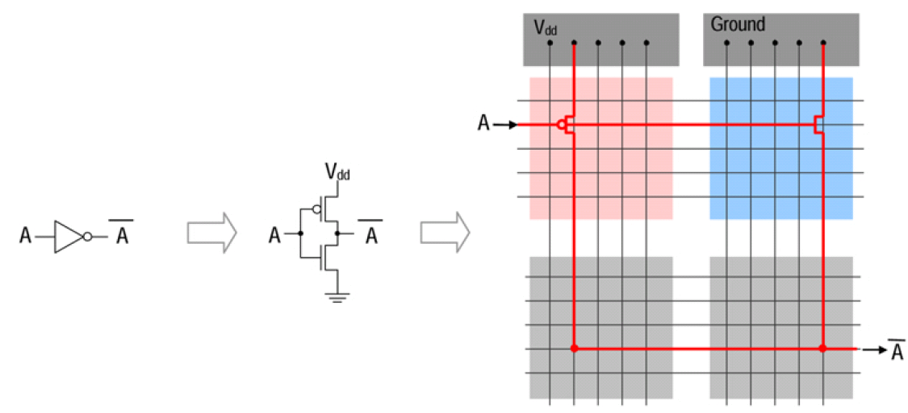
Two-terminal FET-based Model
Example:
Implement the Boolean function f = Aꞌ with CMOS based nanoarrays.

Slide 23
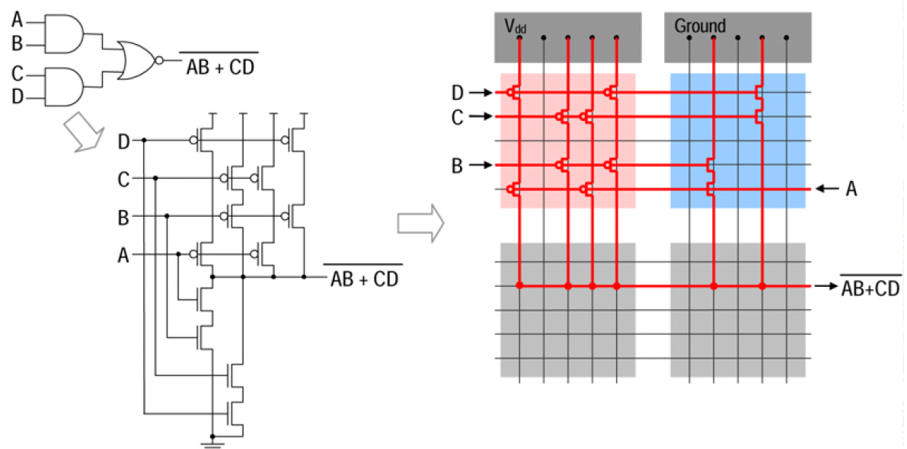
Two-terminal FET-based Model
Example:
Implement the Boolean function f = (A B + C D)ꞌ with CMOS based nanoarrays.

Slide 24
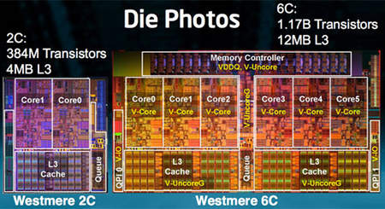
Two-terminal vs. Four-terminal
Shannon’s work: A Symbolic Analysis of Relay and Switching Circuits(1938)

Slide 25
Two-terminal vs. Four-terminal

Slide 26
Two-terminal vs. Four-terminal
What are the Boolean functions implemented in (a) ad (b)?

Slide 27
A Lattice of Four-terminal Switches
3 × 3 2D switching network and its lattice form

Slide 28
Four-terminal Switch-based Model
Switches are controlled by Boolean literals.
f_{L} evaluates to 1 iff there exists a top-to-bottom path.
g_{L} evaluates to 1 iff there exists a left-to-right path.

Slide 29
Logic Synthesis Problem
How can we implement a given target Boolean function f_{T} with a lattice of four-terminal switches?
Example: f_{T} = x₁x₂x₃+x₁x₄

Slide 30
Logic Synthesis Problem
Example: f_{T} = x₁x₂x₃+x₁x₄+x₁x₅
9 TOP-TO-BOTTOM PATHS!

Slide 31
Synthesis Method
Example: f_{T} = x₁x₂x₃+x₁x₄+x₁x₅
f_{T}^{D} = (x₁+x₂+x₃)(x₁+x₄)(x₁+x₅)
f_{T}^{D} = x₁ + x₂x₄x₅ + x₃x₄x₅
Start with f_{T} and its dual.
Assign each product of f_{T} to a column.
Assign each product of f_{T} ^{D} to a row.
Compute an intersection set for each site.
Arbitrarily select a literal from an intersection set and assign it to the corresponding site.

Slide 32
Synthesis Method

Slide 33
Math Behind the Method – Theorem 1
Theorem 1 (Altun and Riedel, 2010): If f_{T} and f_{T}^{D} are implemented as subsets of all top-to-bottom and left-to-right paths, respectively, then f_{L} = f_{T} and g_{L} = f_{T}^{D}.

Slide 34
Math Behind the Method – Theorem 1
Theorem 1 allows us to only consider column-paths. We do not need to enumerate all paths!

Slide 35
Math Behind the Method – Theorem 2
Lemma (Fredman and Khachiyan, 1996): Consider products P_{i} and P_{j} of f_{T} and f_{T}^{D} in ISOP forms, respectively. P_{i} ∩ P_{j} ≠ Ø
Theorem 2 (Altun and Riedel, 2010): Consider a product P_{i} of f_{T} in ISOP form. For any literal x of P_{i} there exists at least one product P_{j} of f_{T}^{D} such that P_{i} ∩ P_{j} = x.

Slide 36
Math Behind the Method – Theorem 2
Theorem 2 (Altun and Riedel, 2010): Consider a product P_{i} of f_{T} in ISOP form. For any literal x of P_{i} there exists at least one product P_{j} of f_{T}^{D} such that P_{i} ∩ P_{j} = x.
Each column is for each product!

Slide 37
Method’s Performance
The time complexity:
O(m²n²)
Size of the lattice: m×n
n and m are the number of products of the target function f_{T} and its dual f_{T}^{D}, respectively.

Slide 38
Implementing Parity Functions
A Parity function f evaluates to 1 iff the number of variables assigned to 1 is an odd number:

Slide 39
Implementing Parity Functions

Slide 40
Implementing Parity Functions
Lattice size: (log m +1)×n
compared to m×n
n and m are the number of products of the target function f_{T} and its dual f_{T}^{D}, respectively.

Slide 41
Implementing parity functions
OPTIMAL
XOR₃
XOR₃
Lattice size: (log m +1)×n= (log 4 +1)×4=12
Lattice size: 3×3=9

Slide 42
Implementing parity functions
OPTIMAL
Lattice size: (log m +1)×n= (log 8 +1)×8=32
Lattice size: 3×5=15

Slide 43
Optimal Lattice Sizes
We need at least 3 rows to implement the target functions.
Can we implement the target functions with 2 columns?
NO for f_{T1}; YES for f_{T2}.
The minimum lattice sizes for f_{T1} and f_{T2} are 9 and 6.

Slide 44
Defect Tolerance
(?) Finding largest (k x k) defect-free sub-crossbar
in (N x N) defective crossbar (k < N)

Slide 45
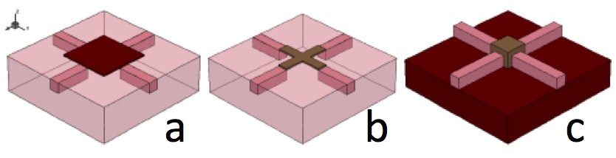
Technology Development
TCAD Simulations / Real Device Test
SPICE Modelling
Power – Delay – Area Analysis

Slide 46
Technology Development
Based on 65nm post layout results 2X area improvement
over the conventional CMOS implementations
How to implement nano arrays including switching lattices in 3D?

Slide 47
Suggested Readings
Shannon, C. E. (1938). A symbolic analysis of relay and switching circuits. Electrical Engineering, 57(12), 713-723
Whitesides, G. M., & Grzybowski, B. (2002). Self-assembly at all scales.Science, 295(5564), 2418-2421.
Snider, G., Kuekes, P., Hogg, T., & Williams, R. S. (2005). Nanoelectronic architectures. Applied Physics A, 80(6), 1183-1195.
Altun, M., & Riedel, M. D. (2012). Logic synthesis for switching lattices.Computers, IEEE Transactions on, 61(11), 1588-1600.
Strukov, D. B., & Likharev, K. K. (2012). Reconfigurable nano-crossbar architectures. Nanoelectronics and Information Technology, 543-562.
Alexandrescu, D., Altun, M., Anghel, L., Bernasconi, A., Ciriani, V., Frontini, L., & Tahoori, M. (2017). Logic synthesis and testing techniques for switching nano-crossbar arrays. Microprocessors and Microsystems, 54, 14-25.
Cevik, I., Aksoy, L., & Altun, M. (2020, March). Cmos implementation of switching lattices. In 2020 Design, Automation & Test in Europe Conference & Exhibition (DATE) (pp. 274-277). IEEE.

