Slide 1

ELE 523E
COMPUTATIONAL NANOELECTRONICS
Mustafa Altun
Electronics & Communication Engineering
Istanbul Technical University
Web: http://www.ecc.itu.edu.tr/
FALL 2021
W2: Emerging Computing, 11/10/2021

Slide 2
Outline
Overview of Boolean algebra
Overview of computational complexity
Reversible quantum computing
DNA computing
Computing with nano arrays
Emerging transistors
Probabilistic/Stochastic computing
Bit/Digit serial computing
Approximate computing

Slide 3
Boolean Algebra
 | Elementary Algebra | Boolean Algebra
Variables | Numbers (1, 3.2, π) | TRUE and FALSE
Operators | Addition (+) Multiplication (×) | AND (˄) OR (˅) NOT (¬)
Example | y = x₁x₂ + x₁x₃+x₂x₃ | f = x₁x₂ ˅ x₁x₃ ˅ x₂x₃
Usage | Fundamental Math | Logic, Computer Science

Slide 4
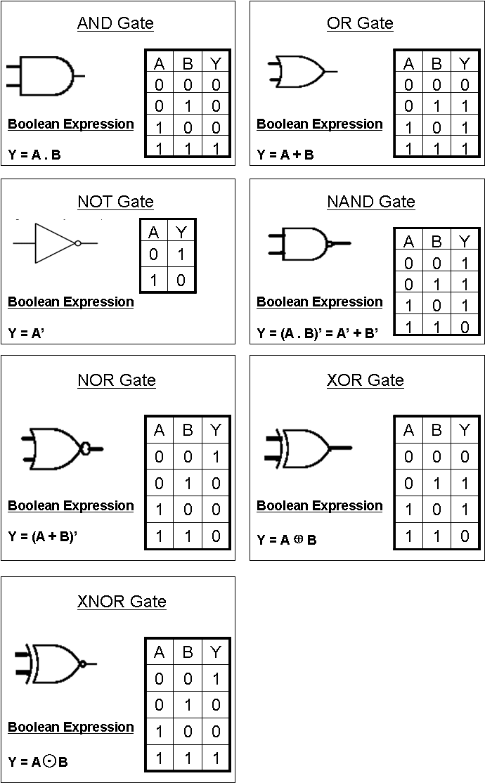
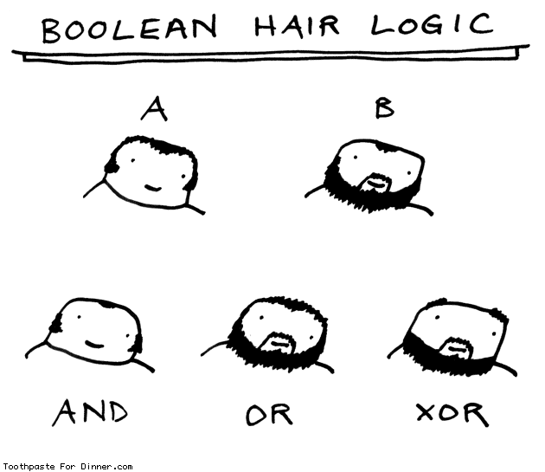
Boolean Gates
NAND and
NOR are
universal.
How to implement gates, extensively any given Boolean function, with emerging devices?

Slide 5
Computational Complexity
Focus on classifying computational problems according to their inherent difficulty.
  Time
  Circuit size
  Number of processors
Determine the practical limits regarding the restrictions on resources.
Based on algorithms
  Reaching optimal solutions.
Emerging devices aim to improve computational complexity of important problems.

Slide 6
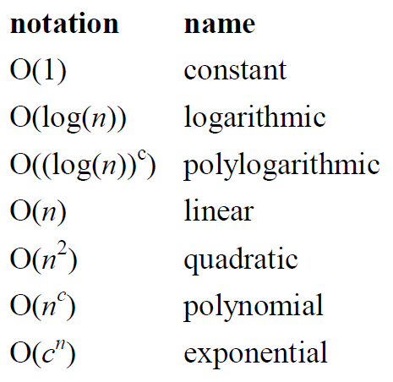



Notations
Big O notation
C is a positive real number.
Complexity is usefull in long-term (to infinity)
Example:

Slide 7
Time Complexity Examples
Example:
Counting the class of n students
One by one
Every row has a constant A number of students.
n is upper bounded by a number B.
Example:
Finding the intersection of two sets with n and m elements.
Example:
Travelling salesman problem: Given a list of n cities and the distances between each pair of cities, what is the shortest possible route that visits each city exactly once and returns to the origin city?

Slide 8
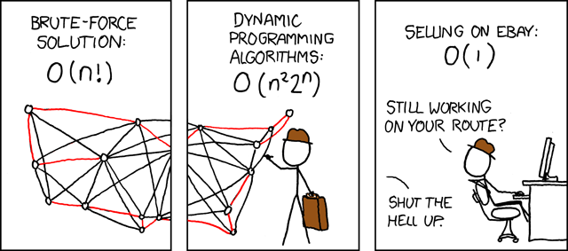
Time Complexity Examples
Travelling Salesman Problem

Slide 9
Time Complexity Examples
Example:
Factorizing semi-prime (RSA) numbers. For each RSA number n, there exist prime numbers p and q such that n = p × q.
15 = 3 × 5
4633 = 41 × 113
The prize for RSA-1024 is $100.000.
RSA-2048 takes approximately 10 billion years with the best known algorithm.
What is P (polinomial) vs NP (non-deterministic P)?

Slide 10
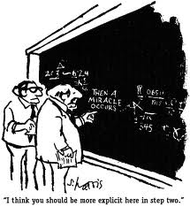
Emerging Devices

Slide 11
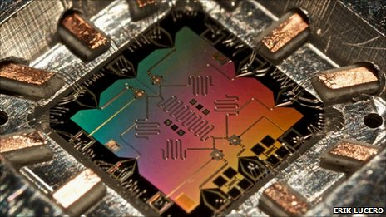
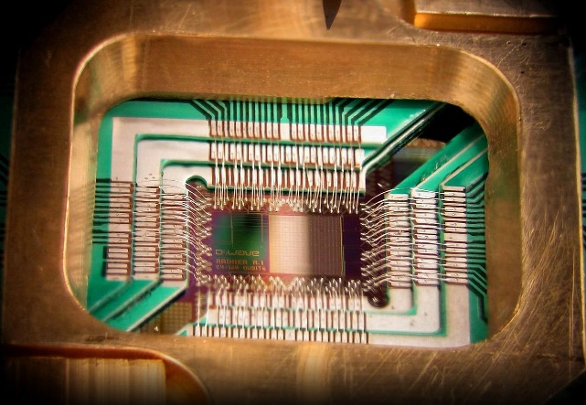
Quantum Computing
Theoretically, quantum computers solve RSA-2048 problem in seconds compared to 10 billion years.
Shor’s algorithm.
Cracking RSA keys - a breakthrough in cryptology.
Quantum key distribution
Practically, where are we now?
Erik Lucero’s circuit to factorize 15, 2012
NASA quantum computer by D-Wave, 2016

Slide 12
Quantum Computing
September 2012: The first working "quantum bit" based on a single atom in silicon suitable for the building blocks of modern computers.
October 2012: Nobel Prizes were presented to David J. Wineland and Serge Haroche for their basic work on understanding the quantum world - work which may eventually help makequantum computing possible.
May 2013: Google launching the Quantum Artificial Intelligence Lab with 512-qubit quantum computer.
December 2015: NASA publicly displayed the world's first fully operational $15-million quantum computer.
May 2017: IBM made 16 qubit processor available on the IBM Q Experience (an online platform that gives public users access to a set of IBM’s prototype quantum processors via the Cloud)
September 2020: IBM promises 1000-qubit quantum computer-milestone-by 2023
September 2020: The best quantum computers money can buy: Underpowered, unreliable but amazing

Slide 13
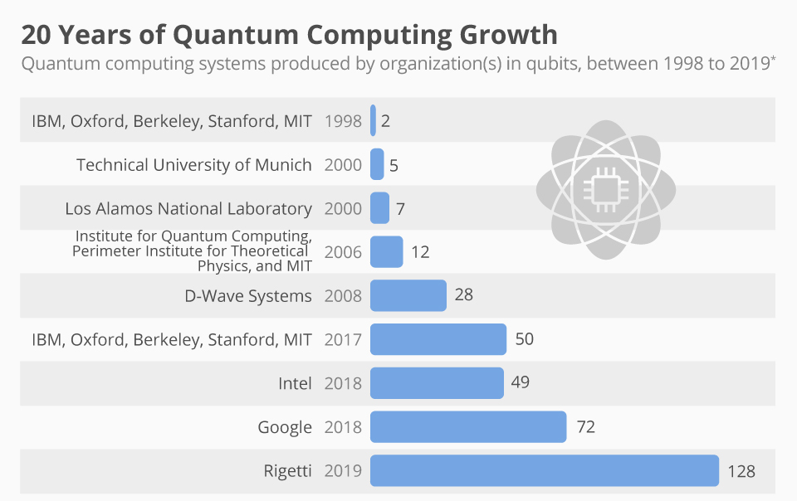
Quantum Computing

Slide 14





Bits vs. Qubits
Bits
0 or 1 at a time
Deterministic
Discrete and stable states
State of a bit:
In state 0 or 1 with a probability of
Qubits
0 or 1 at the same time
Probabilistic
Superposition of states
State of a qubit:
In state 0 with a probability of
In state 1 with a probability of

Slide 15
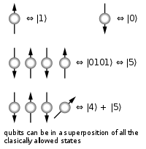
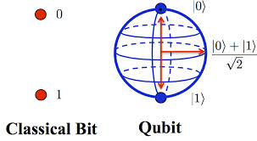
Bits vs. Qubits

Slide 16
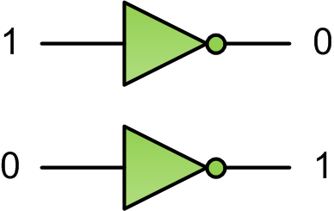
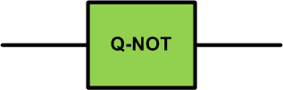


Reversible Quantum Gates
Classical NOT gate
Quantum NOT gate

Slide 17




Reversible Quantum Gates
Quantum gates are reversible

Slide 18
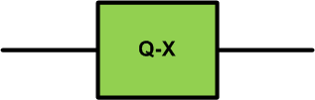

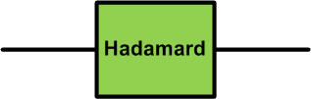

Reversible Quantum Gates
Example:
Find the corresponding matrix of a quantum gate X.
Example:
Find the output of a Hadamard gate. Prove that it is reversible.

Slide 19

Reversible Quantum Gates
Can the following matrix be a Q-gate matrix?
What are the properties of Q-gate matrices?
What are the other gate types for single qubits?
How about the gates for multiple qubits.
Is there a universal quantum gate?

Slide 20
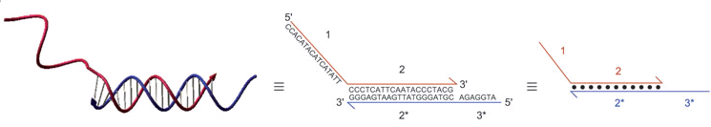
DNA Computing
Parallel computing
  For certain problems, DNA computers are faster and smaller than any other computer built so far.
  A test tube of DNA can contain trillions of strands.
Computing with DNA strands
  Depending on absence and presence of DNA molecules.
  Strands have directions.
  How do strands stick together?

Slide 21
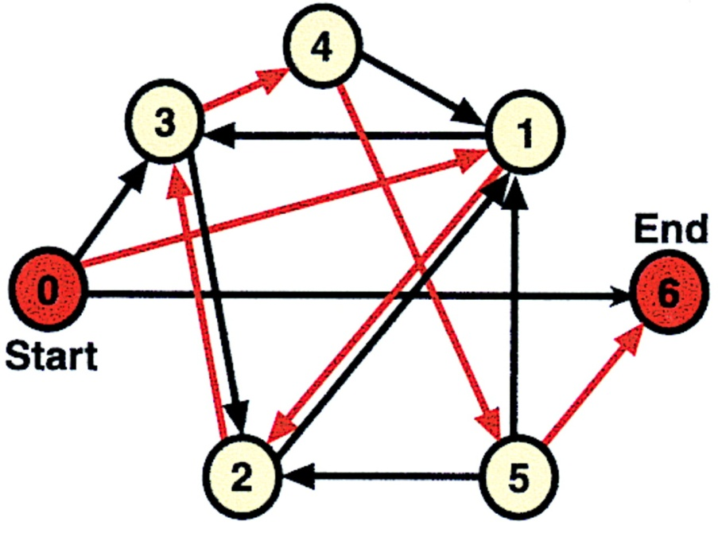
DNA Computing for TSP
Adleman’s motivating experiment,1994
Modified travelling salesman problem (TSP): Given 7 towns, is there a route from town 0 to town 6 with visiting each town exactly once?

Slide 22
DNA Computing for TSP
Step-1: Construct strands for each link (road) considering directions
Step-2: Make the strands join where they have matching numbers.
Step-3: Eliminate all the strands other than 0-to-6 ones.
Step-4: Eliminate strands other than the ones having 6 strands.
Step-5: Look for 1, 2, 3, 4, and 5 strands one-by-one.

Slide 23
DNA Computing for TSP
Computational complexity?

Slide 24
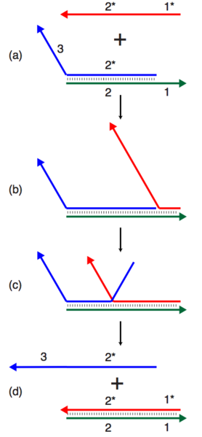
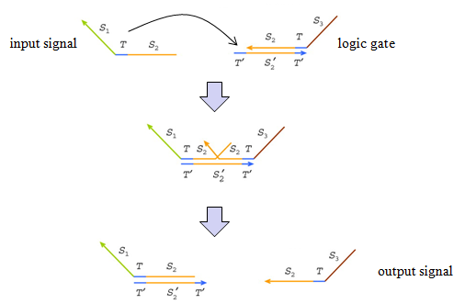
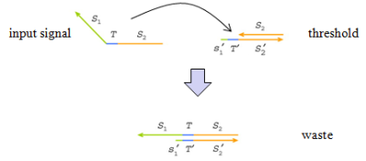
DNA Strand Displacement

Slide 25
DNA Computing
Main advantages
  Parallel
  Dense, small area
  Can solve untractable problems
Disadvantages
  Slow
  Fragile
  Unreliable, randomness

Slide 26
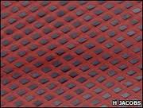
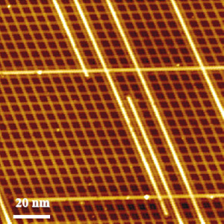
Computing with Nano Arrays
Self-assembled nano arrays
Computing models for nano arrays
  Two-terminal switch-based
    Diode-based
    Transistor-based
  Four-terminal switch-based

Slide 27
Two-terminal Diode-based Model

Slide 28
Two-terminal Diode-based Model
Example:
Implement the Boolean function f = A+B with diode based nanoarrays.
Diode-resistor logic

Slide 29
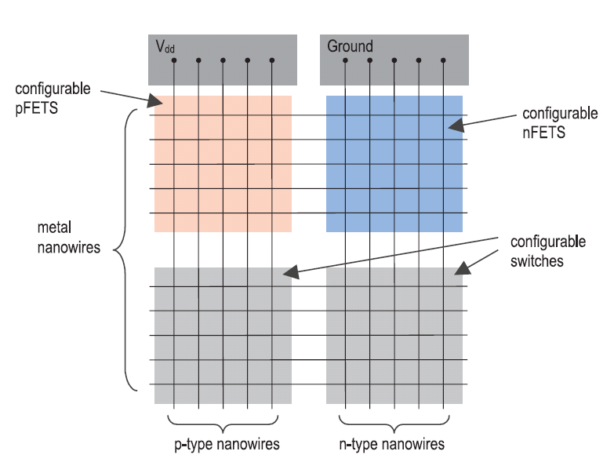
Two-terminal FET-based Model
From Snider, G., et al., (2004). CMOS-like logic in defective, nanoscale crossbars. Nanotechnology.

Slide 30
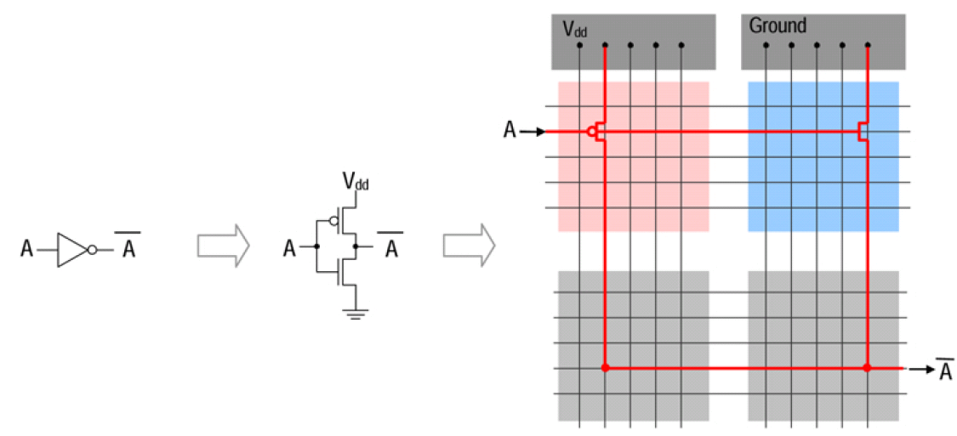
Two-terminal FET-based Model
Example:
Implement the Boolean function f = Aꞌ with CMOS based nanoarrays.

Slide 31
Two-terminal vs. Four-terminal

Slide 32
Two-terminal vs. Four-terminal
What are the Boolean functions implemented in (a) ad (b)?

Slide 33


Computing with Separate Devices
Nanowire transistor
Single electron transistor
Direct replacement of CMOS transistors
Some advantages over CMOS
Interconnection problems
Lack of integration

Slide 34
Probabilistic Computing
Deterministic
Subsequent state of the system is determined deterministically
Probabilistic
Subsequent state of the system is determined probabilistically
Deterministic
Deterministic
Deterministic
Probabilistic

Slide 35
Why Probabilistic Computing?
Strengths
  Easier to implement arithmetic operations.
  Works efficiently in encoding/decoding
  High degree of transient error tolerance.
  Exploit randomness that is a fact in nanoscale.
  Used in modeling probabilistic behavior of nanotechnologies.
Weaknesses
  Accuracy problems.
  Long computational times.

Slide 36
Probabilistic Computing
Stochastic computing (SC) is a probabilistic computing that depends on random bit streams.
Random Bit Streams
Stochastic Computing
0,1,0,1,1,0,1,0
x
P(x=1) = 4/8
x=4/8
AND
z
y=2/8
0,1,0,0,0,1,0,0
y
P(y=1) = 2/8
The stream has a binomial distribution in terms of the number of 1s

Slide 37
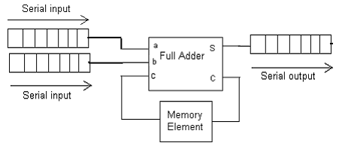
Bit/Digit Serial Computing
Serial processing of weighted binary inputs for area efficiency.
Bit serial adder
Example:
Compare bit parallel and seril adders to process 8-bit inputs in terms of area, power, delay, latency, and energy.

Slide 38
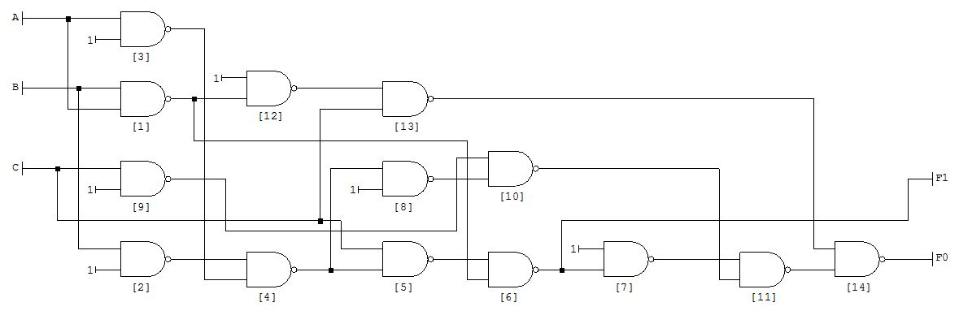
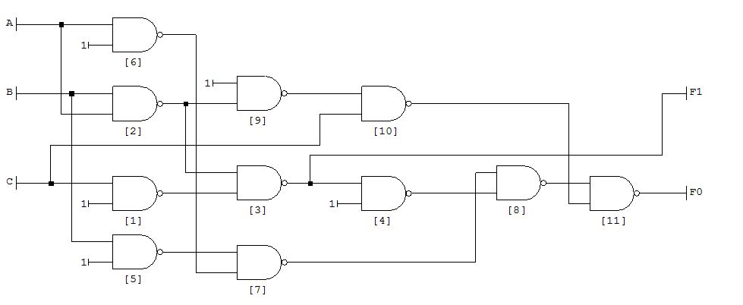
Approximate Computing
Approximate computing is not necessarily probabilistic that can results in deterministic errors.
Exact adder (14 Gates)
App. adder (11 Gates)
Used for applications not requiring high accuracy (Image processing)

Slide 39
Suggested Readings/Videos
Haselman, M., & Hauck, S. (2010). The future of integrated circuits: A survey of nanoelectronics. Proceedings of the IEEE, 98(1), 11-38.
IBM Quantum Experience: https://www.ibm.com/quantum-computing/
DNA computing: Computing with soup (2012), Article in The Economics, http://www.economist.com/node/21548488
DeBenedictis, E. P. (2016). The Boolean Logic Tax. Computer, 49(4), 79-82.
How We’ll Put a Carbon Nanotube Computer in Your Hand, Article in IEEE Spectrum, http://spectrum.ieee.org/semiconductors/devices/how-well-put-a-carbon-nanotube-computer-in-your-hand
Alaghi, A., & Hayes, J. P. (2013). Survey of stochastic computing. ACM Transactions on Embedded computing systems (TECS), 12(2s), 92.
Han, J., & Orshansky, M. (2013, May). Approximate computing: An emerging paradigm for energy-efficient design. In 2013 18th IEEE European Test Symposium (ETS) (pp. 1-6). IEEE.

