Slide 1

ELE 523E
COMPUTATIONAL NANOELECTRONICS
Mustafa Altun
Electronics & Communication Engineering
Istanbul Technical University
Web: http://www.ecc.itu.edu.tr/
FALL 2021
W8: Faults Analysis and Tolerance, 29/11/2021

Slide 2
Outline
Definitions: defect, faults, errors, failures…
  Reliability versus quality
Faults in nanoscale
Fault models
  Stuck-at faults
  Transition faults
Fault and failure analysis
  Deterministic
  Probabilistic
Fault tolerance in nano-crossbar arrays
  Deterministic
  Fault and failure analysis
Transient fault tolerance

Slide 3
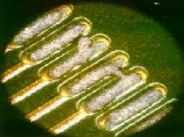
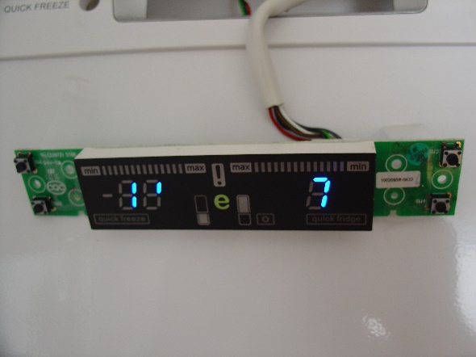
Definitions
Defect: a physical problem
Fault: an abnormal condition or defect
Defect and faults ocur at the component, equipment, or sub-system level which may lead to a failure
Error: incorrect value or information in computing
0
1
Fault/Defect
Error
Failure

Slide 4
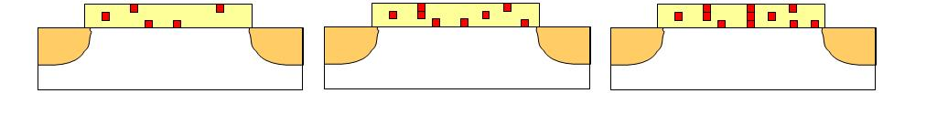
Definitions
Latent Fault/Defect: not causing an error yet
Latent Error: not causing a failure yet
Gate Oxide Breakdown
Latent Defect
Latent Defect
0
1
Don’t Care Condition
0
AND
0
0
1
Latent Error

Slide 5
Definitions
Permanent versus Temporary faults
Permanent versus Transient faults
Pre-field (Quality) versus In-field (Reliability) faults
Fault tolerance: there is fault, but no error
Error tolerance: there is error, but no failure
Quality
Faults happen before first usage
Post-fabrication fault analysis
Relatively easier to fix faults
  Detecting faults followed by reconfiguration or refabrication
Reliability
Faults happen any time in use
Transient probability analysis is needed
Harder to fix faults
  The only way is redundancy
  Dummy devices added

Slide 6
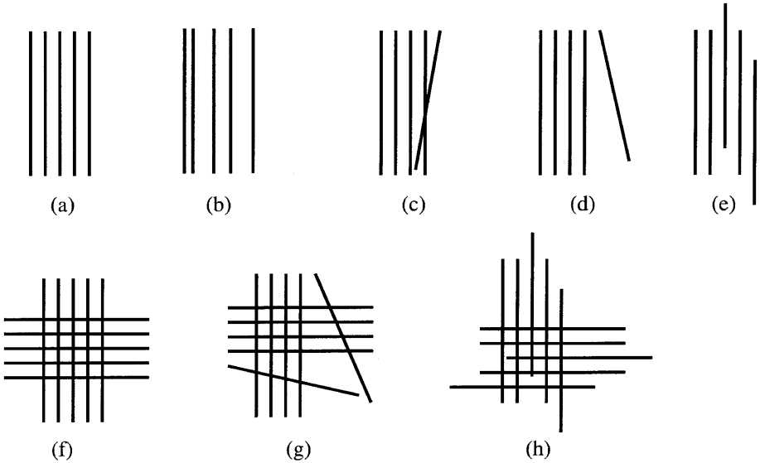
Faults in Nanoelectronics
Faults are the main headache in nanoscale.
  Up to 20% fault ratio in fabrication processes
  Transient fault ratios are also high
  Faults are inevitable and must be handled
Faults in self-assembled nano arrays

Slide 7
Fault Models
Model: a simplified and idealized understanding of physical systems
Models make easier to understand, define, quantify, visualize, or simulate faults
Limitations
  "All models are wrong, but some are useful "
  More failure mechanisms ⟼ less accurate models
  More fault types ⟼ more complex models, sometimes not realistic
8 different defects with 8 different models
How about model dependencies?

Slide 8
Fault Models
Different components have different reliability predictions
Different components have different transient fault models

Slide 9
Fault Models and Analysis
Stuck-at faults
  Stuck-at 1 and stuck-at 0
  Stuck-at ON and stuck-at OFF
  Stuck-at open and stuck-at shorted (bridging faults)
Transition faults
  Switching faults: 0-to-1 and 1-to-0
  Bit flips
Degradation based faults
Pre-field faults are analyzed/detected by certain deterministic tests
In-field faults are predicted with probability analysis

Slide 10
Stuck-at 1 Fault Anaysis
Fault/Error probability ϵ: a gate constantly evaluates logic 1 (stuck-at 1) with ϵ.
Ideally
With a fault
0
AND
0
0
0
0 with a probability of 1- ϵ
1 with a probability of ϵ
AND
0
1
1
AND
0
0
1
AND
1
1 with a probability of 1
1

Slide 11
Stuck-at 1 Fault Anaysis
Fault/Error probability ϵ: a gate constantly evaluates logic 1 (stuck-at 1) with ϵ.
Ideally
With a fault
0
OR
0
0 with a probability of 1- ϵ
1 with a probability of ϵ
0
0
OR
1
1
1
OR
1
1 with a probability of 1
0
1
OR
1
1

Slide 12
Stuck-at 1 Fault Anaysis
Error/fault probability ϵ : independently each gate constantly evaluates logic 1 with ϵ.
Example:
What is the probability Px that the circuit produces an incorrect result.
a
OR
b
AND
x
c
Px = (1-c)ϵ + (c)(1-a)(1-b) (1-(1-ϵ)(1-ϵ))

Slide 13
Stuck-at 1 Latent Fault Anaysis
Error/fault probability ϵ : each gate constantly evaluates logic 1 with ϵ.
Example:
What is the probability Pl that the circuit produces a correct result with a latent fault.
a
OR
b
AND
x
c
Pl = 1-Px-(1-ϵ)²

Slide 14
Stuck-at 0 Fault Anaysis
Fault/Error probability ϵ: a gate constantly evaluates logic 0 (stuck-at 0) with ϵ.
Ideally
With a fault
0
AND
0
0
0
AND
0
0 with a probability of 1
1
1
AND
0
0
0 with a probability of ϵ
1 with a probability of 1- ϵ
1
AND
1
1

Slide 15
Stuck-at 0 Fault Anaysis
Fault/Error probability ϵ: a gate constantly evaluates logic 0 (stuck-at 0) with ϵ.
Ideally
With a fault
0
OR
0
0 with a probability of 1
0
0
OR
1
1
1
0 with a probability of ϵ
1 with a probability of 1- ϵ
OR
1
0
1
OR
1
1

Slide 16
Stuck-at 0 Fault Anaysis
Error/fault probability ϵ : each gate constantly evaluates logic 0 with ϵ.
Example:
What is the probability Px that the circuit produces an incorrect result.
a
OR
b
AND
x
c
Px = (c)(1-(1-a)(1-b)) (1-(1-ϵ)(1-ϵ))

Slide 17
Stuck-at 0 Latent Fault Anaysis
Error/fault probability ϵ : each gate constantly evaluates logic 0 with ϵ.
Example:
What is the probability Pl that the circuit produces a correct result with a latent fault.
a
OR
b
AND
x
c
Pl = 1-Px-(1-ϵ)²

Slide 18
Transition Fault Analysis
Error/fault probability ϵ : a gate evaluates the incorrect result, the complement of the correct Boolean value, with ϵ.
Ideally
With a fault
0
AND
0
0
0
0 with a probability of 1- ϵ
1 with a probability of ϵ
AND
0
1
1
AND
0
0
1 with a probability of 1- ϵ
0 with a probability of ϵ
1
AND
1
1

Slide 19
Transition Fault Analysis
Error/fault probability ϵ : a gate evaluates the incorrect result, the complement of the correct Boolean value, with ϵ.
Ideally
With a fault
0
OR
0
0 with a probability of 1- ϵ
1 with a probability of ϵ
0
0
OR
1
1
1
0 with a probability of ϵ
1 with a probability of 1- ϵ
OR
1
0
1
OR
1
1

Slide 20
Transition Fault Analysis
Error/fault probability ϵ : each gate evaluates the incorrect result, the complement of the correct Boolean value, with ϵ.
Example:
What is the probability Px that the circuit produces an incorrect result.
a
OR
b
AND
x
c
Px = ϵ - (2ϵ²- ϵ)c

Slide 21
Transition Fault Analysis
Error/fault probability ϵ : each gate evaluates the incorrect result, the complement of the correct Boolean value, with ϵ.
Example:
What is the probability Py that the circuit produces an incorrect result.
a
c
AND
OR
y
b
c
AND
Py = 3ϵ - 5ϵ² + 2ϵ³- (ϵ - 2ϵ²)(a+b)c + (2ϵ² - 4ϵ³)abc

Slide 22
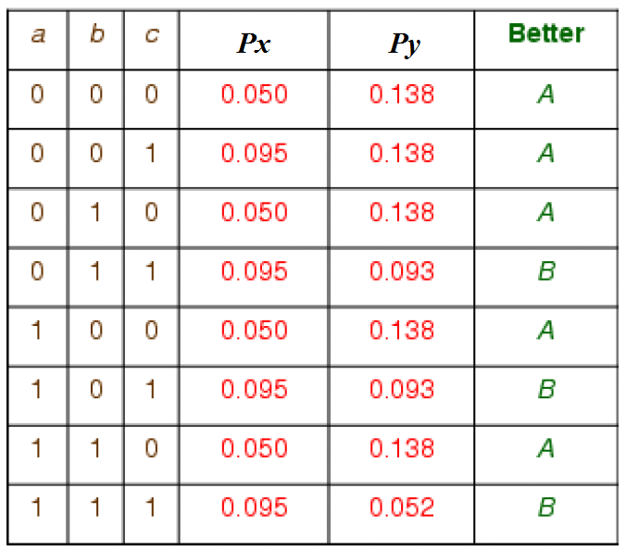
Transition Fault Analysis
Both circuits, A and B, implement the same Boolean function (a+b)c.
Which circuit is better in fault tolerance?
A
Px = ϵ - (2ϵ²- ϵ)c
B
Py = 3ϵ - 5ϵ² + 2ϵ³- (ϵ - 2ϵ²)(a+b)c + (2ϵ² - 4ϵ³)abc

Slide 23
Faults in Nano-Crossbar Arrays
Ideally
f = A B + C D
With a fault
f = A B + B C D
With a fault
f = A + C D
How to tolerate faults?
Each crosspoint is either closed (diode connected) or open.
What if a crosspoint is closed when it is supposed to be open?
What if a crosspoint is open when it is supposed to be closed?

Slide 24
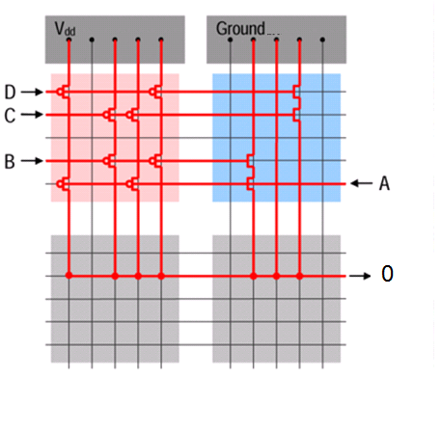
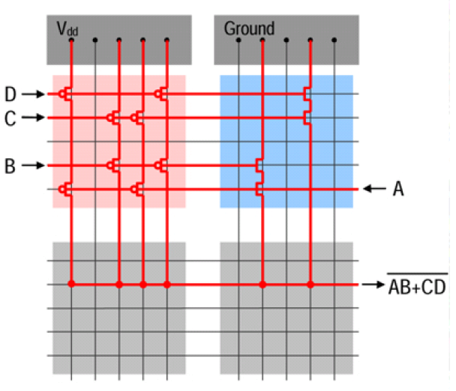
Faults in Nano-Crossbar Arrays
Ideally
f = (A B + C D)ꞌ
With a fault
f = 0
How to tolerate faults?
Each crosspoint is either closed (FET or shorted) or open.
What if a crosspoint is closed when it is supposed to be open?

Slide 25
Faults in Nano-Crossbar Arrays
Ideally
f = x₁ x₂ꞌ x₃+ x₁ x₄ꞌ + x₂ x₃ x₄ꞌ + x₂ x₄ x₅ + x₃ x₅
0
With a fault
f = x₁ x₂ꞌ x₃+ x₁ x₄ꞌ + x₂ x₃ x₄ꞌ + x₂ x₄ x₅ + x₃ x₅
1
With a fault
f = x₁ x₂ꞌ x₃+ x₁ x₄ꞌ + x₂ x₃ x₄ꞌ + x₂ x₄ x₅ + x₃ x₅
How to tolerate faults?
Each crosspoint is either closed or open depending on the applied literal.
What if a crosspoint is always closed when it is supposed to switch?
What if a crosspoint is always open when it is supposed to switch?

Slide 26
Fault Tolerance Stages
Stages: Fabrication
Post-fabrication
In-field/ Service
Stakeholder: Chip Manufacturer
Application Designer
End User
Mitigation Methods- Adding Redundancy: Error-correcting codes, TMR, NAND demultiplexing
Mitigation Methods: Configuring around defects
Mitigation Methods: Self-testing, reconfiguring
Permanent Faults
Permanent+
Transient Faults
Design
Nanomaterials: carbon nanotube, nanowires
Fabrication, verification and test
Final Product
Test and verification

Slide 27
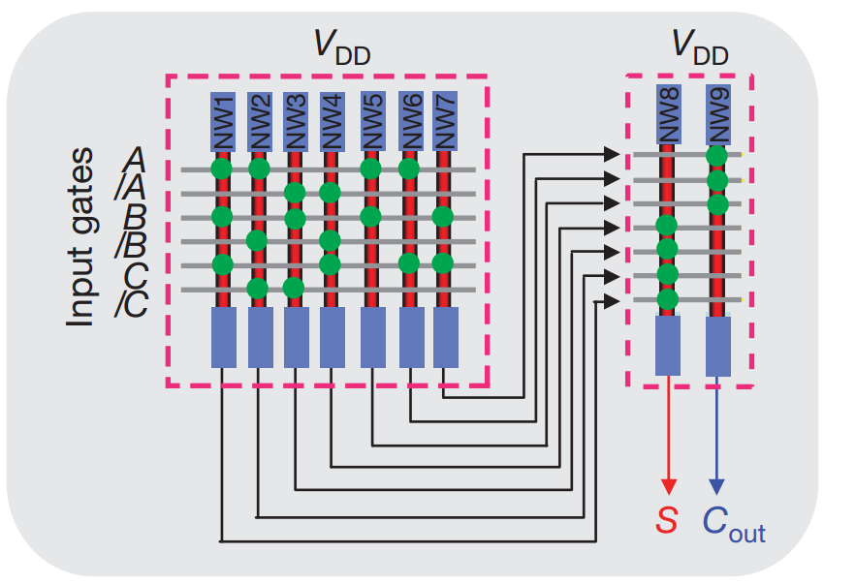
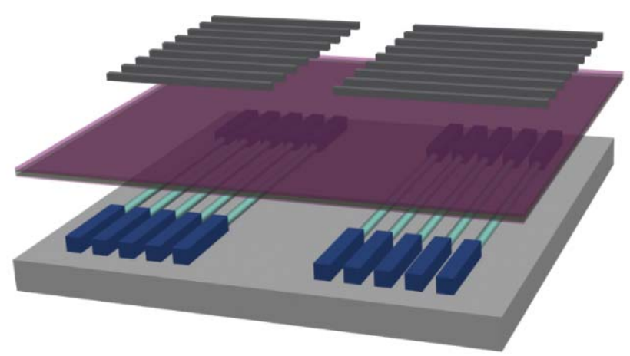
Post-fabrication and Defects
Nano-array fabricated with bottom-up methods
In post-fabrication, the ciruit is configured

Slide 28
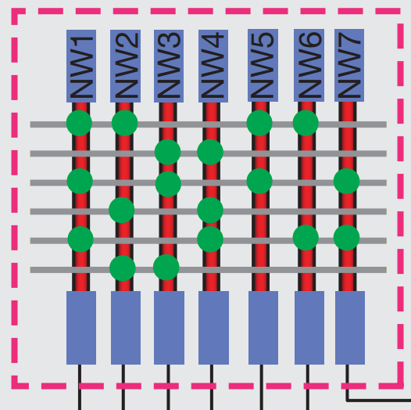
Configuration of a circuit
A logic function is implemented with configuration
A full-adder with activating and deactivating the switches
Activated
Deactivated

Slide 29
Configuration of a circuit
In a defect-free array, straitghtforward process
Input Lines
I₁ I₂ I₃ I₄ I₅ I₆
A B C A B C
O₁
O₂
O₃
O₄
O₅
O₆
O₇
Mapping
A B
B C
Output Lines
A C
A B C
Activated switch
Deactivated switch
F = A B + B C + A C + A B C
F = A B + B C + A C + A B C
(1) Given function
(2) Realized function

Slide 30
Defects
Stuck-at deactivated, switch cannot be activated
Stuck-at activated, switch cannot be deactivated
: Stuck-at deactivated switch
: Stuck-at activated switch
: Configurable switch
: Defective switch

Slide 31
Mapping with Defects
In a defective array, every mapping is not valid
Input Lines
I₁ I₂ I₃ I₄ I₅ I₆
A B C A B C
Mapping
A B
O₁
O₂
O₃
O₄
O₅
O₆
O₇
A B C
A C
Output Lines
A B C
Activated switch
C
Deactivated switch
F’ = A B + A B C + A C + A B C + C
F = A B + B C + A C + A B C
(2) Realized function
(1) Given function
F
F’

Slide 32
Defect-aware mapping
Mapping is performed with employing defects
Previous mapping
A B C A B C
Input Lines
I₁ I₂ I₃ I₄ I₅ I₆
B A C A B C
Mapping
A B
A B
O₁
O₂
O₃
O₄
O₅
O₆
O₇
B C
A B C
A C
A C
Output Lines
A B C
Activated switch
A B C
C
Deactivated switch
F = A B + B C + A C + A B C
F = A B + B C + A C + A B C
(1) Given function
(2) Realized function
F
F’

Slide 33
Defect-unaware mapping
First, a defect-free sub-array is found
Input Lines
I₁ I₂ I₃ I₄ I₅ I₆ I₇
I₁ I₂ I₃ I₄ I₅ I₆ I₇
O₁
O₂
O₃
O₄
O₅
O₆
O₇
Defect-free sub-aray
O₁
O₂
O₃
O₄
O₅
O₆
O₇
Output Lines
F = A B + B C + A C + A B C
(1) Given function
I₇ and O₅
discarded I₇

Slide 34
Defect-unaware mapping
Second, configuration is starightforward
Input Lines
I₁ I₂ I₃ I₄ I₅ I₆ I₇
A B C A B C
A B
O₁
O₂
O₃
O₄
O₅
O₆
O₇
B C
Mapping
A C
Output Lines
A B C
F’ = A B + B C + A C + A B C
F = A B + B C + A C + A B C
(2) Realized function
(1) Given function
F
F’

Slide 35
In-field Transient Faults
Transient faults occur according to a time-domain
They are predicted with probability analysis
Diode and FET Components show different behaviour regarding to the fault type
  Stuck-at OFF: switch is not capable of conducting current, infinite resistance
  Stuck-at ON: switch is constantly conducting current, zero resistance
Diode
Stuck-at OFF only switch
Stuck-at ON entire output line
FET
Stuck-at OFF entire output line
Stuck-at ON only switch

Slide 36
Diode-based Nanoarray
Stuck-at OFF, no connection between terminals
  Only faulty switch is affected
Stuck-at ON, terminals always connected
  Entire line is affected
Terminals
Gnd
Vdd
: Stuck-at OFF switch
: Stuck-at ON switch
: Functional switch
: Unusable switch

Slide 37
FET-based Nanoarray
Stuck-at OFF, no connection between terminals
  Entire line is affected
Stuck-at ON, terminals always connected
  Only faulty switch is affected
: Stuck-at OFF switch
: Stuck-at ON switch
: Functional switch
: Unusable switch

Slide 38
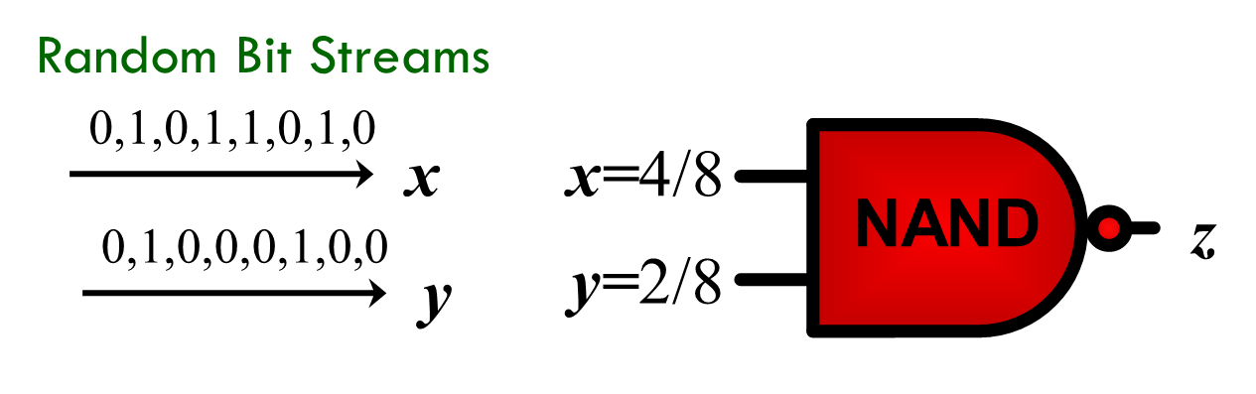
Transient Fault Tolerance
Von Neumann’s multiplexing unit, 1956
Randomly shuffled N number of inputs and outputs
Values are calculated as the number of 1 valued input/output lines over N
Parallel operation
Stochastic computing
Values are calculated as the number of 1 valued input/output lines over N
Serial operation

Slide 39
Multiplexing for Transition Faults
Error probability ϵ : a gate evaluates the incorrect result, the complement of the correct Boolean value, with ϵ.
Calculate z with and without error
ϵ ⟶ ϵ(1-2z)

Slide 40
Multiplexing for Stuck-at 1 Faults
Error/fault probability ϵ : each gate constantly evaluates logic 1 with ϵ.
Calculate z with and without error
ϵ ⟶ ϵ(1-z)

Slide 41
Multiplexing for Stuck-at 0 Faults
Error/fault probability ϵ : each gate constantly evaluates logic 0 with ϵ.
Calculate z with and without error
ϵ ⟶ ϵ(z)

Slide 42
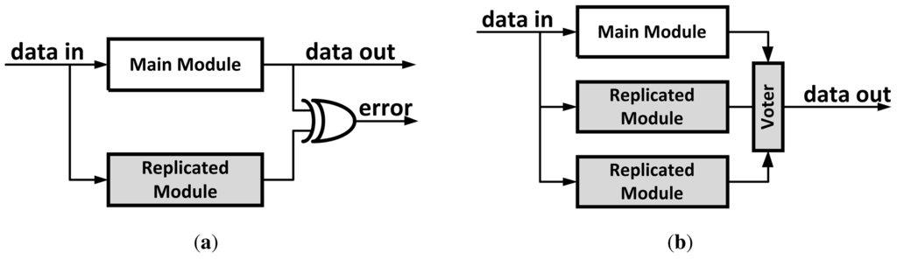
Transient Fault Tolerance
Dual modular redundancy (DMR)
Increase area 2 times plus an XOR gate
For only a single output fault
For only detection
Triple modular redundancy (TMR)
Increase area 3 times plus XOR gates
For only a single output fault
For both detection and correction

Slide 43
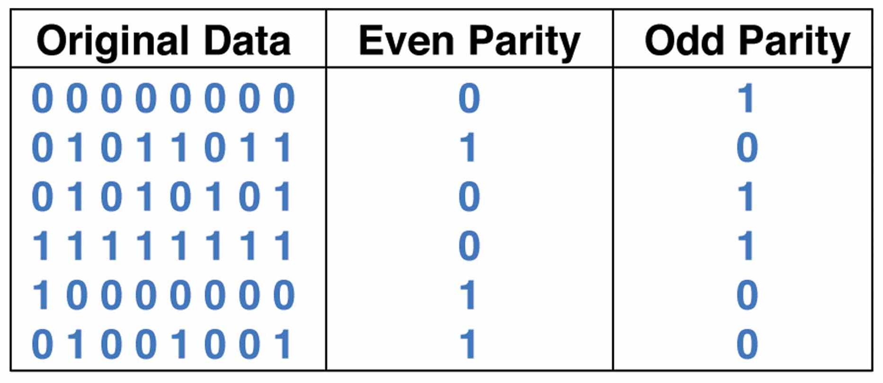
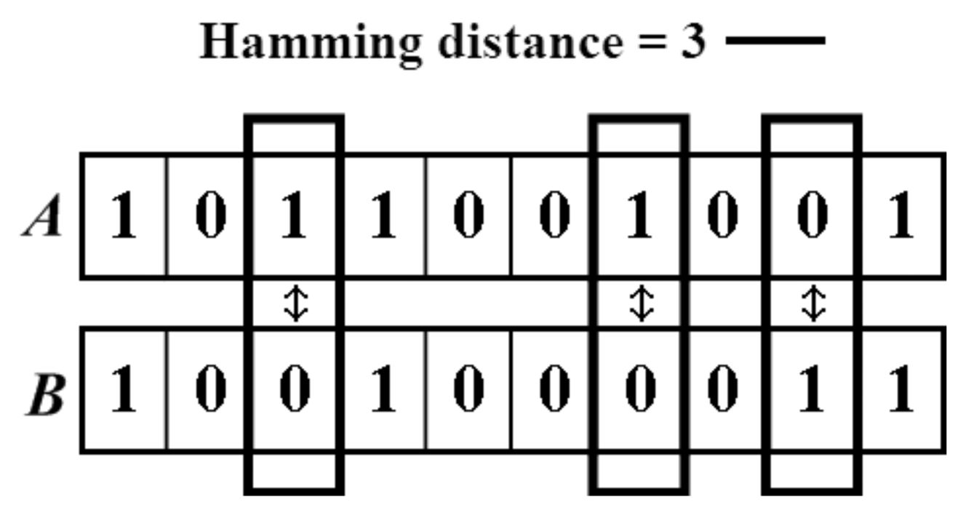
Transient Fault Tolerance
Extra parity bit
Applicable for large circuits
For only odd number of output faults
For only detection
Satisfying Hamming distance
Practical for large circuits
For multiple output faults
For both detection and correction

Slide 44
Suggested Readings
Moore, E. F., & Shannon, C. E. (1956). Reliable circuits using less reliable relays. Journal of the Franklin Institute, 262(3), 191-208.
Von Neumann, J. (1956). Probabilistic logics and the synthesis of reliable organisms from unreliable components. Automata studies, 34, 43-98.
Han, J., Taylor, E., Gao, J., & Fortes, J. (2005, July). Faults, error bounds and reliability of nanoelectronic circuits. In 2005 IEEE International Conference on Application-Specific Systems, Architecture Processors (ASAP'05) (pp. 247-253). IEEE.
DeHon, A. (2003). Array-based architecture for FET-based, nanoscale electronics. Nanotechnology, IEEE Transactions on, 2(1), 23-32.
Han, J., & Jonker, P. (2003). A defect and fault-tolerant architecture for nanocomputers. Nanotechnology, 14(2), 224.
Rao, W., Orailoglu, A., & Karri, R. (2007, April). Logic level fault tolerance approaches targeting nanoelectronics plas. In 2007 Design, Automation & Test in Europe Conference & Exhibition (pp. 1-5). IEEE.
Tunali, O., & Altun, M. (2016) Permanent and Transient Fault Tolerance for Reconfigurable Nano-Crossbar Arrays. IEEE Transactions on Computer-Aided Design of Integrated Circuits and Systems.

