Slide 1
Defect Tolerance in Diode, FET, and Four-Terminal Switch based Nano-Crossbar Arrays
This work is supported by the TUBITAK-Career project #113E760
Onur Tunalı & Mustafa Altun
Presenter: Mustafa Altun
Electronics & Communication Engineering
Istanbul Technical University
Web: http://www.ecc.itu.edu.tr/
July 8th, 2015
IEEE/ACM International Symposium on Nanoscale Architectures, NANOARCH 2015

Slide 2
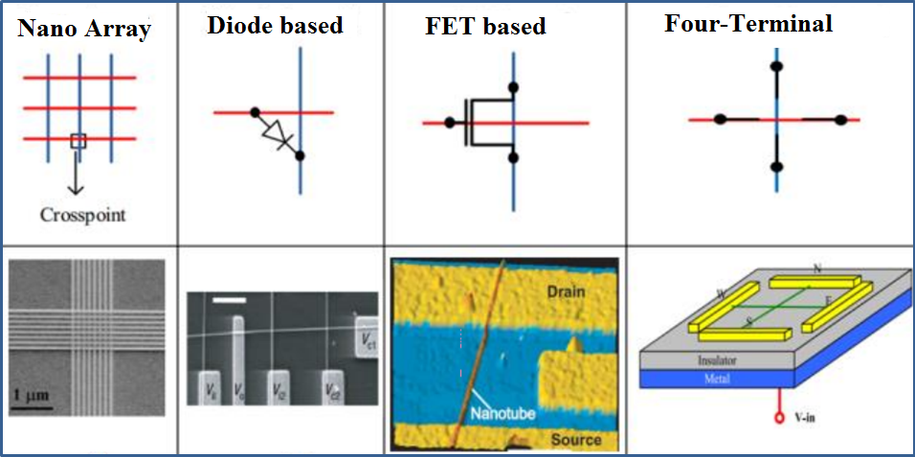
Nano-Crossbar Arrays and Defects
Nano array and 3 different logic families
Defects are the main headache in nano arrays
Objective: Designing a fast heuristic algorithm for logic mapping on defective crossbars of 3 different logic families

Slide 3
Defects in Diode based Nano Arrays
Ideally
f = A B + C D
With a defect
f = A B + B C D
With a defect
f = A + C D
How to tolerate defects?
Each crosspoint is either closed (diode connected) or open.
What if a crosspoint is closed when it is supposed to be open?
What if a crosspoint is open when it is supposed to be closed?

Slide 4
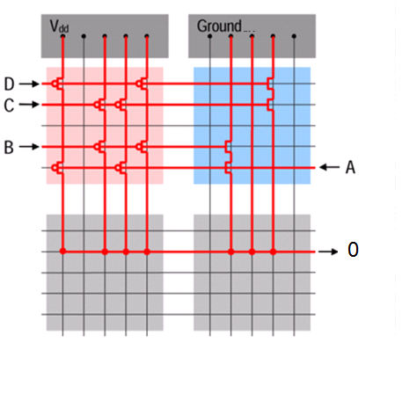
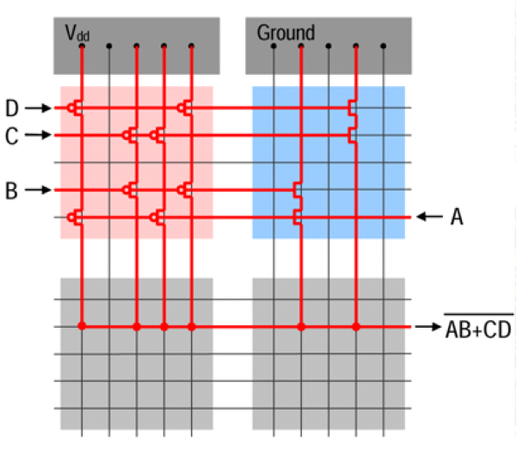
Defects in FET based Nano Arrays
Ideally
f = (A B + C D)ꞌ
With a defect
f = 0
How to tolerate defects?
Each crosspoint is either closed (MOS or shorted) or open.
What if a crosspoint is closed when it is supposed to be open?

Slide 5
Defects in Four-terminal Switch based Nano Arrays
Ideally
f = x₁ x₂ꞌ x₃+ x₁ x₄ꞌ + x₂ x₃ x₄ꞌ + x₂ x₄ x₅ + x₃ x₅
0
With a defect
f = x₁ x₂ꞌ x₃+ x₁ x₄ꞌ + x₂ x₃ x₄ꞌ + x₂ x₄ x₅ + x₃ x₅
1
With a defect
f = x₁ x₂ꞌ x₃+ x₁ x₄ꞌ + x₂ x₃ x₄ꞌ + x₂ x₄ x₅ + x₃ x₅
How to tolerate defects?
Each crosspoint is either closed or open depending on the applied literal.
What if a crosspoint is always closed when it is supposed to switch?
What if a crosspoint is always open when it is supposed to switch?

Slide 6
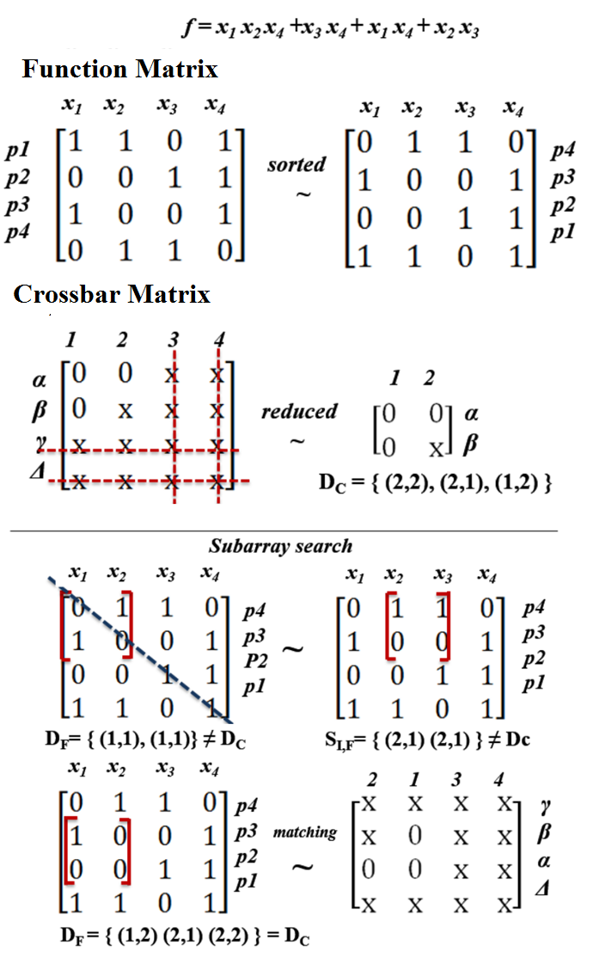
Proposed Algorithm
Algorithm Steps:
Sort function and crossbar matrix
Obtain reduced matrix
Start subarray search
Compare sets of double indices, if equal sets found in 20,000 trials there is a matching otherwise not.
Key concepts:
Row and column permutations of matrix produce equivalent logic function.
Double index is (a, b) tuple which shows the number of same elements in a row and a column
Necessary and sufficent condition: If two matrices have the same set of double indices, then they are identical

Slide 7
Experimental Results
For each benchmark function, 600 crossbars are generated. 600 is chosen due to stabilization of tolerance fluctuations.
It takes 0.2 seconds for each sample in average to check a valid mapping that satisfies an accuracy of 99% compared with an exhaustive search. This shows the effectiveness of our algorithm.

Slide 8
THANK YOU!

