Slide 1
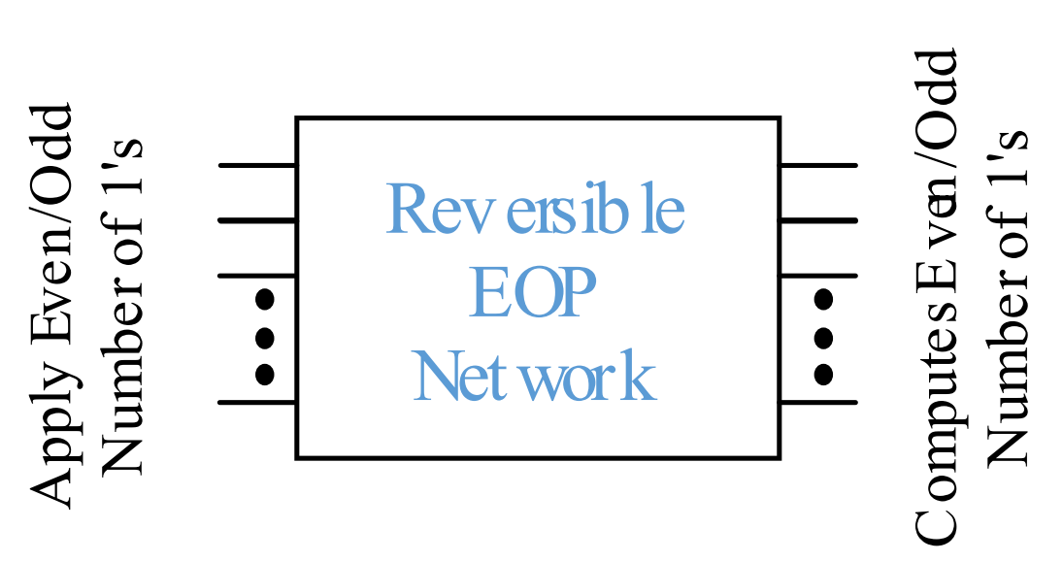
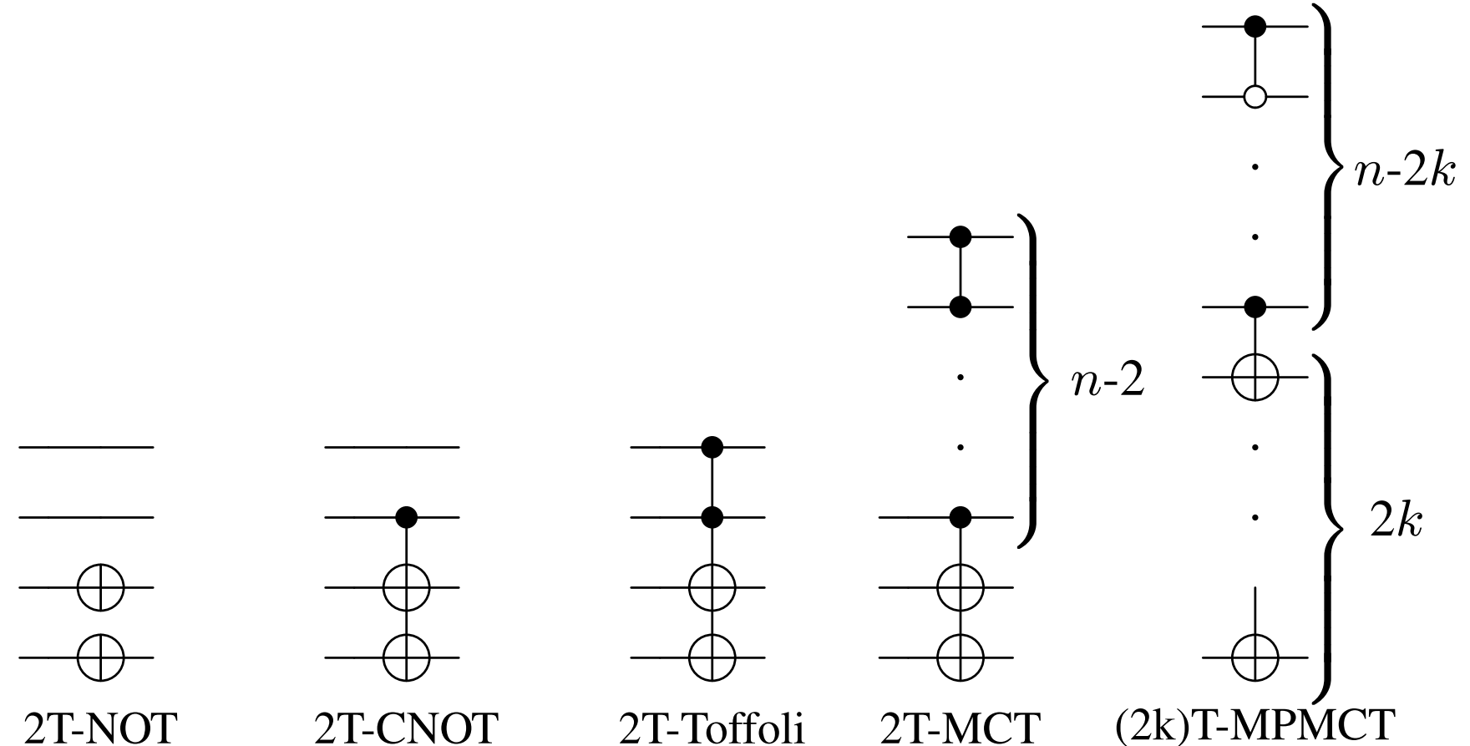
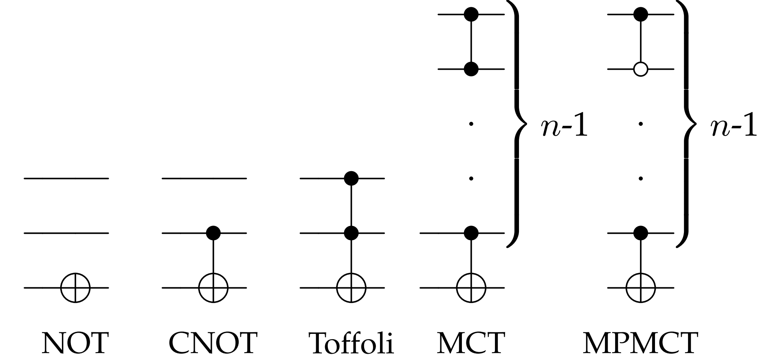
Implementation of CMOS Logic Circuits with
Perfect Fault Detection Using Preservative
Reversible Gates
Sajjad Parvin and Mustafa Altun
Emerging Circuits and Computation Group, Istanbul Technical University, Istanbul, Turkey
sajadparvin.stu93@gmail.com, altunmus@itu.edu.tr
Preliminaries
Proposed Gate Library
A reversible function f is a logic function where its input and output have a bijective relationship.
It is Latent-Fault-Free.
Fault observability is 100%.
Even Targets Multiple Polarity Multi-Control Toffoli (ET-MPMCT) gate library
No fault masking
at output.
A fault propagates to
output.
Fault preservative.
It has Even/Odd Preservative (EOP) feature due to even number of targets.
Bijective function
A Latent-Fault is a dormant fault and might not affect the current operation but might be erroneous for the next operation.
Latent-Fault in irreversible logic:
Latent-Fault in two-input AND gate
EOP circuit
Conventional reversible gates: “Multiple Polarity Multi-Control Toffoli (MPMCT) gate library”
No fault masking
at output.
A fault propagates to
output.
Not fault preservative.
ET-MPMCT gate library
A fault is always detected in a circuit implemented using EOP gates. In case of fault occurrence, evenness/oddness from inputs to outputs is not preserved.
MPMCT gate library
Design Flow of the Proposed Technique
g_{i} , i=0 to 2, are garbage bits
Results
References
D. Das and N. A. Touba, “Synthesis of circuits with low-cost concurrent error detection based on bose-lin codes,” 16th IEEE VLSI Test Symposium, pp. 309–315, 1998.
N. Alves, A. Buben, K. Nepal, J. Dworak, and R. I. Bahar, “A cost effective approach for online error detection using invariant relationships,” IEEE TCAD, vol. 29, no. 5, pp. 788–801, 2010.
M. Altun, S. Parvin, and M. H. Cilasun, “Exploiting reversible computing for latent-fault-free error detecting/correcting cmos circuits,” IEEE Access, vol. 6, pp. 74475–74484, 2018.
Acknowledgment
Area is reported in µm².
FTR (Fault Tolerance Rate) = $\frac{Number of detectable and observable faults at the output}{Total number of injected faults}$
This work was supported by TUBITAK-1002 project number 215E268.
Power is reported in µW.

