Slide 1
EHB 111E NANOELECTRONICS
Mustafa Altun
Electronics & Communication Engineering
Istanbul Technical University
Web: http://www.ecc.itu.edu.tr/
FALL 2013
Nanoelectronics, 03/12/2013

Slide 2
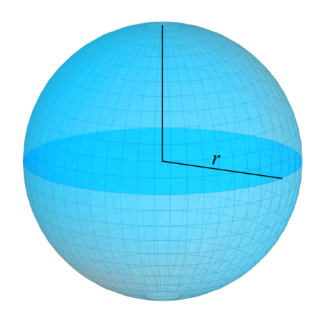
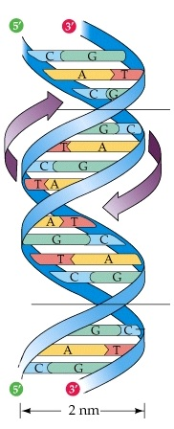
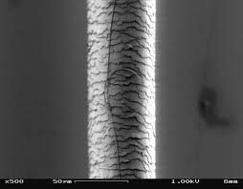
What is Nanoelectronics?
Nano Electronics
1 nm = 10⁻⁹m = 10 angstroms.
Atomic Van der Waals radius r: 0.3 to 3 angstroms.
Silicon Van der Waals radius: 2 angstroms.
Diameter of DNA helix: 2nm.,
Thickness of a cell membrane: 7.5nm.
Currently, commercially used, the smallest CMOS technology: 22nm.
Thickness of a human hair: 50um = 50000nm.
Sphere model of an atom
DNA helix
Human hair

Slide 3
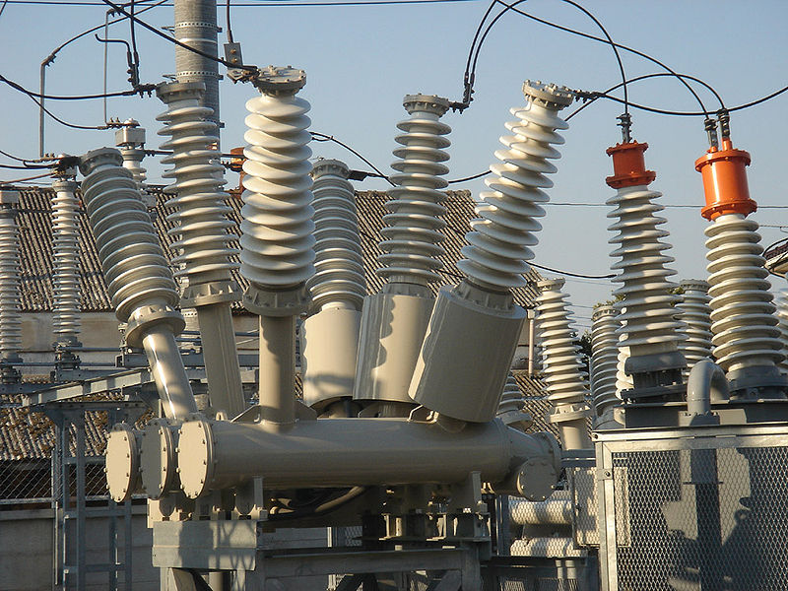
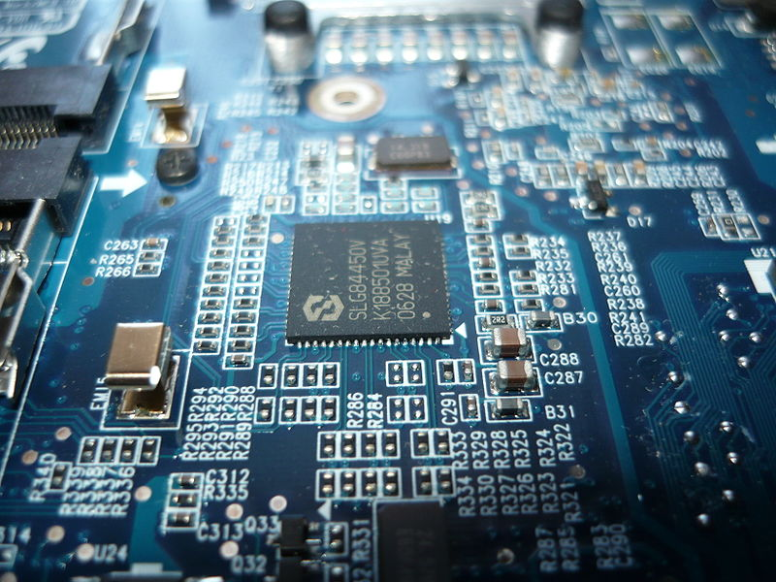
What is Nanoelectronics?
Nano Electronics
Electrical engineering
HIGH VOLTAGE/CURRENT
Power transmissions
Electrical machines
Electronics engineering
LOW VOLTAGE/CURRENT
Computers
Integrated circuits
Electrical
Electronics

Slide 4
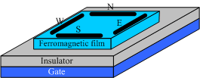
What is Nanoelectronics?
Nanoelectronics is not exactly nanoscale electronics, but emerging and nanoscale electronics.
New future technologies
Disruptive, completely new (disrupt an existing market)
In an exploratory phase, not commercially used
Beyond CMOS devices
Nanowire transistor
Spin wave switch
Single electron transistor

Slide 5
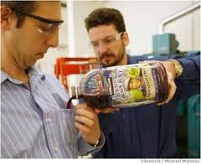
Why Nanoelectronics?
Non-stinky socks
Water resistant cloths
Main goal: to beat CMOS
CMOS shrinking problems
Moore’s Law’s anticipated limit, approaching the size of atoms
Short channel affects and leakage
Uncertainty, probabilistic phenomena
Fabrication challenges
10nm is seen as critical point

Slide 6
Why Nanoelectronics?
Probabilistic phenomena
Every physical behavior is probabilistic!
The smaller the more probabilistic
Example:
A transistor with 1 electron vs. 10 electrons vs. 100,000 electrons in conduction. When applied a controlling gate voltage of 1V, each electron passes from source to drain with a probability of 0.9. What are the probabilities that the transistor conduct current (at least one electron passes from source to drain)?

Slide 7
Nanoelectronics Research
Dramatic increase in interest and funding of nanoelectronics.
Top funding agencies (Horizon 2020-$20b, NSF-$7b, NIH- $30b, Tubitak- $1b …) pour money to nanoengineering and nanoscience.
Leading universities have research groups on nanoelectronics.
The most prestigious conferences on circuit design DAC and ICCAD have increasing number of papers targeting nanotechnologies.
Better to add the word “nano* ” to your paper/presentation/proposal!

Slide 8
Aspects of Nanoelectronics
Theoretical
Physics rules – probability based
Quantum mechanics
The uncertainty principle
Schrödinger equation
Theory of relativity
Experimental
Fabrication processes
Self assembly
Computational
Computing 0s 1s
Achieve logic operations AND OR

Slide 9
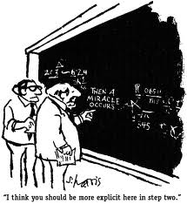
Emerging Electronic Devices

Slide 10
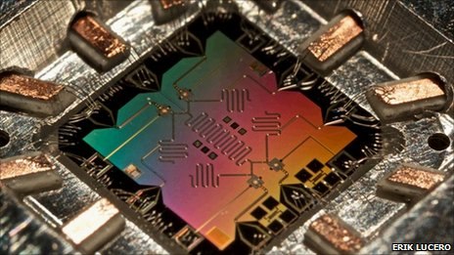
Quantum Computing
Theoretically, quantum computers solve RSA-2048 problem in seconds compared to 10 billion years.
Shor’s algorithm.
Cracking RSA keys.
Would be a breakthrough in cryptology.
Practically, where are we now?
Erik Lucero’s circuit to factorize 15

Slide 11
Quantum Computing
February 2012: IBM scientists achieved several breakthroughs in quantum computing with superconducting integrated circuits
September 2012: The first working "quantum bit" based on a single atom in silicon suitable for the building blocks of modern computers.
October 2012: Nobel Prizes were presented to David J. Wineland and Serge Haroche for their basic work on understanding the quantum world - work which may eventually help makequantum computing possible.
May 2013: Google launching the Quantum Artificial Intelligence Lab with 512-qubit quantum computer.

Slide 12
DNA Computing
Parallel computing
For certain problems, DNA computers are faster and smaller than any other computer built so far.
A test tube of DNA can contain trillions of strands.
Computing with DNA strands
Depending on absence and presence of DNA molecules.
Strands have directions.
How do strands stick together?

Slide 13
DNA Computing
Main advantages
Parallel
Dense, small area
Can solve untractable problems
Disadvantages
Slow
Fragile
Unreliable, randomness

Slide 14
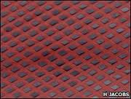
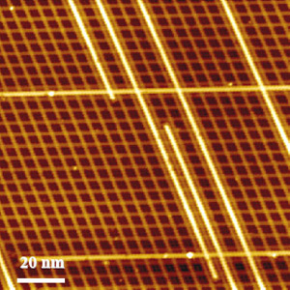
Computing with Nano Arrays
Self-assembled nano arrays
Computing models for nano arrays
Two-terminal switch-based
Diode-based
Transistor-based
Four-terminal switch-based

Slide 15
Why Nanoelectronics?
Top-Down vs. Bottom-Up Fabrication
Top-Down
From a stone to a sculpture
More accurate
Lithography based
Traditional
Hard-to-manipulate in nanoscale
Bottom-Up
From separate molecular materials to an organized structure
Self-assembly
Regular arrays
More efficient
Self-assembled circuit with 64,000 elements in three minutes

Slide 16
Computing with Seperate Devices
Nanowire transistor
Single electron transistor
Direct replacement of CMOS transistors
Some advantages over CMOS
Interconnection problems
Lack of integration

Slide 17
Suggested Readings/Videos
Feynman, R. P. (1960). There's plenty of room at the bottom. Engineering and Science, 23(5), 22-36.
Richard Feynman Nanotechnology Lecture, 1984
http://www.youtube.com/watch?v=4eRCygdW--c

Slide 18
Our Group Information
State-of-the-art research
Nanoarrays
DNA computing
Quantum computing
Stochastic computing
Make you think out of the box
Unconventional
Math and circuit based, especially the probability theory
Emerging Circuits and Computation
http://www.ecc.itu.edu.tr/

