Slide 1











Integrated Synthesis Methodology for Crossbar Arrays
M. Ceylan Morgul, Luca Frontini, Onur Tunali, Elena Ioana Vatajelu,
Valentina Ciriani, Lorena Anghel, Csaba Andras Moritz, Mircea R. Stan,
Dan Alexandrescu, Mustafa Altun
This project has received funding from the European Union's H2020 research and innovation programme under the Marie Skłodowska-Curie grant agreement No 691178.
This work is supported by the TUBITAK-Career project #113E760

Slide 2
Outline
Introduction
Proposed Integration Methodology
Logic Synthesis
Defect/Fault Tolerance
Conclusions

Slide 3
Introduction
Nano-crossbars are emerged as an alternative to CMOS technology
  Cheap bottom-top nano-fabrication techniques
  Fabrics yield to be regular and dense
  Area and power efficient
  Easy to implement Boolean functions

Slide 4
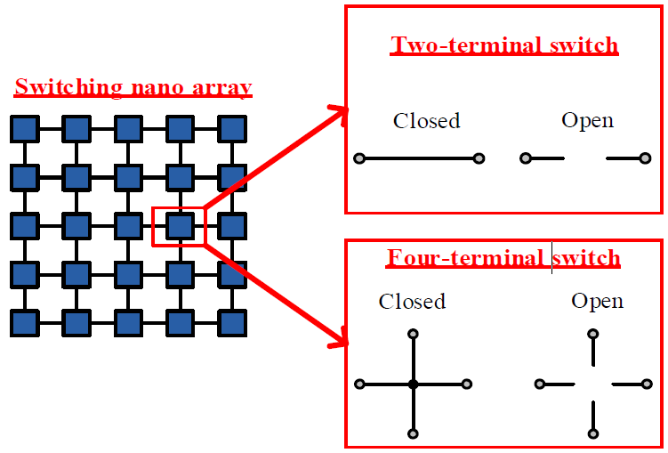
Introduction
Switching Nano-arrays
Two-terminal switch
Switching nano array
Four-terminal switch

Slide 5
Introduction
Switching Nano-arrays
Diode based
Memristor based
Two-terminal switch
Switching nano array
Four-terminal switch
Notes:
controlled by the voltage difference between the terminals.

Slide 6
Introduction
Switching Nano-arrays
Diode based
Memristor based
Two-terminal switch
Switching nano array
Four-terminal switch
FET based
Four-terminal
Notes:
FET based switch; here, the red line represents the controlling input. This is a unique opportunity that allows us to integrate well developed conventional circuit design techniques into nano-crossbar arrays
A four-terminal switch is given The controlling input, has a separate physical formation from the crossbar

Slide 7
Introduction

Slide 8
Introduction
Nanowire four-terminal switch
Spin-wave switch

Slide 9
Outline
Introduction
Proposed Integration Methodology
Logic Synthesis
Defect/Fault Tolerance
Conclusions

Slide 10
Integration Methodology
Fabrication
Testing Transient Fault Tolerance Performance
Transient Fault
Tolerance
Logic Synthesis
Performance Optimization
Permanent Defect Tolerance

Slide 11
Outline
Introduction
Proposed Integration Methodology
Logic Synthesis
Defect/Fault Tolerance
Conclusions

Slide 12
Logic Synthesis
Fabrication
Testing Transient Fault Tolerance Performance
Transient Fault
Tolerance
Logic Synthesis
Performance Optimization
Permanent Defect Tolerance

Slide 13
Logic Synthesis
Crossbar size limits (area) and Function size
Fabrication Complexity
Function output number (Multi or single output realization)
Power and Delay Specifications
Application specification (memory based etc.)

Slide 14
Introduction
$$x_{1}x_{2}x_{3}+x_{1}x_{2}x_{5}x_{6}+x_{2}x_{3}x_{4}x_{5}+x_{4}x_{5}x_{6}$$

Slide 15
Introduction
$$x_{1}x_{2}x_{3}+x_{1}x_{2}x_{5}x_{6}+x_{2}x_{3}x_{4}x_{5}+x_{4}x_{5}x_{6}$$

Slide 16
Introduction
$$x_{1}x_{2}x_{3}+x_{1}x_{2}x_{5}x_{6}+x_{2}x_{3}x_{4}x_{5}+x_{4}x_{5}x_{6}$$

Slide 17
Introduction
$$x_{1}x_{2}x_{3}+x_{1}x_{2}x_{5}x_{6}+x_{2}x_{3}x_{4}x_{5}+x_{4}x_{5}x_{6}$$

Slide 18
Introduction
$$x_{1}x_{2}x_{3}+x_{1}x_{2}x_{5}x_{6}+x_{2}x_{3}x_{4}x_{5}+x_{4}x_{5}x_{6}$$

Slide 19
Introduction
$$x_{1}x_{2}x_{3}+x_{1}x_{2}x_{5}x_{6}+x_{2}x_{3}x_{4}x_{5}+x_{4}x_{5}x_{6}$$

Slide 20
Logic Synthesis
Implementation of fXOR2 with different nanocrossbar types

Slide 21
Outline
Introduction
Proposed Integration Methodology
Logic Synthesis
Defect/Fault Tolerance
Conclusions

Slide 22
Defect/Fault Tolerance
Fabrication
Testing Transient Fault Tolerance Performance
Transient Fault
Tolerance
Logic Synthesis
Performance Optimization
Permanent Defect Tolerance

Slide 23
Defect/Fault Tolerance
Permanent Faults occur mostly in fabrication and are tolerated in post-fabrication by redundancy and reconfigurability (mapping).
Transient Faults occur in field and are tolerated by redundancy

Slide 24
Defect/Fault Tolerance
Defect tolerance is achieved by realizing a target logic function on a defective crossbar using row and column permutations
For the worst-case, N!M! permutations are required to find a successful mapping for NXM crossbar.
  Defect-unaware algorithms aim to find the largest possible kXk defect-free sub-crossbar from a defective NXN crossbar where k ≤ N;
  Defect-aware considers the defect characteristics (stuck-at-0 or stuck-at-1), then decide which switch to employ during the mapping.

Slide 25
Defect/Fault Tolerance
Proposed method utilizes a sensitivity analysis of crossbar to specify critical switches, and strengthens them with mitigation factors

Slide 26

Defect/Fault Tolerance
For each input, the simulation algorithm compares the given output with the correct one.
$E_{ij}^{0},E_{ij}^{1}$the number of defective outputs with a SA0 (resp., SA1)

Slide 27


Defect/Fault Tolerance
For each input, the simulation algorithm compares the given output with the correct one.
$E_{ij}^{0},E_{ij}^{1}$the number of defective outputs with a SA0 (resp., SA1)
$$E_{ij}^{0}$$
$$E_{ij}^{1}$$
Lattice design
Sensitivity maps

Slide 28
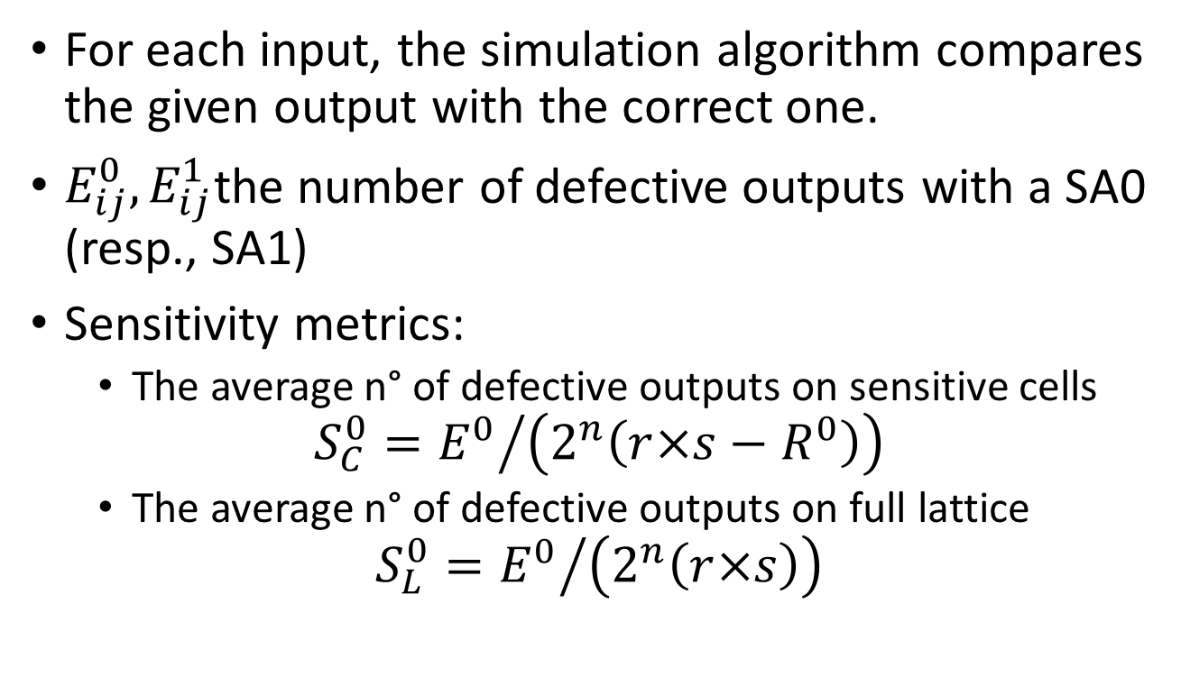
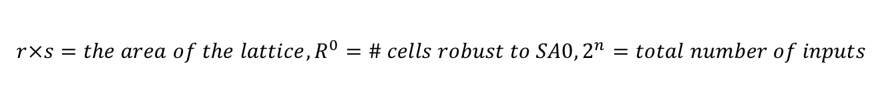
Defect/Fault Tolerance
For each input, the simulation algorithm compares the given output with the correct one.
$E_{ij}^{0},E_{ij}^{1}$the number of defective outputs with a SA0 (resp., SA1)
Sensitivity metrics:
  The average n° of defective outputs on sensitive cells
$$S_{C}^{0}={E^{0}}/{\left(2^{n}\left(r×s−R^{0}\right)\right)}$$
  The average n° of defective outputs on full lattice
$$S_{L}^{0}={E^{0}}/{\left(2^{n}\left(r×s\right)\right)}$$
$$r×s=the area of the lattice, R^{0}=\# cells robust to SA0, 2^{n}=total number of inputs$$

Slide 29
Defect/Fault Tolerance

Slide 30
Defect/Fault Tolerance

Slide 31
Defect/Fault Tolerance
SA0
SA1
Repair cells

Slide 32
Defect/Fault Tolerance
Monte-Carlo test is costly
  Algebraic Analysis: using Inclusion Ratio and probabilistic fault
Transient faults are modelled as SA0 or SA1
Fault Tolerance: Redundancy
In optimal the area:
Switch redundancy
f = x₁x₂ + x₂x₃ + x₃x₄
f = x₁x₂x₃+ x₂x₃ + x₃x₄
Enlarging the area:
Adding row or column

Slide 33
Outline
Introduction
Proposed Integration Methodology
Logic Synthesis
Defect/Fault Tolerance
Conclusions

Slide 34
Conclusions
Nano-switches are good alternatives to CMOS Boolean logic implementations
They are prone to defects and variability
Defect characterization and fault modeling are required for
  Reliable computation (fault mitigation)
  Area and power minimization under fault mitigation

Slide 35
Integrated Synthesis Methodology for Crossbar Arrays
M. Ceylan Morgul, Luca Frontini, Onur Tunali, Elena Ioana Vatajelu,
Valentina Ciriani, Lorena Anghel, Csaba Andras Moritz, Mircea R. Stan,
Dan Alexandrescu, Mustafa Altun
This project has received funding from the European Union's H2020 research and innovation programme under the Marie Skłodowska-Curie grant agreement No 691178.
This work is supported by the TUBITAK-Career project #113E760

