Slide 1

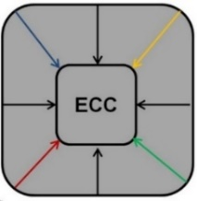


Logic Synthesis and Defect Tolerance for Memristive Crossbar Arrays
Onur Tunali ¹ and Mustafa Altun ²
onur.tunali@itu.edu.tr and altunmus@itu.edu.tr
Nanoscience and Nanoengineering Department ⁽¹⁾ and Electronics and Communications Department ⁽²⁾
Istanbul Technical University
This work is part of a project that has received funding from the European Union's H2020 research and innovation programme under the Marie Skłodowska-Curie grant agreement No 691178.
This work is supported by the TUBITAK-Career project #113E760
Emerging Circuits and Computation Group (ECC)
www.ecc.itu.edu.tr

Slide 2
Outline
Summary of Contributions
Memristive crossbar arrays
Logic synthesis
  Two-level design
  Multi-level design
  Simulation results
Defect aspects
  Defect model
  Defect tolerant mapping
  Simulation results
Conclusion
Notes:
I have 4 part in this presentation. First part is a general information and operational features of memristive crossbars.
Logic synthesisi is basically how to realize a given logic function with crossbar

Slide 3
Summary of Contributions
A multi-level logic design demonstrated and area cost comparison with two-level design given
Area optimization with considering both the logic function and its negation during logic synthesis shown
A defect model established and a preliminary hybrid defect tolerant logic mapping algorithm proposed
Notes:
- A brief overview of our contributions

Slide 4
Memristive Crossbar Arrays
^{[1]}
There are 4 planes:
  Input latch
  NAND plane
  AND plane
  Output latch
Power Supply
CMOS Controller
Input Latch
x₁
x₂
x₃
x₁
x₂
x₃
f
f
M₁
Nand Plane
M₂
M₃
And Plane
M₄
M₅
Output Latch
f
__________________________________
^{[1]} L. Xie, H. A. Du Nguyen, M. Taouil, S. Hamdioui, and K. Bertels, “Fast boolean logic mapped on memristor crossbar,” in Computer Design (ICCD), 2015 33rd IEEE International Conference on. IEEE, 2015, pp. 335–342.
Notes:
Operational purposes
Best paper award

Slide 5
Memristive Crossbar Arrays
Power Supply
Memristor programming
  Active : switching R_{ON} and R_{OFF}
  Disabled: always R_{OFF} ^{[2]}
CMOS Controller
x₁
x₂
x₃
x₁
x₂
x₃
f
f
M₁
M₂
M₃
M₄
M₅
f
__________________________________
^{[2]} G. Snider, “Computing with hysteretic resistor crossbars,” Applied Physics A: Materials Science & Processing, vol. 80, no. 6, pp. 1165– 1172, 2005
Notes:
- This is a common assumption accepted in two papres. First 2005 initial paper of Snider.

Slide 6



Memristive Crossbar Arrays
Power Supply
IL
How crossbar operates
  1) INA: Initialize all the memristors to R_{OFF}
  2) RI: IL block receives inputs from CMOS controller
  3) CFM: All minterms (products) are configured
  4) EVM: Evaluate all minterms configured in NAND plane and write to AND plane;
  5) EVR: Evaluate the results of AND
  6) INR: Invert the results to obtain f from f
  7) SO: Send outputs to OL.
CMOS Controller
$$\overline{m_{1}}$$
AND
x₁
x₂
x₃
x₁
x₂
x₃
f
f
...
M₁
$$\overline{m_{i}}$$
...
M₂
$$\overline{m_{n}}$$
M₃
M₄
M₅
f
OL
f
INV
f
Voltage values for every step can be found in [1]
__________________________________
^{[1]} L. Xie, H. A. Du Nguyen, M. Taouil, S. Hamdioui, and K. Bertels, “Fast boolean logic mapped on memristor crossbar,” in Computer Design (ICCD), 2015 33rd IEEE International Conference on. IEEE, 2015, pp. 335–342.
Notes:
- Snider boolean logic: Roff is 1 and Ron is 0 as opposed to conventional norm.

Slide 7
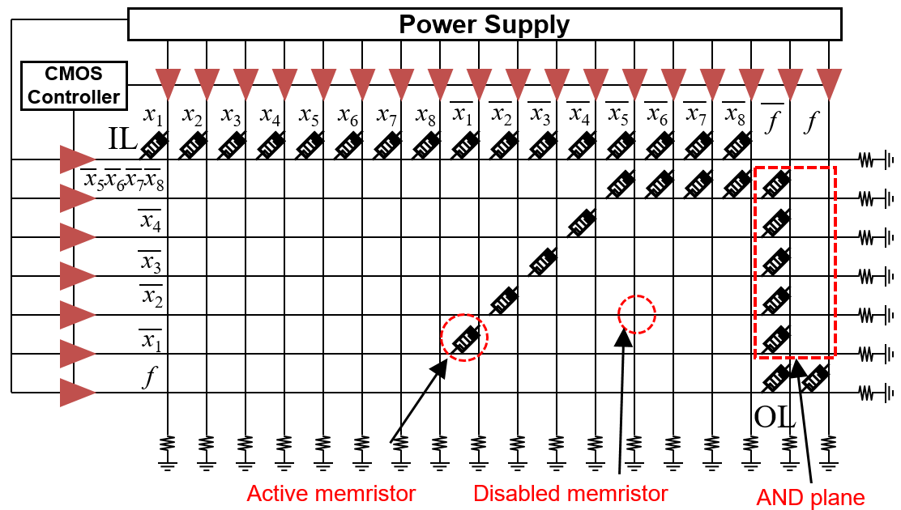

Logic Synthesis
Realization of a given logic function with programming crossbar
$f= \overline{x_{1}}+\overline{x_{2}}+\overline{x_{3}}+\overline{x_{4}}+\overline{x_{5}} \overline{x_{6}}$ $\overline{x_{7}}$ $\overline{x_{8}}$

Slide 8

Logic Synthesis (Two-level Design)
$f= \overline{x_{1}}+\overline{x_{2}}+\overline{x_{3}}+\overline{x_{4}}+\overline{x_{5}} \overline{x_{6}}$ $\overline{x_{7}}$ $\overline{x_{8}}$
Synthesis is straightforward
Area cost can easily be formalized
Area cost :
  (# of Minterms + # of Outputs) x (# of Literals + 2 x (# of Outputs))
M
N

Slide 9





Logic Synthesis (Multi-level Design)
Contrary to two-level, outputs of minterms are used as inputs to next minterm
IL
IL
n_{L} < n
$$\overline{m_{1}}$$
AND
SO
INR
EVR
$$\overline{m_{1}}$$
Multi-level Connection
SO
INR
EVM
...
...
INA
INA
CR
$$\overline{m_{i}}$$
$$\overline{m_{i}}$$
...
...
RI
CFM
EVM
RI
CFM
EVM
$$\overline{m_{n}}$$
$$\overline{m_{n}}$$
n_{L} : number of levels
f
OL
f
INV
f
OL
f
INV
Two-level Desıgn
Multı-level Desıgn
Notes:
- Every minterm is realized with a NAND gate

Slide 10
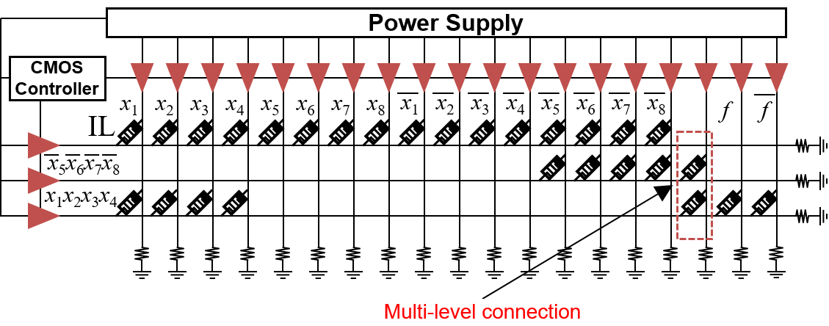

Logic Synthesis (Multi-level Design)
Contrary to two-level, results of minterms are feeded back to minterms as inputs
$f= \overline{x_{1}}+\overline{x_{2}}+\overline{x_{3}}+\overline{x_{4}}+\overline{x_{5}} \overline{x_{6}}$ $\overline{x_{7}}$ $\overline{x_{8}}$
Notes:
This is the same logic function shown in two-level desing
As you can see result of first NAND (minterm) is fed back as input

Slide 11

Logic Synthesis (Multi-level Design)
Synthesis requires EDA tools (ABC: Berkley, SIS, Espresso etc.)
Area cost hard to formalize (which gate output fed as input)
However, drastic area reductions!
$f= \overline{x_{1}}+\overline{x_{2}}+\overline{x_{3}}+\overline{x_{4}}+\overline{x_{5}} \overline{x_{6}}$ $\overline{x_{7}}$ $\overline{x_{8}}$
Two-level Desıgn
Multı-level Desıgn
Area cost = 126
Area cost = 57!

Slide 12
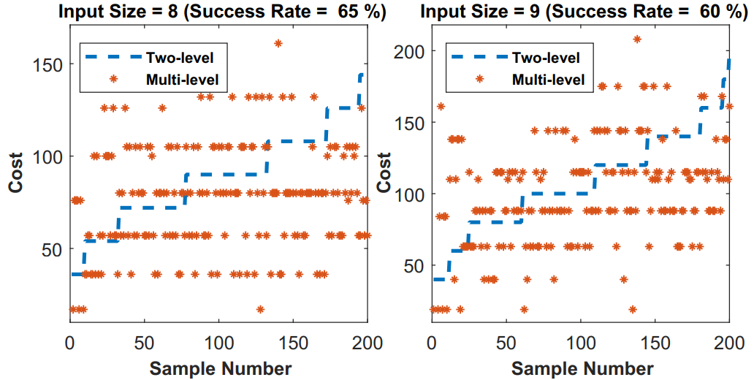
Logic Synthesis (Simulation Results)
Monte-carlo simulation, randomly generated logic functions
Success rate indicates ratio of lower area cost for multi-level design
Step line (blue) indicates increase in the number of products sample logic function has
Two-level and Multı-level Area Cost Comparıson

Slide 13
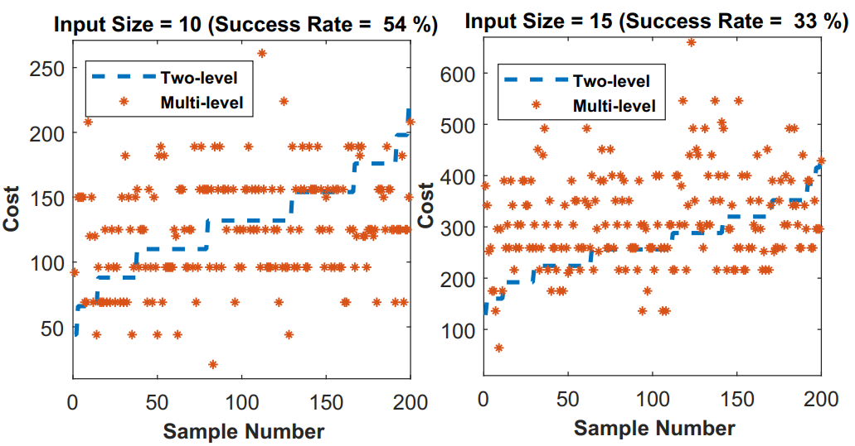
Logic Synthesis (Simulation Results)
Trend 1: The higher the number of products, the higher success rate
Trend 2: The higher the number of inputs, the lower success rate
All functions in simulation have single output!
Two-level and Multı-level Area Cost Comparıson

Slide 14
Logic Synthesis (Simulation Results)
Table I
Area Cost Comparıson of Two and Multı Level Desıgn
Industrial benchmark functions with multiple outputs
Multi-level design performed poorly for the most cases
Only favorable cases t481 having single output and cordic having 2 outputs resulted 3 to 5 times area reduction
Bench Name | Original Circuit |  | Negation of Circuit
 | Two-level | Multi-level | Two-level | Multi-level
rd53 | 544 | 3000 | 560 | 2000
con1 | 198 | 480 | 198 | 527
misex1 | 570 | 4836 | 1590 | 4161
bw | 3300 | 52875 | 3564 | 53110
sqrt8 | 1008 | 2745 | 792 | 3300
rd84 | 6216 | 48124 | 7128 | 20276
b12 | 2496 | 7800 | 2064 | 2691
t481 | 16388 | 5760 | 12274 | 8034
cordic | 45800 | 9594 | 59650 | 10668

Slide 15
Defect Aspects
Only switching defects considered
Defective switch cannot operate properly
  Stuck-at open : memristor is always in R_{OFF} state meaning high resistance
  Stuck-at closed: memristor is always in R_{ON} state meaning low resistance
Stuck-at open defect same as the disabled memristor, avoidable
Stuck-at closed disrupts both vertical and horizontal line, needs redundancy

Slide 16
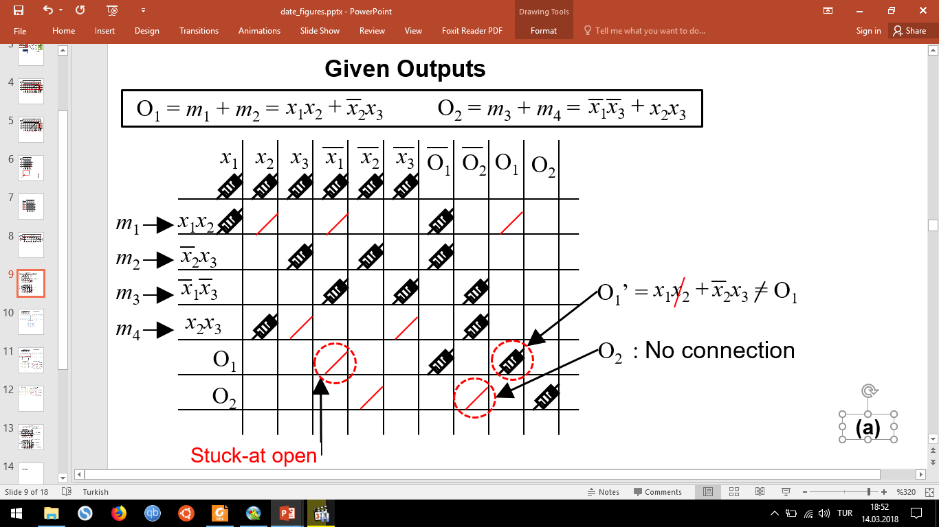
Defect Aspects (Defect Model)

Slide 17
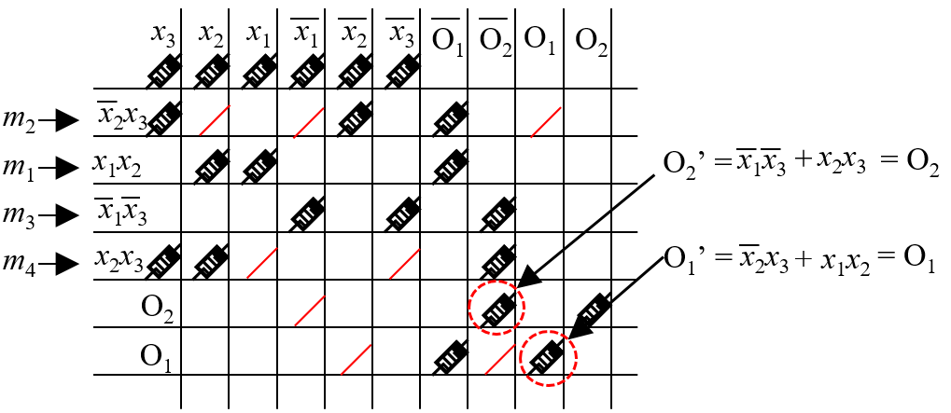
Defect Aspects (Defect Tolerant Mapping)

Slide 18
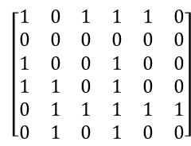
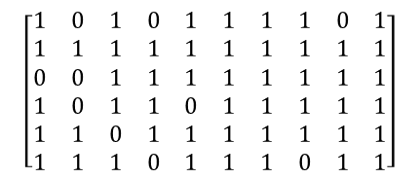
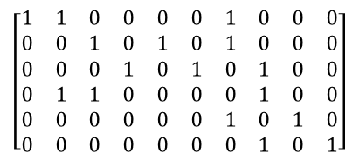
Defect Aspects (Defect Tolerant Mapping)
Function Matrix (FM)
Crossbar Matrix (CM)
O₁ = m₁ + m₂ =
x₁x₂ +
x₂x₃
Functıonal swıtch
O₂ = m₃ + m₄ =
x₁x₃ +
x₂x₃
x₁
x₂
x₃
x₁
x₂
x₃
O₁
O₂
O₁
O₂
V₁
V₂
V₃
V₄
V₅
V₆
V₇
V₈
V₉
V₁₀
m₁
m₂
m₃
m₄
O₁
O₂
$$\left[\begin{matrix}1 & 1 & 0 & 0 & 0 & 0 & 1 & 0 & 0 & 0 \\ 0 & 0 & 1 & 0 & 1 & 0 & 1 & 0 & 0 & 0 \\ 0 & 0 & 0 & 1 & 0 & 1 & 0 & 1 & 0 & 0 \\ 0 & 1 & 1 & 0 & 0 & 0 & 0 & 1 & 0 & 0 \\ 0 & 0 & 0 & 0 & 0 & 0 & 1 & 0 & 1 & 0 \\ 0 & 0 & 0 & 0 & 0 & 0 & 0 & 1 & 0 & 1\end{matrix}\right]$$
$$\left[\begin{matrix}1 & 0 & 1 & 0 & 1 & 1 & 1 & 1 & 0 & 1 \\ 1 & 1 & 1 & 1 & 1 & 1 & 1 & 1 & 1 & 1 \\ 0 & 0 & 1 & 1 & 1 & 1 & 1 & 1 & 1 & 1 \\ 1 & 0 & 1 & 1 & 0 & 1 & 1 & 1 & 1 & 1 \\ 1 & 1 & 0 & 1 & 1 & 1 & 1 & 1 & 1 & 1 \\ 1 & 1 & 1 & 0 & 1 & 1 & 1 & 0 & 1 & 1\end{matrix}\right]$$
H₁
H₂
H₃
H₄
Defectıve swıtch
H₅
H₆
Input ınclusıon
Matching Matrix
m₁ m₂ m₃ m₄ O₁ O₂
No
matchıng
H₁
$$\left[\begin{matrix}1 & 0 & 1 & 1 & 1 & 0 \\ 0 & 0 & 0 & 0 & 0 & 0 \\ 1 & 0 & 0 & 1 & 0 & 0 \\ 1 & 1 & 0 & 1 & 0 & 0 \\ 0 & 1 & 1 & 1 & 1 & 1 \\ 0 & 1 & 0 & 1 & 0 & 0\end{matrix}\right]$$
H₂
H₃
H₄
H₅
Possıble matchıng
H₆

Slide 19
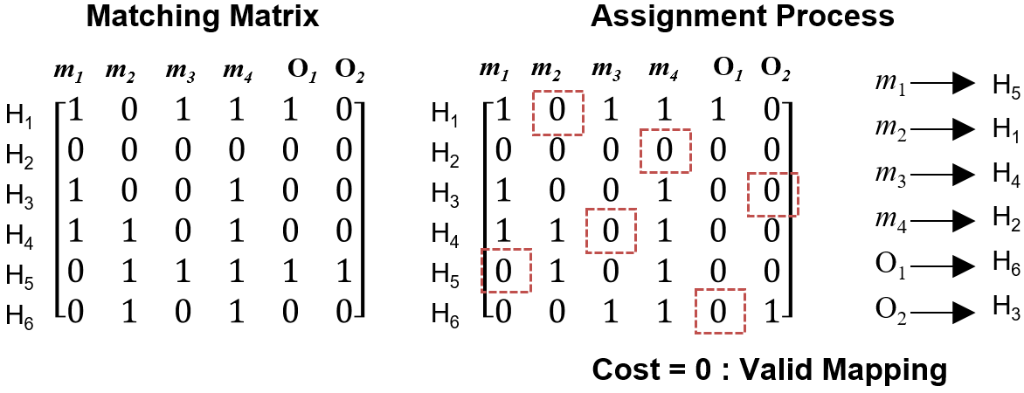
Defect Aspects (Exact Algorithm)
^{[3]}
Runtime unsatisfactory for larger functions!
__________________________________
^{[3]} J. Munkres, “Algorithms for the assignment and transportation problems,” Journal of the society for industrial and applied mathematics, vol. 5, no. 1, pp. 32–38, 1957.

Slide 20
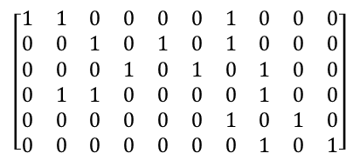
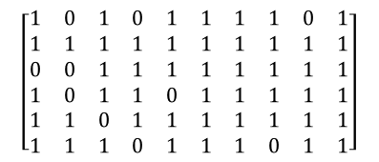
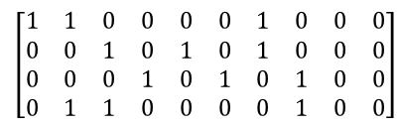
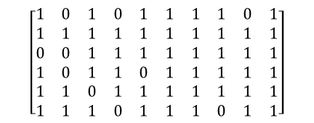
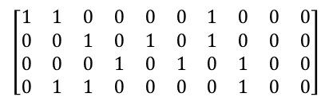
Defect Aspects (Hybrid Algorithm)
Row by row matchıng
$$\left[\begin{matrix}1 & 1 & 0 & 0 & 0 & 0 & 1 & 0 & 0 & 0 \\ 0 & 0 & 1 & 0 & 1 & 0 & 1 & 0 & 0 & 0 \\ 0 & 0 & 0 & 1 & 0 & 1 & 0 & 1 & 0 & 0 \\ 0 & 1 & 1 & 0 & 0 & 0 & 0 & 1 & 0 & 0\end{matrix}\right]$$
(1)
$$\left[\begin{matrix}1 & 0 & 1 & 0 & 1 & 1 & 1 & 1 & 0 & 1 \\ 1 & 1 & 1 & 1 & 1 & 1 & 1 & 1 & 1 & 1 \\ 0 & 0 & 1 & 1 & 1 & 1 & 1 & 1 & 1 & 1 \\ 1 & 0 & 1 & 1 & 0 & 1 & 1 & 1 & 1 & 1 \\ 1 & 1 & 0 & 1 & 1 & 1 & 1 & 1 & 1 & 1 \\ 1 & 1 & 1 & 0 & 1 & 1 & 1 & 0 & 1 & 1\end{matrix}\right]$$
O₁ = m₁ + m₂ =
x₁x₂ +
x₂x₃
O₂ = m₃ + m₄ =
x₁x₃ +
x₂x₃
x₁
x₂
x₃
x₁
x₂
x₃
O₁
O₂
O₁
O₂
(2)
m₁
m₂
m₃
m₄
O₁
O₂
$$\left[\begin{matrix}1 & 1 & 0 & 0 & 0 & 0 & 1 & 0 & 0 & 0 \\ 0 & 0 & 1 & 0 & 1 & 0 & 1 & 0 & 0 & 0 \\ 0 & 0 & 0 & 1 & 0 & 1 & 0 & 1 & 0 & 0 \\ 0 & 1 & 1 & 0 & 0 & 0 & 0 & 1 & 0 & 0 \\ 0 & 0 & 0 & 0 & 0 & 0 & 1 & 0 & 1 & 0 \\ 0 & 0 & 0 & 0 & 0 & 0 & 0 & 1 & 0 & 1\end{matrix}\right]$$
$$\left[\begin{matrix}1 & 1 & 0 & 0 & 0 & 0 & 1 & 0 & 0 & 0 \\ 0 & 0 & 1 & 0 & 1 & 0 & 1 & 0 & 0 & 0 \\ 0 & 0 & 0 & 1 & 0 & 1 & 0 & 1 & 0 & 0 \\ 0 & 1 & 1 & 0 & 0 & 0 & 0 & 1 & 0 & 0\end{matrix}\right]$$
(3)
$$\left[\begin{matrix}1 & 0 & 1 & 0 & 1 & 1 & 1 & 1 & 0 & 1 \\ 1 & 1 & 1 & 1 & 1 & 1 & 1 & 1 & 1 & 1 \\ 0 & 0 & 1 & 1 & 1 & 1 & 1 & 1 & 1 & 1 \\ 1 & 0 & 1 & 1 & 0 & 1 & 1 & 1 & 1 & 1 \\ 1 & 1 & 0 & 1 & 1 & 1 & 1 & 1 & 1 & 1 \\ 1 & 1 & 1 & 0 & 1 & 1 & 1 & 0 & 1 & 1\end{matrix}\right]$$
(4)
(5)
Steps:
(1)
(2)
(3)
(4)
(5)
Row by row matching
No matching found in unmatched row
Backtracking searches matched rows of the CM
Previously assigned row of the FM is updated
Row by row matching continues
Exact algorıthm

Slide 21
Defect Aspects (Simulation Results)
Table II
Runtıme and Success Rate comparıson of hba and ea
200 random defective crossbars with 10% defect rate
Optimum area size
Hybrid algorithm performs at most 50 times faster for larger circuits
Exact algorithm performs 3 – 15% in terms of success rate
NAME | AREA COST | IR | HBA |  | EA
 |  |  | Psucc | Time | Psucc | Time
rd53 | 544 | 33% | 98% | 0.001 | 98% | 0.001
squar5 | 858 | 16% | 100% | 0.001 | 100% | 0.001
inc | 1248 | 17% | 100% | 0.001 | 100% | 0.002
misex1 | 570 | 19% | 100% | 0.001 | 100% | 0.001
sqrt8 | 792 | 21% | 100% | 0.001 | 100% | 0.002
sao2 | 1736 | 29% | 94% | 0.001 | 97% | 0.003
rd73 | 2600 | 34% | 78% | 0.002 | 92% | 0.013
clip | 3500 | 23% | 76% | 0.005 | 79% | 0.082
rd84 | 6216 | 33% | 82% | 0.006 | 89% | 0.093
ex1010 | 11760 | 23% | 100% | 0.003 | 100% | 0.062
table3 | 10584 | 25% | 100% | 0.004 | 100% | 0.032
misex3c | 11856 | 13% | 100% | 0.003 | 100% | 0.035
exp5 | 19454 | 10% | 65% | 0.006 | 80% | 0.024
apex4 | 25480 | 21% | 100% | 0.008 | 100% | 0.173
alu4 | 25652 | 19% | 100% | 0.008 | 100% | 0.28

Slide 22
Conclusion and Future Work
A multi-level logic design demonstrated and area cost comparison with two-level design given
Area optimization with considering both the logic function and its negation during logic synthesis shown
A defect model established and a preliminary hybrid defect tolerant logic mapping algorithm proposed
Novel EDA tools for multi-level synthesis, especially technology dependent
Area yield analysis concerning both logic synthesis and defects
Notes:
Electronics design automation tools are necessary

Slide 23
Thank You for Listening
Questions?

