Slide 1


Nano-Crossbar based Computing: Lessons Learned and Future Directions
This project has received funding from the European Union's H2020 research and innovation programme under the Marie Skłodowska-Curie grant agreement No 691178.
This work is supported by the TUBITAK-2501 project #218E068.
Mustafa Altun, Ismail Cevik, Ahmet Erten, Osman Eksik, Mircea Stan, and Csaba Andras Moritz
Presenter: Mustafa Altun
Electronics & Communication Engineering
Istanbul Technical University
Web: http://www.ecc.itu.edu.tr/
March 10th, 2020
Design, Automation, and Test in Europe (DATE) , Grenoble France

Slide 2
Outline
Project Details
H2020 Rise Program
  Experiences in implementation
  Lessons learned
Project Summary in Numbers
Project’s Technical Contribution
  Computing with nano crossbars
  Lessons learned
  Future directions

Slide 3

Project Details
title: | Synthesis and Performance Optimization of a Switching Nano-Crossbar Computer - NANOxCOMP
coordinator: | Mustafa Altun, ECC Group, Istanbul Technical University
partner(s): | Dr. Dan Alexandrescu, IROC Techonogies, France Prof. Lorena Anghel, TIMA Lab., France (partnership terminated) Prof. Valentina Ciriani, ALOS Lab., University of Milan, Italy. Prof. Csaba A. Moritz, Nanoscale Computing Fabrics Lab., University of Massachusetts, USA Prof. Kaushik Roy, Nanoelectronics Research Lab., Purdue University, USA Prof. Georgios Sirakoulis, Department of Electrical and Computer Engineering, Democritus University of Thrace, Greece (new partner) Prof. Mircea Stan, High-Performance Low-Power Lab., University of Virginia, USA Prof. Mehdi B. Tahoori, Dependable Nano-Computing Group, Karlsruhe Institute of Technology, Germany
funding agency & program: | European Union/European Commission H2020 MSCA Research and Innovation Staff Exchange Program (RISE)
Budget & duration: | 724.500 EURO & 2015-2019

Slide 4










Project Details
Gathers globally leading research groups working on nanoelectronics and EDA
Focusing on computing with nano-crossbar arrays
Targets variety of nano crossbar based emerging technologies including nanowire/nanotube crossbar arrays, magnetic switch-based structures, and crossbar memories
Contributes to the construction of emerging computers beyond CMOS by proposing nano-crossbar based computer architectures.

Slide 5
Specifics of MCSA RISE
Evaluation is mostly based on research excellence
  Propose with a good research idea
Money only for secondments/exchanges: 4500EURO per month
  4500 for the seconded researcher per month; at least 2000 for the researcher
  No secondment no Money!
  Seconded researchers should be employees in the sending organization
Cooperation between partners is the crucial part of RISE.
  Find good and attractive partners
  Large consortium is a plus
Although RISE is constructed on exchanges, you are expected to conduct productive research with publications/patents
  Have another project to support RISE
    Need funded researchers/scholars to work hard throughout the duration of the RISE project
    Need extra research money especially for experimental works

Slide 6
Lessons Learned
PREPERATION
  Formation of the consortium
    Decision: industry partner or third country
    Faced Problem: only SME’s are eligible as industry partners
    Faced Problem: 2000EURO per month is not satisfactory for industry employees
    Faced Problem: limited budget makes hard to find partners
IMPLEMENTATION
  Difficulty of finding researchers to send
    Have an other project covering different research areas
    Have a sizable research group
  Difficulty of keeping the harmony between partners
    Joint papers, conference presentations, visits

Slide 7
Lessons Learned
BENEFITS
  Building a network for long lasting collaborations
  Good for career developments of secondees, international experience
  Quality research with publications if not much Money needed
  Invaluable experience in implementing a project with a consortium having many partners
  Networking for future projects

Slide 8
Project Summary in Numbers
Started in 2015, the project has been successfully completed in 2019 with achievements including:
34 researchers have been seconded to project partners, performing a total of 110,43 secondment months.
  17 of them are early stage researchers
  9 of them are female researchers.
32 peer-reviewed papers contributed by 30 project secondees or partners.
  12 of them are journal papers.
35 dissemination, outreach, and management activities have been performed.

Slide 9
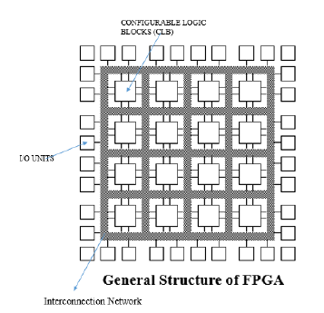
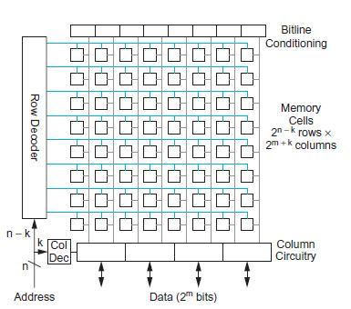
Research Motivation
MAIN GOAL: Showing efficient ways of computing with nano-crossbar arrays
WHY CROSSBAR ARRAYS?
REGULAR AND DENSE – AREA EFFICIENT
EASY TO MANIFACTURE
GOOD FOR RECONFIGURABILITY
How about logic/computing in ASIC?
Memory Structure

Slide 10
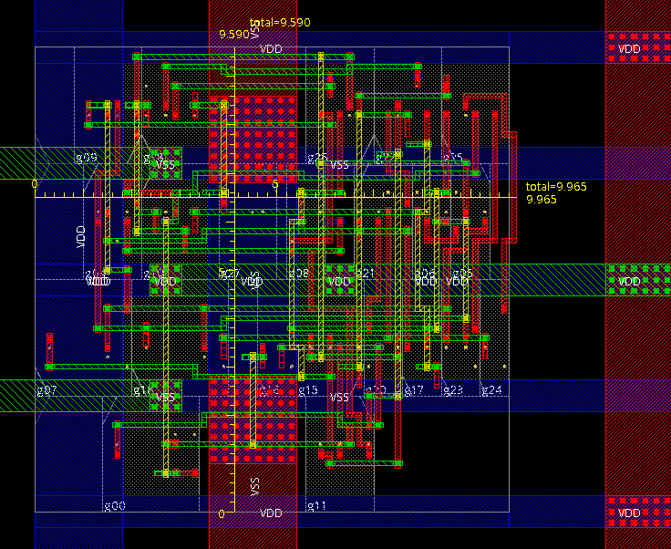
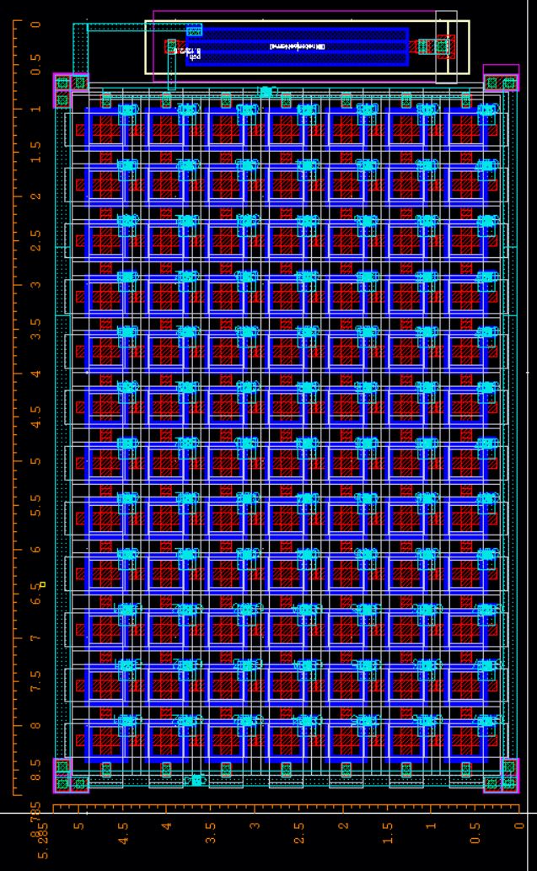
Research Motivation
How about logic/computing in ASIC?
Same logic function implementations with conventional CMOS and crossbar based CMOS

Slide 11
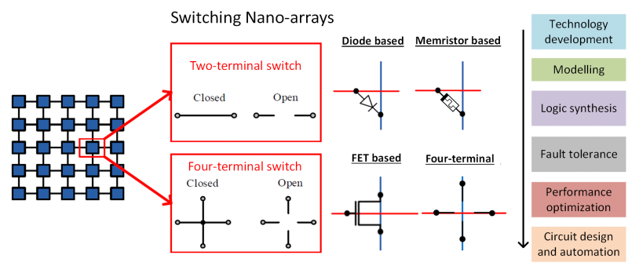
Research Progress
MAIN GOAL: Showing efficient ways of computing with nano-crossbar arrays

Slide 12
Two-terminal vs. Four-terminal

Slide 13
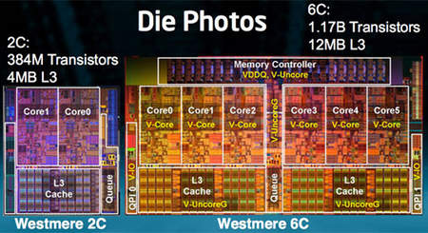
Two-terminal vs. Four-terminal
Shannon’s work: A Symbolic Analysis of Relay and Switching Circuits(1938)

Slide 14
Two-terminal vs. Four-terminal
What are the Boolean functions implemented in (a) ad (b)?

Slide 15
Research Progress: Logic Synthesis
MAIN GOAL: Showing efficient ways of computing with nano-crossbar arrays

Slide 16
Diode/Memristor-based Model

Slide 17
Diode/Memristor-based Model
Example:
Implement the Boolean function f = A+B with diode based nanoarrays.
Diode-resistor logic

Slide 18
Diode/Memristor-based Model
Example:
Implement the Boolean function f = A B with diode based nanoarrays.
Diode-resistor logic

Slide 19
Diode/Memristor-based Model
Example:
Implement the Boolean function f = A B + C D with diode based nanoarrays.

Slide 20
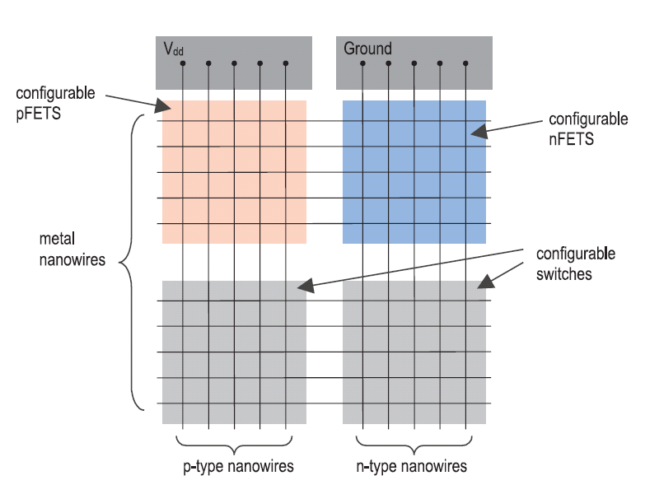
FET-based Model
From Snider, G., et al., (2004). CMOS-like logic in defective, nanoscale crossbars. Nanotechnology.

Slide 21
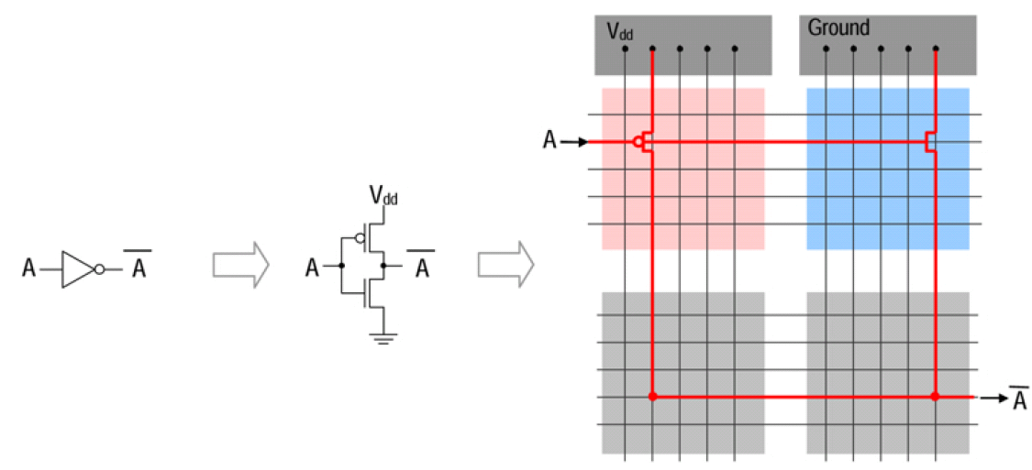
FET-based Model
Example:
Implement the Boolean function f = Aꞌ with FET based nanoarrays using CMOS-like logic.

Slide 22
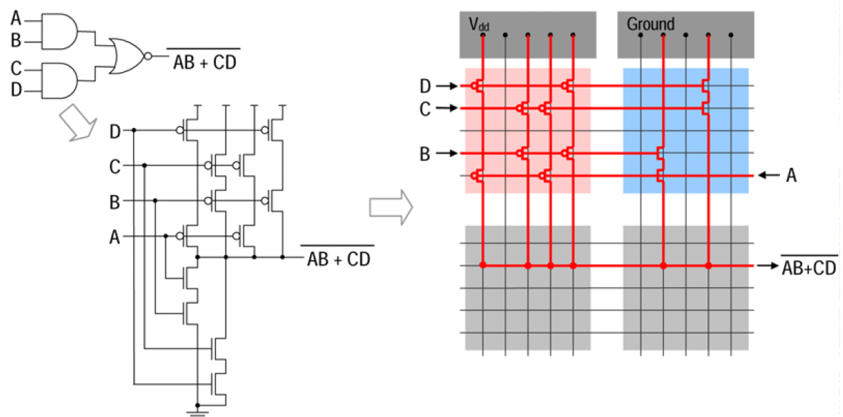
FET-based Model
Example:
Implement the Boolean function f = (A B + C D)ꞌ with FET based nanoarrays using CMOS-like logic.

Slide 23
Four-terminal Switch-based Model
3 × 3 2D switching network and its lattice form

Slide 24
Four-terminal Switch-based Model
Switches are controlled by Boolean literals.
f_{L} evaluates to 1 iff there exists a top-to-bottom path.
g_{L} evaluates to 1 iff there exists a left-to-right path.

Slide 25
Four-terminal Switch-based Model
f_{3x3} = x₁x₄x₇ + x₂x₅x₈ +x₃x₆x₉ +x₁x₄x₅x₈ +x₂x₅x₄x₇ +x₂x₅x₆x₉ +x₃x₆x₅x₈ +x₁x₄x₅x₆x₉ +x₃x₆x₅x₄x₇
Realizations of $f = abc + \overline{a}\overline{b}c + a\overline{c}\overline{d} + \overline{a}c\overline{d}$

Slide 26
Experimental Results
Implementation of fXOR2 with different nanocrossbar types

Slide 27
Experimental Results

Slide 28
Research Progress: Fault Tolerance
MAIN GOAL: Showing efficient ways of computing with nano-crossbar arrays

Slide 29
Defect/Fault Tolerance for FET/Diode/Memristor based Arrays
Permanent Faults occur mostly in fabrication and are tolerated in post-fabrication by redundancy and reconfigurability (mapping).
Transient Faults occur in field and are tolerated by redundancy

Slide 30
Defect/Fault Tolerance for FET/Diode/Memristor based Arrays
Given logic function
f = x₁ x₂ + x₁ x₃ + x₂ x₃ + x₁ x₂ x₃
I₁ I₂ I₃ I₄ I₅ I₆
x₂ x₃ x₁ x₁ x₂ x₃
O₁
O₂
O₃
O₄
Mapping
Algorithm
P₁
P₂
P₄ P₃
Defective crossbar
Assignment and configuration
: Configurable Switch
: Activated Switch
: Defective Switch
: Deactivated Switch
Defect tolerance is achieved by realizing a target logic function on a defective crossbar using row and column permutations
For the worst-case, N!M! permutations are required to find a successful mapping for NXM crossbar.

Slide 31
Defect/Fault Tolerance for Four-Terminal Switch based Arrays
Lattice design
Sensitivity maps
Realize a target logic function on a sensitive crossbar such that total sensitivity is minimized thanks to redundant paths in lattices.

Slide 32
Research Progress: RC Modelling
MAIN GOAL: Showing efficient ways of computing with nano-crossbar arrays

Slide 33
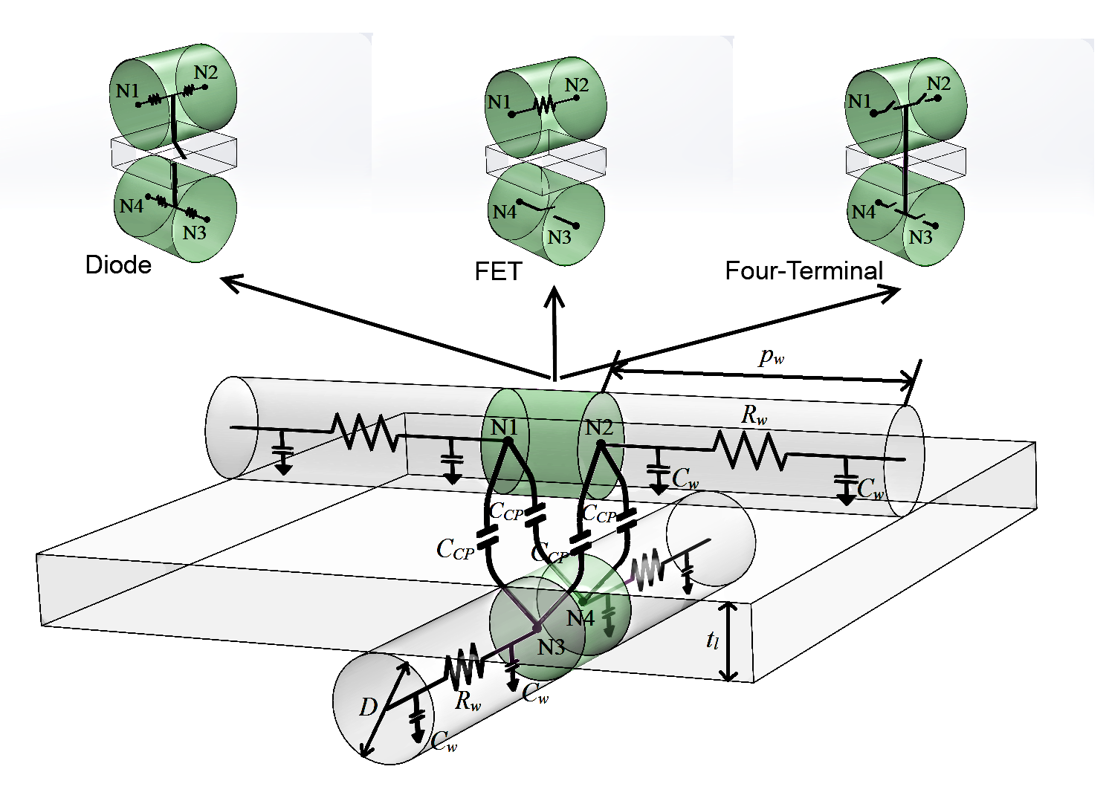
RC Modelling
POST CMOS TECHNOLOGIES

Slide 34
Research Progress: Technology Development
MAIN GOAL: Showing efficient ways of computing with nano-crossbar arrays

Slide 35
Technology Development for Four-Terminal Switch based Arrays
How about the technology?
CMOS Implementation of Switching Lattices

Slide 36
Technology Development for Four-Terminal Switch based Arrays
CMOS Implementation of Switching Lattices
Drain/Source contact-free (Metal-free) layouts!

Slide 37
Technology Development for Four-Terminal Switch based Arrays
Circuit Structures

Slide 38
Technology Development for Four-Terminal Switch based Arrays
EXPERIMENTAL RESULTS
Same logic function with conventional CMOS and crossbar based 65nm CMOS
In average 2X area improvement

Slide 39
Technology Development for Four-Terminal Switch based Arrays
EXPERIMENTAL RESULTS
Post layout results on logic functions show that switching lattices occupy much smaller area than those of the conventional CMOS implementations, while they have competitive delay and power consumption values

Slide 40
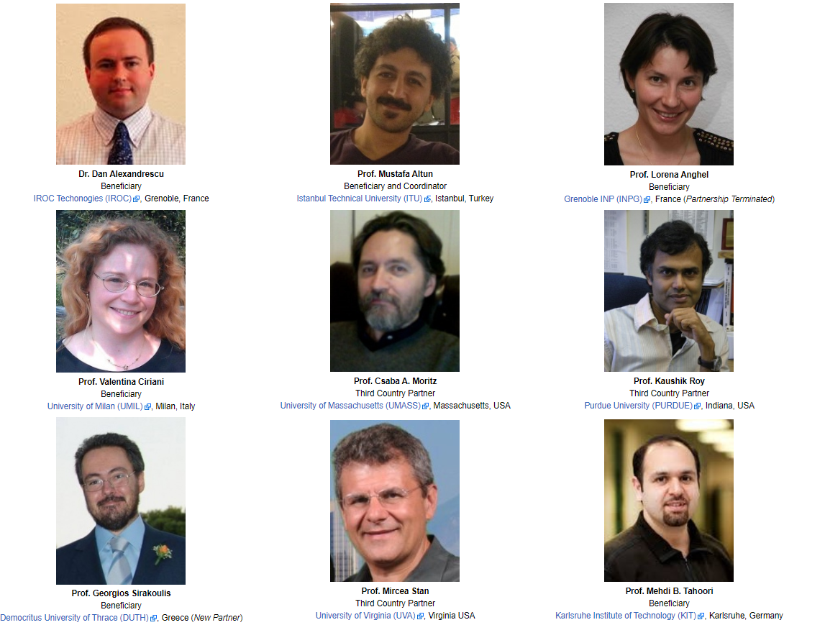
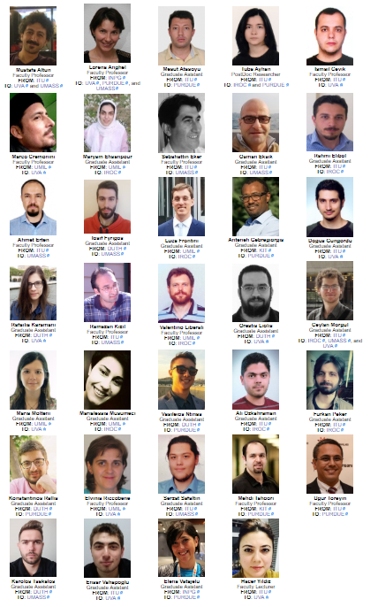
PARTNERS
SECONDEES
THANK YOU!
Web: http://www.nanoxcomp.itu.edu.tr/

