Slide 1



Realization of Four-Terminal Switching Lattices: Technology Development and Circuit Modeling
Presenters: Mustafa Altun and Serzat Safaltin
Budget: 724.000 EURO
Duration: 2015-2019
Synthesis and Performance Optimization of a Switching Nano-Crossbar Computer
This project has received funding from the European Union's H2020 research and innovation programme under the Marie Skłodowska-Curie grant agreement No 691178.
This work is supported by the TUBITAK-Career project #113E760.
Dr. Mustafa Altun, – Coordinator – Emerging Circuits and Computation Group, Istanbul Technical University, Turkey
Dr. Dan Alexandrescu, IROC Technologies, Grenoble, France
Dr. Lorena Anghel, TIMA Lab., Grenoble, France
Dr. Valentina Ciriani, ALOS Lab., University of Milan, Italy.
Dr. Csaba A. Moritz, Nanoscale Computing Fabrics Lab., University of Massachusetts, USA
Dr. Kaushik Roy, Nanoelectronics Research Lab., Purdue University, USA
Dr. Mircea Stan, High-Performance Low-Power Lab., University of Virginia, USA
Dr. Mehdi B. Tahoori, Dependable Nano-Computing Group, Karlsruhe Institute of Technology, German
March 27th, 2019
Design, Automation, and Test in Europe (DATE)

Slide 2
Project Flow
Why we use four-terminal switches?
How to realize them?
Which technology?

Slide 3
Two-terminal vs. Four-terminal

Slide 4
Two-terminal vs. Four-terminal
The Boolean functions implemented in (a) ad (b) are same!

Slide 5
Logic Synthesis Problem
How can we implement a given target Boolean function f_{T} with a lattice of four-terminal switches?
Example: f_{T} = x₁x₂x₃+x₁x₄

Slide 6
Logic Synthesis Problem
Example: f_{T} = x₁x₂x₃+x₁x₄+x₁x₅
9 TOP-TO-BOTTOM PATHS!

Slide 7
First Method’s Performance
f_{T} = x₁x₂x₃+x₁x₄+x₁x₅
f_{T}^{D} = x₁ + x₂x₄x₅ + x₃x₄x₅
Size of the lattice: m×n
n and m are the number of products of the target function f_{T} and its dual f_{T}^{D}, respectively.

Slide 8
Other Synthesis Methods
Optimal and heuristics methods to decrease lattice size
Methods based on SAT
Methods based on decompositions
Methods for spesific type of funtions such as parity functions
Methods using multi-lattices
Methods for multi-output functions
Switching lattices has a great computing potential

Slide 9
Computing Potential
Switching lattices has a great computing potential

Slide 10
Technology for Switching Lattices
How about the technology?
We propose CMOS-compatible technology with TCAD simulations
By fitting the TCAD data to the standard CMOS current-voltage equations, we develop a Spice model of a four-terminal switch
We are currently working toward the fabrication.

Slide 11
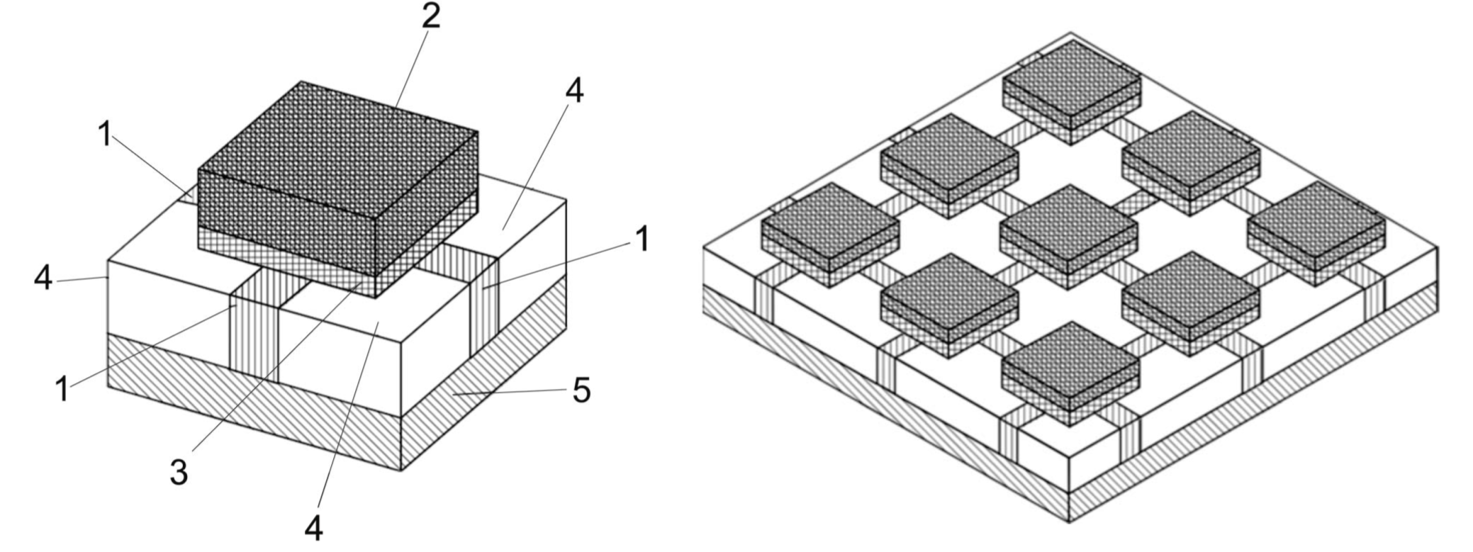
Device Structures
1: Diffusion region 2: Gate electrode 3. Gate insulator region
4: Local Oxidation of Silicon (LOCOS) or Shallow Trench Isolation (STI) layers
5: Bulk layer

Slide 12
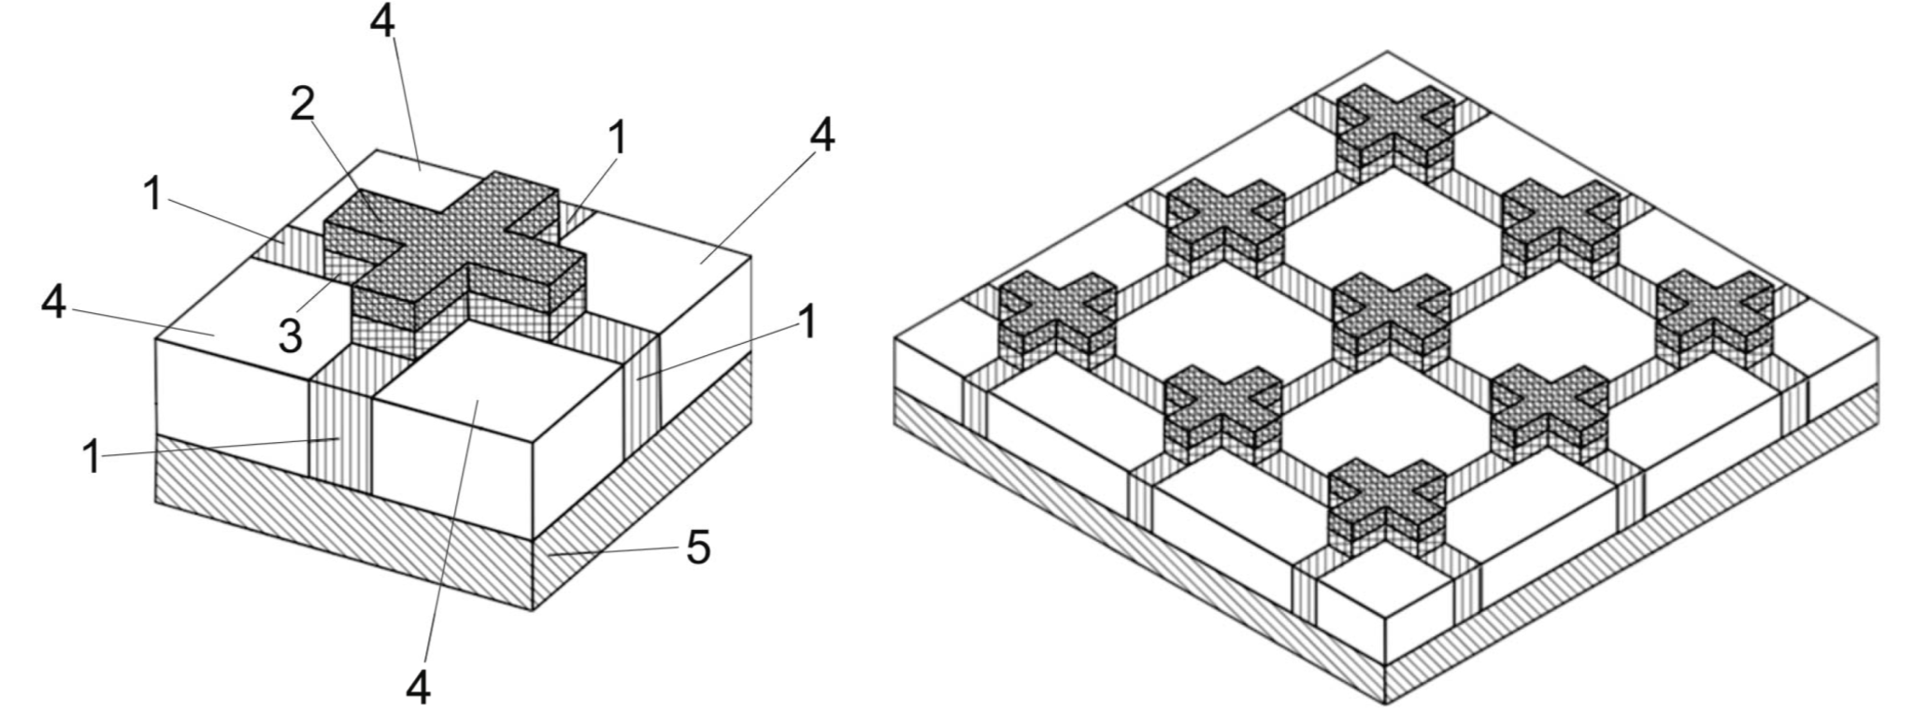
Device Structures
1: Diffusion region 2: Gate electrode 3. Gate insulator region
4: Local Oxidation of Silicon (LOCOS) or Shallow Trench Isolation (STI) layers
5: Bulk layer

Slide 13
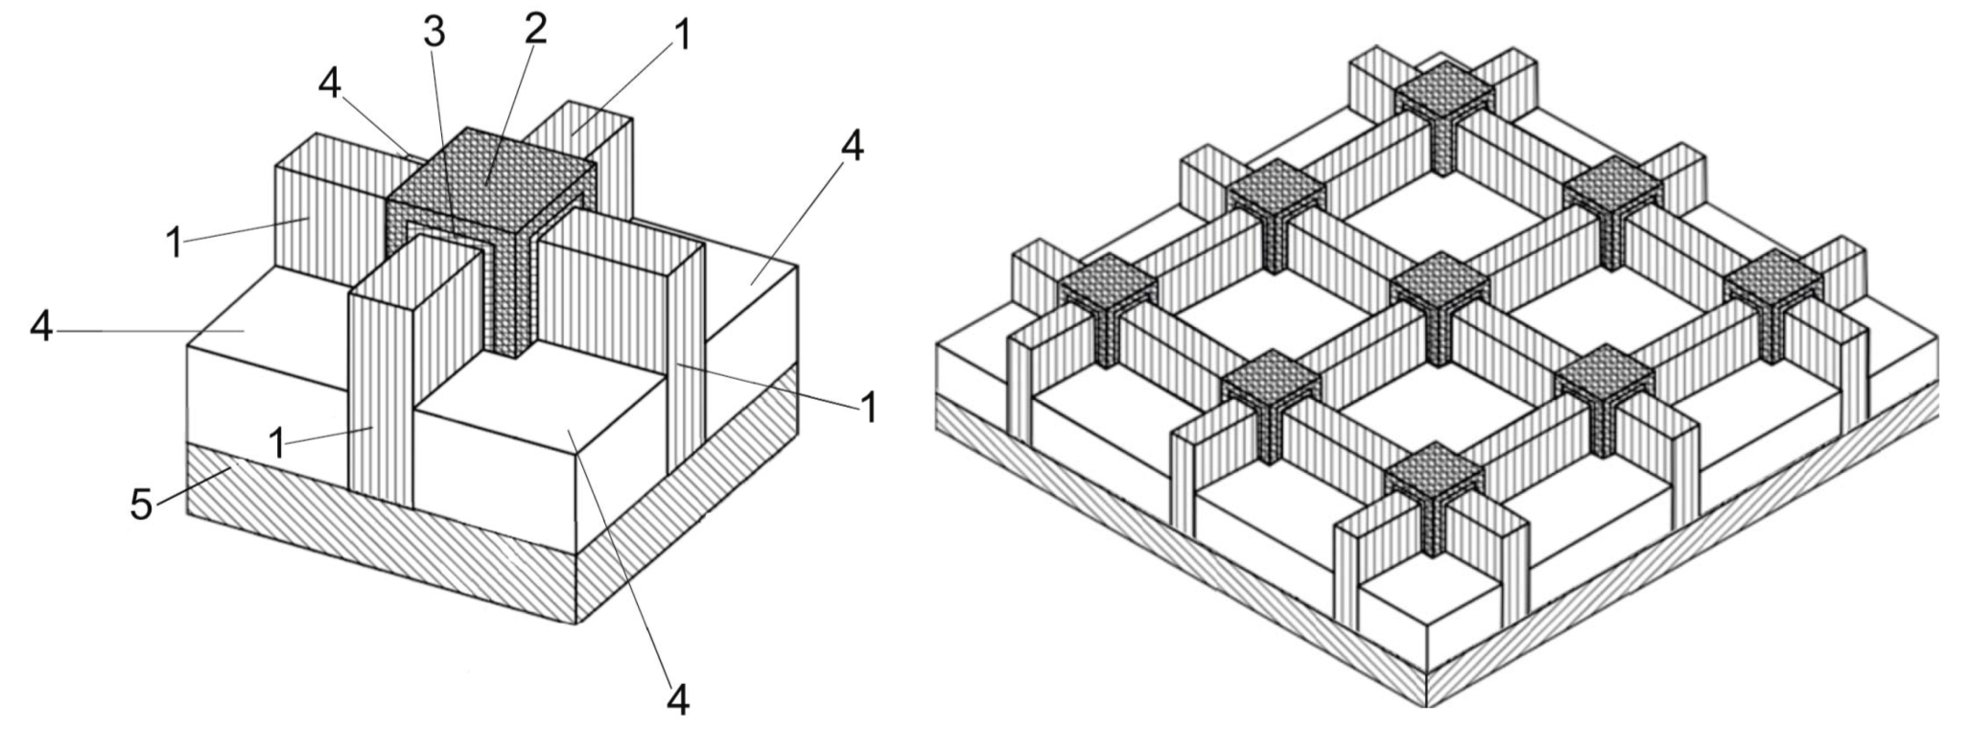
Device Structures
1: Diffusion region 2: Gate electrode 3. Gate insulator region
4: Local Oxidation of Silicon (LOCOS) or Shallow Trench Isolation (STI) layers
5: Bulk layer

Slide 14
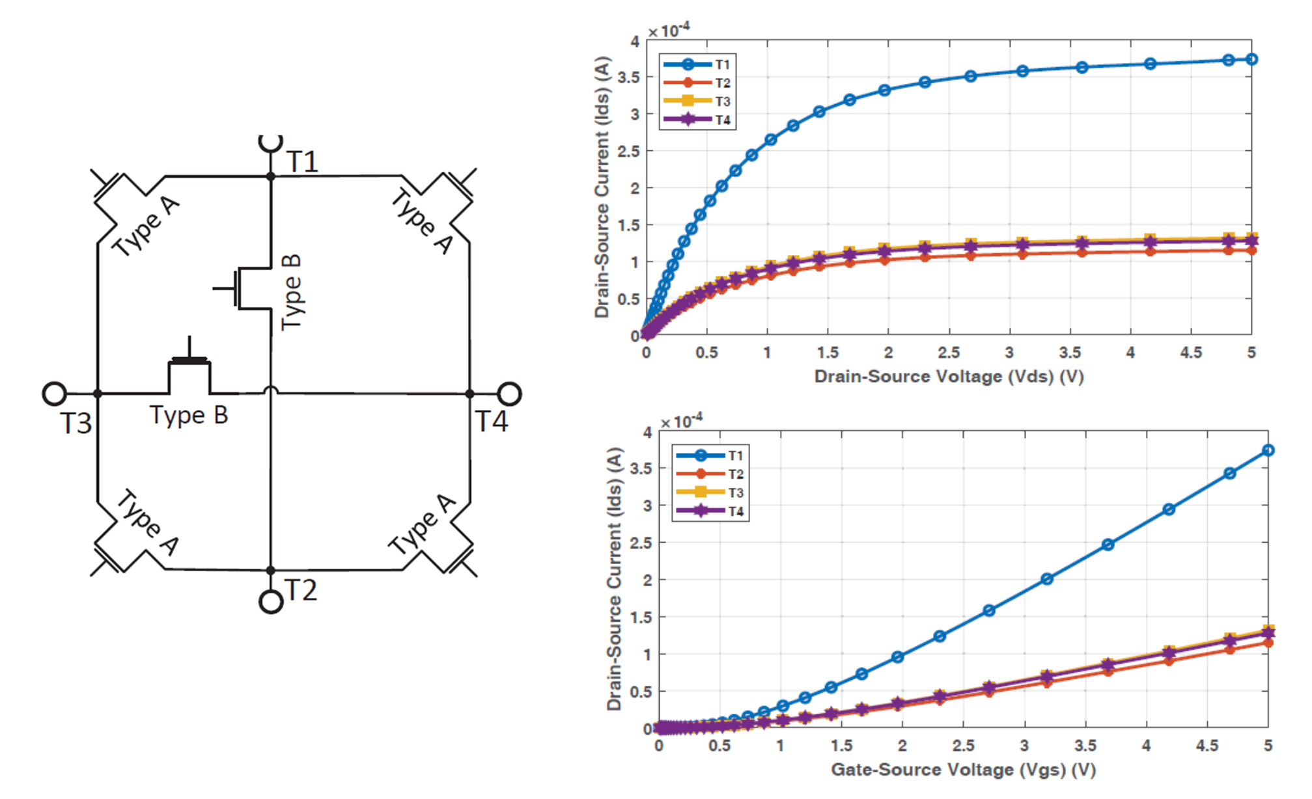
Spice Model

Slide 15
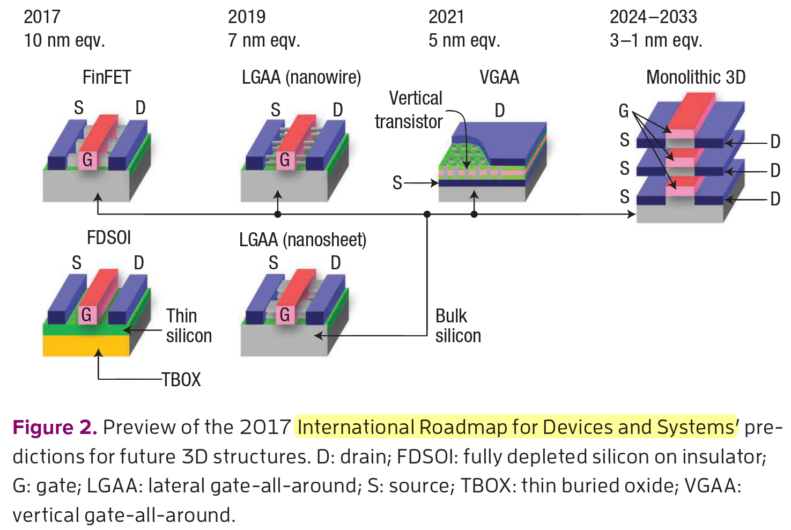
Fabrication Steps
Challenges for integration of 4-terminal architecture
  2D – compatible with current and emerging fabrication methods...
  3D – wiring and critical dimension limits operation but great potential for dense wiring…
  Materials?
    same as 2-terminal devices
Four-Terminal Logic Realization
  Structure?
    GAA, VGAA, M3D, fine grained vertical 3D, FinFET…
  Device Type?
    Depletion, Immersion
What works for 2-terminal approach will work for 4-terminal.
Notes:
Our approach for development isn’t device dependent, it is technology depentent. means what Works for 2-terminal architectural approach for any device type and/or structure will sure work for 4-terminal devices.

Slide 16
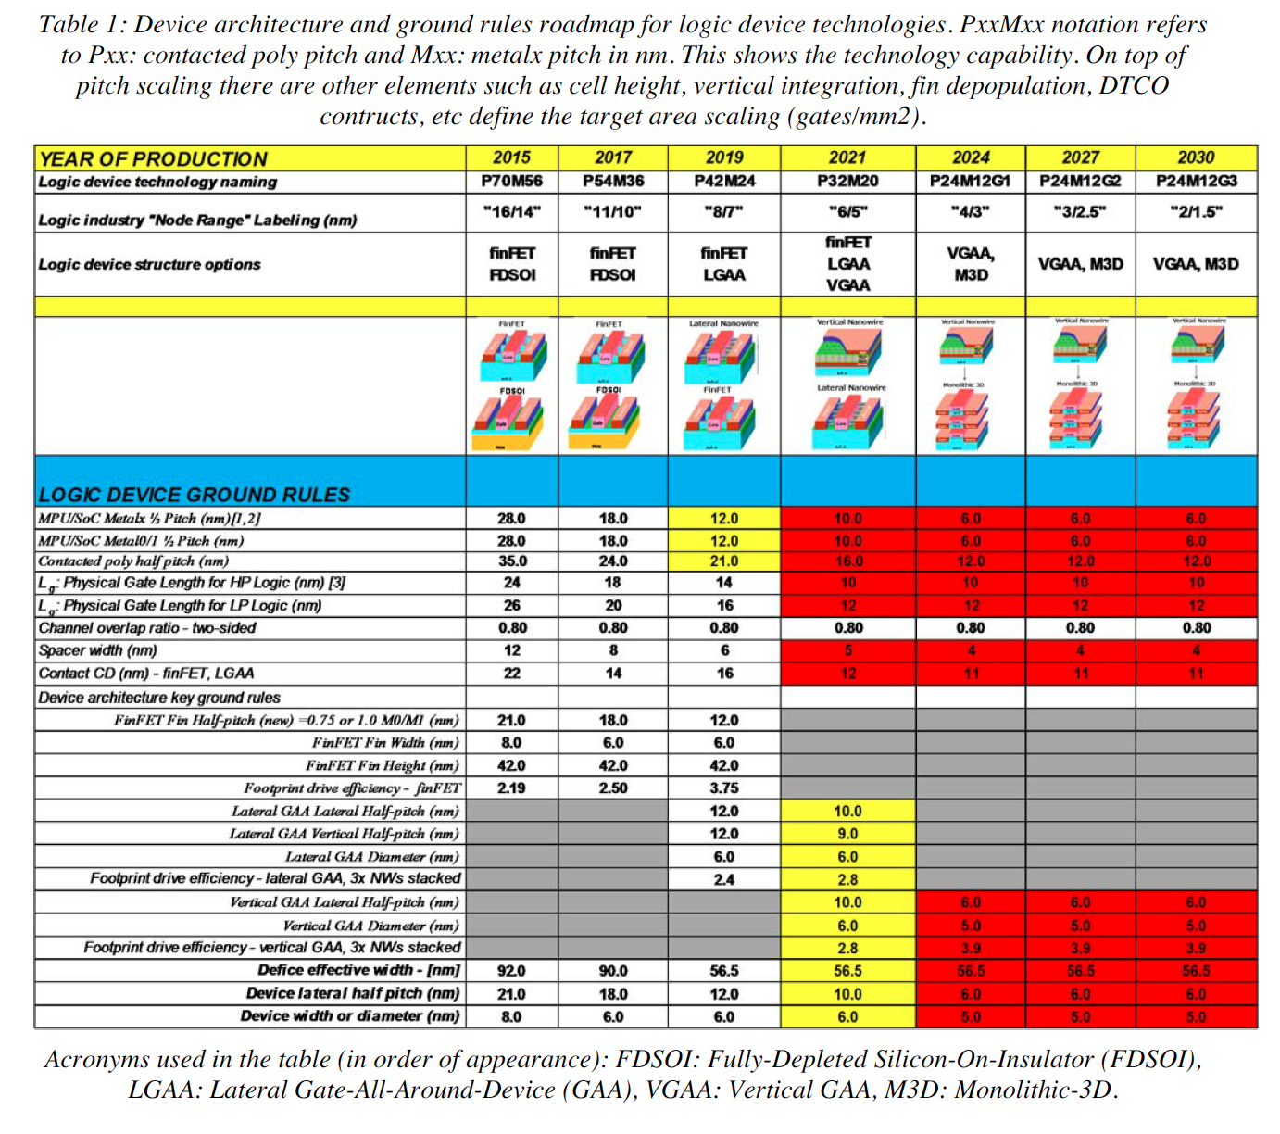

Fabrication Steps
Device scaling
  compatible to state-of-art (Moore’s Law)
TCAD vs Experimental Device
  leakage current
  isolation limits
What can be done with 2-terminal device can also be done with 4-terminal device approach.
Notes:
emerging fab: selective ALD, Laser lithography

Slide 17
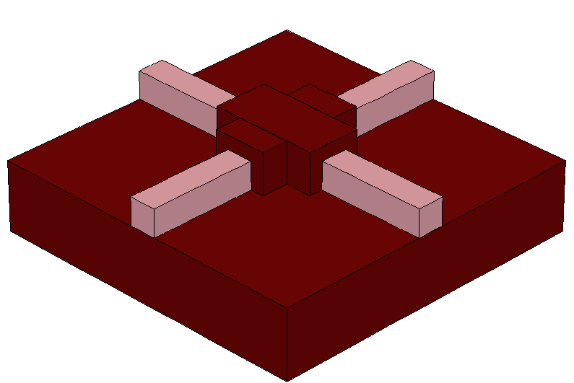
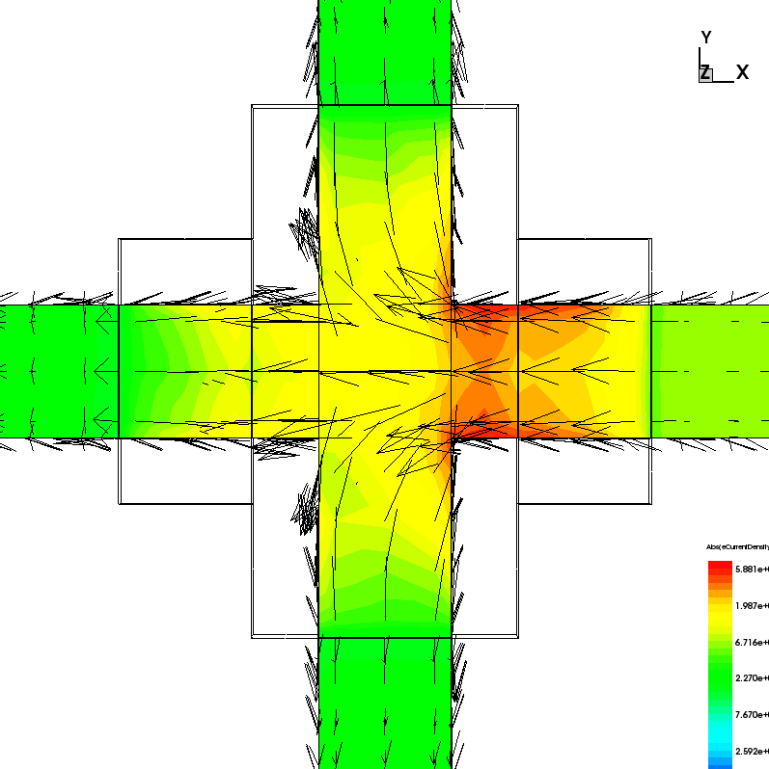
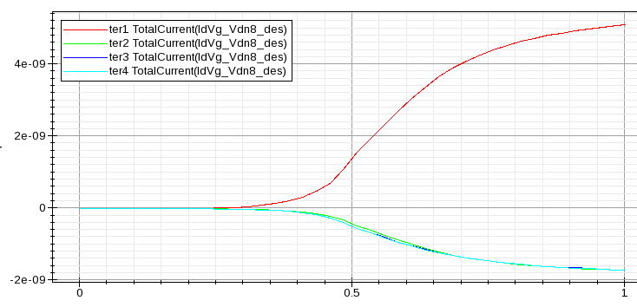
Fabrication Steps
Fabrication Plan 1
First plan is to fabricate junctionless device…
Pros: no doping steps.
Cons: scale dependent, low ON/OFF ratio.
SOI substrate, simple process flow…
2-terminal fabrication processes can be implemented with minor modification…
T4
T2
T1
T3
Notes:
emerging fab: selective ALD, Laser lithography

Slide 18
Fabrication Steps
EBL → RIE → EBL → ALD → EBL → Metallization
Starting Wafer
Material: SOI Si, N-type
RIE
E-Beam Lithography
RIE
Notes:
emerging fab: selective ALD, Laser lithography

Slide 19
Fabrication Steps
E-Beam Lithography
Atomic Layer Deposition
Lift-off
Metal deposition
Notes:
emerging fab: selective ALD, Laser lithography

Slide 20
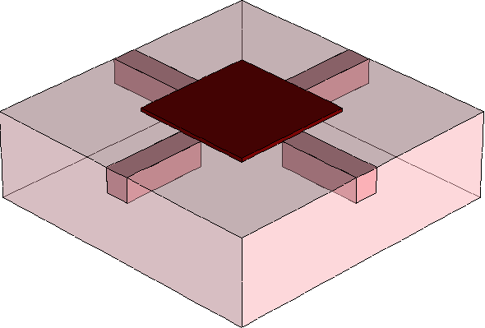
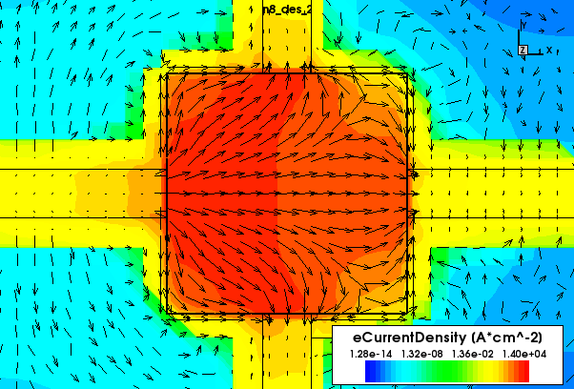
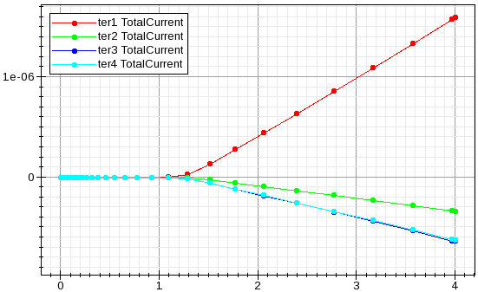
Fabrication Steps
Fabrication Plan 2
Square shaped N-type or P-type MOSFET
Pros: pn junction, high ON/OFF ratio.
Cons: scaling-doping-geometric features…
At least 20 process steps including lithography, deposition, etching, surface cleaning…
T4
T2
T1
T3
Notes:
emerging fab: selective ALD, Laser lithography

Slide 21
Fabrication Steps
Future
  novel materials
    SiGe, high-k gate oxides…
  2D materials
    graphene, MoS₂…
  Flexible Circuits
    metal-organic network, conductive polymers
  Novel Fabrication Methods
    nano inkjet printing, nano imprint lithography, selective EPI growth…
Advancement of 2-terminal devices and systems have same trend with 4-terminal devices

Slide 22

Emerging Circuits and Computation Group
Web: http://www.ecc.itu.edu.tr/
THANK YOU!

