Slide 1
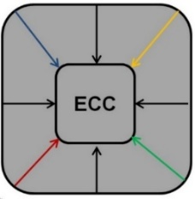


Yield Analysis of Nano-Crossbar Arrays For
Uniform and Clustered
Defect Distributions
ICECS ¹⁷ IEEE International Conference on Electronics, Circuits and Systems
5-8 December, Batumi - Georgia
Onur Tunali ¹ and Mustafa Altun ²
onur.tunali@itu.edu.tr and altunmus@itu.edu.tr
Nanoscience and Nanoengineering Department ⁽¹⁾ and Electronics and Communications Department ⁽²⁾
Istanbul Technical University
This work is part of a project that has received funding from the European Union's H2020 research and innovation programme under the Marie Skłodowska-Curie grant agreement No 691178.
This work is supported by the TUBITAK-Career project #113E760
Emerging Circuits and Computation Group (ECC)
www.ecc.itu.edu.tr

Slide 2
Outline
Nano-crossbars arrays (Reconfigurable)
Logic mapping of nano-crossbar arrays
Main problem and previous works
Yield in the context of crossbars (Area Size)
Probability of successful logic mapping
Yield formalization for uniform defects
Clustered defect distribution
Regional analysis of defects
Experimental results
Conclusion

Slide 3
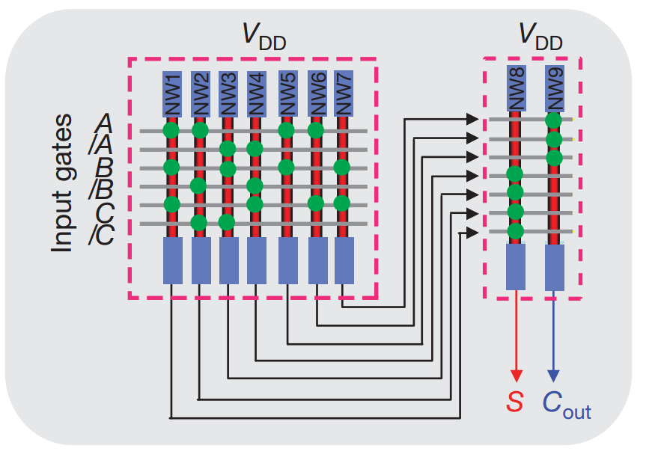
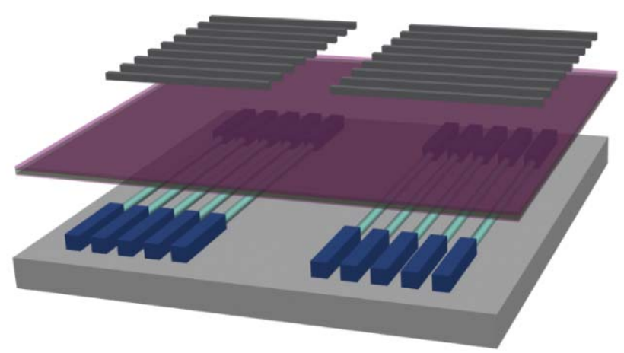
Nano-crossbar Arrays
^{[1]}
^{[1]}
Cross section of an activated switch
Very similar to Programmable Logic Arrays (PLA)
Switching Element
__________________________________
^{[1]} H. Yan, H. S. Choe, S. Nam, Y. Hu, S. Das, J. F. Klemic, J. C. Ellenbogen, and C. M. Lieber, “Programmable nanowire circuits for nanoprocessors,” Nature

Slide 4
Logic Mapping of Nano-crossbar
Given logic function
f = x₁ x₂ + x₁ x₃ + x₂ x₃ + x₁ x₂ x₃
I₁ I₂ I₃ I₄ I₅ I₆
x₂ x₃ x₁ x₁ x₂ x₃
O₁
O₂
O₃
O₄
Mapping
Algorithm
P₁
P₂
P₄ P₃
Defective crossbar
Assignment and configuration
: Configurable Switch
: Activated Switch
: Defective Switch
: Deactivated Switch

Slide 5
Logic Mapping of Nano-crossbar
Given logic function
f = x₁ x₂ + x₁ x₃ + x₂ x₃ + x₁ x₂ x₃
I₁ I₂ I₃ I₄ I₅ I₆
O₁
O₂
O₃
O₄
NO MAPPING!
Too many defects
: Configurable Switch
: Defective Switch

Slide 6
Main Problem and Previous Works
How can we predict sufficient area size of crossbar ensuring a successful mapping of a given logic function independent of defect distributions ?
  We formalize the yield and probability of successful logic mapping of a crossbar in terms of area overheads.
  Then, we minimize area overhead while maximizing the mapping probability.

Slide 7
Main Problem and Previous works
The most of previous works use 1.5 times larger crossbars for logic mapping disregarding the yield. Another tendency is to consider only uniform defect distributions. In addition, certain studies use random logic functions.
  We cover both uniform and clustered distributions.
  We show that 1.5 times area overheads are too generous.
  And, we show that random logic functions are not suitable to obtain reliable results.

Slide 8
Yield in the context of crossbars
1. Step : Formulation of optimal area size
f = x₁ x₂ + x₁ x₃ + x₂ x₃ + x₁ x₂ x₃
6 literals ( x₁, x₂ , x₃ , x₁, x₂, x₃)
Inputs of crossbar
(N)
4 Products ( P₁, P₂ , P_{3,} P₄ )
x₂ x₃ x₁ x₁ x₂ x₃
Optimal Area = # of products x # of literals
Size = M x N
P₁
P₂
P₄ P₃
Outputs of crossbar
(M)
Area Cost = 4 x 6 = 24

Slide 9
Yield in the context of crossbars
2. Step : Formulation of area size with overheads
k_{i} : Input overhead coefficient
How large input size
(N. k_{i})
k₀ : Output overhead coefficient
x₂ x₃ x₁ x₁ x₂ x₃
P₁
P₂
P₄ P₃
Area size with = (M.k₀) x ( N.k_{i} )
overheads
How large output size
(M. k₀)
Area Cost = 6 x 9 = 63

Slide 10
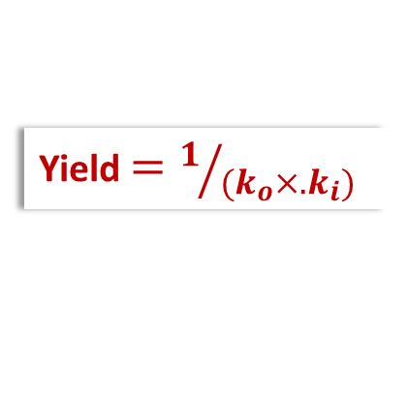
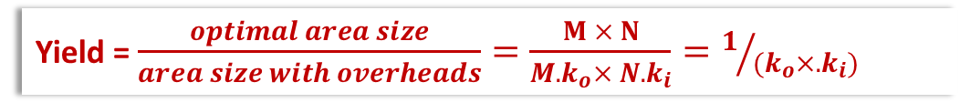
Yield in the context of crossbars
3. Step : Formulation of yield
Yield = $\frac{optimal area size}{area size with overheads}=\frac{M × N}{M.k_{o}× N{.k}_{i}}=1/{{(k}_{o}×{.k}_{i})}$
Yield $=1/{{(k}_{o}×{.k}_{i})}$
Yield only related area overhead coefficients
Maximizing yield means less area cost

Slide 11

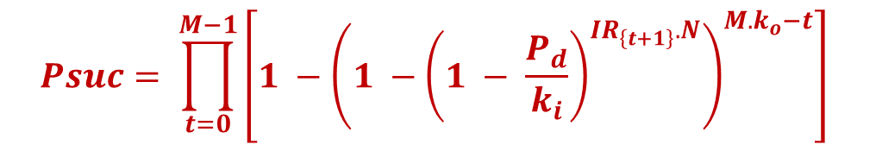

Probability of Successful Mapping
Probability of successful logic mapping with uniform defects
$$Psuc= \prod_{t=0}^{M−1}{\left[1 −{\left(1 −{\left(1 − \frac{P_{d}}{k_{i}}\right)}^{IR_{\left\{t+1\right\}}.N}\right)}^{M.k_{o}−t}\right] }$$
Number of products denoted with M
Increasing $k_{i}$ diminish defect rate
Increasing $k_{o}$ raise outputs
${IR}_{i}$: Logic inclusion ratio of
i^{th} product
$M x N$: Optimal area size
$k_{i}$: Input coefficient
$k_{o}$: Output coefficient
$P_{d}$: Defect Rate

Slide 12
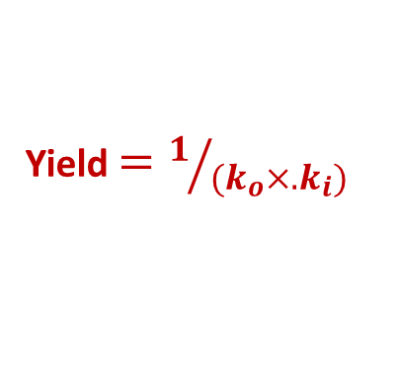
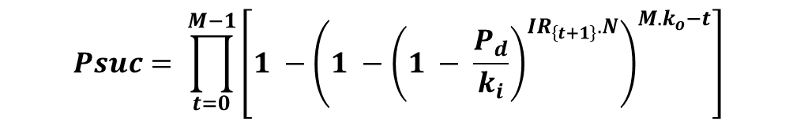
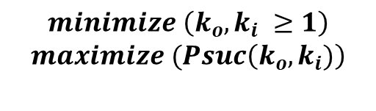
Yield Formalization for Uniform Defects
Maximizing yield means finding minimum area coefficients making Psuc = 1
Since yield is only dependent on area coefficients, given constraints ensures a maximum yield
Knowing only logic function and defect rate we predict sufficient area size for successful logic mapping
$$Psuc= \prod_{t=0}^{M−1}{\left[1 −{\left(1 −{\left(1 − \frac{P_{d}}{k_{i}}\right)}^{IR_{\left\{t+1\right\}}.N}\right)}^{M.k_{o}−t}\right] }$$
$$minimize \left(k_{o},k_{i} ≥1\right)$$
$$maximize (Psuc\left(k_{o},k_{i})\right)$$
Yield $=1/{{(k}_{o}×{.k}_{i})}$

Slide 13
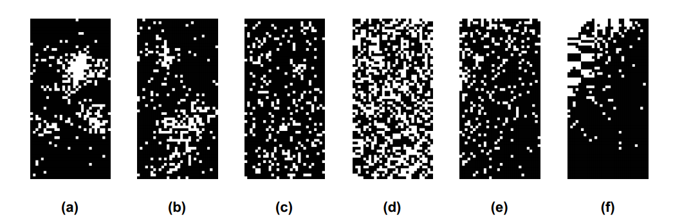
Clustered Defect Distribution
Since “cluster is in the eye of beholder”, it is hard to formulate and different regions have different defect rates. Also, we don’t have enough field data.
Defect rate is 20%: (a) – (b) denser to looser clustering patterns (c) uniform distribution (d) literal distribution and (e) – (f) sorted uniform and clustered distributions

Slide 14
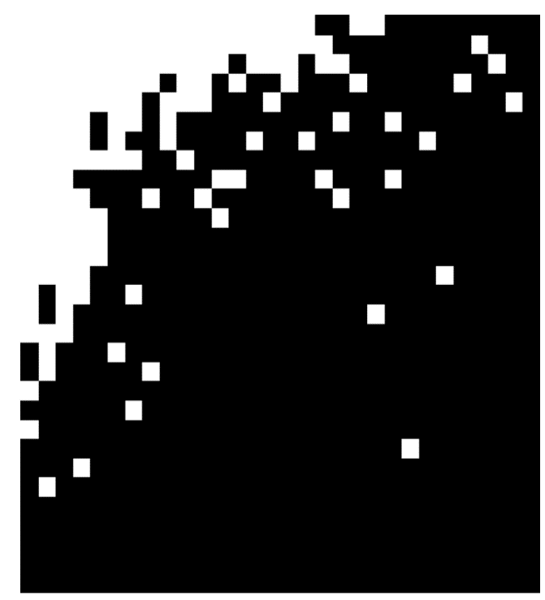
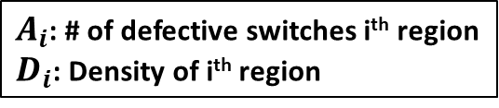

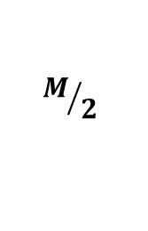
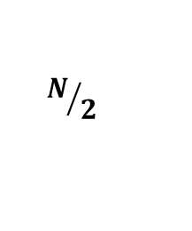
Regional Analysis of Defects
Defect distributions are sorted. Then, regional densities are found and charted for comparison
$$N/2$$
$$D_{i}=\left\{\begin{aligned}\frac{A_{0}}{\frac{M}{2}×\frac{N}{2}}, i=1 \\ &\frac{A_{i}−A_{i−1}}{\frac{M}{2}+\frac{N}{2}+1}, i>1\end{aligned}\right.$$
A₀
$$M/2$$
A₁
A₂
$A_{i}$: # of defective switches i^{th} region
$D_{i}$: Density of i^{th} region

Slide 15
Regional Analysis of Defects
Comparison of regional densities of uniform and clustered distributions gives us which uniform defect rate (Pd) to use in yield analysis
Pd = 30% All region densities are larger than clustered distributions

Slide 16

Literal Distributions
Literal distribution shows the crossbar representation of a logic function. Using a matrix is a common choice. Activated switches are shown with 1s.
f = x₁ x₂ + x₁ x₃ + x₂ x₃ + x₁ x₂ x₃
x₁ x₂ x₃ x₁ x₂ x₃
x₁ x₂ x₃ x₁ x₂ x₃
P₁
P₂
P₃ P₄
P₁
P₂
P₃ P₄
$$\left[\begin{matrix}1 & 1 & 0 & 0 & 0 & 0 \\ 1 & 0 & 1 & 0 & 0 & 0 \\ 0 & 1 & 1 & 0 & 0 & 0 \\ 0 & 0 & 0 & 1 & 1 & 1\end{matrix}\right]$$

Slide 17


Literal Distributions
Due to logic function properties, a product cannot have a variable and its negation at the same time. So there are 2 constraints literal distributions need to adhere:
We will show that randomly generated logic function matrices produce unreliable results.
x₁ x₂ x₃ x₁ x₂ x₃
  At most, only half of a matrix row can be 1
P₁
$$\left[\begin{matrix}1 & 1 & 1 & 1 & 0 & 0\end{matrix}\right]$$
P₁ = x₁ x₂ x₃ x₁
invalid
  If an element corresponding to a variable is 1, the element corresponding to its negation must be zero.
x₁ x₂ x₃ x₁ x₂ x₃
P₁
$$\left[\begin{matrix}0 & 1 & 1 & 0 & 1 & 0\end{matrix}\right]$$
P₁ = x₂ x₃ x₂
invalid

Slide 18
Experimental Results Random Functions
Success Rates wıth Dıfferent Yıeld Values Regardıng Random Benchmarks
Defect Rate Pd = 20%
Bench |  | k_{o} - k_{i} = 1 - 1 |  | k_{o} - k_{i} = 1.1 - 1.1 |  | k_{o} - k_{i} = 1.2 - 1 |  | k_{o} - k_{i} = 1 - 1.2
No | IR | Uni | Clu | Uni | Clu | Uni | Clu | Uni | Clu
1* 2 | 40% 40% | 0% 0% | 0% 0% | 0% 4% | 0% 0% | 0% 16% | 0% 0% | 0% 10% | 0% 0%
3* 4 | 35% 35% | 0% 4% | 0% 0% | 0% 100% | 0% 0% | 100% 100% | 8% 8% | 100% 100% | 2% 10%
5* 6 | 30% 30% | 100% 100% | 0% 0% | 100% 100% | 64% 64% | 100% 100% | 90% 75% | 100% 100% | 84% 76%
7* 8 | 25% 25% | 100% 100% | 6% 16% | 100% 100% | 98% 100% | 100% 100% | 98% 100% | 100% 100% | 98% 100%
Bench |  | k_{o} - k_{i} = 1 - 1 |  | k_{o} - k_{i} = 1.1 - 1.1 |  | k_{o} - k_{i} = 1.2 - 1 |  | k_{o} - k_{i} = 1 - 1.2
No | IR | Uni | Clu | Uni | Clu | Uni | Clu | Uni | Clu
1* 2 | 40% 40% | 0% 0% | 0% 0% | 0% 4% | 0% 0% | 0% 16% | 0% 0% | 0% 10% | 0% 0%
3* 4 | 35% 35% | 0% 4% | 0% 0% | 0% 100% | 0% 0% | 100% 100% | 8% 8% | 100% 100% | 2% 10%
5* 6 | 30% 30% | 100% 100% | 0% 0% | 100% 100% | 64% 64% | 100% 100% | 90% 75% | 100% 100% | 84% 76%
7* 8 | 25% 25% | 100% 100% | 6% 16% | 100% 100% | 98% 100% | 100% 100% | 98% 100% | 100% 100% | 98% 100%
* generated according to the logic function constraints
k_{o} : Output coefficient k_{i} : Input coefficient IR : Logic inclusion ratio Uni : Uniform Clu : Clustered

Slide 19
Experimental Results Benchmarks
Success Rate of Tunali’s Algorıthm (Best Runtıme – Reasonable Success rate)
wıth Proposed and 1.5 Times Area Overheads
Pd = 20%
Benchmarks |  |  | Tunali [9]
 |  |  | Optimum |  | Proposed |  |  |  |  |  | ko - ki = 1.5-1.5
Name | Size | IR | Uni | Clu | Uni | ko | ki | Clu | ko | ki | Uni | Clu
xor5 | 16 × 10 | 50% | 76% | 16% | 100% | 1.4 | 1.4 | 100% | 1.6 | 1.6 | 100% | 100%
squar5 | 32 × 10 | 50% | 12% | 0% | 100% | 1.5 | 1 | 100% | 1.8 | 1 | 100% | 100%
bw | 87 × 10 | 40% | 60% | 10% | 100% | 1.2 | 1 | 100% | 1.2 | 1 | 100% | 100%
ex5p | 256 × 16 | 50% | 0% | 0% | 100% | 1.3 | 1 | 100% | 1.5 | 1 | 100% | 100%
apex4 | 438 × 18 | 46% | 0% | 0% | 100% | 1.2 | 1 | 100% | 1.3 | 1 | 100% | 100%
sao2 | 58 × 20 | 36% | 0% | 0% | 100% | 1.5 | 1 | 100% | 1.5 | 1.4 | 100% | 100%
table3 | 175 × 28 | 41% | 0% | 0% | 100% | 1.4 | 1 | 100% | 1.4 | 1 | 100% | 100%
t481 | 481 × 32 | 31% | 0% | 0% | 100% | 1.2 | 1 | 100% | 1.2 | 1.1 | 100% | 100%
table5 | 158 × 34 | 35% | 0% | 0% | 94% | 1.3 | 1.2 | 100% | 1.6 | 1.5 | 100% | 100%
duke2 | 87 × 44 | 20% | 0% | 32% | 100% | 1.3 | 1.2 | 100% | 1.6 | 1.5 | 100% | 100%
apex1 | 206 × 90 | 10% | 0% | 58% | 100% | 1.2 | 1 | 100% | 1.4 | 1.3 | 100% | 100%
apex3 | 280 × 108 | 8% | 0% | 40% | 100% | 1.2 | 1 | 100% | 1.2 | 1.2 | 100% | 100%
Benchmarks |  |  | Tunali [9]
 |  |  | Optimum |  | Proposed |  |  |  |  |  | ko - ki = 1.5-1.5
Name | Size | IR | Uni | Clu | Uni | ko | ki | Clu | ko | ki | Uni | Clu
xor5 | 16 × 10 | 50% | 76% | 16% | 100% | 1.4 | 1.4 | 100% | 1.6 | 1.6 | 100% | 100%
squar5 | 32 × 10 | 50% | 12% | 0% | 100% | 1.5 | 1 | 100% | 1.8 | 1 | 100% | 100%
bw | 87 × 10 | 40% | 60% | 10% | 100% | 1.2 | 1 | 100% | 1.2 | 1 | 100% | 100%
ex5p | 256 × 16 | 50% | 0% | 0% | 100% | 1.3 | 1 | 100% | 1.5 | 1 | 100% | 100%
apex4 | 438 × 18 | 46% | 0% | 0% | 100% | 1.2 | 1 | 100% | 1.3 | 1 | 100% | 100%
sao2 | 58 × 20 | 36% | 0% | 0% | 100% | 1.5 | 1 | 100% | 1.5 | 1.4 | 100% | 100%
table3 | 175 × 28 | 41% | 0% | 0% | 100% | 1.4 | 1 | 100% | 1.4 | 1 | 100% | 100%
t481 | 481 × 32 | 31% | 0% | 0% | 100% | 1.2 | 1 | 100% | 1.2 | 1.1 | 100% | 100%
table5 | 158 × 34 | 35% | 0% | 0% | 94% | 1.3 | 1.2 | 100% | 1.6 | 1.5 | 100% | 100%
duke2 | 87 × 44 | 20% | 0% | 32% | 100% | 1.3 | 1.2 | 100% | 1.6 | 1.5 | 100% | 100%
apex1 | 206 × 90 | 10% | 0% | 58% | 100% | 1.2 | 1 | 100% | 1.4 | 1.3 | 100% | 100%
apex3 | 280 × 108 | 8% | 0% | 40% | 100% | 1.2 | 1 | 100% | 1.2 | 1.2 | 100% | 100%

Slide 20
Experimental Results Benchmarks
Success Rate of Yuan’s Algorıthm (Reasonable Runtıme – Best Success rate)
wıth Proposed and 1.5 Times Area Overheads
Pd = 20%
Benchmarks |  |  | Yuan [10]
 |  |  | Optimum |  | Proposed |  |  |  |  |  | ko; ki = 1:5; 1:5
Name | Size | IR | Uni | Clu | Uni | ko | ki | Clu | ko | ki | Uni | Clu
xor5 | 16 × 10 | 50% | 78% | 12% | 100% | 1.4 | 1.4 | 100% | 1.6 | 1.6 | 100% | 100%
squar5 | 32 × 10 | 50% | 14% | 0% | 100% | 1.5 | 1 | 100% | 1.8 | 1 | 100% | 100%
bw | 87 × 10 | 40% | 60% | 14% | 100% | 1.2 | 1 | 100% | 1.2 | 1 | 100% | 100%
ex5p | 256 × 16 | 50% | 0% | 0% | 100% | 1.3 | 1 | 100% | 1.5 | 1 | 100% | 100%
apex4 | 438 × 18 | 46% | 0% | 0% | 100% | 1.2 | 1 | 100% | 1.3 | 1 | 100% | 100%
sao2 | 58 × 20 | 36% | 0% | 0% | 100% | 1.5 | 1 | 100% | 1.5 | 1.4 | 100% | 100%
table3 | 175 × 28 | 41% | 0% | 0% | 100% | 1.4 | 1 | 100% | 1.4 | 1 | 100% | 100%
t481 | 481 × 32 | 31% | 0% | 0% | 100% | 1.2 | 1 | 100% | 1.2 | 1.1 | 100% | 100%
table5 | 158 × 34 | 35% | 0% | 0% | 100% | 1.3 | 1.2 | 100% | 1.6 | 1.5 | 100% | 100%
duke2 | 87 × 44 | 20% | 0% | 50% | 100% | 1.3 | 1.2 | 100% | 1.6 | 1.5 | 100% | 100%
apex1 | 206 × 90 | 10% | 0% | 70% | 100% | 1.2 | 1 | 100% | 1.4 | 1.3 | 100% | 100%
apex3 | 280 × 108 | 8% | 0% | 86% | 100% | 1.2 | 1 | 100% | 1.2 | 1.2 | 100% | 100%
Benchmarks |  |  | Yuan [10]
 |  |  | Optimum |  | Proposed |  |  |  |  |  | ko; ki = 1:5; 1:5
Name | Size | IR | Uni | Clu | Uni | ko | ki | Clu | ko | ki | Uni | Clu
xor5 | 16 × 10 | 50% | 78% | 12% | 100% | 1.4 | 1.4 | 100% | 1.6 | 1.6 | 100% | 100%
squar5 | 32 × 10 | 50% | 14% | 0% | 100% | 1.5 | 1 | 100% | 1.8 | 1 | 100% | 100%
bw | 87 × 10 | 40% | 60% | 14% | 100% | 1.2 | 1 | 100% | 1.2 | 1 | 100% | 100%
ex5p | 256 × 16 | 50% | 0% | 0% | 100% | 1.3 | 1 | 100% | 1.5 | 1 | 100% | 100%
apex4 | 438 × 18 | 46% | 0% | 0% | 100% | 1.2 | 1 | 100% | 1.3 | 1 | 100% | 100%
sao2 | 58 × 20 | 36% | 0% | 0% | 100% | 1.5 | 1 | 100% | 1.5 | 1.4 | 100% | 100%
table3 | 175 × 28 | 41% | 0% | 0% | 100% | 1.4 | 1 | 100% | 1.4 | 1 | 100% | 100%
t481 | 481 × 32 | 31% | 0% | 0% | 100% | 1.2 | 1 | 100% | 1.2 | 1.1 | 100% | 100%
table5 | 158 × 34 | 35% | 0% | 0% | 100% | 1.3 | 1.2 | 100% | 1.6 | 1.5 | 100% | 100%
duke2 | 87 × 44 | 20% | 0% | 50% | 100% | 1.3 | 1.2 | 100% | 1.6 | 1.5 | 100% | 100%
apex1 | 206 × 90 | 10% | 0% | 70% | 100% | 1.2 | 1 | 100% | 1.4 | 1.3 | 100% | 100%
apex3 | 280 × 108 | 8% | 0% | 86% | 100% | 1.2 | 1 | 100% | 1.2 | 1.2 | 100% | 100%

Slide 21
Conclusion
As a conclusion our contributions are as follows:
  We cover both uniform and clustered defect distributions
  We introduce an approximate formalization for an optimized yield considering uniform distributions;
  We propose a method to examine defect distributions by dividing crossbars into sub regions;
  By comparing uniform and clustered defects, we formulate a loose upper bound for yield considering clustered distributions;
  We show that our method is adaptive to changing parameters of logic functions and nano-crossbars.

Slide 22
Thank You For Listening
QUESTIONS ?

