Slide 1



Synthesis and Performance Optimization of a Switching Nano-Crossbar Computer
NANOxCOMP

Slide 2


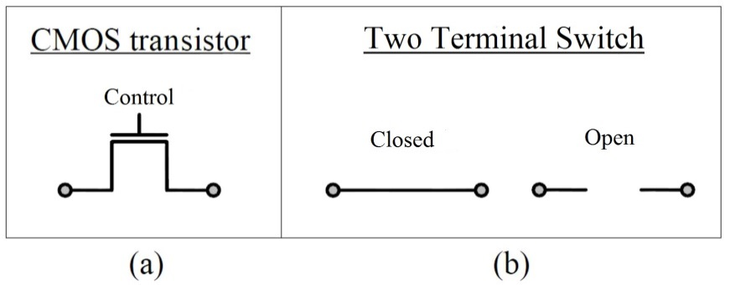
Introduction
1938: Claude Shannon’s thesis “A symbolic analysis of relay and switching circuits”
Carole Cable, www.cartoonstock.com

Slide 3

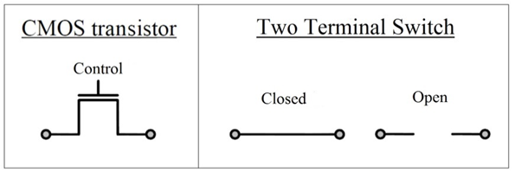
Introduction
1963: CMOS
1965: Moore’s Law
  In every twelve months, number of elements in an IC (Integrated circuit) would be duplicated.
Even Gordon Moore himself claimed in 2005 that the validity of Moore’s Law will be lost.
  transistor’s physical working limits
February 2016: Mitchell Waldrop stated:
  “Next month, the worldwide semiconductor industry will formally acknowledge……Moore's law …is nearing its end.”

Slide 4
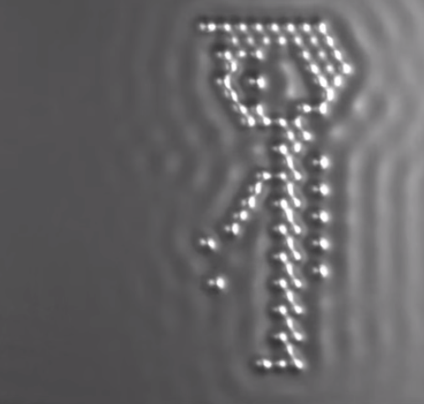

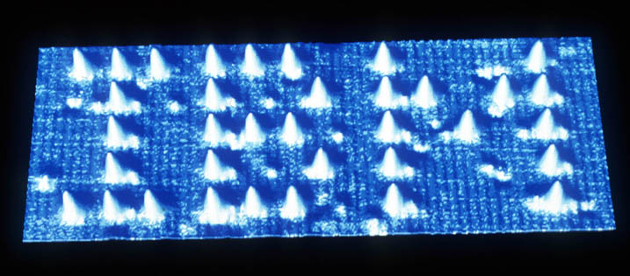
Introduction
Nano Scaled Technologies
  Single-electron transistors, quantum circuits, nanowires…
  Molecular and DNA computing
  Bottom-Up vs Top-Bottom Fabrications
Self-Assambly fabrication
  Cheap / Fast
  Ordered/Regular shaped
  Ex: Nanoarrays
A Boy And His Atom: The World's Smallest Movie, IBM
“Solar cells made through oil-and-water 'self-assembly”, http://news.bbc.co.uk, 2010

Slide 5
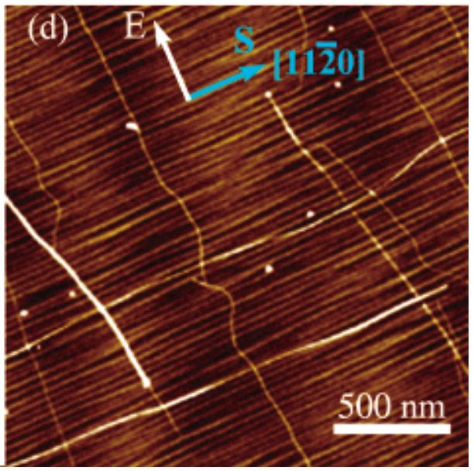
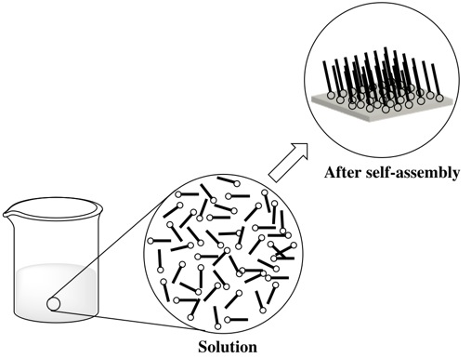
Introduction
Ismach, A.; Joselevich, E. Orthogonal self-assembly of carbon nanotube crossbar architectures by simultaneous graphoepitaxy and field-directed growth. Nano Lett. 2006, 6, 1706–1710.

Slide 6
Project Goal
First
Second
Finally

Slide 7
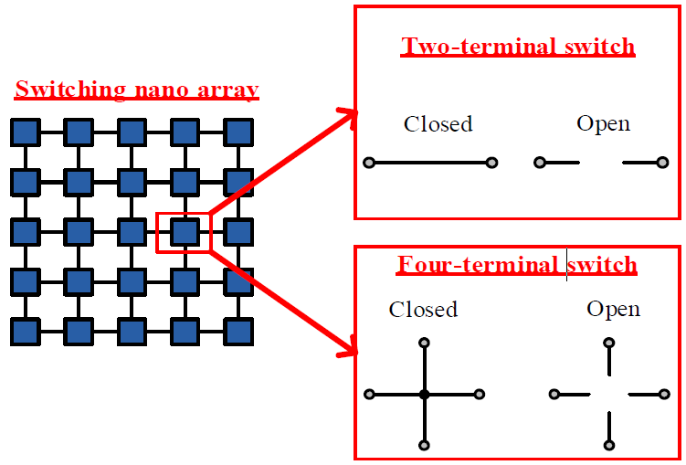
Switching Nanoarrays

Slide 8
So Far…

Slide 9
Logic Synthesis Methodologies
Diode Based Switched Nanoarray
f = AB
f = A+B

Slide 10
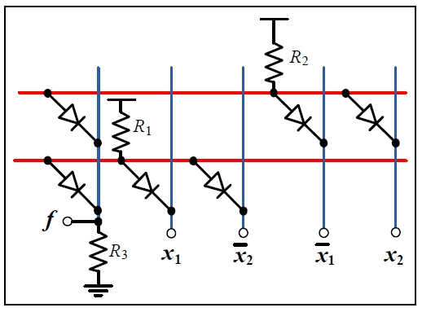
Implementation Methodologies
Diode Based Switched Nanoarray
XOR₂ = x1⊕ x2
Array Size = (number of products in f ) x (“number of literals in f ”+ 1)

Slide 11
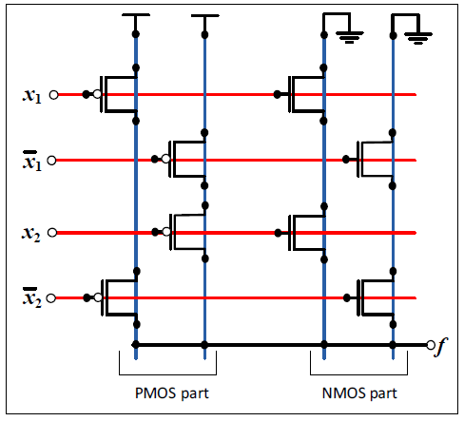
Implementation Methodologies
CFET Based Switched Nanoarray
XOR₂ = x1⊕ x2
Array Size = (number of literals in f ) x
(“number of products in f ” + “number of products in f D”)

Slide 12
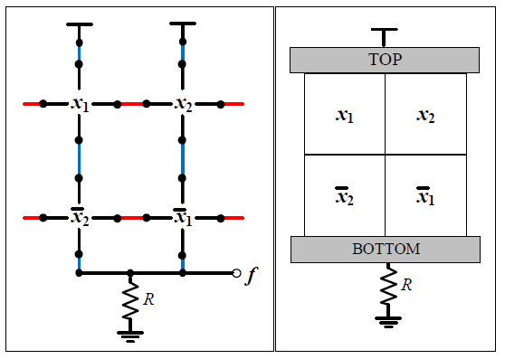
Implementation Methodologies
Four Terminal Switched Nanoarray
XOR₂ = x1⊕ x2
Array Size = (number of products in f ) x (number of products in f D)

Slide 13
Implementation Methodologies
Four Terminal Switched Nanoarray
Array Size = (number of products in f ) x (number of products in f D)

Slide 14
Implementation Methodologies
Four Terminal Switched Nanoarray
Function of the Networks = $x_{1}x_{2}x_{3}$+$x_{1}x_{2}x_{5}x_{6}$+$x_{2}x_{3}x_{4}x_{5}$+$x_{4}x_{5}x_{6}$

Slide 15
Implementation Methodologies
Four Terminal Switched Nanoarray
Function Name | Altun’s Method | Altun’s Special Method for XOR function | Traditional two-terminal Switch | Optimum 4-Terminal
XOR3 | 16 | 12 | 10 | 9
XOR4 | 64 | 25 | 16 | 15

Slide 16
Optimization
for Four Terminal Switched Nanoarray
Algorithm steps:
Determine Upper Bound and Lower Bound for the function
The Possible Implementable Nanoarray Shapes (3x3,3x4...)
Check the possible implementable shapes
  Starting from the one has lowest area
Declare Optimal Size

Slide 17
Optimization
Benchmark Name | CMOS | Diode | 4-Terminal | Optimal 4-Terminal |  | Benchmark Name | CMOS | Diode | 4-Terminal | Optimal 4-Terminal
Alu 0 | 6 | 18 | 30 | 6 |  | Dc1 2 | 16 | 36 | 72 | 12
Alu 1 | 6 | 18 | 30 | 6 |  | Dc1 5 | 12 | 15 | 35 | 6
Alu 2 | 6 | 18 | 30 | 6 |  | Dc1 6 | 9 | 18 | 36 | 6
Alu 3 | 6 | 18 | 30 | 6 |  | Ex5 31 | 32 | 104 | 156 | 24
B12 0 | 24 | 32 | 80 | 12 |  | Ex5 33 | 21 | 77 | 110 | 21
B12 1 | 35 | 70 | 120 | 16 |  | Ex5 46 | 18 | 54 | 81 | 18
B12 3 | 8 | 20 | 30 | 8 |  | Ex5 49 | 12 | 54 | 72 | 12
B12 4 | 8 | 28 | 42 | 8 |  | Ex5 50 | 14 | 63 | 81 | 14
B12 6 | 35 | 77 | 132 | 18 |  | Ex5 61 | 12 | 48 | 64 | 12
B12 7 | 24 | 66 | 110 | 18 |  | Ex5 62 | 10 | 35 | 49 | 10
B12 8 | 14 | 70 | 90 | 14 |  | Misex1 1 | 8 | 16 | 48 | 8
C17 0 | 9 | 18 | 36 | 6 |  | Misex1 2 | 35 | 55 | 132 | 15
C17 1 | 8 | 20 | 30 | 8 |  | Misex1 3 | 40 | 60 | 156 | 24
Clpl 0 | 16 | 32 | 64 | 12 |  | Misex1 4 | 28 | 44 | 121 | 16
Clpl 1 | 9 | 18 | 36 | 9 |  | Misex1 5 | 25 | 45 | 90 | 15
Clpl 2 | 4 | 8 | 16 | 4 |  | Misex1 6 | 42 | 66 | 143 | 18
Clpl 3 | 36 | 72 | 144 | 18 |  | Misex1 7 | 20 | 36 | 81 | 15
Clpl 4 | 25 | 50 | 100 | 15 |  | Mp2d 4 | 90 | 75 | 345 | 24
Dc1 1 | 6 | 10 | 25 | 6 |  | Newtag | 32 | 72 | 108 | 18

Slide 18
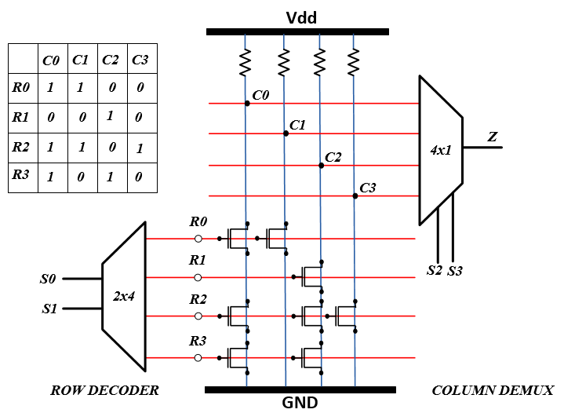
Memory Example
4x4 pseude-nMOS ROM Array

Slide 19
Defect Mapping

Slide 20
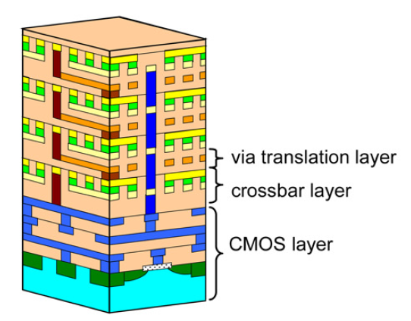
3D Technology Model
Motivation:
Performance Analysis
SPICE simulation
Meeting with current electronic devices on a plathform
A Generic Model which fits all technology and structure

Slide 21
3D Technology Model
From Literature
Ziegler MM, et al., Scalability simulations for nanomemory systems integrated on the molecular scale, 2003

Slide 22
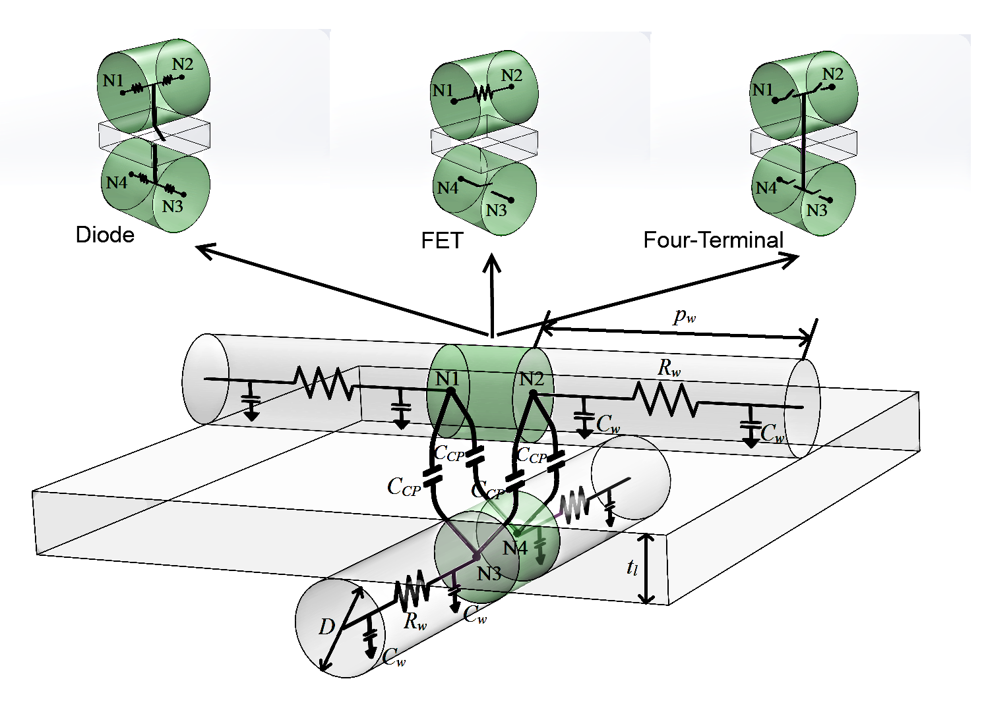
3D Technology Model

Slide 23
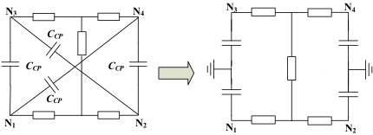
3D Technology Model
Elmore delay model fitting

Slide 24
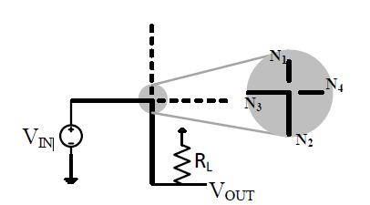
PERFORMANCE ANALYSIS:
POWER, DELAY, AREA
Wire diameter 1 – 10 nm
Pitch size 10 – 30 nm
Fan-out Capacitance no-load – 2 fF

Slide 25
PERFORMANCE ANALYSIS:
POWER, DELAY, AREA
Analysis Output | FET | Diode | Four-terminal
Delay (ps) | 0.15-0.25 | 0.013-0.024 | 0.04-0.16
Delay (ps) with 0.1fF fan-out | 20-120 | 2-15 | 2-18
Power (uW) | 0.02-0.16 | 0.01-0.25 | 0.02-0.3
Power 0.1fF fan-out (uW) | 2.5-2.6 | 2.5-2.7 | 2.5-2.8
Area (nm²) | 200-900 | 200-900 | 200-900
Power × Delay (uW × ps) | 0.02-0.09 | 0.02-0.018 | 0.01-0.6

Slide 26
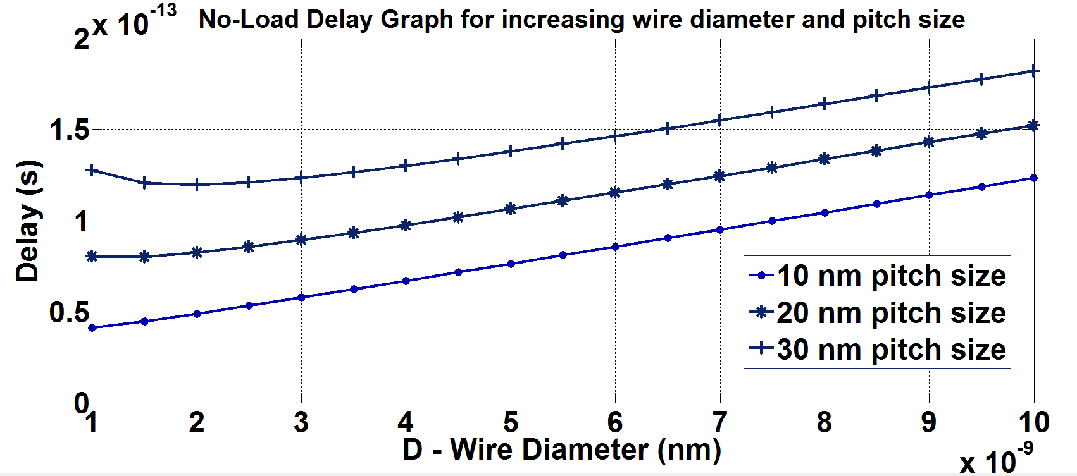
-- Delay Analysis
FET delay for no-load case.

Slide 27
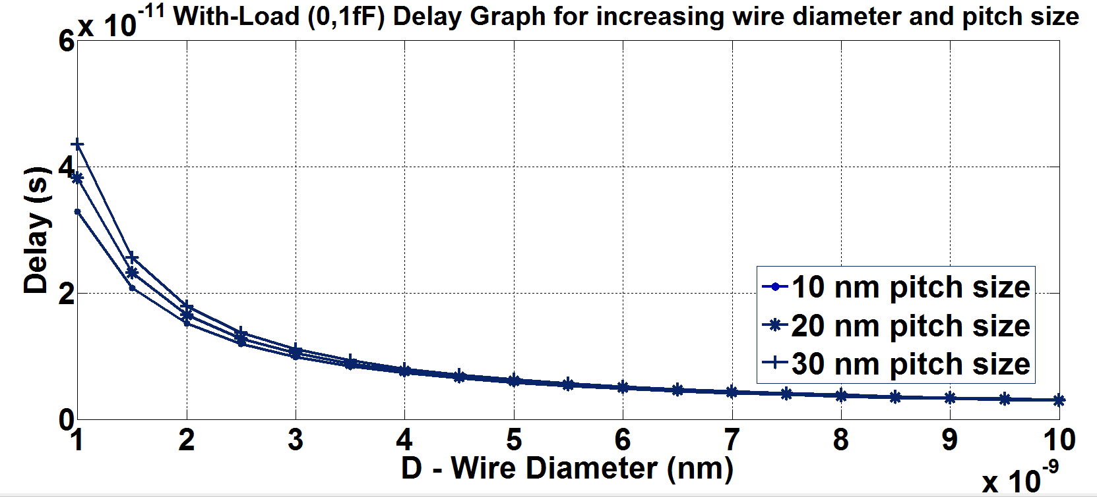
-- Delay Analysis
FET delay with a fan-out capacitance (0.1 fF).

Slide 28
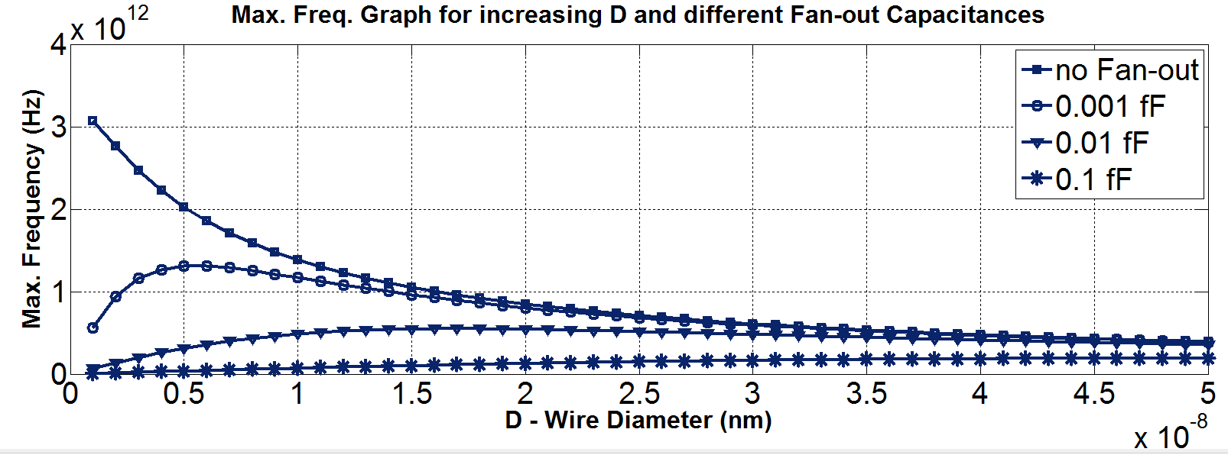
-- Maximum Frequency
FET maximum frequency graph for different fan-out capacitances (20 nm p_{w}).

Slide 29
-- A Case: 1 bit Full-Adder

Slide 30
-- Performance Analysis for 1 bit Full-Adder
 | No fan-out | 0,1 fF | 0,5 fF | 2 fF
High-to-Low Delay (ps) | 0.46 | 15.7 | 77.1 | 307
Low-to-High Delay (ps) | 1.75 | 60.1 | 293 | 1160
Power (1GHz) (uW) | 0.212 | 2.71 | 12.7 | 50.2
Maximum Frequency (GHz) | 452 | 13.1 | 2.69 | 0.67 <1!

Slide 31
Conclusion
Nanoarray Types
  Two and Four Terminal Switch Based
Memory
# of Switch Optimization
Defect Mapping
Technology Model
Performance Analysis

Slide 32
Thank You All
Emerging
Circuits and Computation Group

