Slide 1



A Satisfiability-Based Approximate Algorithm for Logic Synthesis Using Switching Lattices
Levent Aksoy and Mustafa Altun
Emerging Circuits and Computation (ECC) Group
Istanbul Technical University
This project has received funding from the European Union's H2020 research and innovation programme under the Marie Skłodowska-Curie grant agreement No 691178.
This work is supported by the TUBITAK-Career project #113E760.
Design, Automation and Test in Europe, 25-29 March 2019, Florence Italy

Slide 2
Outline
Introduction
Background
Problem Definitions
Motivation
The Proposed Algorithm
Experimental Results
Conclusions

Slide 3
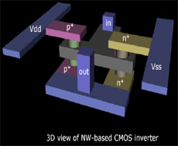
Introduction
As the Moore’s law has been reaching its limit, researchers have been exploring new technologies and structures
Nanotechnology has been an emerging technology to tackle the CMOS limitations
  builds materials and devices on the scale of atoms and molecules
  realizes electronic systems with features unavailable to silicon-based devices
  provides new computing structures
    logic gates, memory cores, and programmable logic arrays and interconnects [1, 2, 3]
[1] Y. Huang, X. Duan, Y. Cui, L. J. Lauhon, K.-H. Kim, and C. M. Lieber, “Logic gates and computation from assembled nanowire building blocks,” Science, vol. 294, no. 5545, pp. 1313–1317, 2001.
[2] A. Dehon, “Nanowire-based programmable architectures,” ACM JECT, vol. 1, pp. 109–162, 2005.
[3] NASA, “Nannoelectronics for logic and memory,” https://www.nasa.gov/centers/ames/research/technology-onepagers/nanoelectronics.html

Slide 4
Background
A four-terminal switch is developed for cross-points of nanoarrays
  has four-terminals and a control input x
  if x has the value 0, all its terminals are disconnected. Otherwise, they are connected
A switching lattice is a two-dimensional network of four-terminal switches
  each switch is connected to its horizontal and vertical neighbors
A four-connected path in a switching lattice
  a sequence of switches connected by taking horizontal and vertical moves
The mxn switching lattice function f_{mxn}
  evaluates to 1 if there is a four-connected path between the top and bottom plates
  includes sum-of-products (SOP) of control inputs of switches in each path
3x3 lattice
Control Inputs

Slide 5
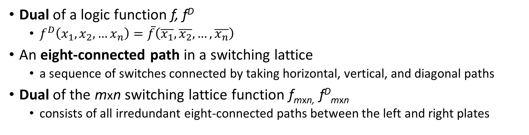
Background
Dual of a logic function f, f^{D}
  $f^{D}\left(x_{1},x_{2},…x_{n}\right)=\overline{f}\left(\overline{x_{1}}, \overline{x_{2}}, …, \overline{x_{n}}\right)$
An eight-connected path in a switching lattice
  a sequence of switches connected by taking horizontal, vertical, and diagonal paths
Dual of the mxn switching lattice function f_{mxn,} f^{D}_{mxn}
  consists of all irredundant eight-connected paths between the left and right plates
3x3 lattice

Slide 6
Background
Lattice functions provide a rich variety of logic functions
Number of products in the mxn lattice function
Number of products in the dual of mxn lattice function
m/n | 2 | 3 | 4 | 5 | 6 | 7 | 8
2 | 2 | 3 | 4 | 5 | 6 | 7 | 8
3 | 4 | 9 | 16 | 25 | 36 | 49 | 64
4 | 6 | 17 | 36 | 67 | 118 | 203 | 344
5 | 10 | 37 | 94 | 205 | 436 | 957 | 2146
6 | 16 | 77 | 136 | 621 | 1668 | 4883 | 14880
7 | 26 | 163 | 602 | 1905 | 6562 | 26317 | 110838
8 | 42 | 343 | 1528 | 5835 | 25686 | 139231 | 797048
m/n | 2 | 3 | 4 | 5 | 6 | 7 | 8
2 | 4 | 8 | 16 | 32 | 64 | 128 | 256
3 | 7 | 17 | 41 | 99 | 239 | 577 | 1393
4 | 10 | 28 | 78 | 216 | 600 | 1666 | 4626
5 | 13 | 41 | 139 | 453 | 1497 | 4981 | 16539
6 | 16 | 56 | 250 | 1018 | 4286 | 18730 | 81192
7 | 19 | 73 | 461 | 2439 | 13833 | 86963 | 539537
8 | 22 | 92 | 872 | 6004 | 45788 | 421182 | 3779226

Slide 7
Problem Definitions
Switching lattices can be used to realize logic functions
  map the appropriate literals of the function and/or constant values (0 and 1) to the control inputs of switches
The lattice mapping (LM) problem
  Given a target function f and an mxn lattice function f_{mxn}, find the appropriate assignments to the lattice function variables such that f can be realized on the mxn lattice or prove that there exists no such assignment
The lattice synthesis (LS) problem
  Given the target function f, find an mxn lattice such that there exists an appropriate assignment to the lattice variables, realizing f and m times n is minimum
f(a, b, c, d) = $\overline{a}\overline{b}c+abc+a\overline{b}\overline{c}+b\overline{c}\overline{d}$
using the 3x4 lattice
using the 3x3 lattice

Slide 8
Motivation
The exact algorithm
  formulates the LM problem as a quantified Boolean formula (QBF) problem [4]
The approximate algorithms
  the exact QBF formulation is restricted, reducing the problem size [4]
  the target function is decomposed using p-circuits and the exact algorithm [4] is used to find the realizations of these smaller functions [5]
  a number of promising lattice candidates are determined and a method of [4] is used to find if one of these lattices leads to a solution [6]
The proposed approximate algorithm called JANUS
  introduces efficient methods to find better upper bounds, reducing the search space
  uses an efficient SAT formulation, considering also the dual of target and lattice functions
[4] G. Gange, H. Søndergaard, and P. J. Stuckey, “Synthesizing optimal switching lattices,” ACM TODAES, vol. 20, pp. 6:1–6:14, 2014.
[5] A. Bernasconi, V. Ciriani, L. Frontini, V. Liberali, G. Trucco, and T. Villa, “Logic synthesis for switching lattices by decomposition with p-circuits,” DSD, pp. 423–430, 2016.
[6] M. Morgul and M. Altun, “Optimal and heuristic algorithms to synthesize lattices of four-terminal switches,” Integration, vol. 64, pp. 60-70, 2019.

Slide 9
The Proposed Algorithm
JANUS takes the target function f as an input and returns its implementation on a switching lattice as an output
Determine the initial lower bound (lb) and upper bound (ub) of the LS problem
If lb = ub, return the solution found while computing ub
Determine the middle point mp = ⎣ (lb+ub)/2 ⎦ and generate a set of lattice candidates C
For each lattice candidate in C,
  generate the related LM problem and solve it
  if there is a solution to the LM problem, set ub to the lattice candidate size and go to Step 6
If there are no solutions for all lattice candidates in C, set lb to mp+1
If lb < ub, go to Step 3. Otherwise, return the solution

Slide 10

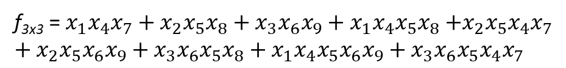



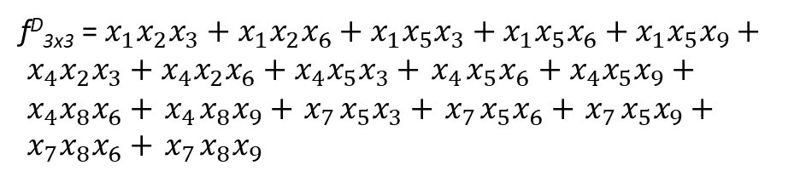

Computing the Initial Lower Bound
Structural check is to find if all the products of a function are covered by the products of another function
Compute the irredundant SOP forms of the target function and its dual
Set lattice size s to 1
For each possible lattice candidate with size s
  Apply structural check to the target and lattice functions and to the duals of the target and lattice functions
  If both check is passed, lower bound is determined to be s and return
If lower bound is not determined, increment s by 1 and go to Step 3
f = $\overline{a}\overline{b}c+abc+a\overline{b}\overline{c}+b\overline{c}\overline{d}$
f^{D}= $\overline{a}\overline{b}\overline{c}+abc+a\overline{b}\overline{c}+\overline{b}c\overline{d}$
when s = 6
f_{1x6} = $x_{1}{+x}_{2}+x_{3}+x_{4}+x_{5}+x_{6}$
f_{2x3} = $x_{1}x_{4}+x_{2}x_{5}+x_{3}x_{6}$
f^{D}_{3x2} = $x_{1}x_{2}+x_{1}x_{4}+x_{3}x_{2}+x_{3}x_{4}+x_{3}x_{6}+x_{5}x_{4}+x_{5}x_{6}$
f^{D}_{6x1} = $x_{1}{+x}_{2}+x_{3}+x_{4}+x_{5}+x_{6}$
when s = 9
f_{3x3} = $x_{1}x_{4}x_{7}+x_{2}x_{5}x_{8}+x_{3}x_{6}x_{9}+x_{1}x_{4}x_{5}x_{8}$ $+x_{2}x_{5}x_{4}x_{7}$
$+ x_{2}x_{5}x_{6}x_{9}+x_{3}x_{6}x_{5}x_{8}+x_{1}x_{4}x_{5}x_{6}x_{9}$ $+{ x}_{3}x_{6}x_{5}x_{4}x_{7}$
f^{D}_{3x3} = $x_{1}x_{2}x_{3}+x_{1}x_{2}x_{6}+x_{1}x_{5}x_{3}+x_{1}x_{5}x_{6}+x_{1}x_{5}x_{9}+ x_{4}x_{2}x_{3}+x_{4}x_{2}x_{6}+x_{4}x_{5}x_{3}+{ x}_{4}x_{5}x_{6}$ $+{ x}_{4}x_{5}x_{9}+{ x}_{4}x_{8}x_{6}+{ x}_{4}x_{8}x_{9}+{ x}_{7}x_{5}x_{3}+{ x}_{7}x_{5}x_{6}+{ x}_{7}x_{5}x_{9}+{ x}_{7}x_{8}x_{6}+{ x}_{7}x_{8}x_{9}$

Slide 11

Computing the Initial Upper Bound
f(a, b, c, d) = $\overline{a}\overline{b}c+abc+a\overline{b}\overline{c}+b\overline{c}\overline{d}$
JANUS uses three previously proposed methods
  Dual production (DP) method [7]
  Product separation (PS) method [4]
  Dual product separation (DPS) method [6]
and three proposed methods
  Improved PS (IPS) method
  Improved DPS (IDPS) method
  Divide and synthesize (DS) method
    partitions the products of the target function into two functions, f₁ and f₂
    finds their lattice realizations using JANUS and merges them into a single lattice
    explores alternative realizations which lead to a lattice with smaller size
DP Method
4x4 lattice
PS Method
3x7 lattice
IPS Method
3x5 lattice
[7] M. Altun and M. Riedel, “Logic synthesis for switching lattices, IEEE Transactions on Computers, vol. 61, pp. 1588–1600, 2012.

Slide 12
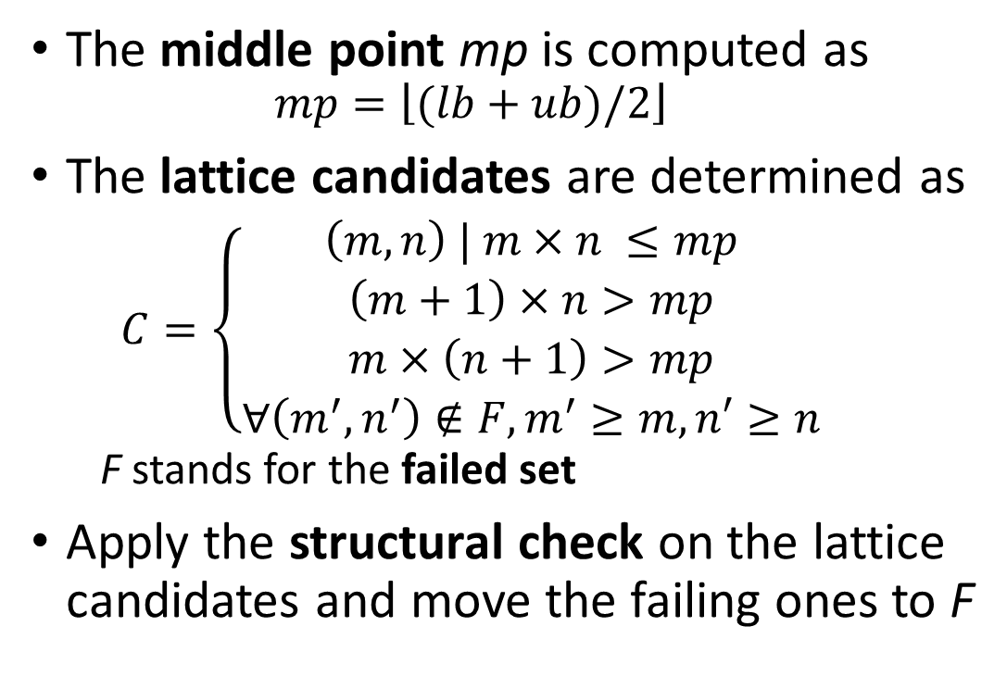
Generation of Lattice Candidates
f(a, b, c, d) = $\overline{a}\overline{b}c+abc+a\overline{b}\overline{c}+b\overline{c}\overline{d}$
lb = 9, ub = 15, mp = 12
The middle point mp is computed as
  $$mp=\left\lfloor (lb+ub)/2\right\rfloor$$
The lattice candidates are determined as
  $$C=\left\{\begin{aligned}\left(m,n\right) | m×n ≤mp \\ \left(m+1\right)×n>mp \\ m×\left(n+1\right)>mp \\ ∀\left(m^{′},n^{′}\right)∉F, m^{′}≥m, n′≥n\end{aligned}\right.$$
  F stands for the failed set
Apply the structural check on the lattice candidates and move the failing ones to F
1x12 2x6 3x4 4x3 2x6 1x12
1x11 11x1
1x10 2x5 5x2 10x1
1x9 3x3 9x1
C = {3x4, 4x3}
lb = 9, ub = 12, mp = 10
1x10 2x5 5x2 10x1
1x9 3x3 9x1
C = {3x3}

Slide 13

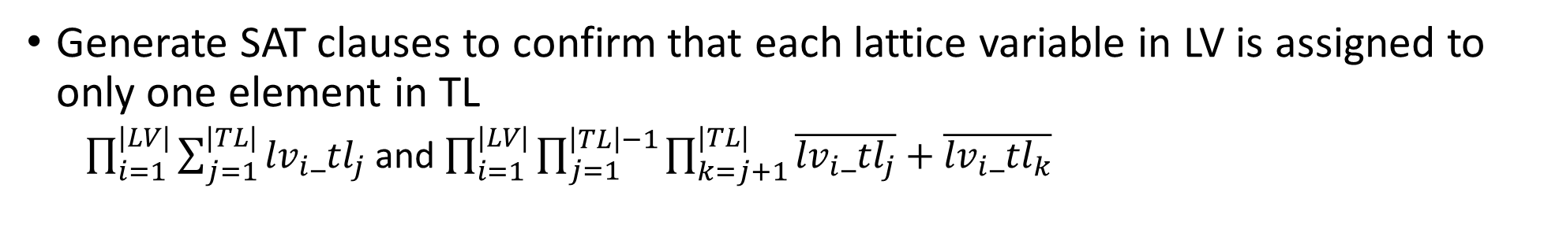

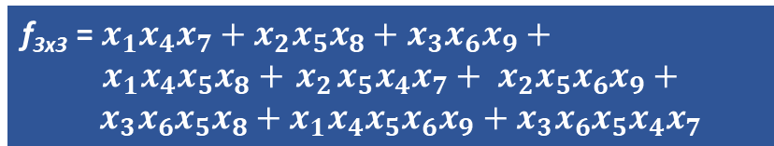

Finding a Solution to the LM Problem
LM problem is formulated as a SAT problem
f = $\overline{a}\overline{b}c+abc+a\overline{b}\overline{c}+b\overline{c}\overline{d}$
Lattice variable (LV) set includes the lattice variables
Target literal (TL) set includes the literals of the target function and constants 0 and 1
Mapping variable, lv_{i}_tl_{j}, where lv_{i} ∈ LV and tl_{j} ∈ TL, indicates that the lattice variable lv_{i} is assigned to the target literal tl_{j} when lv_{i}_tl_{j} is high
f_{3x3} = $x_{1}x_{4}x_{7}+x_{2}x_{5}x_{8}+x_{3}x_{6}x_{9}+$
$x_{1}x_{4}x_{5}x_{8}+{ x}_{2}x_{5}x_{4}x_{7}+ x_{2}x_{5}x_{6}x_{9}+ x_{3}x_{6}x_{5}x_{8}+x_{1}x_{4}x_{5}x_{6}x_{9}$ $+{ x}_{3}x_{6}x_{5}x_{4}x_{7}$
$$LV=\{x_{1},x_{2},x_{3},x_{4},x_{5},x_{6},x_{7},x_{8},x_{9}\}$$
$$TL=\{a,\overline{a},b,\overline{b},c,\overline{c},\overline{d},0,1\}$$
Mapping variable examples:${ x_{1}_a,x}_{3}_\overline{c}{,x}_{7}_0$
Generate SAT clauses to confirm that each lattice variable in LV is assigned to only one element in TL
  $\prod_{i=1}^{|LV|}{\sum_{j=1}^{|TL|}{{lv}_{i}_{tl}_{j}}}$ and $\prod_{i=1}^{|LV|}{\prod_{j=1}^{\left|TL\right|−1}{\prod_{k=j+1}^{|TL|}{\overline{{lv}_{i}_{tl}_{j}}}+\overline{{lv}_{i}_{tl}_{k}}}}$

Slide 14
Finding a Solution to the LM Problem
f(a,b,c,d) = $\overline{a}\overline{b}c+abc+a\overline{b}\overline{c}+b\overline{c}\overline{d}$using the 3x3 switching lattice
Guarantee that the target function is realized
  For each truth table entry, generate the combinational circuit corresponding to the lattice function and assign the target function value at this entry to the circuit output
  Generate the product-of-sum (POS) formula of each gate in the circuit
Link the mapping variables to the circuit inputs
When abcd = 0000: $x_{1}_a⇒\overline{x_{1_0000}}$, $x_{1}_\overline{a}⇒x_{1_0000}$
When abcd = 1000: $x_{1}_a⇒x_{1_1000}$, $x_{1}_\overline{a}⇒\overline{x_{1_1000}}$

Slide 15
Finding a Solution to the LM Problem
Consider the realization of the dual of the target function using the dual of the given lattice function as well
  generate another SAT problem using a similar formulation
Check the complexity of both SAT problems and give the one with the least complexity to the SAT solver
  time limit for the SAT solver is set to 1200s
If the SAT solver returns a solution, the mapping variables set to high determine the assignment to the lattice variables
If the SAT solver returns no solution in the time limit, the given lattice is added to failed set F

Slide 16




Realization of Multiple Logic Functions
JANUS-MF handles multiple logic functions
Finds the realization of each function on a switching lattice using JANUS
Merges these realizations into a single lattice
Finds alternative realizations of these functions that can reduce the final lattice size
$s\left(a,b,c_{in}\right)= \overline{a}\overline{b}c_{in}+\overline{a}b\overline{c_{in}}+a\overline{b}\overline{c_{in}}+abc_{in}$ $c_{out}\left(a,b,c_{in}\right)=ab+ac_{in}+bc_{in}$
$$s\left(a,b,c_{in}\right)$$
$$c_{out}\left(a,b,c_{in}\right)$$
$$Using 3x7 lattice$$
$$Using 3x6 lattice$$

Slide 17
Experimental Results
JANUS can be found at http://www.ecc.itu.edu.tr/images/d/d4/JANUS.zip
  developed in Perl
  uses espresso [8] to find the irredundant form of a target function and its dual
  uses glucose4.1 [9] to solve a SAT problem
Benchmarks were obtained from [10, 11]
Algorithms were run on an Intel Xeon CPU at 2.4GHz with 28 cores and 128GB RAM
  time limit was set to 6 hours
[8] R. K. Brayton, G. D. Hachtel, C. McMullen, and A. Sangiovanni-Vincentelli, Logic Minimization Algorithms for VLSI Synthesis. Springer, 1984.
[9] G. Audemard and L. Simon, “Predicting learnt clauses quality in modern sat solver,” in IJCAI, 2009, pp. 399–404.
[10] https://people.eng.unimelb.edu.au/gkgange/synth/
[11] S. Yang, “Logic synthesis and optimization benchmarks user guide: Version 3.0,” MCNC, Tech. Rep., Jan. 1991.

Slide 18
Results on Selected Single Output Functions
Instance | Lower and Upper Bounds |  |  |  | [5] | [6] |  | Approximate [4] |  | Exact [4] |  | JANUS
 | lb | oub | nub | lubt(s) | sol | sol | time(s) | sol | time(s) | sol | time(s) | sol | time(s)
5xp1_1 | 16 | 105 | 32 | 4.1 | 5x10 | 5x5 | 501.2 | 6x5 | 21600.0 | 5x5 | 21600.0 | 4x6 | 2023.2
5xp1_3 | 15 | 135 | 40 | 57.3 | 4x11 | 5x27 | 21600.0 | 11x4 | 21600.0 | 11x4 | 21600.0 | 4x9 | 19745.8
b12_06 | 15 | 44 | 24 | 4.3 | 6x8 | 5x4 | 23.8 | 5x4 | 4.6 | 5x4 | 139.3 | 5x4 | 23.8
clpl_03 | 16 | 36 | 24 | 0.6 | 6x9 | 3x6 | 19.6 | 3x6 | 2.3 | 3x6 | 200.0 | 3x6 | 84.9
ex5_07 | 24 | 40 | 27 | 0.7 | 3x13 | 4x6 | 19.7 | 3x9 | 332.2 | 4x6 | 473.2 | 3x8 | 2.5
ex5_13 | 24 | 36 | 27 | 0.9 | 3x13 | 3x8 | 10.0 | 4x6 | 57.6 | 4x6 | 190.2 | 3x8 | 2.8
ex5_15 | 20 | 72 | 33 | 3.9 | 4x13 | 4x7 | 48.5 | 6x12 | 21600.0 | 6x5 | 21600.0 | 3x8 | 2562.4
ex5_17 | 20 | 105 | 42 | 25.5 | 4x10 | 4x7 | 1425.6 | 10x6 | 21600.0 | 6x6 | 21600.0 | 3x9 | 4377.6
ex5_21 | 20 | 57 | 30 | 0.4 | 4x9 | 3x7 | 8.2 | 4x7 | 1364.6 | 3x7 | 280.9 | 3x7 | 790.8
ex5_23 | 24 | 92 | 36 | 34.1 | 4x11 | 4x8 | 2465.0 | 11x5 | 21600.0 | 3x9 | 15418.6 | 3x9 | 3726.4
ex5_24 | 20 | 105 | 33 | 7.0 | 5x14 | 15x7 | 21600.0 | 3x11 | 21600.0 | 4x7 | 21600.0 | 3x8 | 1638.8
mp2d_02 | 28 | 50 | 33 | 0.7 | 4x13 | 4x9 | 33.9 | 4x7 | 730.7 | 4x7 | 4580.7 | 4x7 | 948.9
mp2d_04 | 15 | 57 | 36 | 5.5 | 7x3 | 7x3 | 18.9 | 7x3 | 58.8 | 7x3 | 3043.1 | 7x3 | 286.8
Average | 19.8 | 71.8 | 32.1 | 11.2 | 45.3 | 39.8 | 3675.0 | 35.4 | 10165.5 | 26.6 | 10178.9 | 24.5 | 2785.7

Slide 19
Results on Multiple Logic Functions
Instance | #outputs | straight-forward method |  |  | JANUS-MF
 |  | sol | size | time(s) | sol | size | time(s)
b12 | 9 | 5x46 | 230 | 37.6 | 4x45 | 180 | 2451.8
bw | 28 | 5x119 | 595 | 12.7 | 3x135 | 405 | 14.1
misex1 | 7 | 5x31 | 155 | 25.3 | 3x42 | 126 | 30.4
squar5 | 8 | 5x31 | 155 | 31.7 | 3x36 | 108 | 59.7

Slide 20
Conclusions and Future Work
An approximate algorithm that can realize logic functions using switching lattices was proposed
  has techniques that reduce the search space significantly
  includes an efficient SAT formulation for the LM problem
  can find better solutions than the previously proposed exact and approximate algorithms using less computational effort
A divide and conquer algorithm can handle instances that available methods find them hard to solve
Rather than a single lattice, small multiple lattices can be used to realize logic functions

Slide 21
Questions
THANKS for YOUR ATTENTION
Contact: Levent Aksoy
E-mail: aksoyl@itu.edu.tr

