Slide 1
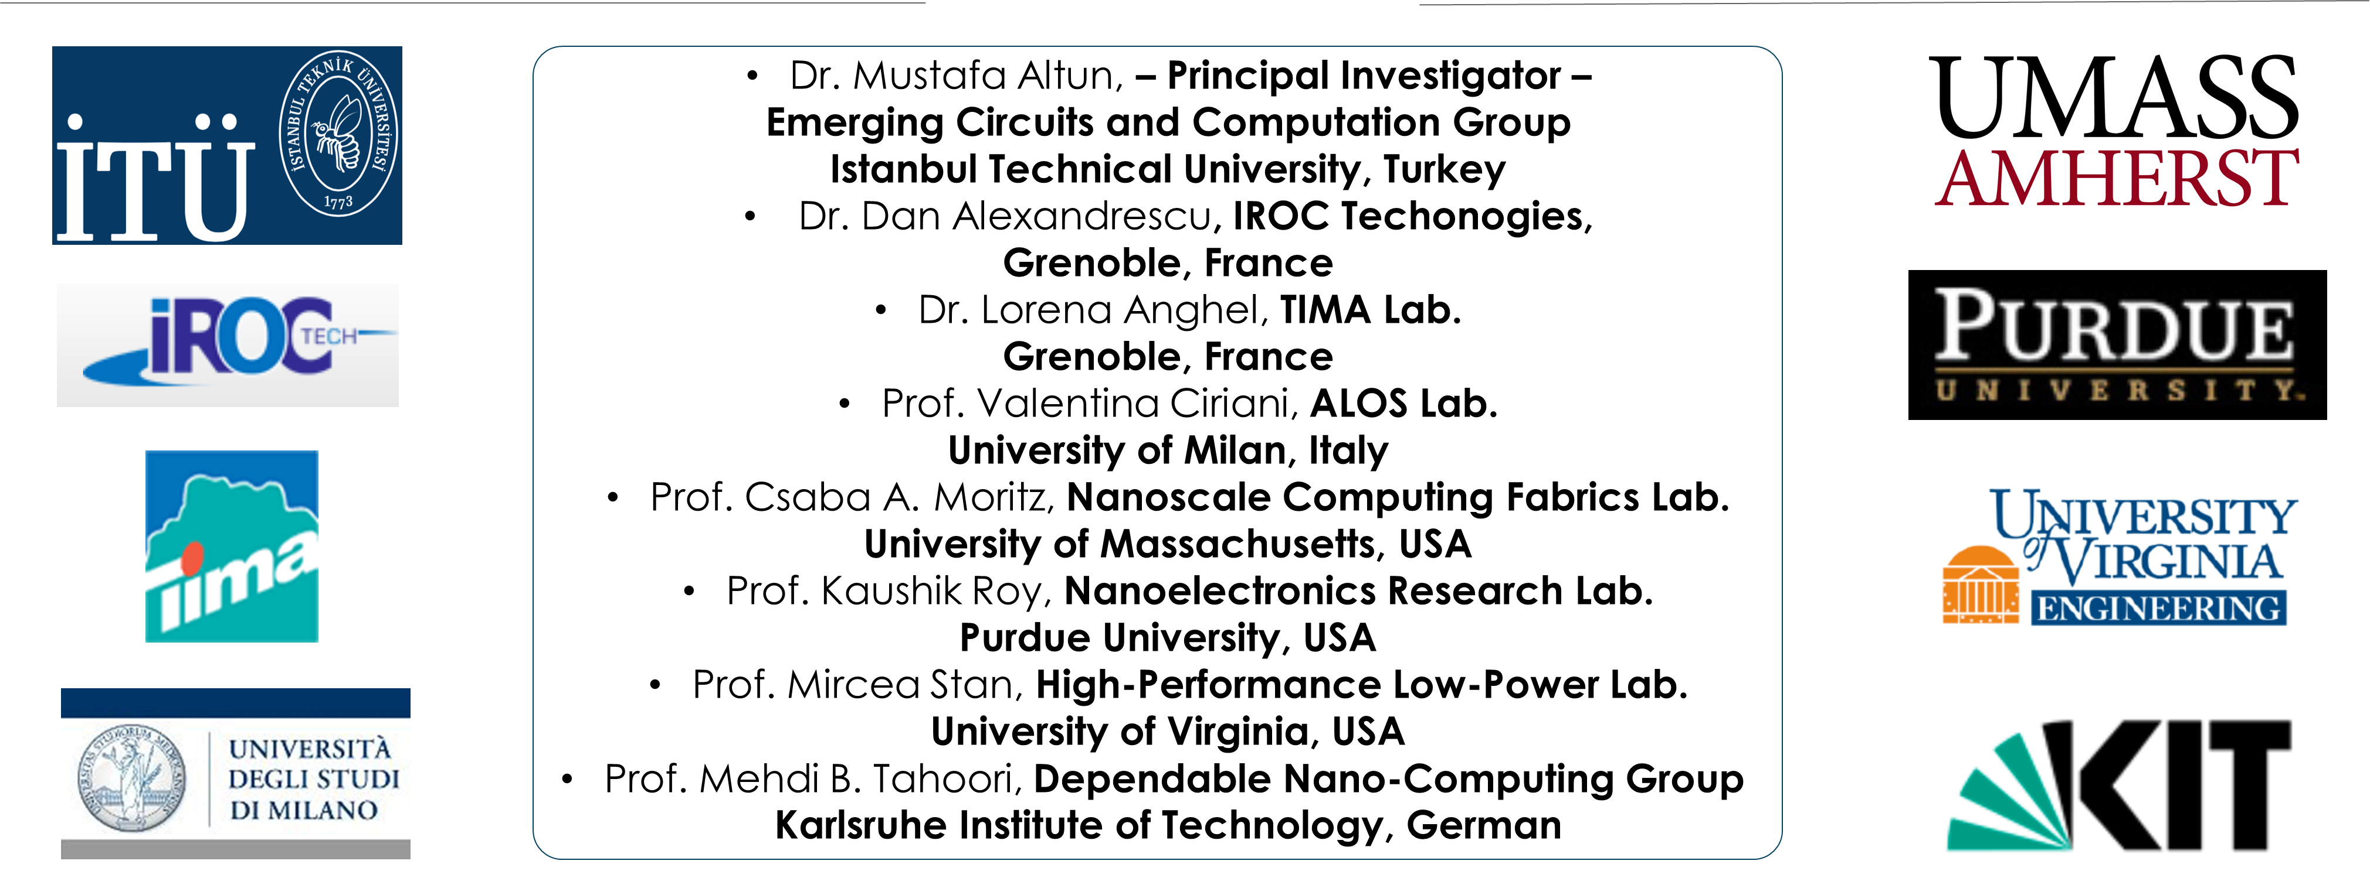
Computing with Nano-Crossbar Arrays: Logic Synthesis and Fault Tolerance
This project has received funding from the European Union's H2020 research and innovation programme under the Marie Skłodowska-Curie grant agreement No 691178.
This work is supported by the TUBITAK-Career project #113E760
Presenter: Mustafa Altun, PhD
Web: http://www.ecc.itu.edu.tr/
March 28th, 2017
Design, Automation, and Test in Europe (DATE)

Slide 2
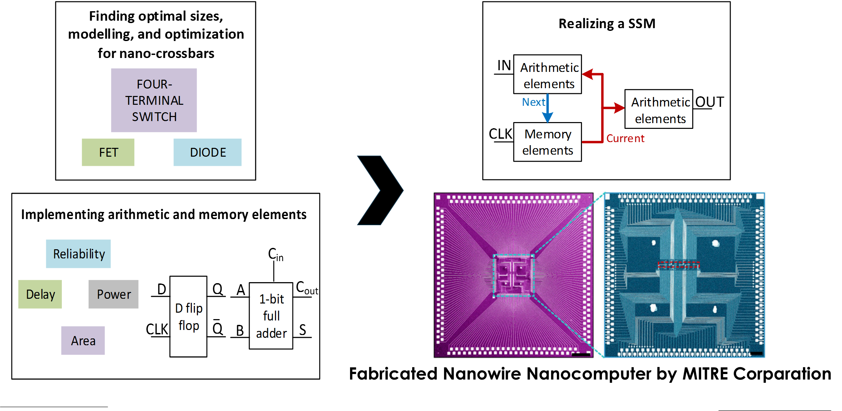
Project Details and Progress
Gathers globally leading research groups working on nanoelectronics and EDA
Targets variety of emerging technologies including nanowire/nanotube crossbar arrays, magnetic switch-based structures, and crossbar memories
Contributes to the construction of emerging computers beyond CMOS by proposing nano-crossbar based computer architectures.

